Slide 1
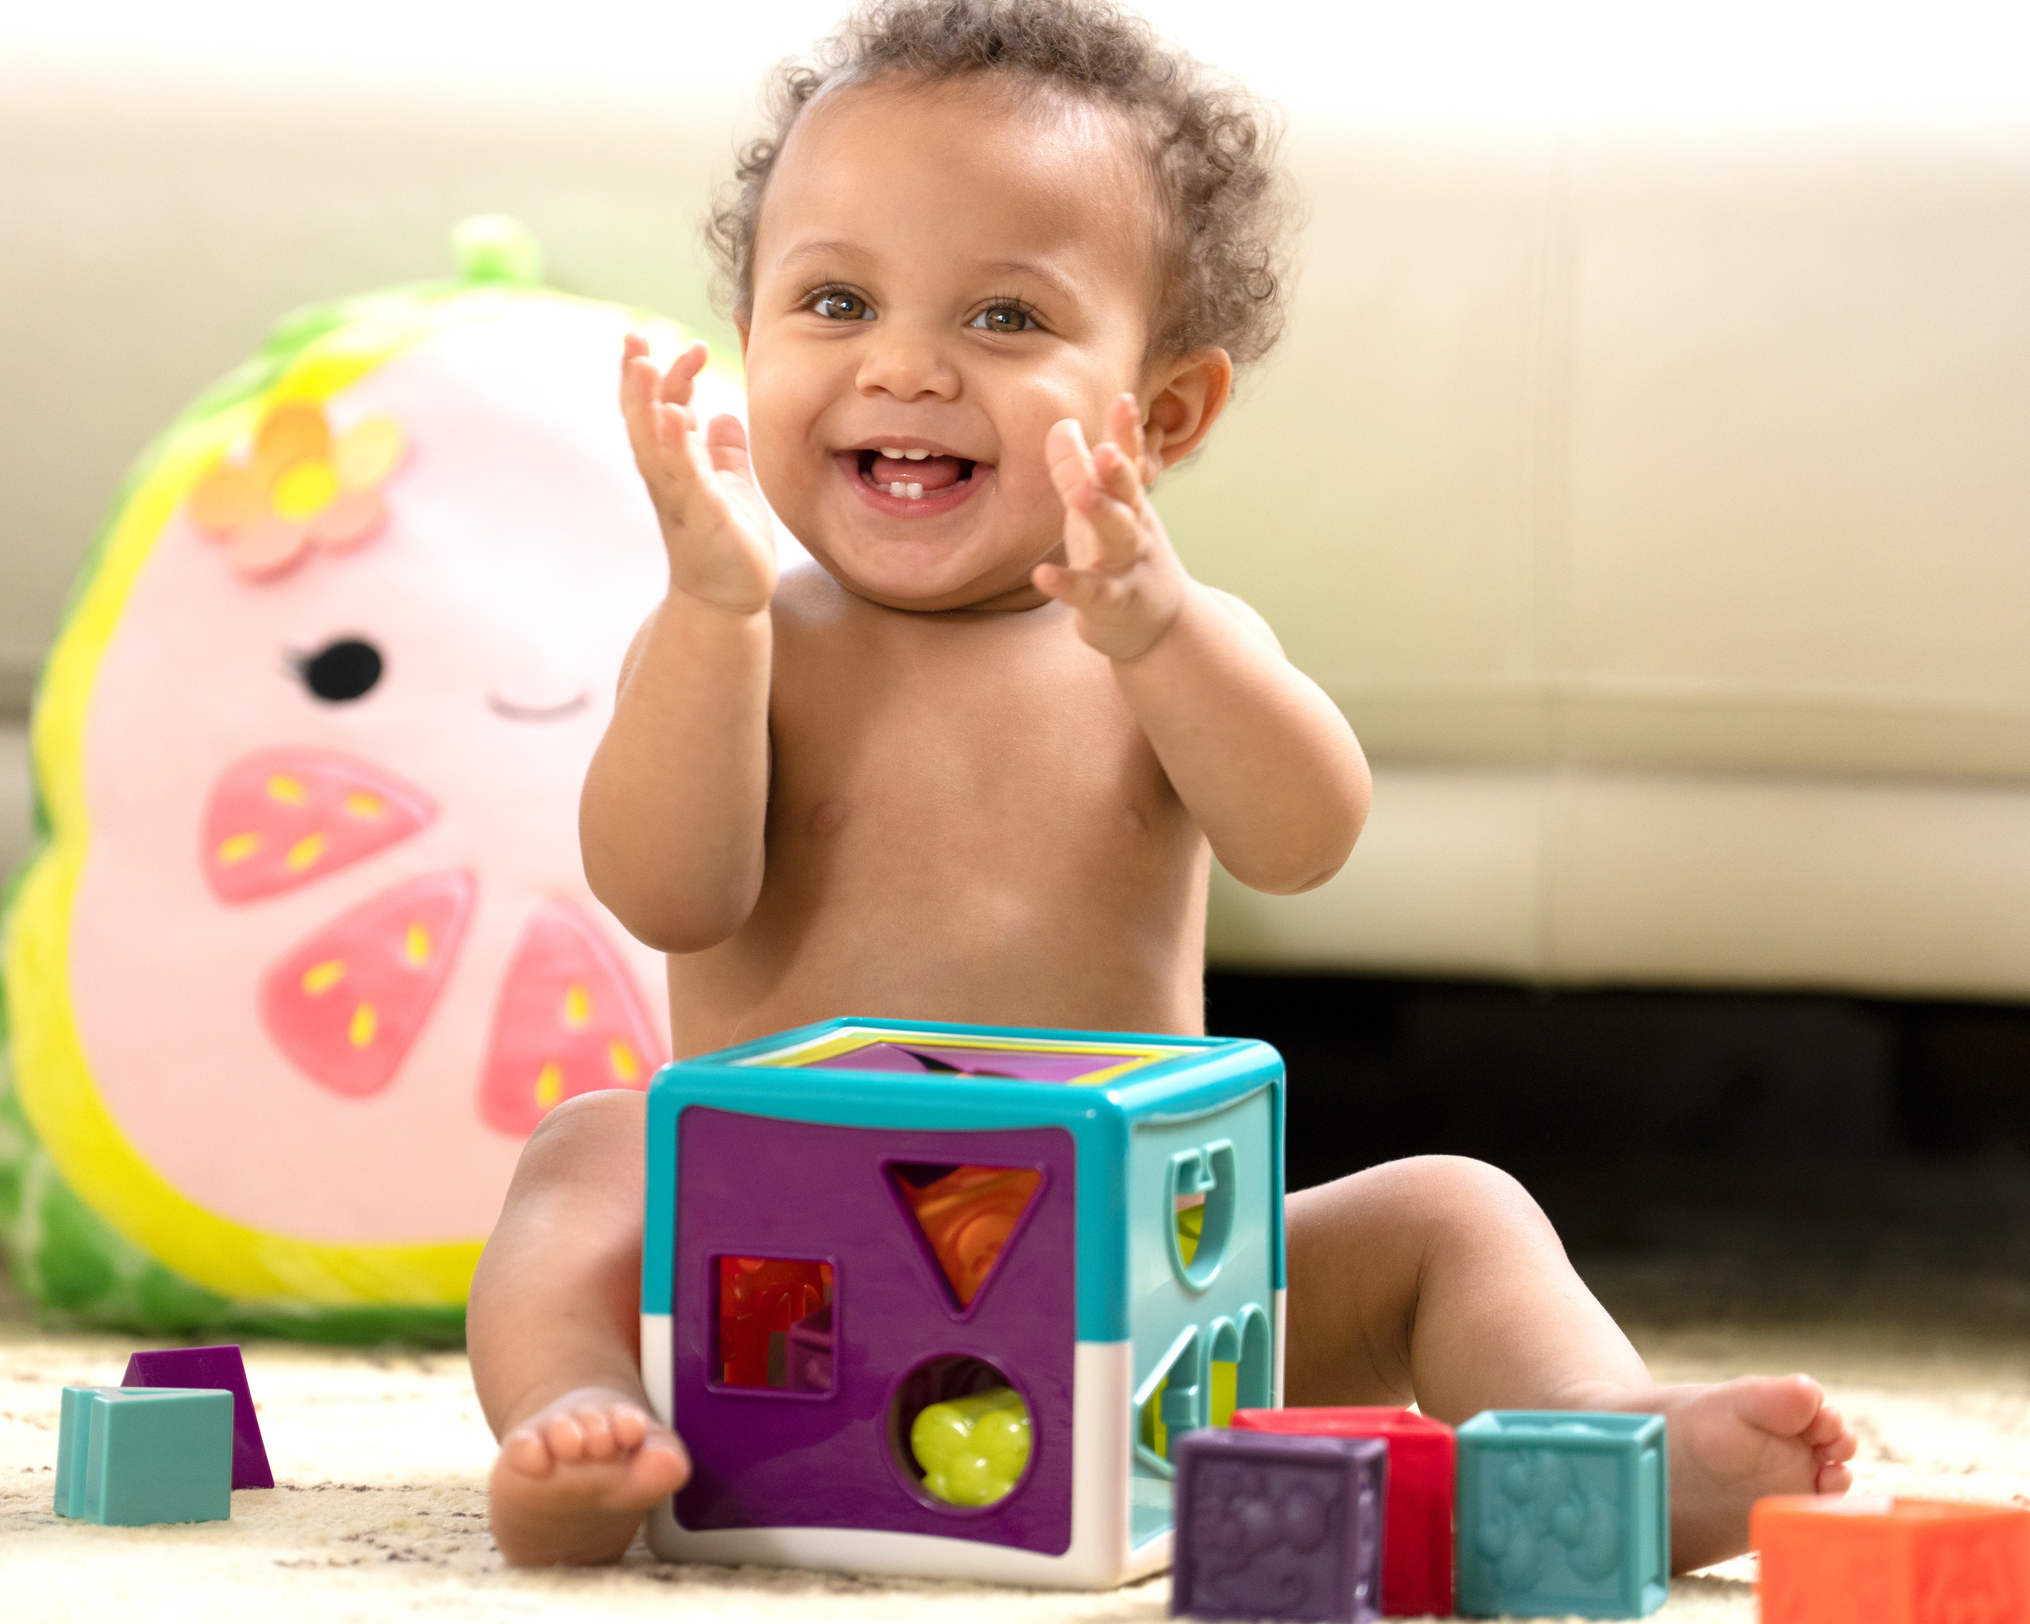
DEVELOPING LIFELONG LEARNERS FROM BIRTH AND BEYOND
Parent Workshop
Education Excellence
Early Years

Slide 2

Notes:
Thank you for joining us today.
This is a very relaxed and informal session, reassure that there is no need to speak out unless you wish to do so.

Slide 3
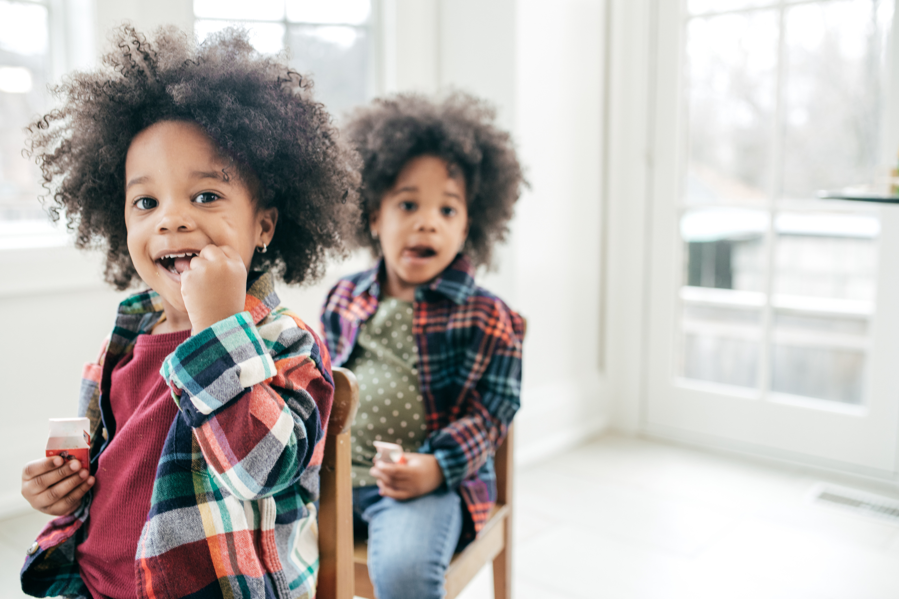
PLAY IS A CHILD’S WORK:
  Explore the importance of play
  Simple play ideas
  Promoting independence at home
  Puppets

Slide 4
EVERYTHING!
Parents with children under six usually get less than an hour of personal time a day.
Less than an hour.
So of course this feels heavy, of course it feels overwhelming. It’s not because you are doing it wrong, it’s because it is hard.
YOU ARE NOT ALONE.
Notes:
if right now- your coffee is cold and your patience is thin. You are not alone.
Your doing something that takes ALL of you and your still showing up.
That is not small, that is everything.
1. A child’s brain develops faster in the first 5 years than at any other time.
2. Children absorb parent’s emotions like sponges- even the unspoken ones.
3. The way you speak to your chid becomes their inner voice.
4. Children learn more from watching you, than listening to you.
5. Overpraising can lead to low resislience and fear of failure.
6. Tantrums are a normal part of emotional development, not bad behaviour.
7. Your unresolved childhood wounds can influence your parenting style.
8. Connection, not control, is the foundation of discipline.
9. Too much screen time can delay emotional and social growth.
10. Your presence matters more than your perfection.

Slide 5

Lighting Up The Brain
Notes:
during the earliest years, the brain is running at speed. with around 100 billion neurons at birth, the brain is ready for the firing up of chemical and electrical impulses. This causes pathways to form through the brain and central nervous system. Every thought and action creates a new connection in the brain. If this is repeated regularly, a new pathway in the brain is formed, the neurons fire and wire together.
travelling to work.
both positive and negative experiences impact, for e.g a baby crying who knows her needs will be met, creates a positive connection.

Slide 6

Building brains through play...

Slide 7
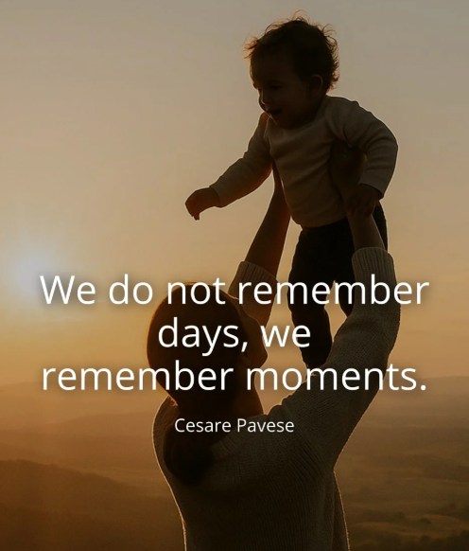
Lighting Up The Brain
Dr Harding, an international child development expert, identifies how young child’s brain not only craves play but thrives on it.
Play is one of the most powerful ways to shape brain development. Scientists have discovered that it takes approximately 400 repetitions to create a new synapse in the brain, unless it is done in play, in which case it only takes 10 - 20 repetitions. Acting as your child’s play partner helps to shape their experiences, fosters engagements and develops their brain.
Notes:
Dr Harding identifies how a young child’s brain not only craves play but thrives on it. The impact of immersive play on a young child’s brain is remarkable. When playing a child’s brain will start to ‘jump’ and ‘light up’ with joy as connections between neurons make impressive progress.
How does this happen?
Through rich sensory experiences
Play for exploration
Long, uninterrupted time to play
Following their own interests and fascinations
Repetition which consolidates and extends learning
All of this helps children forge new neural pathways laying a solid foundation for future learning and growth.

Slide 8

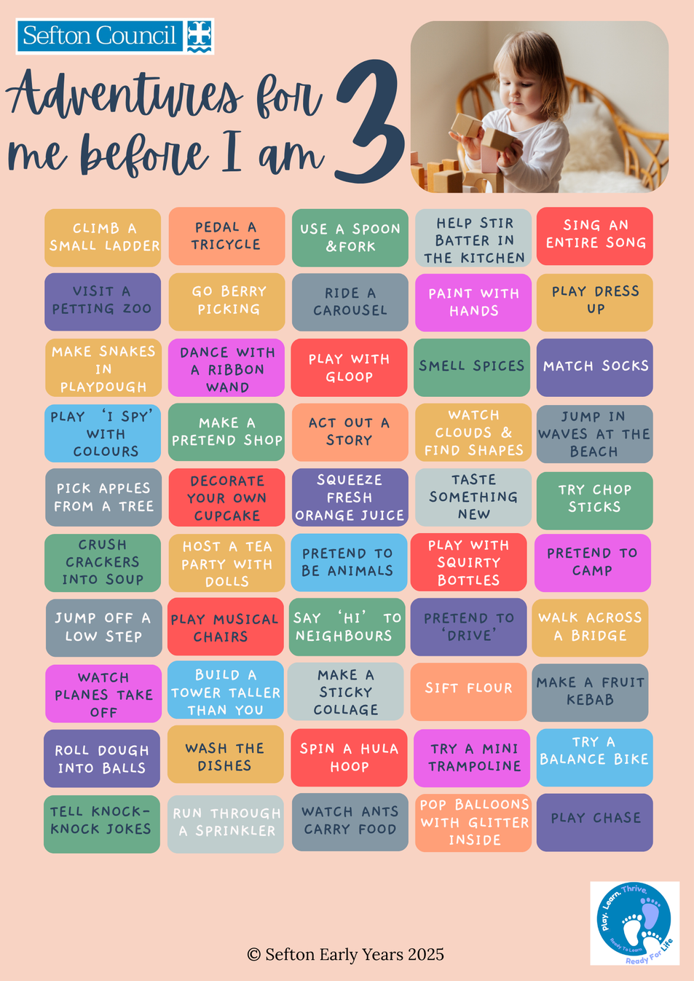
Simple play ideas
Notes:
Thrive before 5 supports our children being ready to learn. Simple experiences for children to experience with their caregivers help build the foundations that every child needs to thrive.

Slide 9
Developing Independence
How we want it to be
set a goal
achieve it
reality...
learning
more struggling
getting it
starting
achieve
practice
struggle
doubting
fail

Slide 10
HOW TO SUPPORT THE DEVELOPMENT OF INDEPENDENCE
  Start by encouraging children to start with something easy and small- the discovery of doing things for themselves soon has a ripple effect.
  The key is to forget perfection- most will struggle with tasks at first.
  Positive praise is important as it will keep confidence levels high and encourage children to try again.
  Support parents by modelling your expectations, e.g. ‘I’m sure they can carry that lunch box themselves’.
Notes:
Children enjoy that their actions have an effect which encourages them to do more tasks for themselves.
There is likely to be mess!
A simple 'you're getting there' gives a child the encouragement that they need.

Slide 11

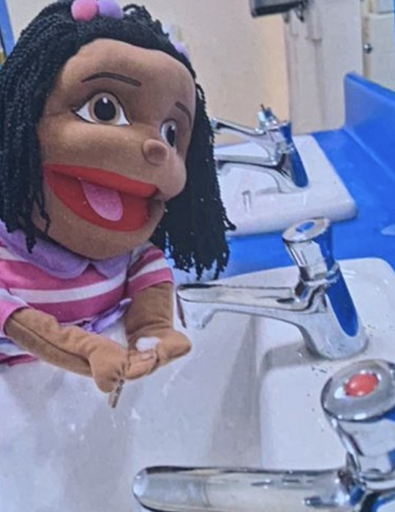
An Introduction to Independent Isla...
I can do it myself.
I can have a go.
I will try new things.
I can ask for help if I need it.

Slide 12
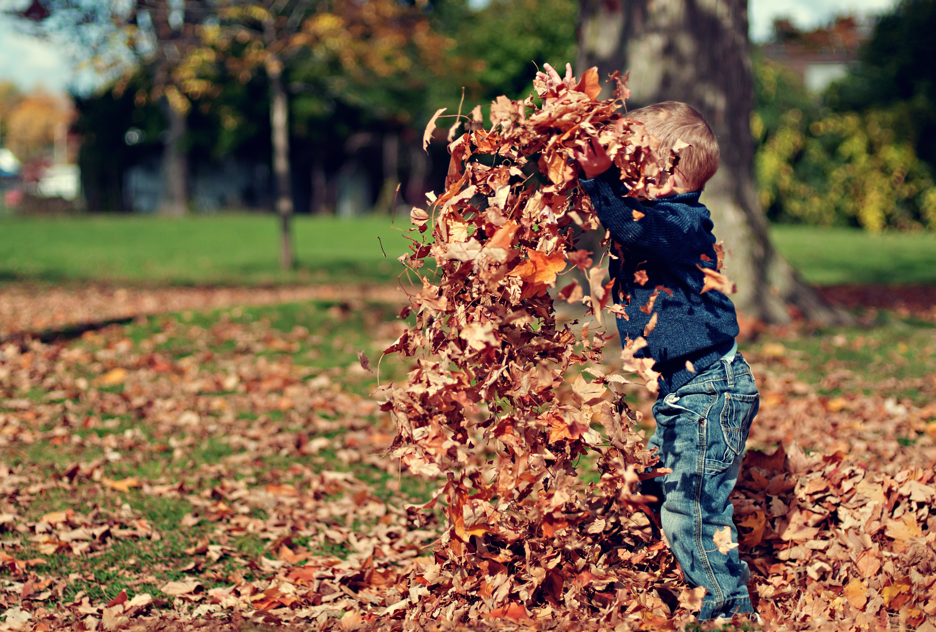
SCREENING OUT
  Growing up on Mars
  Screening out
  Outdoors and messy play
  Promoting communication at home
  Puppets

Slide 13

Growing up on Mars
The Anxious Generation: J.Haidt: 2024
Notes:
Your child has just turned 10.
She tells you that she has been chosen to join the first permenant human settlement on Mars.
Her academic performance secured her place.
Unbeknownst to you she has signed herself up because she loves outer space, and all her friends have signed up to.
She begs you to let her go.
Before saying no, you agree to find out more. You learn that the reason they are recruiting children is because they adapt better to the unsusual conditions of Mars than adults, particularly the low gravity. If children go through puberty on Mars, their bodies will be permentantly tailored to living there unlike settlers who come over as adults. It is unknown whether Mars-adapted children would be able to return to earth.
There's other reasons for saying no- the radiation levels are incredibly high and so a greater number of ions would shoot through the DNA of each cell in your daughters body.
The planners have built protective shields but there is a higher risk of cancer after spending a year in space.
The gravity is also a concern- Mars has gravity, but it's only 38% of what a child would experience on earth. Children raised in low gravity environments are at high risk of developing deformities in their skeletons, hearts, eyes and brains.

Slide 14
Would you let her go?
No company could ever take our children away and endanger them without our consent, or they would face massive liabilities.
Right?
The Anxious Generation: J.Haidt: 2024
Notes:
OF COURSE NOT!
tHIS IS A COMPLETELY INSANE IDEAS- SENDING CHILDREN TO mARS, PERHAPS NEVER RETURING TO EARTH? wHY WOULD ANY PARENT ALLOW IT?
The leaders don't appear to know anything about child development and they don't seem to care about children's safety. Worse still- the company did not require proof of parental permission. As long as your child ticks a box to say she has obtained parental permission, she can blast off to Mars.

Slide 15
CHILDREN’S ATTENTION SPAN
1 - 2 years: 2 - 6 minutes
2 - 3 years: 6 - 8 minutes
3 - 4 years: 8 - 12 minutes
4 - 5 years: 12 - 25 minutes
5 - 6 years: 18 - 30 minutes
Notes:
NEW
Back and forth interactions play a key role in shaping brain development, developing children's attention span and supporting their overall health and wellbeing.
When children have screen time, back and forth interactions reduce and behaviours become passive.

Slide 16
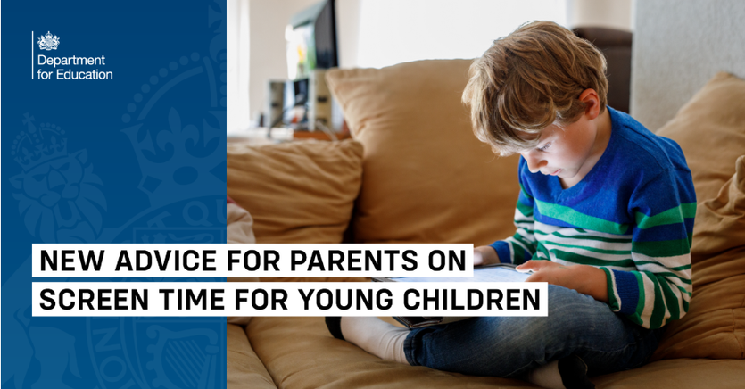
New Screen Time Advice for Parents:
Time spent on screens:
  Children under 2: no screen time unless for interaction and conversation.
  Children aged 2-5 years, no more than 1 hour of screen time per day.
Content:
  Slow-paced age-appropriate content can support early childhood development.
  Co-viewing is linked to better cognitive development.
Baby and toddler screen time guidance - Best Start in Life
Notes:
Released 27th March.
Screens are part of everyday life for young families. With 98% of two-year-olds watching screens daily, avoiding them altogether isn't realistic — but managing them well can make a difference to how young children grow and develop.
Over a thousand parents were asked what support they needed, and the message was clear: families want practical, non-judgemental guidance on how much screen time is too much and how to limit any negative impact on their children. This new advice is the government's response to that call.
video calls to family
never during meals and the hour before bed.

Slide 17

THE PROBLEM: THE BRAIN CABLES
In children who exceeded screen time guidance, brain scans shows ignificantly lower ‘white matter integrity’.
When this network is underdeveloped, the brain’s signals literally, travel slower resulting in:
  slower early reading skills
  lower scores on language assessments
  a harder time to process new information.
Notes:
researchers performed MRI scans on the brains of healthy 3 to 5 year olds.
They discovered that children who exceeded screen time guidelines had significantly lower white matter integrity
We can think of the white matter as internal fibre optic cables- it is the communication network that allows the different areas of the brain to talk to each other.
of course we must look at the data objectively- whilst the study does not prove that using an ipad actively destroys white matter, it does show a massive, undeniable association.
Research indicates that for pre-school aged boys, screen exposure is more strongly associated with developmental delays and behavioural issues, than it is with girls, suggesting that their brains may be less resilient to the digital dopamine hit.

Slide 18
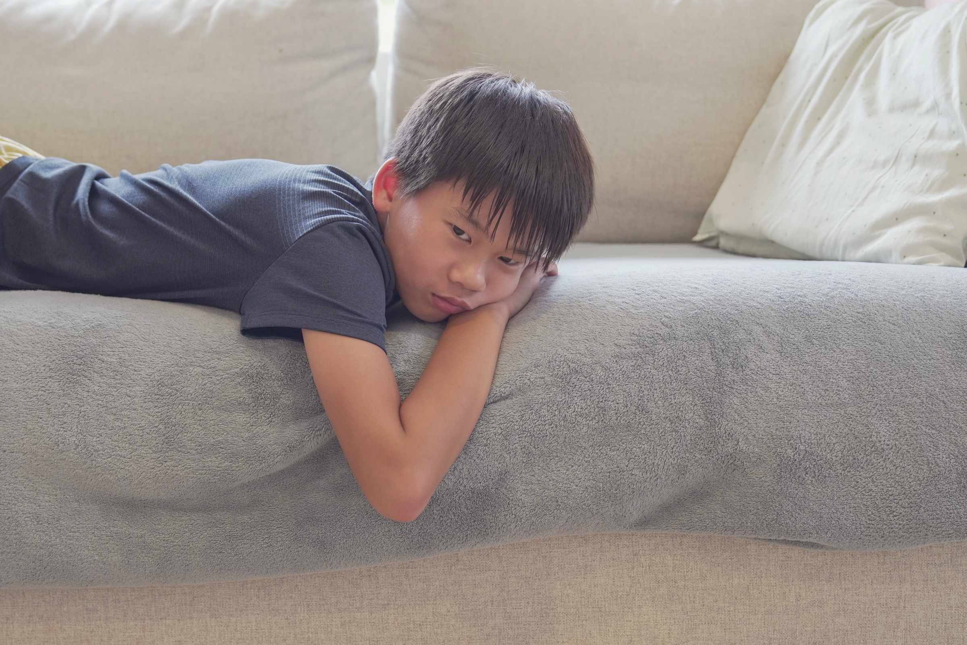
FAST-PACED = BRAIN DRAIN
New data found that short-form, fast-paced videos were associated with lower cognitive flexibility immediately after viewing.
The theory?
The brain gets used to the 15 second change, making real-life feel ‘boring’.
Notes:
We worry about what children watch, but we should worry about the speed.
We can develop healthy dopamine patterns through
using a visual schedule reduces stress and prevents the dopamine roller coaster cause by unpredictability.
slow rewards- tasks that require effort and result in a sense of accomplishment- building blocks, lego, art and craft, solving puzzles.
nature- getting natural sensory input
creative- free creative time

Slide 19
SUPPORTING LANGUAGE
Reduced screen time supports back and forth conversations to take place. Shared reading promotes vocabulary development.
Messy play helps to improve children’s vocabulary, playing with different messy activities to help them discover new words such as fluffy, slimy, sticky, smooth etc. It encourages children to communicate effectively with others.
Outdoors encourages improves children’s mental health and well-being. It supports their communication and language, physical development motivation and self-esteem.
Notes:
Reducing screen time supports back and forth conversations, with these serve and return interactions supporting brain development. They learn that their words have power and believe that people are worth talking to.
Messy play stimulates children’s senses and allows them to experiment and explore through play. Mess means children are having fun. Mess means children are engaged. Mess means children are learning and developing their language.
Being outdoors supports mental health and wellbeing. Children are born ready to be and learn outside. They are innately curious, driven learners who flourish if allowed to find out more about the world around them through playful contact throughout the year.
Outdoor learning nourishes opportunities for awe and wonder which allows each child to revisit their interests, play, learn and have fun.

Slide 20
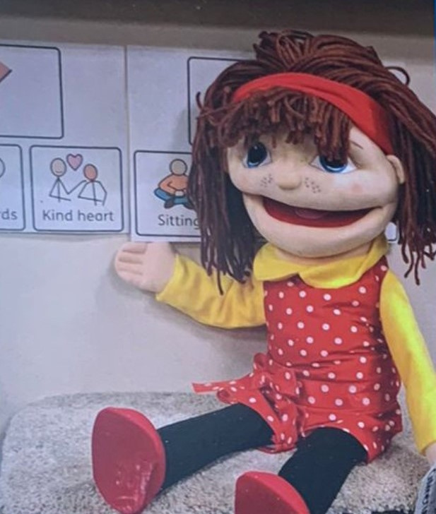
An Introduction to Communicating Catherine...
I am friendly to others.
I can listen carefully.
I can share my ideas with others.
I can wait.

