Slide 1





Building a Strong Brain
SUCCESS
EXPERIENCES
INDEPENDENCE
ATTENDANCE
re-read
every day
interests
READING
chat
sing
describe
calm
TALKING & LISTENING
interests
join in
time
talk
PLAY
1:1 time
affection
routine
respond
LOVING RELATIONSHIPS

Slide 2


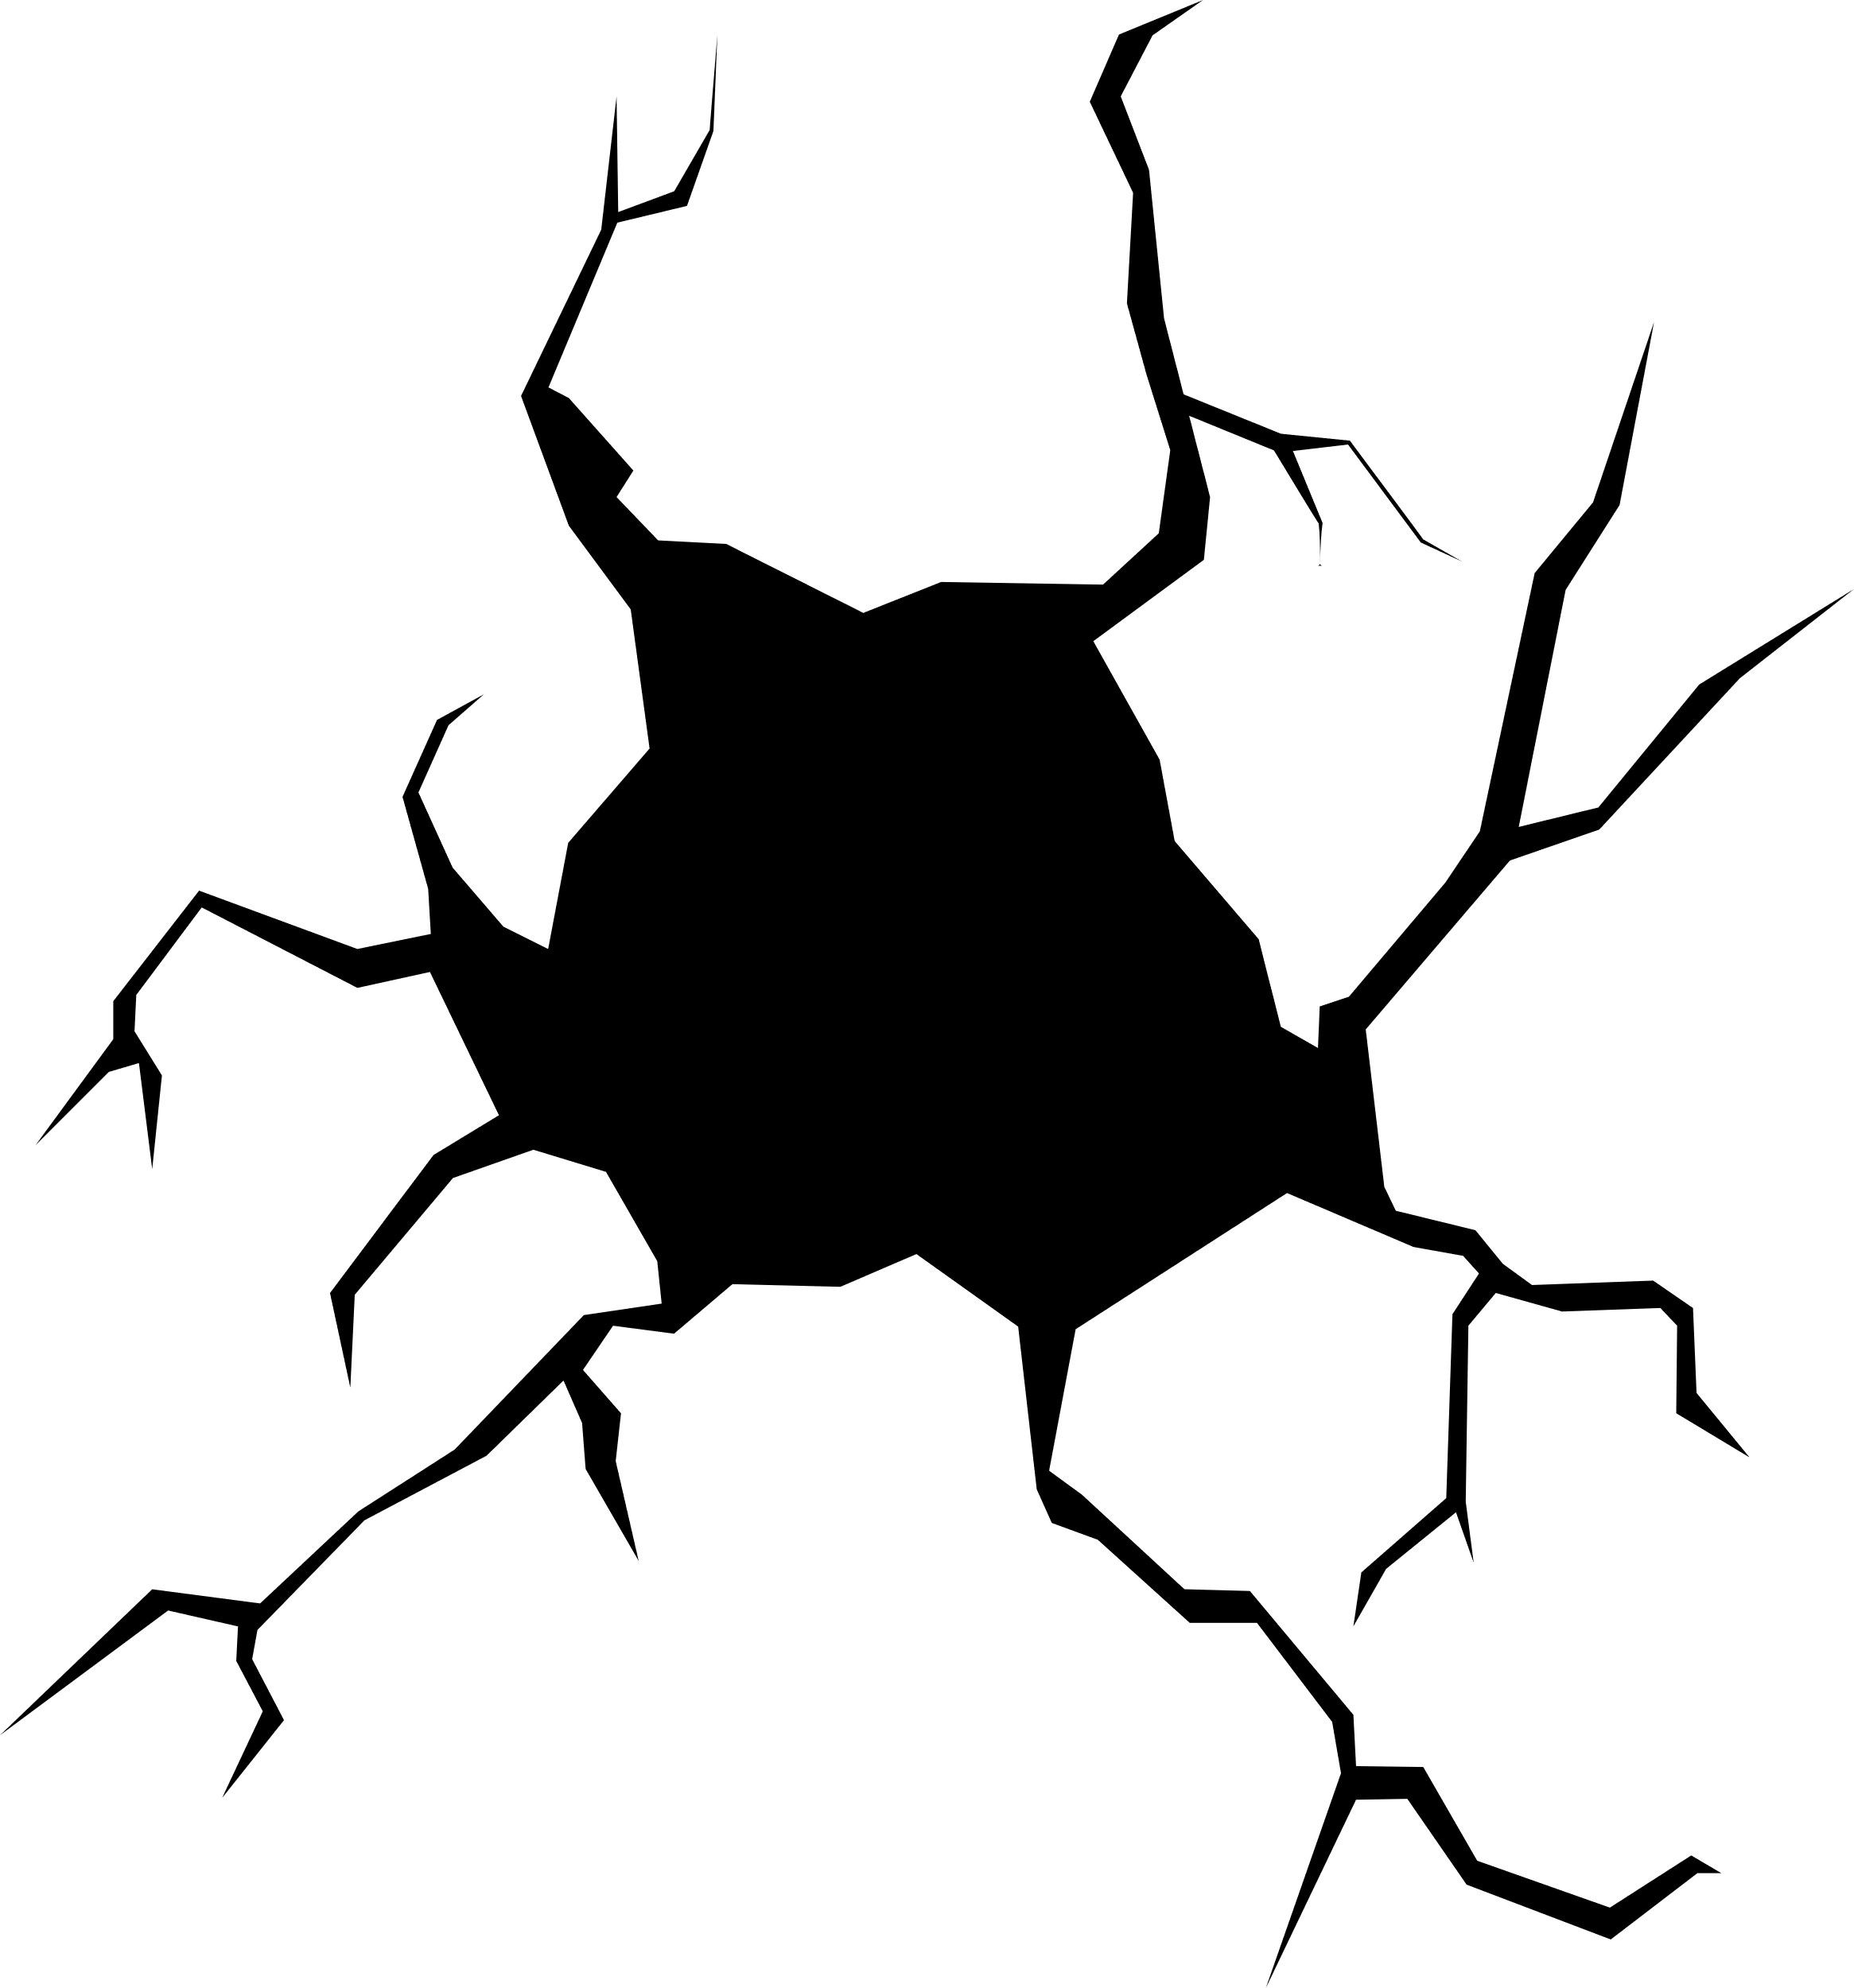
Building a Strong Brain
SUCCESS
EXPERIENCES
INDEPENDENCE
ATTENDANCE
1:1 time
interests
re-read
every day
READING
STRESS
chat
sing
describe
calm
1:1 time
NO TALK
TALKING & LISTENING
interests
join in
time
talk
PLAY
SCREENS
1:1 time
affection
routine
respond
LACK OF
SLEEP
LOVING RELATIONSHIPS

