Slide 1
Communication and Language Workshop
Miss Houghton

Slide 2
What is communication and language In early years ?
Ability to express ideas
Understand people's feelings
Understand information through lots of different ways
Understand the way language is used
Use of age-appropriate language to express themselves.
Use of correct grammar
Using an expanding vocabulary
holding back-and-forth conversations
explaining events
Speaking in full sentences

Slide 3

Communcation and language early learning goals – listening, attention and understanding
listen attentively and respond to what they hear with relevant questions , comments and actions when being read a story and during whole class discussions / small group interactions.
Make comments about what they hear and ask questions to clarify their understanding.
Hold conversations when engaged in back and forth exchanges with their teachers and peers

Slide 4

Communication and language early learning goals – speaking
Participate in small group, 1:1 and class discussions, offering their own ideas, using recently introduced vocabulary.
Offer explanations for why things happen, making use of newly introduced vocabulary from stories, non-fiction texts, rhymes and poems when appropriate.
Express their ideas and feelings about their experiences using full sentences, including use of past, present and future tenses and making use of conjunctions, with modelling and support from a teacher.

Slide 5
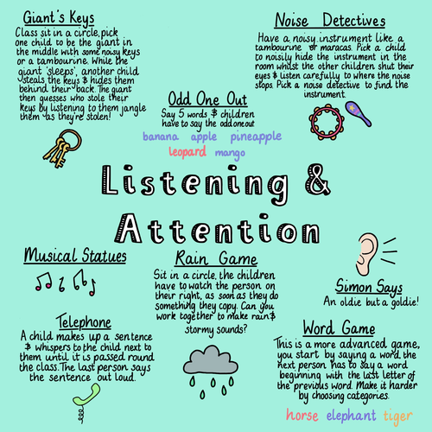
Activities to help with listening, attention and understanding.
Games – Simon says, musical statues, listening teddy, turn taking games, rhythm games, sound bingo(guess the sound).
Interactive stories, use of questioning and discussion
Spot the mistake, what's happened? Can you explain?
Getting your child involved in everyday activities – cooking, washing up, dressing. This can spark lots of conversation

Slide 6

Activities to support speaking
Reading
Story telling games
Singing songs
Puppet and toy play
Language games - I spy
Building blocks – good for counting, describing, prediction and social skills
Talking during daily tasks
Give clear direct instructions
Getting your child to repeat sentences or demands – what have I asked you to do ?
Speaking in full sentences

Slide 7
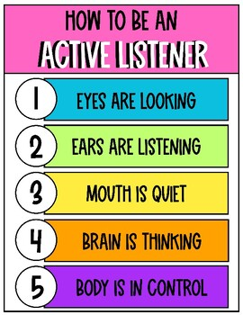
Creating the right environment
Reduce distractions – tv, background noise, toys
Limit screen time
Ensure you are eye level with your child and encourage them to look directly at you.
Make it entertaining so that your child will engage with you – enthusiastic voice
Repeat and model
Follow their lead – you know your child best

Slide 8
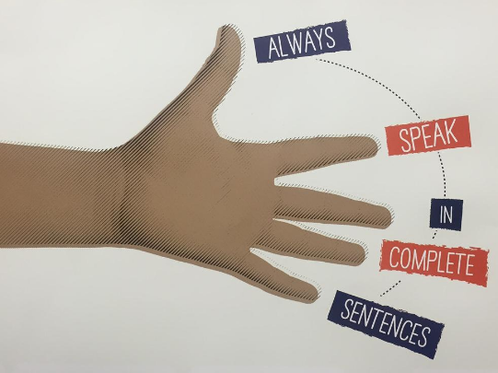
Speaking in full sentences
Examples :
Question : how are you feeling?
I am feeling happy today because I enjoyed riding the bikes in PE.
Question : What was the funniest thing that happened today?
The funniest part of my day was when Miss Houghton did a silly dance.
Question : If you could be any animal what would it be?
I would be a lion because they are big and fierce
Sometimes we may find this tricky, or we may be lazy !
Encourage your child to speak in full clear sentences
Allow them time to talk

Slide 9

Useful websites to support your child with communication and language
https://speechandlanguage.org.uk/help-for-families/
https://www.bbc.co.uk/tiny-happy-people/4-to-5-year-old-child-development-activities
https://literacytrust.org.uk/early-years/
https://www.famly.co/blog/10-simple-communication-and-language-activities
https://send.eani.org.uk/sites/default/files/2023-07/Play%20Activities%20to%20Support%20Communication%20and%20Interactions.pdf

Slide 10
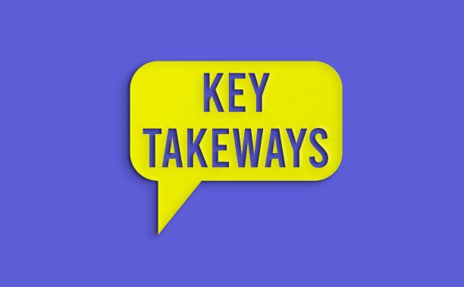
Key take aways from this session
Use the resources given to you , Miss Houghton will provide these as part of the homework on Friday.
Encourage your child to speak in full sentences
Give your child time to talk
Involve them with everyday life – it sparks conversation !
Play games
Model and express how you would like your child to talk
Give clear direct instructions
Provide the right environment

Slide 11
Thank you
Any questions?
Houghtonp@sps.sefton.school
Please email me for further advice or support

