Slide 1

Meet The Teacher
Reception 2026

Slide 2
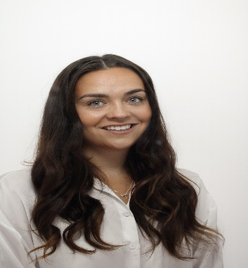
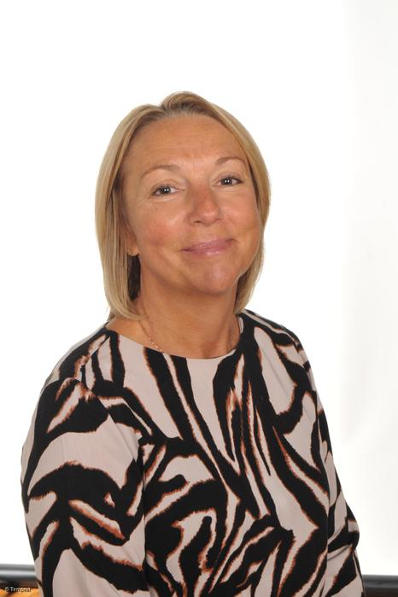
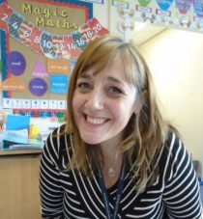
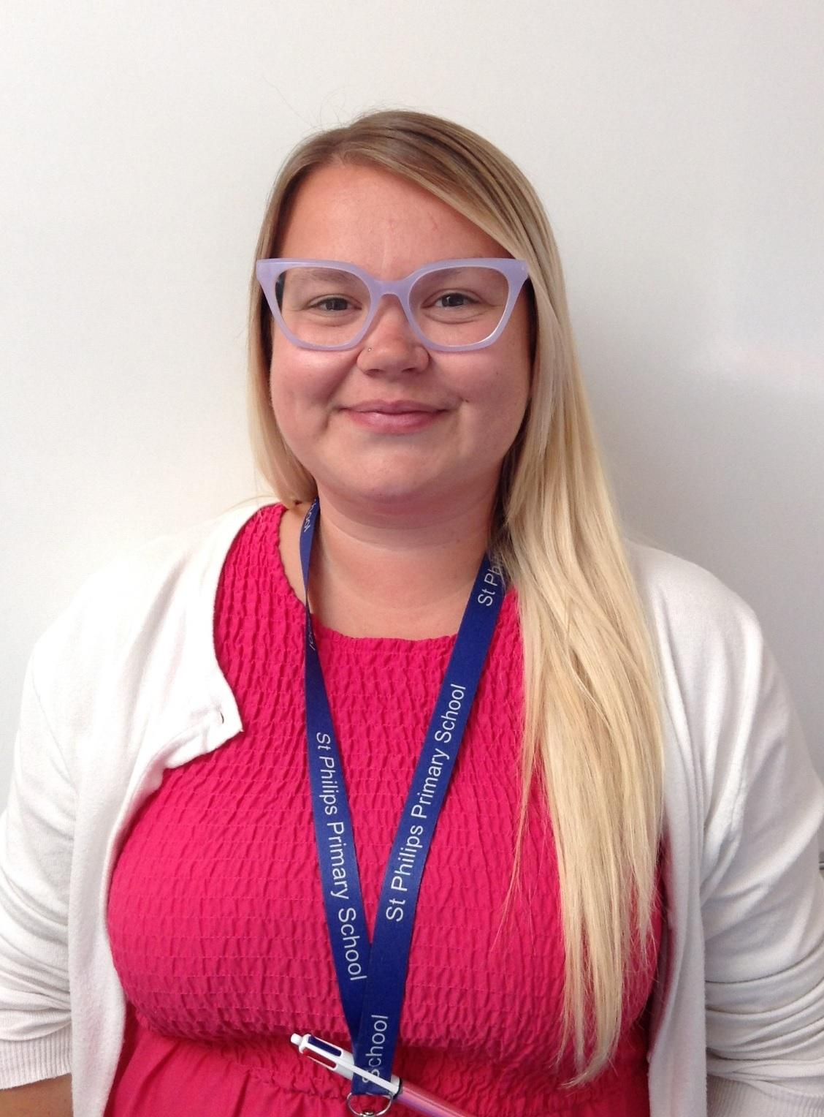
Reception staff
Class teacher – Miss Houghton
Mrs Klaassen – Wednesday mornings
Teaching Assistant –Mrs Rimmer
Teaching Assistant – Mrs Adkins

Slide 3
School website and how to contact us
We will be using and updating our school website and class page frequently over the year. Please keep up to date of any announcements. https://www.stphilipssouthport.com/
Contact details are on the homepage so if you are needing to get in contact with school-
head@sps.sefton.school
admin@sps.sefton.school
Mrs Edward says please be respectful of teachers work life balance. Emails should be proportionate and at sensible times.
Parent Whatsapp use should be respectful of all members of the school community.
Staff are not able to have lengthy conversations at the start of the school day and any more than a brief chat at the end of the day needs to be a planned appointment.
Mrs Edward is usually on the path at the start and end of each day if you need a quick word.

Slide 4

Medical
Any medication updates – please let us know of any changes
Please check that your child’s inhaler is in date.
We have been advised that children should use a spacer when taking their inhaler - if possible please send one into school.
If your child needs any prescribed medication, a medical form needs to be filled in at the office before we are able to administer it.
Thank you

Slide 5
Routines
Doors open at 8.45 and close at 8.55.
Finish at 3.20pm.
If your child is absent from school please telephone the school as soon as possible.
On the day your child returns, please let the teacher know why they were absent.

Slide 6
Attendance and punctuality
It is crucial for children to arrive on time to school. Children’s activities start at 8:45am. If they are late- they are missing learning time.
If your child is being collected at the end of the day, please arrive on time for 3:20pm.
Please do not allow children on the adventure playground before and after the school day.
Please note that no term time holidays will be authorised and fines will be in place.

Slide 7

Curriculum
Curriculum map and autumn newsletter is on the website.
Website
Please keep checking the website dates and news.
We will try to keep the website updated with lots of photos of your children at work and play.
Trips
You will also find information about after school clubs on the website.

Slide 8

Housekeeping!
Please name all uniform –
Winter uniform option 1 Winter uniform option 2
Grey trousers Navy skirt or pinafore
White shirt White blouse
Navy long sleeved jumper Navy long sleeved cardigan
School tie School tie
PE will be on Mondays and Wednesdays so please come to school in your PE kit on those days (including blue jogging bottoms and blue jumpers/hoodies when it’s cold). White or black trainers suitable for sport NOT fashion, may be worn. You are not allowed to wear jewellery for PE (including earrings) so please make sure you have removed these before you come to school.
Please make sure your child has a full water bottle each day.
Please make sure your child brings school book bags each day. No rucksacks please.

Slide 9
Cashless school payments
https://schoolgateway.co.uk/help/
All payments are made electronically on our payment and booking system.

Slide 10




Positive Behaviour and rewards
Stickers
Star of the Week
Behaviour Buddy
Mathematician
Head Teacher Stickers
You’ve been spotted!

Slide 11
Class Dojos

Slide 12
Homework
Homework will be given out on a Friday to be returned the following Wednesday.
Homework needs to be returned on time and on the day it is supposed to be handed in.
Weekly phonics sounds will be put on the website and in homework books.
Please try to read with your child every day.

Slide 13

Essential Letters and Sounds (ELS) is our chosen DfE validated phonics programme.
Children will experience the joy of language whilst rapidly acquiring the phonics skills they need to become fluent, independent readers and writers.
How do we teach phonics?
We use a simple, consistent approach to teaching phonics
We have mnemonics and rhymes to support learning and recall
We teach phonics every single day from the first days of Reception
Phonics throughout the day to review new sounds and graphemes taught
Lots of opportunities for oral blending - /c/ /oa/ /t/
We teach the ‘code’ for reading, alongside teaching vocabulary

Slide 14
Reading
Your child will be assessed against the reading bands when they know some initial sounds
The children will then read through the colour bands
Please try and read at home every night.
In school the children will be involved in:
1:1 reading
Reading across the curriculum.
Story time each day.
Library books – please bring these back every Wednesday.

Slide 15

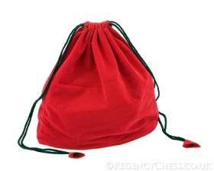
Other
Writing, pencil grip, robot arms and blending hands
Homework books – Each Friday to be returned the following Wednesday
Library books – changed weekly on a Wednesday
Children come to school in PE kits – Monday and Wednesday
Lunches, water bottles, milk & fruit.
Please collect water bottles off the trolley everyday at pick up. Please do not leave them overnight.
Information, newsletters, website, text messages & twitter
No nuts in lunchboxes, this includes peanut butter or Nutella spread.
Please try and refrain from bringing your child to the door in the morning. Encourage independence by getting your child to walk up the ramp by themselves.

Slide 16
Assessment
Baseline
On-going assessment using the EYFS profile
Parents/carers meetings to discuss development
End of year written report
YOU may spot your child doing something amazing – please tell us so we can celebrate this.

Slide 17
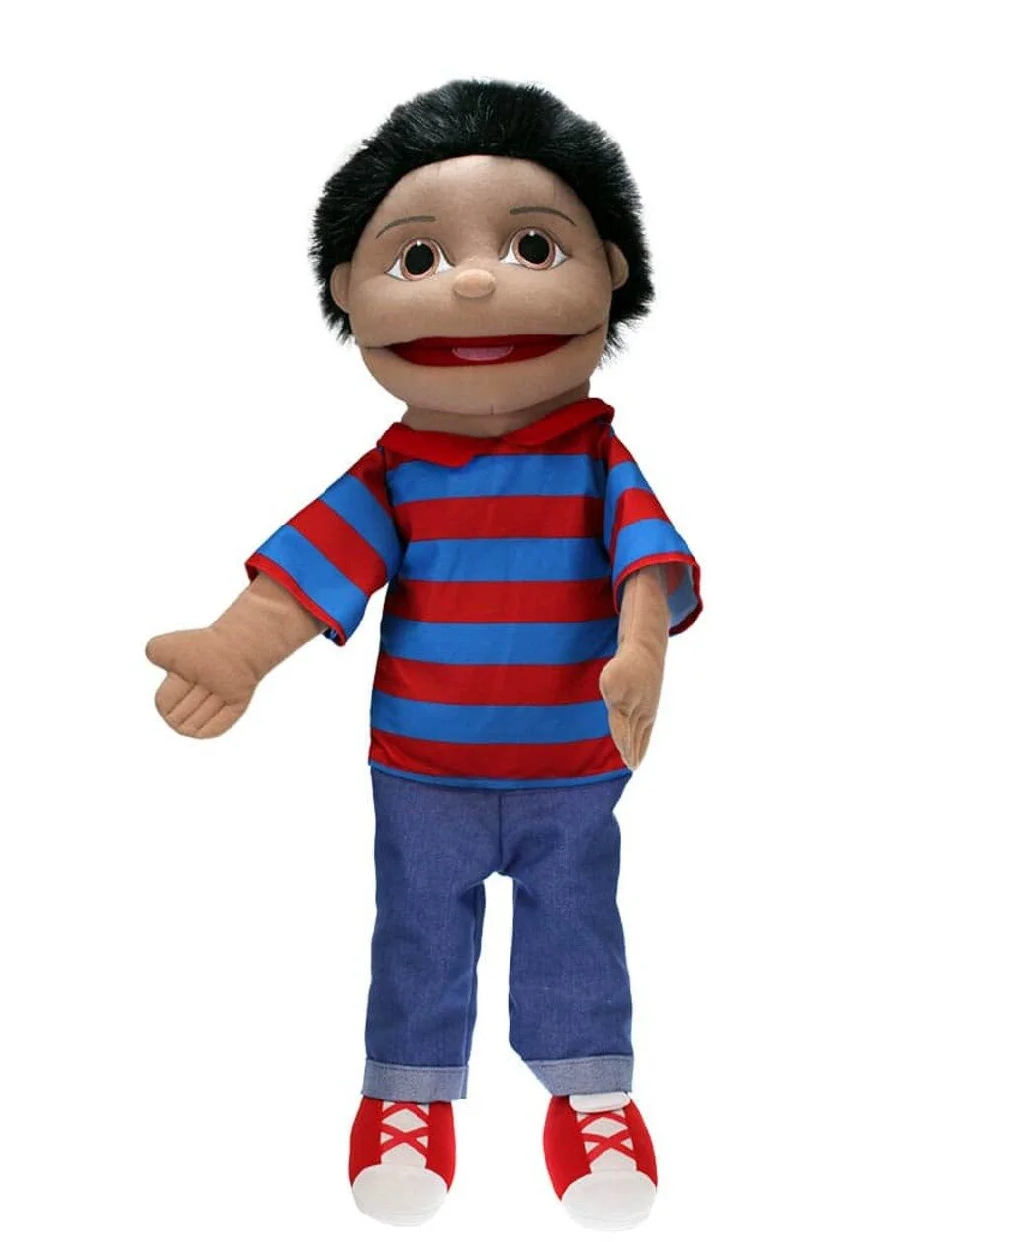
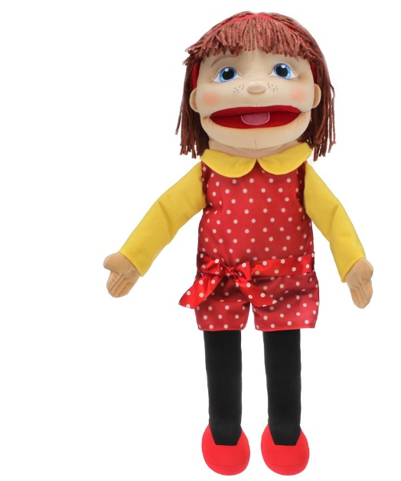
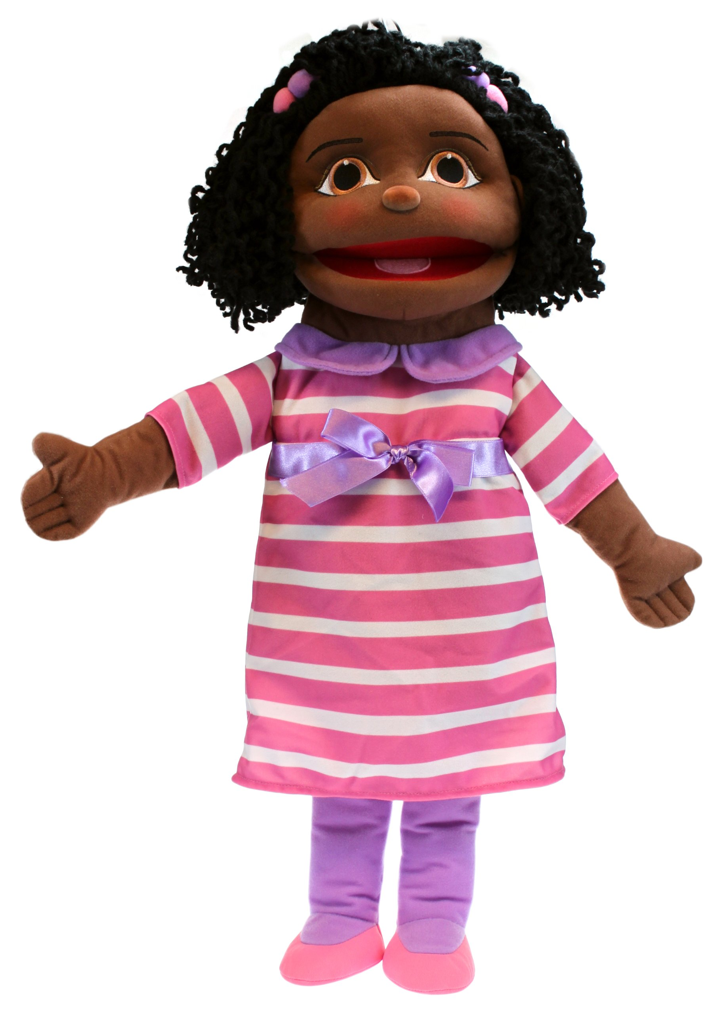
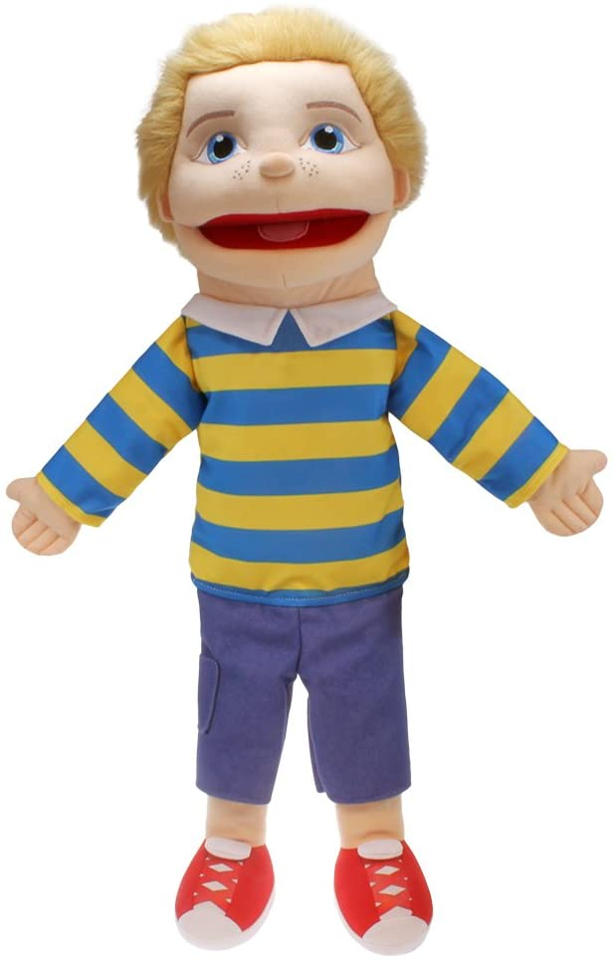
Life long learners
Communicating Catherine
Independent Isla
Resilient Robert
Learning Luke

Slide 18
ST PHILIP’S CE PRIMARY SUPPORT TRIANGLE
SENDCO - Mrs Klaassen
SEN Support
Targeted Support
Enhanced Quality First,
Quality First – Universal Offer for all
High Needs Funding
EHCP’s
Specialist

Slide 19

Important dates for your diary :
MHST workshop – Tuesday 15th September 9am
Phonics workshop – Tuesday 22nd September 9am
Communication and language workshop – Tuesday 29th September 9am
Lifelong learners workshop – Tuesday 6th October 9am
Parents evening – Wednesday 21st October 2pm, appointment only more information to follow.

Slide 20

Any questions?

