Slide 1


Welcome to Year 6!

Slide 2


Slide 3

We have codes of conduct for Governors, staff and parents and expect all members of our school community to abide by these.
Our School Vision:

Slide 4
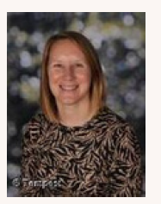
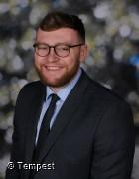
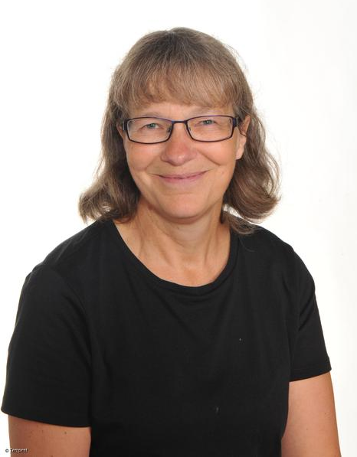
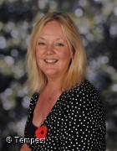
Who will be teaching you?
Mrs Cooper
Monday, Tuesday Wednesdays and Thursday mornings
Mr Highton
Every day apart from Wednesday afternoon
Mrs Walker
Teaching Assistant
Ms Lund
Teaching Wednesday afternoons
Mrs Westby
Welfare assistant

Slide 5
School website and how to contact us
We will be updating our school website and class page frequently over the year. Please keep up to date of any announcements. https://www.stphilipssouthport.com/
Contact details are on the homepage so if you are needing to get in contact with school- head@sps.sefton.school
admin@sps.sefton.school
coopere@sps.sefton.school
Mrs Edward says please be respectful of teachers work life balance. Emails should be proportionate and at sensible times. Parent Whatsapp use should be respectful of all members of the school community.
Staff are not able to have lengthy conversations at the start of the school day and any more than a brief chat at the end of the day needs to be a planned appointment.
Mrs Edward is usually on the path at the start and end of each day if you need a quick word.

Slide 6

Medical
Any medication updates – please let us know of any changes
If your child needs any prescribed medication, a medical form needs to be filled in at the office before we are able to administer it.
Thank you

Slide 7
Routines
Doors open at 8.45, Registration at 8.55
Finish at 3.25pm.
If your child is absent from school please telephone the school as soon as possible
It’s really important to be on time (whenever possible) as morning activities start as soon as we arrive at school.
If your child will be walking home please give written consent to the school.

Slide 8


Housekeeping!
Please name all clothing
PE is on Monday and Thursday (swimming) afternoons- no earrings
Please make sure your child has a water bottle each day
Healthy snacks can be brought in for Junior morning break time – fruit, vegetable sticks, cereal bars (no sweets or nuts please).

Slide 9
Uniform
Option 1 WINTER UNIFORM
GREY TROUSERS (NO OTHER COLOUR)
WHITE SHIRT with buttons and collar
NAVY LONG SLEEVED JUMPER
SCHOOL TIE
DARK COLOURED SCHOOL SHOES – not trainers
DARK SOCKS
Option 2 WINTER UNIFORM
NAVY SKIRT OR PINAFORE DRESS
WHITE BLOUSE with buttons and collar
NAVY LONG SLEEVED CARDIGAN
SCHOOL TIE
NAVY TIGHTS / NAVY OR WHITE SOCKS
DARK COLOURED SCHOOL SHOES – not trainers
Long hair must be tied back, hair accessories should be minimal and school colours.
Jewellery is not permitted.

Slide 10
Attendance and punctuality
It is crucial for children to arrive on time to school. Children’s activities start at 8:45 which is Times Table rockstar practice for Year 4. If they are late- they are missing learning time.
If your child is being collected at the end of the day, please arrive on time for 3:25pm.
Please do not allow children on the adventure playground before and after the school day.
Please note that no term time holidays will be authorised and fines will be in place.

Slide 11


Slide 12
Attendance…
First Response
If your child is absent you must contact the school office by telephone or email to report your child's absence giving clear details of the reason for absence. Failure to do so means that our First Response kicks in and if we cannot get hold of you and we are unable to make contact with you via your emergency contact details, it might be necessary for a senior leader to come to your house!
This is part of our safeguarding response to ensure everyone is safe and well. As you can imagine, a home visit takes up a lot of time and it is usually the case that families have forgotten to call us.
TERM TIME HOLIDAYS ARE NEVER AUTHORISED. Families may be eligible for a fine from the Local Authority.

Slide 13
Cashless school payments
https://schoolgateway.co.uk/help/
All payments are made electronically on our payment and booking system.

Slide 14
Class Timetable

Slide 15
Curriculum
Curriculum map/newsletter is on our website- also a paper copy has been sent home.

Slide 16
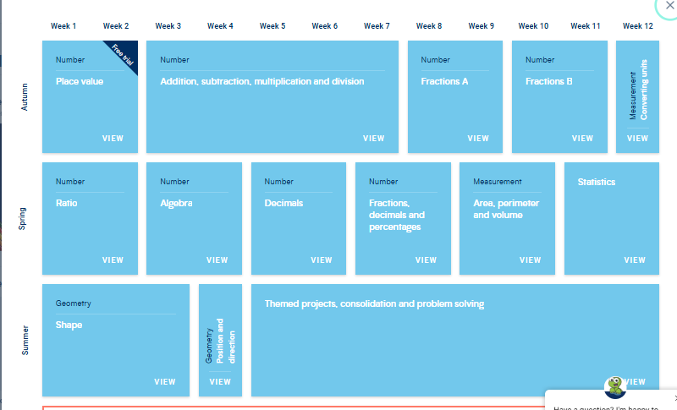
White Rose resources – Maths mastery

Slide 17
Subject ladders
We have English ladders for you to download on our website. Please read them and refer to them throughout the year as they show the expectations for your child in Year 6

Slide 18
Assessment
Children’s attainment is assessed in relation to year group objectives, this could be…
Below, Working towards, Expected , Greater Depth
At the end of each term we will record your child’s attainment on Insight (our data system) using both teacher and test information. This system allows us to analyse your child’s progress and attainment. We will work closely with you if we feel your child is not making the progress that we would expect.
In February and at the end of the Summer term we will use NFER tests in Years 2- 5 to track progress in Maths, Reading and SPAG. We will share your child’s outcomes with you and will give advice around things that you can do at home to help. We will talk to you about the things that we are working on in school.
There will be:
2 parents evenings
An end of year report
An open door policy to discuss any concerns in relation to learning.

Slide 19
Homework
Homework will be given out on a Wednesday.
Spelling test on a Friday.
Homework to be given in by the following Wednesday. Please let us know if any homework is too difficult so we can give a little extra help at school. Homework club is invite only but can be offered to those who are struggling to complete at home (Juniors only)- please speak to the class teacher.
Please help your child to learn their spellings and tables each week.

Slide 20

Spellings
We have a huge emphasis on spellings. Children need to be practising their spellings daily and not for a spelling test.
In Year 6 , children need to be able to spell words from the Year 5 and 6 curriculum list . They must show they can spell these words correctly in their writing.
Spelling sheet for this half term has been sent home already and is on the class web page.
We will be using spelling badges to reward spelling test scores- we have a new system in place this year.
IDL- we may also use IDL to support your child's spelling- you will be given a password to access this at home.

Slide 22
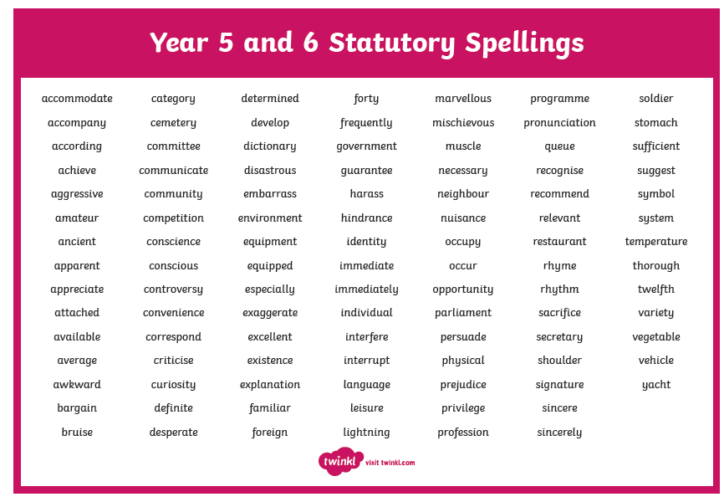

Slide 23

Reading
Your children will continue reading through the colour bands
Please try and read at home at least 5 times a week.
In school the children will be involved in
‘Stop and read’ daily
Reading across the curriculum.
Reading lesson each Friday
Story time at the end of the day.

Slide 24
ST PHILIP’S CE PRIMARY SUPPORT TRIANGLE
SENDCO - Mrs Klaassen
SEN Support
Targeted Support
Enhanced Quality First,
Quality First – Universal Offer for all
High Needs Funding
EHCP’s
Specialist

Slide 25



Behaviour and
Good To Be Green
Very high expectations
Manners
Greetings
Can do attitudes
Ready, Respectful, Responsible

Slide 26
Behaviour and
Good To Be Green
Half termly- ‘Good to be Green’ certificates
Red cards- letter home to parents on a Friday
Yellow cards- miss some of break time.

Slide 27
St Philip’s Standards
Be Ready
Be Respectful
Be Responsible
Fantastic Walking

Slide 28

Fantastic Walking
Walking properly makes you feel great.
We are going to be doing fantastic walking, All THE TIME!
Head up
Arms by your sides
Slow pace.

Slide 29
Assessment
Statutory Assessments take place at the end of KS2 (Year 6).
2027 KS2 SATs Timetable
The statutory tests for Year 6 pupils run across four days in May:
Monday 10 May 2027: English grammar, punctuation and spelling (SPaG) Paper 1 (short answers) and Paper 2 (spelling)
Tuesday 11 May 2027: English reading paper
Wednesday 12 May 2027: Mathematics Paper 1 (arithmetic) and Paper 2 (reasoning)
Thursday 13 May 2027: Mathematics Paper 3 (reasoning)
We will have a meeting about the SATs at a later date.

Slide 30
School Trips…
To be confirmed…
Cinema trip
Liverpool Cathedral - Leaver’s service
End of SATs celebration – Kings Gardens
Anderton Centre – residential
(If there is anyone who doesn’t want their child to go on the residential, please can you let the office know so we don’t continue to ask for the deposit – thank you.)
We require payment of a voluntary parental contribution for all school trips. Sadly due to budget constraints if we do not receive enough payments the trip may not go ahead. Mrs Edward is always available to discuss any concerns in relation to payment of anything requested. We will never leave a child out.

Slide 31

Parent’s meeting:
Weds 21st October
2pm onwards

Slide 32

Please check your filters.
Be aware of the issues around Whatsapp. School expects parents to manage and monitor children's use and we will not investigate upset linked to home use of whatsapp.
Mobile phones are not allowed in school. Phones for children who are walking home in Y5 and Y6 are handed in each day and kept in the school office. The phone is returned at the end of the day.

Slide 33
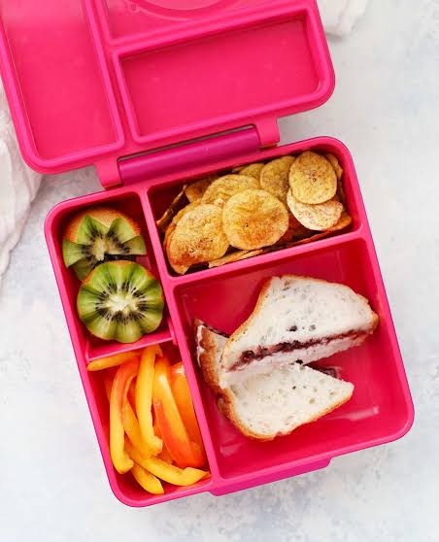
Healthy lunchboxes
https://www.stphilipssouthport.com/packed-lunch-ideas

Slide 34

Volunteers are very welcome!
Safer Recruitment Checks will be completed.

Slide 35

Check website for information:
http://www.stphilipssouthport.com/
and Twitter!

Slide 36

Any questions?

