Slide 1
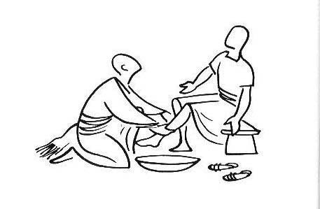

Our Christian
Vision…
Our Motto
Christ in Everything we Do!

Slide 2




What do we think a vision is?
An amazing dream
Something we aim for together
A wish for ideal world with God at the centre.
A target where you aim for the exact thing that you want.
Something you see in your mind’s eye.
A thing that makes the world a better place

Slide 3




Happiness, Love and Security Abound

Slide 4


Everyone is special

Slide 5
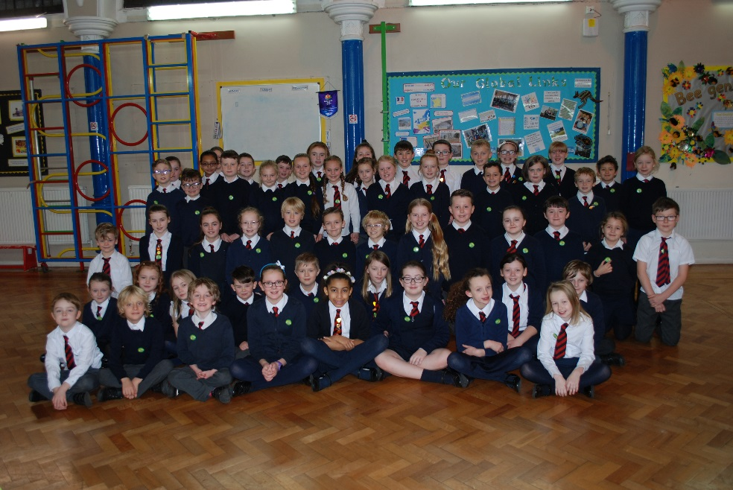
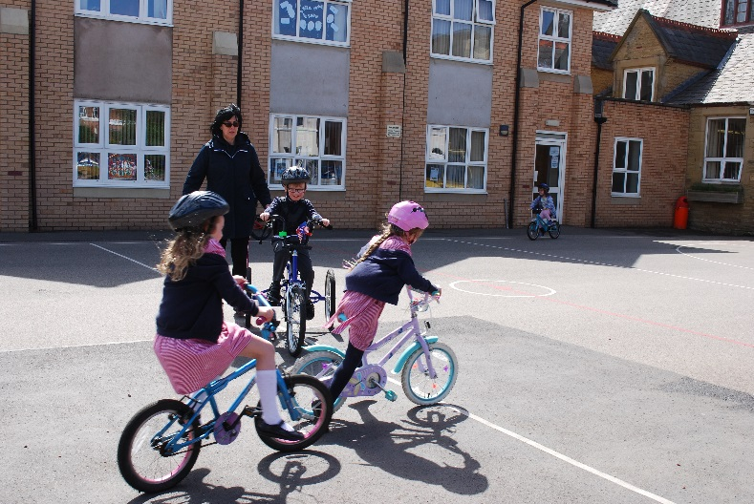

Every achievement is celebrated

Slide 6
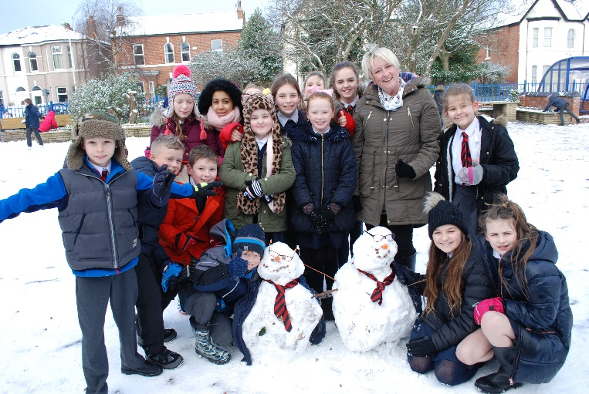
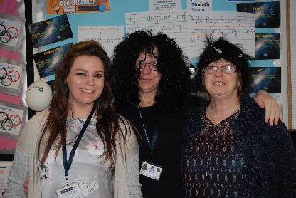
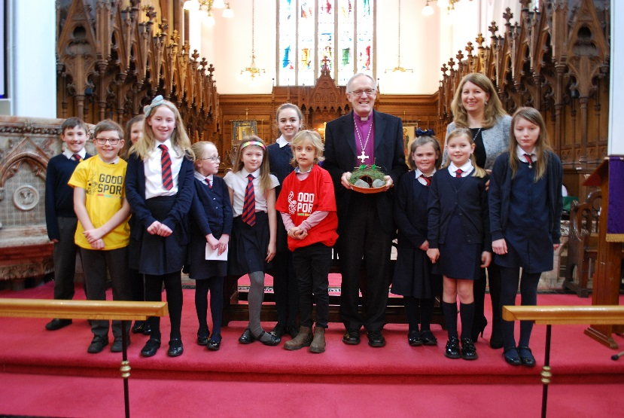
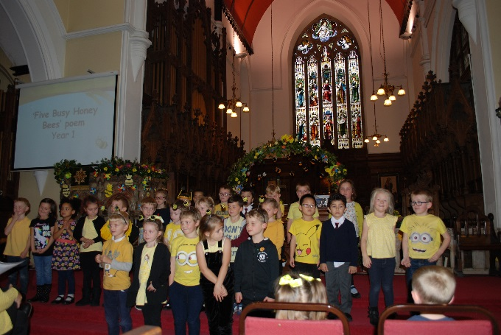
Relationships and teamwork matter

Slide 7


A beacon of light in the community

Slide 8


Christ in everything we do

Slide 9
Think about our school and our vision.
How can you be a part of it?
How can you make a bigger difference?
Reflection

Slide 10
Prayer
Dear Lord Jesus
Thank you for our school.
Thank you that together we can make our vision real every day.
Help us to think, Act and be like you.
Amen

