Slide 1


Commonwealth Day
Notes:
Each year, the 2nd Monday in March is Commonwealth Day…this year the slogan is Towards a Common Future

Slide 2
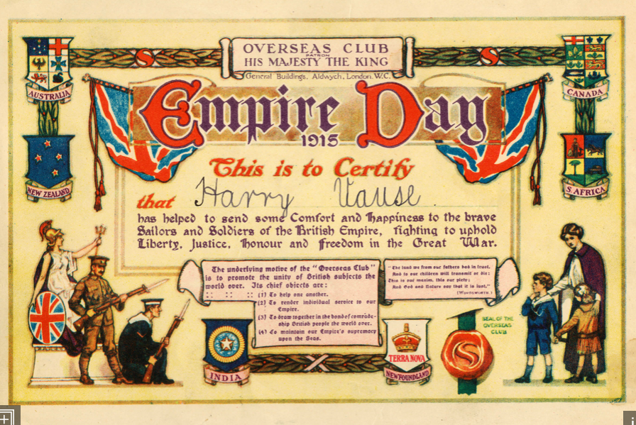
History
Notes:
The Commonwealth began as countries that were part of the British Empire and the 24th of May used to be Empire Day

Slide 3

Notes:
Empire Day was meant to be a “symbol of that unity of feeling . . . to those ideals of freedom, justice, and tolerance for which the British Empire [stood] throughout the world.”

Slide 4
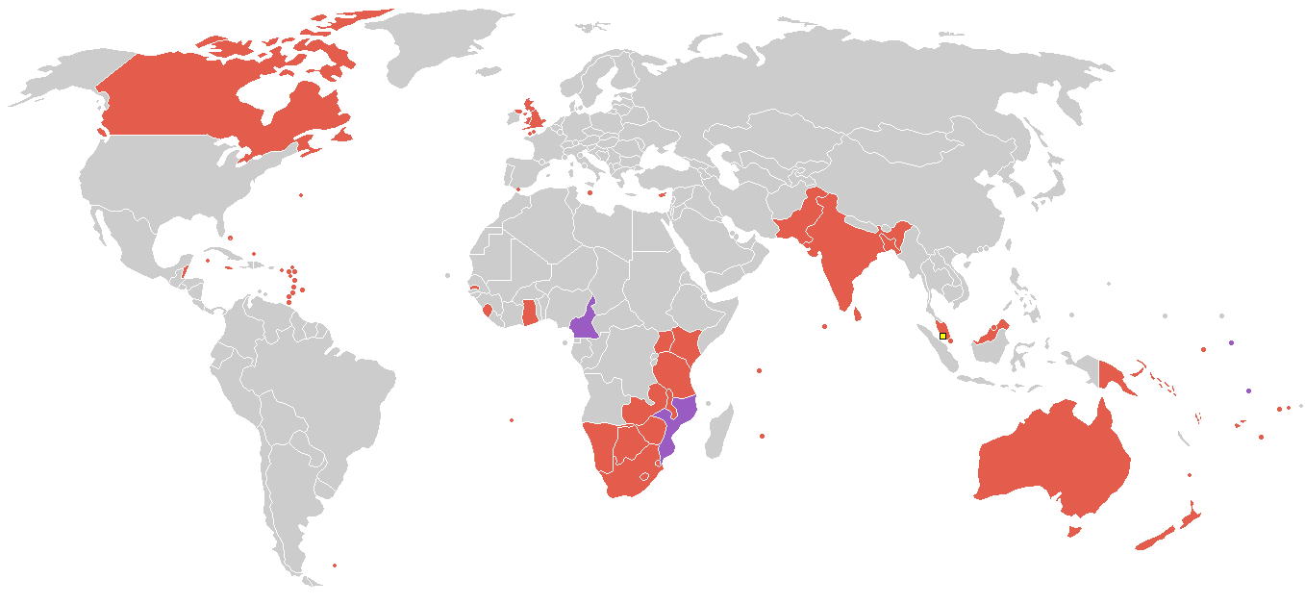
The British Empire
Notes:
Not everyone agrees that the British Empire was a good thing. Countries were taken over by Britain without being asked…The British believed that they were bringing important improvements to the countries they took over.

Slide 5
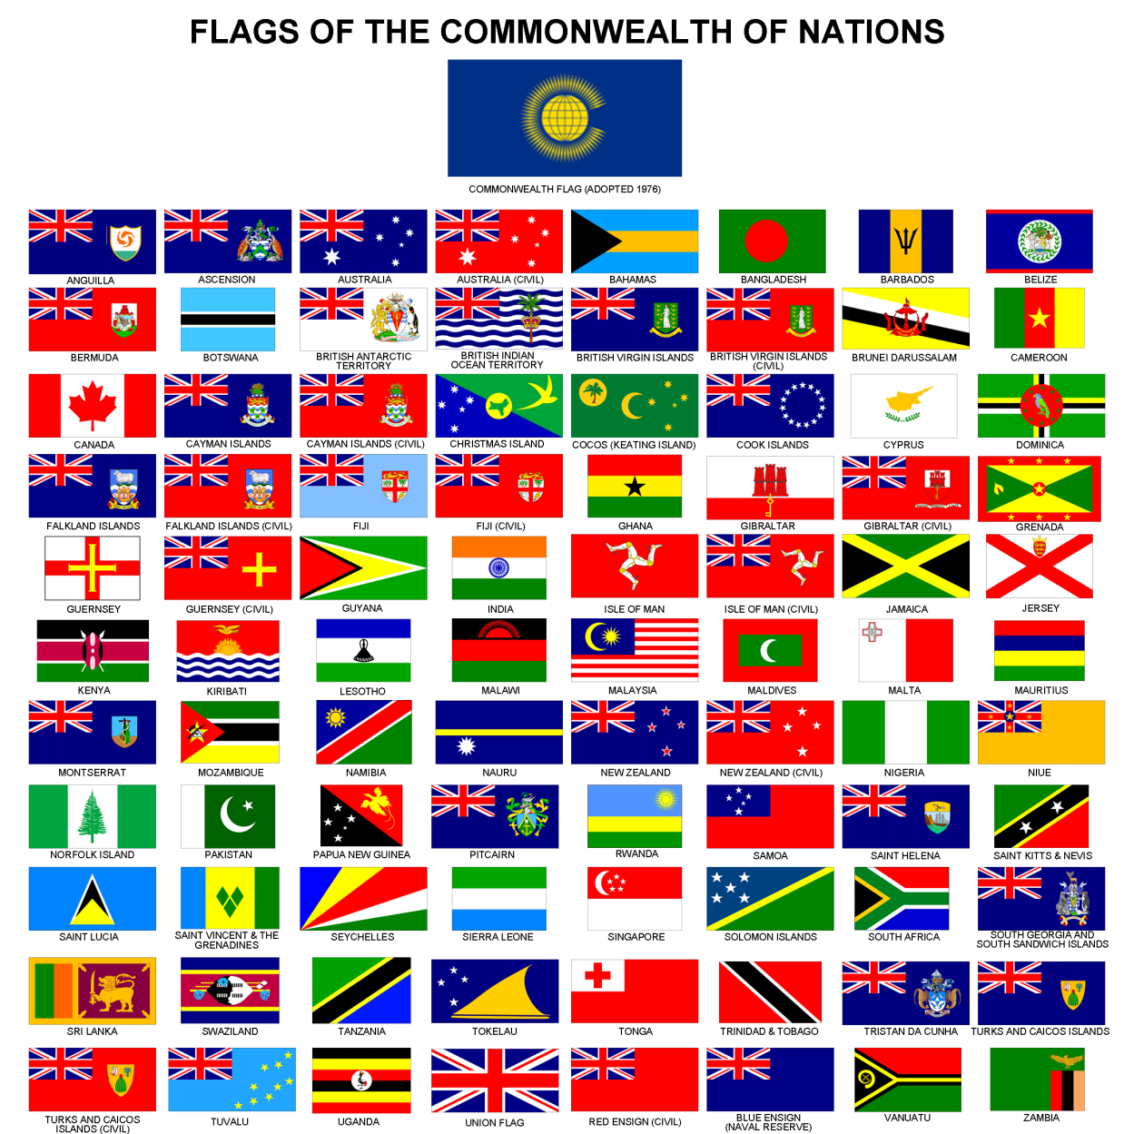
Here are the flags of all the countries in the commonwealth!
Notes:
As these countries gradually gained freedom from the British Empire, most decided to be part of the new, more democratic group called the Commonwealth.

Slide 6
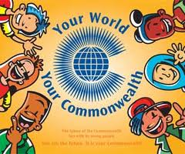
The Commonwealth is a family of 54 nations, spread over every continent and ocean in the world.
Notes:
The Commonwealth is a family of 54 nations, spread over every continent and ocean in the world.
Although the people of the Commonwealth are different in many ways, they work together

Slide 7
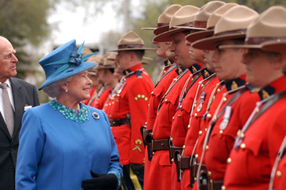
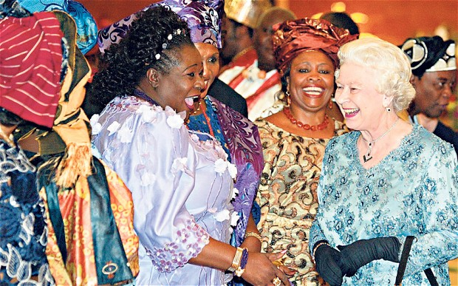
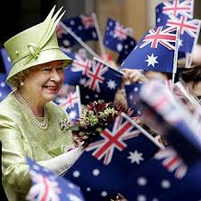
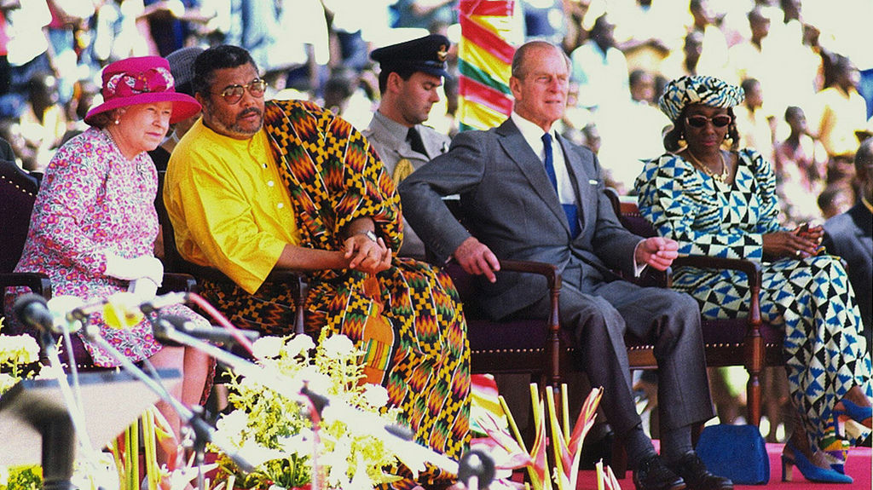
Notes:
The Queen is the head of the Commonwealth. Here she is visiting some of the commonwealth countries.

Slide 8


All the countries in the commonwealth believe in these important values.
1. Men and women are equally important.

Slide 9

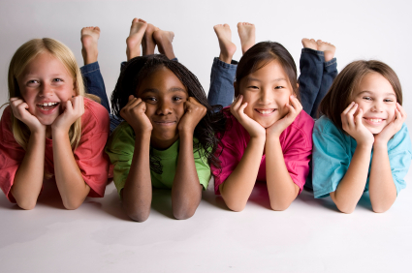
All the countries in the commonwealth believe in these important values.
2. People of all races and skin colours are equally important.

Slide 10

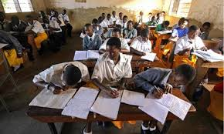
All the countries in the commonwealth believe in these important values.
3. Education is important for everyone.

Slide 11

All the countries in the commonwealth believe in these important values.
4. It encourages respect for others and works to make people’s lives better.

Slide 12

All the countries in the commonwealth believe in these important values.
5. It believes that protecting the environment is important

Slide 13

Commonwealth Games
Notes:
Every four year the commonwealth games take place. These are the friendly games, where countries are working together, and individuals compete.

Slide 14






Slide 15
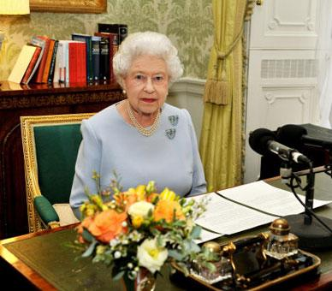
Commonwealth Day
The aim of Commonwealth Day is to remember all the values that are important to the Commonwealth.

Slide 16
Dear God,
We thank you for the Commonwealth.
We thank you for these nations,
which are trying to work together to help their citizens and our world.
We pray for the leaders who come together to discuss important things.
We pray that you will help them this year as they talk about the environment.
We thank you for the beautiful world which you created.
Help these leaders to make decisions which will protect our environment
so that others coming after us can enjoy it too.
Amen.

Slide 17
Commonwealth Day
Notes:
Each year, the 2nd Monday in March is Commonwealth Day…this year the slogan is Towards a Common Future

