Slide 1

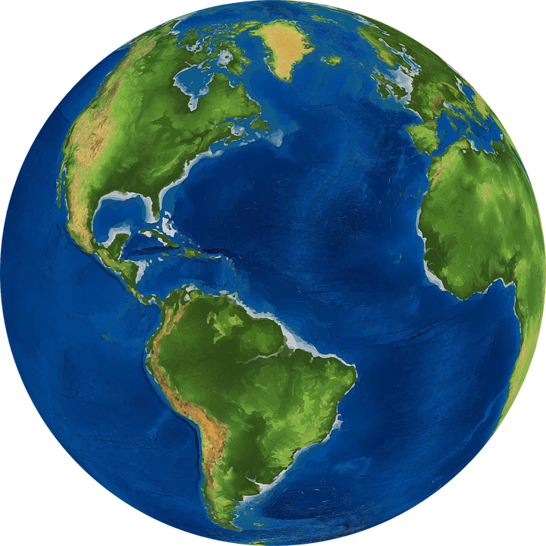
Why should Christians care for the planet?

Slide 2


KOINONIA
The world around me!

Slide 3


Slide 4
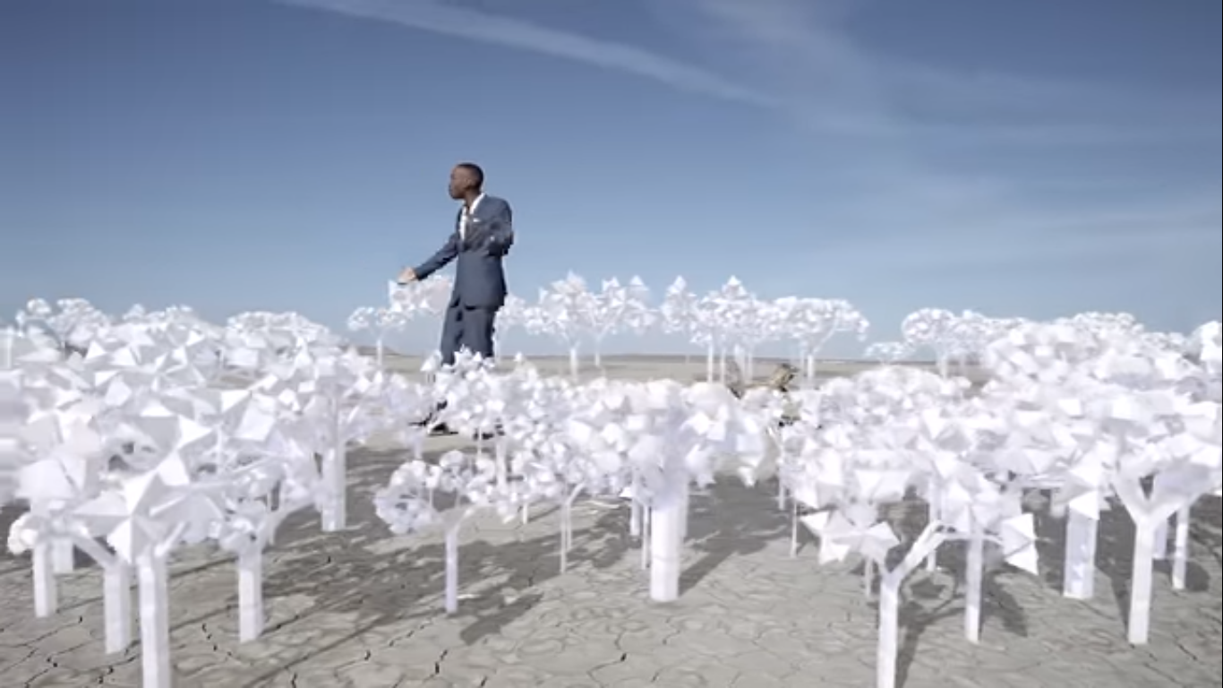

Slide 5
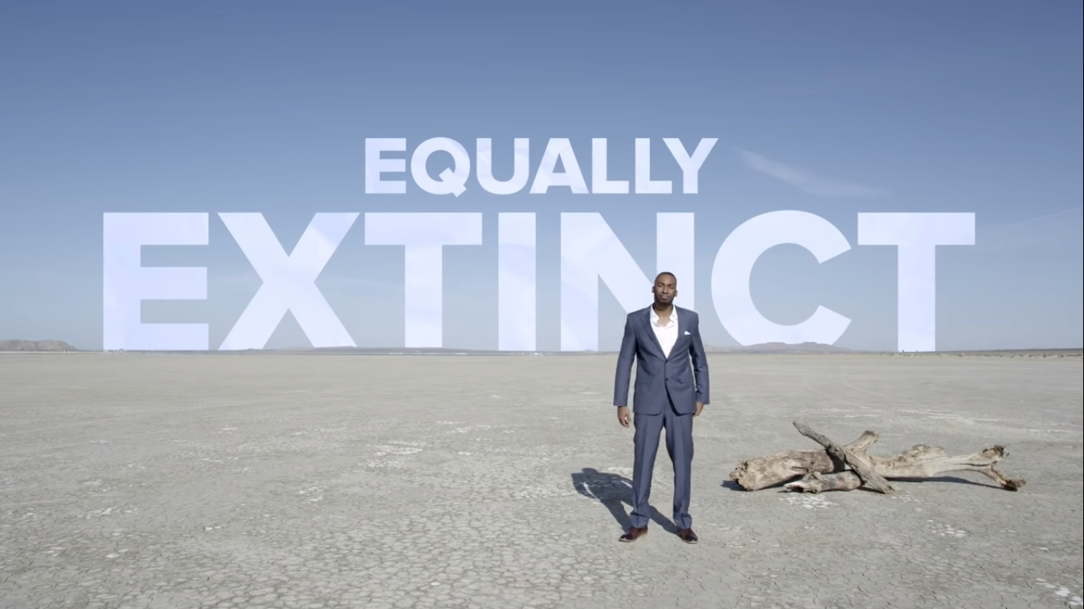

Slide 6
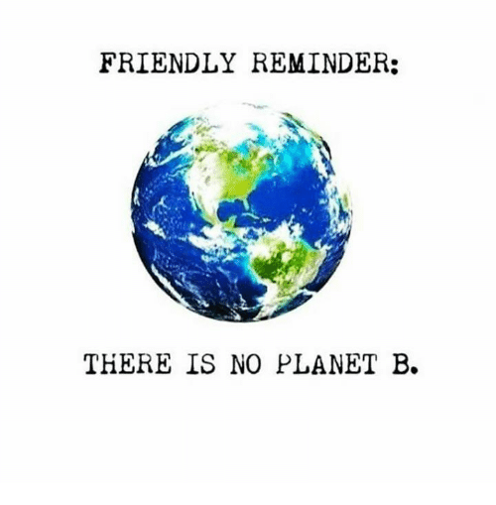

Slide 7
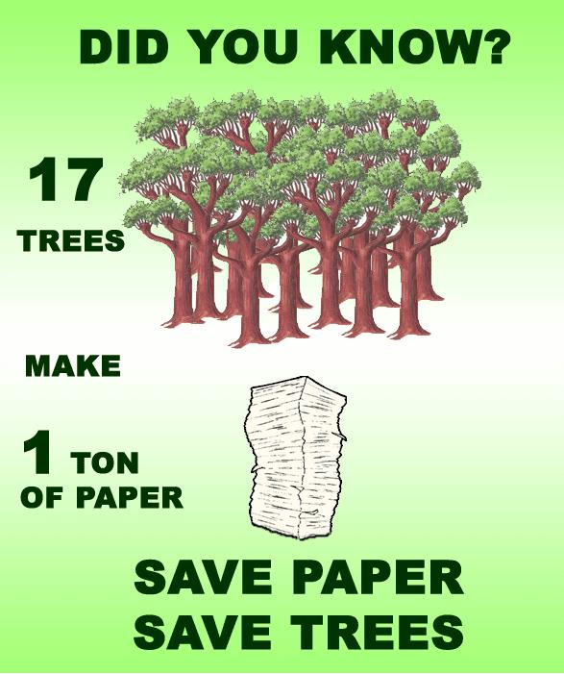
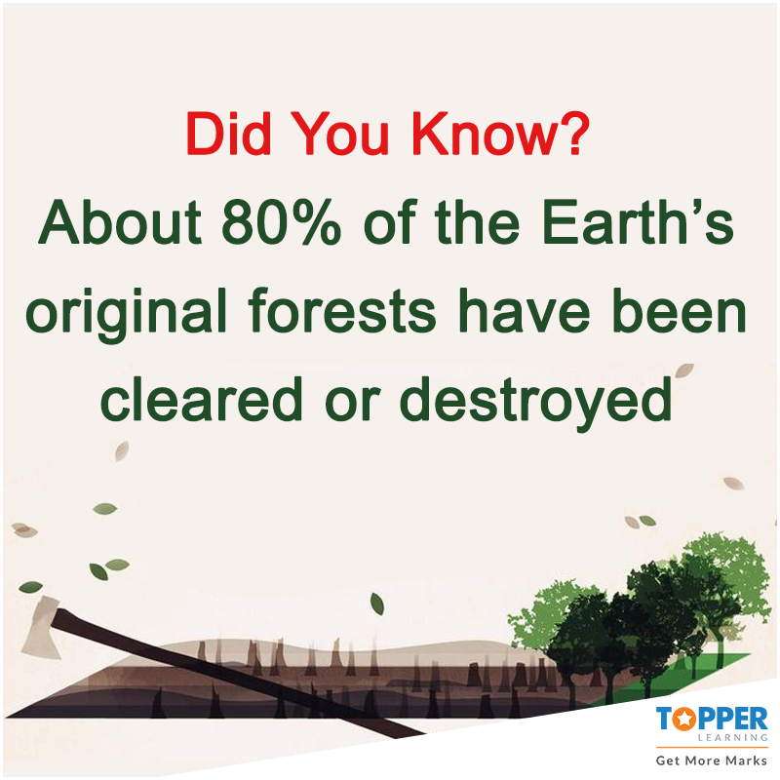
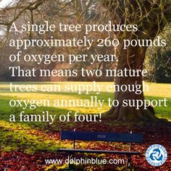
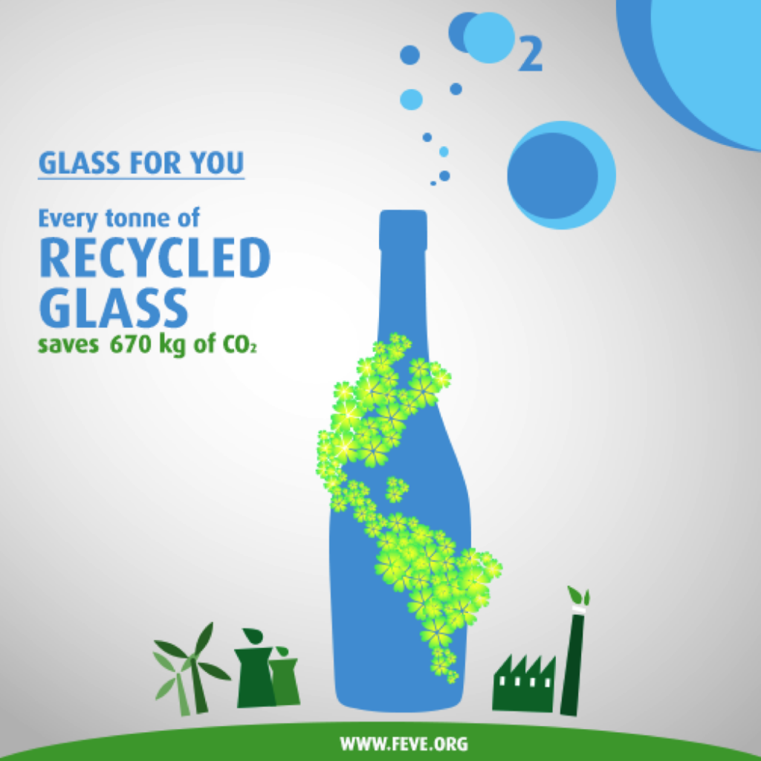
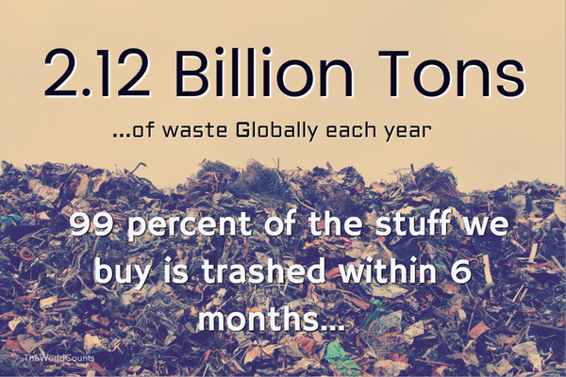
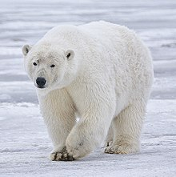
Many kinds of toothpaste contain small plastic beads which may lodge in the gums, are likely harmful to the environment, and are included in toothpaste for decorative purposes only.
The very existence of the universe is the result of God's creative activity

Slide 8
Why should Christians care for the planet?

Slide 9
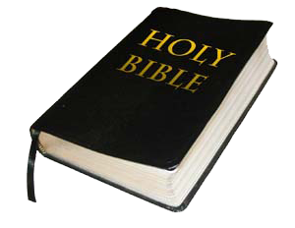
Why should Christians care for the planet?
Genesis 1 verse 31
1. God said it was good!
2. God commands us to!
Genesis 1 verse 28
Genesis 2 verse 15

Slide 10
Over to you….how could you inspire others to help?
How could you present your ideas?
What are your aiming to do?

Slide 11

Over to you….one thing you will do to help

Slide 12


