Slide 1
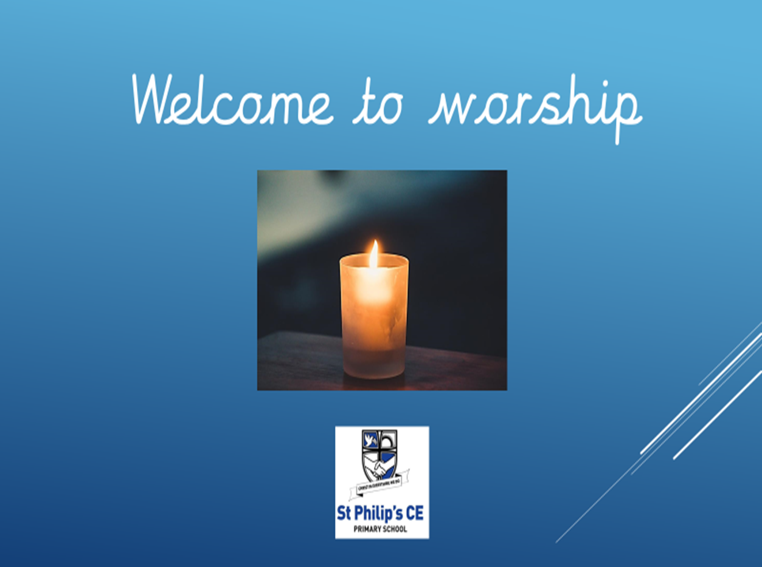

Slide 2
The Lord is here
His spirit is with us

Slide 3


Slide 4
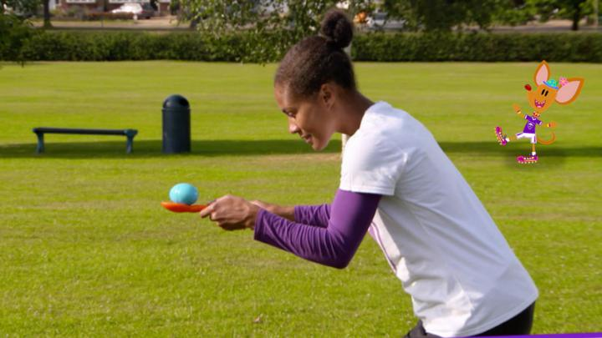
Game – The egg and spoon race – 3 volunteers please! Oliver + Jarvis

Slide 5

Dan
Song – Every Giant Will fall

Slide 6

Bible Story- Mrs Cooper, Oliver and Chloe

Slide 7
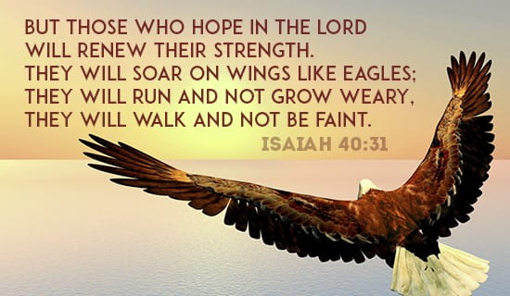

Slide 8
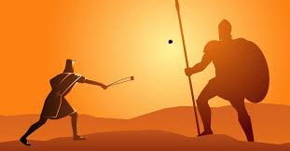
Bible characters who persevered….
Which story is this?
David and Goliath

Slide 9
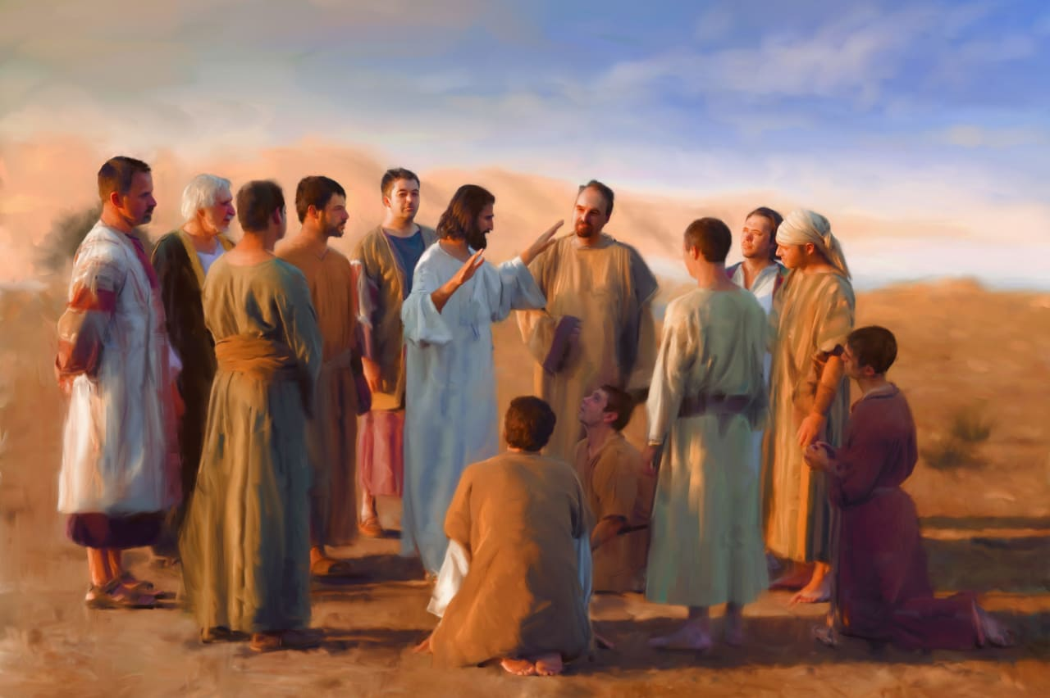
Bible characters who encouraged others to persevere….
What was the job of the disciples?
Which story is this?

Slide 10
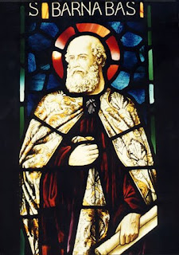
One of the disciples is called Barnabus. This means son of encouragement and that is exactly what he was…’an encourager’ He always saw the good in people and was never slow in offering help and practical assistance to those in need.
‘Barnabus was a good man full of the Holy Spiirt and strong in faith.
Reflect - when was the last time you encouraged someone to keep going to achieve their goal?
Sometimes we can be so busy with our own challenges and goals that we don’t think about those us who may be struggling even more than we are.

Slide 11
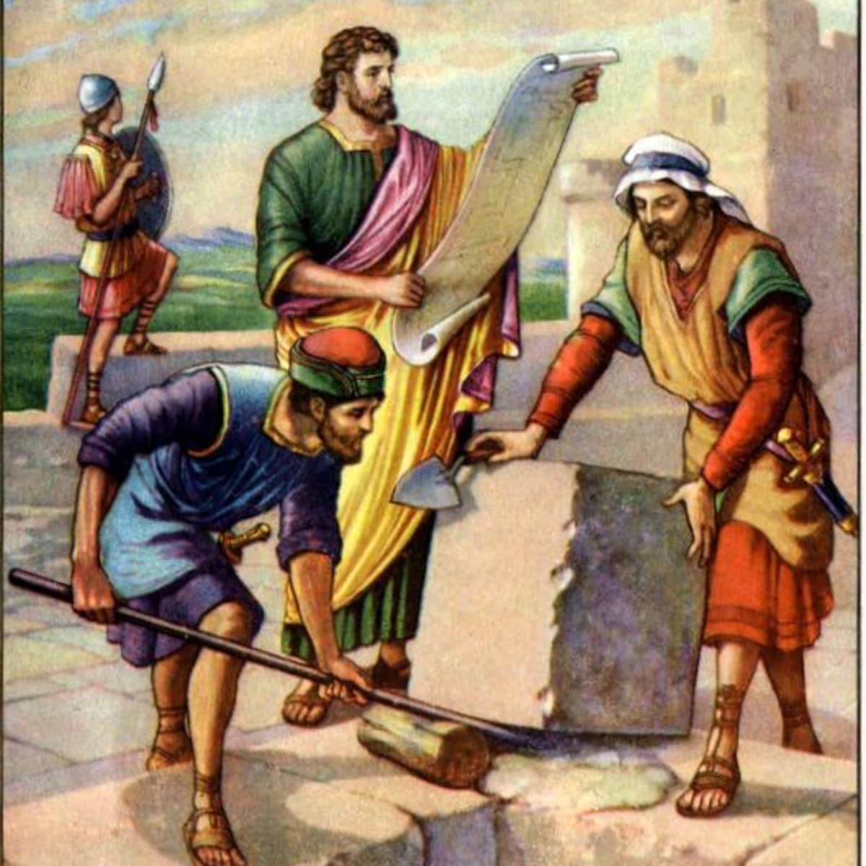
Nehemiah
https://www.youtube.com/watch?v=dEQ82fnmFqU

Slide 12
Nehemiah-
how
did he
persevere?

Slide 13
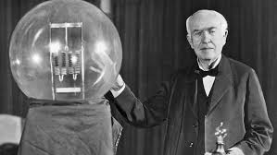
Edison failed 10000 times before he made the electric light. Do not be discouraged if you fail a few times.
Oliver

Slide 14
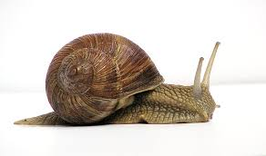
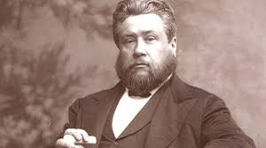
By perseverance the snail reached the ark.
Charles H. Spurgeon ( a famous preacher)
Chloe

Slide 15
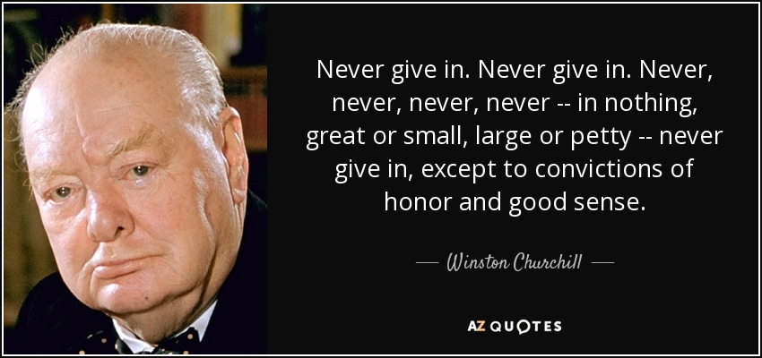
Mrs Cooper

Slide 16

Bethany
Mirror
Reflect - when was the last time you encouraged someone to keep going to achieve their goal?

Slide 17

Your task to do in your classes is-
Door – Gabriel and Isla

Slide 18
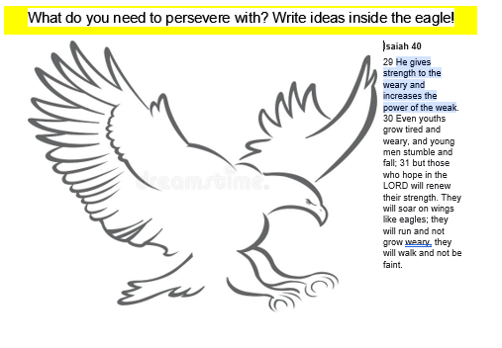

Slide 19

Prayer – Autumn and Liyana

