Slide 1
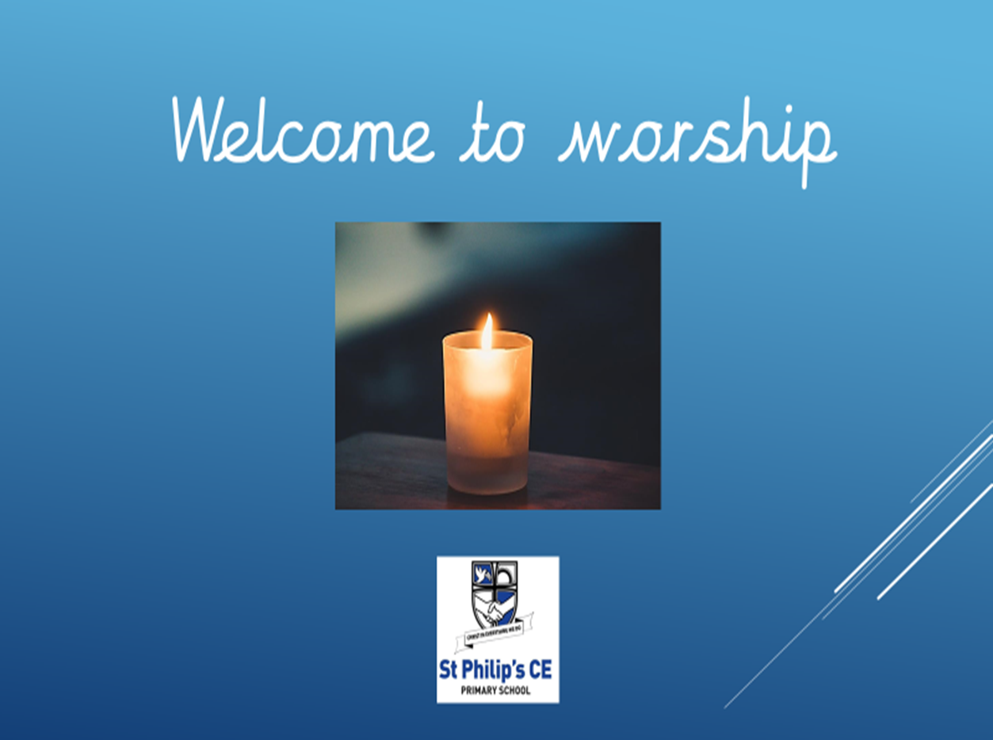

Slide 2
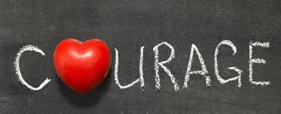

Slide 3
The Lord is here
His spirit is with us

Slide 4


Living Hope
Cora
https://www.youtube.com/watch?v=u-1fwZtKJSM

Slide 5

What is in the box ?
Our challenge is for you to put your hand in our mystery box and guess what is in the box?

Slide 6
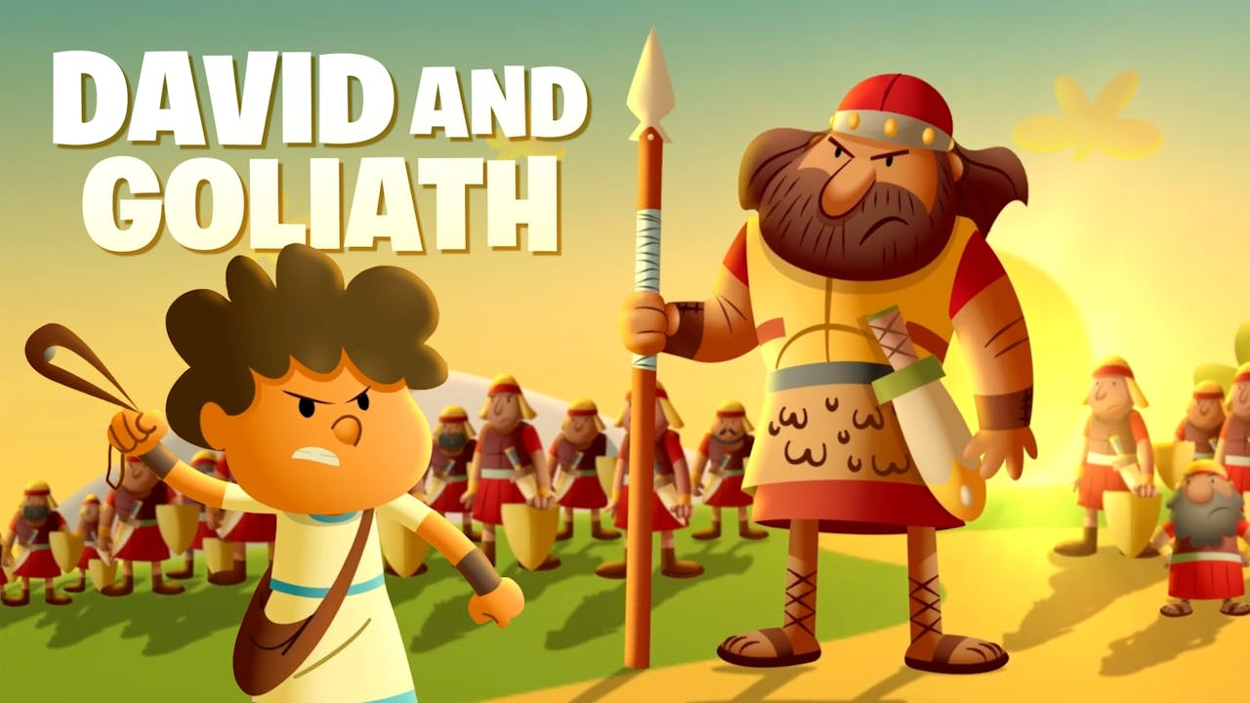

David and Goliath
https://youtu.be/7zLAcUZkxHA

Slide 7
David and Goliath
What can we learn from this?
Did David show courage? Why?

Slide 9

Reflect - when was the last time you showed courage?
“To try is to risk failure. But risk must be taken because the greatest hazard of life is to risk nothing. The person who risks nothing does nothing, has nothing, is nothing. He may avoid suffering and sorrow, but he simply cannot learn, feel, change, grow, live, and love.”

Slide 10
“FEAR has two meanings:
Forget Everything And Run.
Face Everything And Rise.”

Slide 11
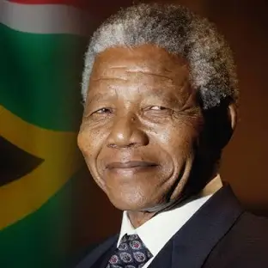
Who is this man?
“I learned that courage was not the absence of fear, but the triumph over it. The brave man is not he who does not feel afraid, but he who conquers that fear.”
~Nelson Mandela

Slide 12
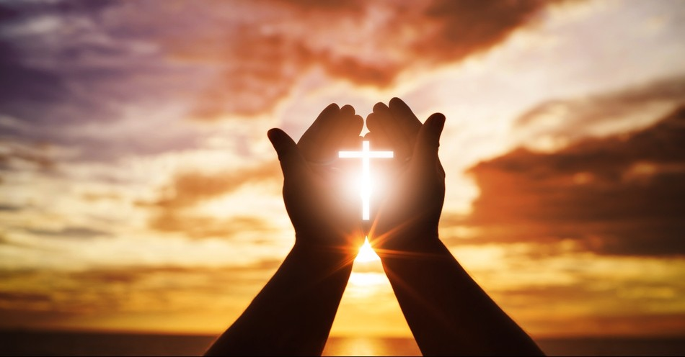
Let us pray

Slide 13

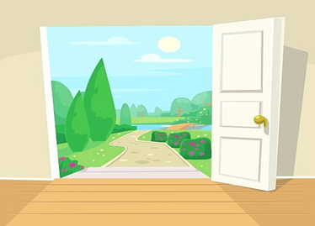
‘Door’ activity

Slide 14


