Slide 1
Jesus we ask you to be with us as we worship here today
We welcome you with open hearts.

Slide 2

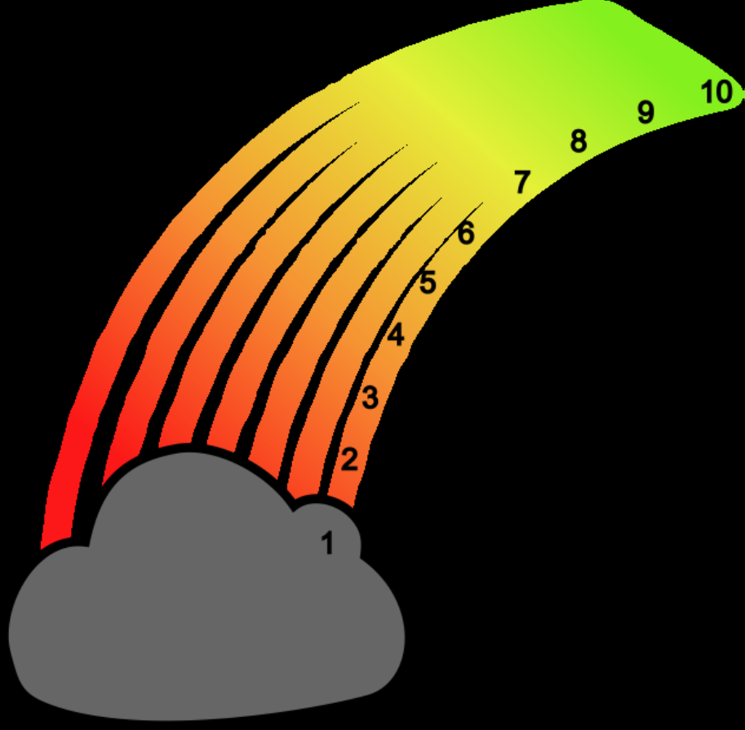
ROAR

Slide 3
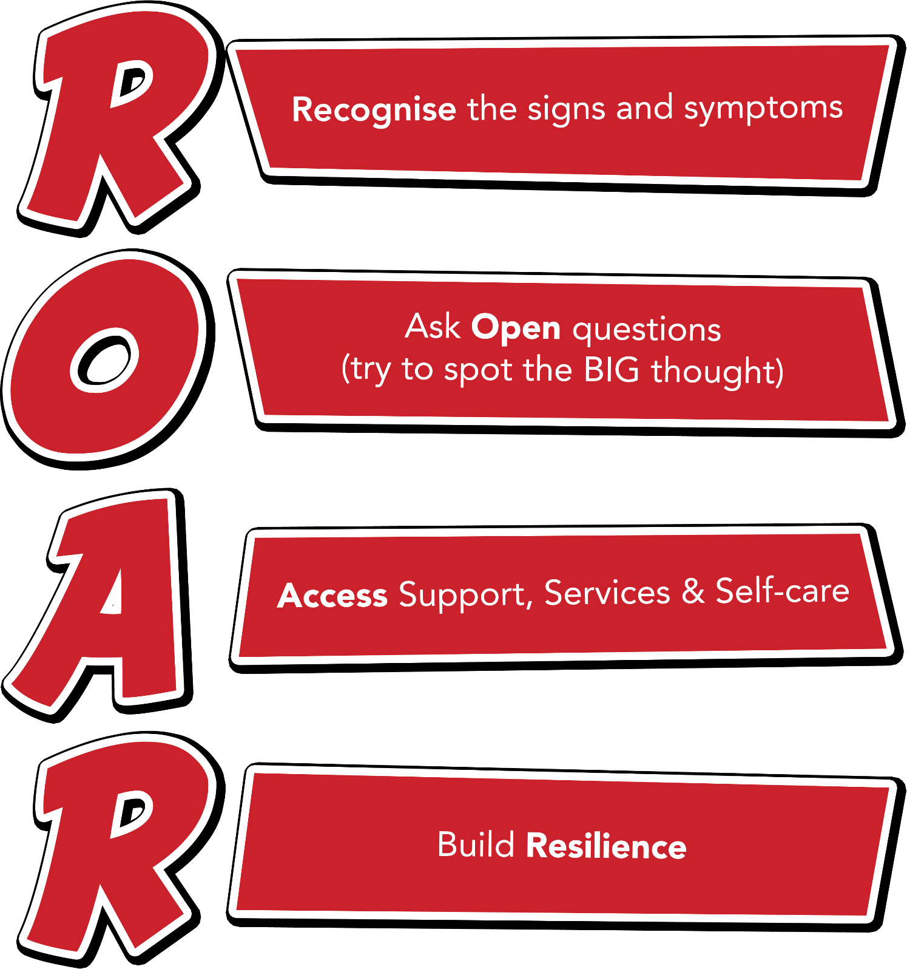
Notes:
Outline each section of the ROAR response. Emphasise that it’s about a first-line response but also about the ongoing resilience building support that schools can provide for their young people.

Slide 4
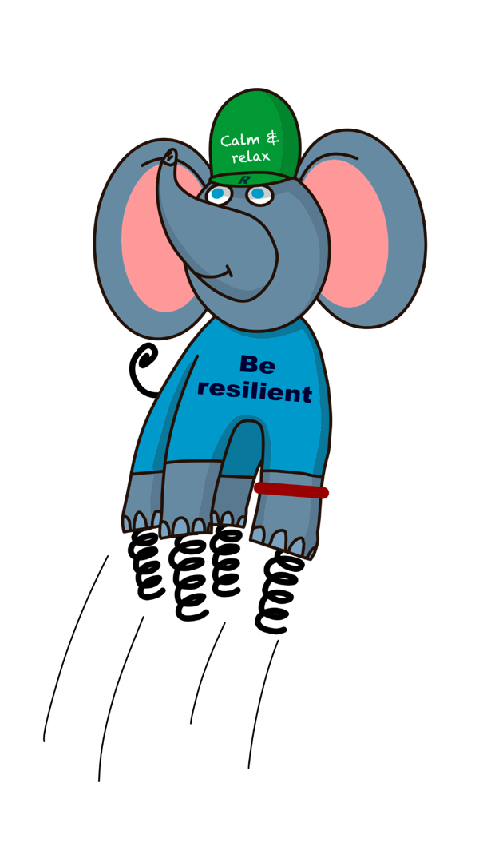

Ralph and the ResiliANTS
Notes:
Explain the background of the resiliANTS found on p18-19 of the handbook. The resiliants have been developed by primary school children based on the 5 key areas of resilience as outlined in professor Angie Hart’s resilience framework (p17). Give delegates a moment to look at this in the handbook.

Slide 5

I

Slide 6
Noble Truths
Noble truths are a series of practical ideas that we can develop and which will help us all to become more resilient.
The Resiliant framework is a toolkit which will help children and young people do well and bounce back if they have a setback or a very difficult challenge to overcome.
The 'noble truths' are beliefs and values that enable the framework to be applied in everyday life. They are not easy to achieve but they are important to keep in your mind.

Slide 7

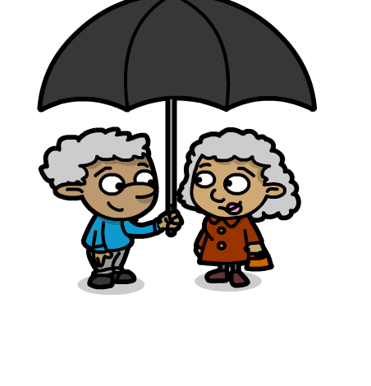


Noble truths
Work in class

Slide 8

Links with school values
Acceptance
Caring
Perseverance
Asking for help
Courage
Trust

Slide 9
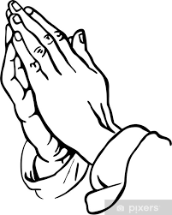
Let us pray

