Slide 1
Jesus we ask you to be with us as we worship here today
We welcome you with open hearts.

Slide 2

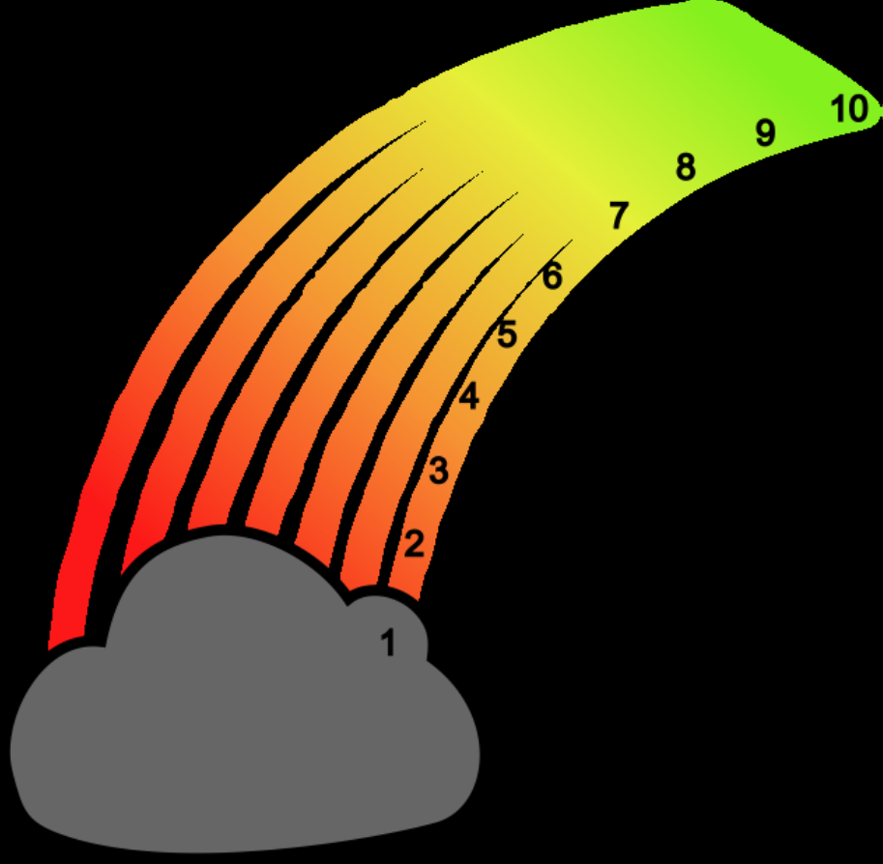
ROAR

Slide 3
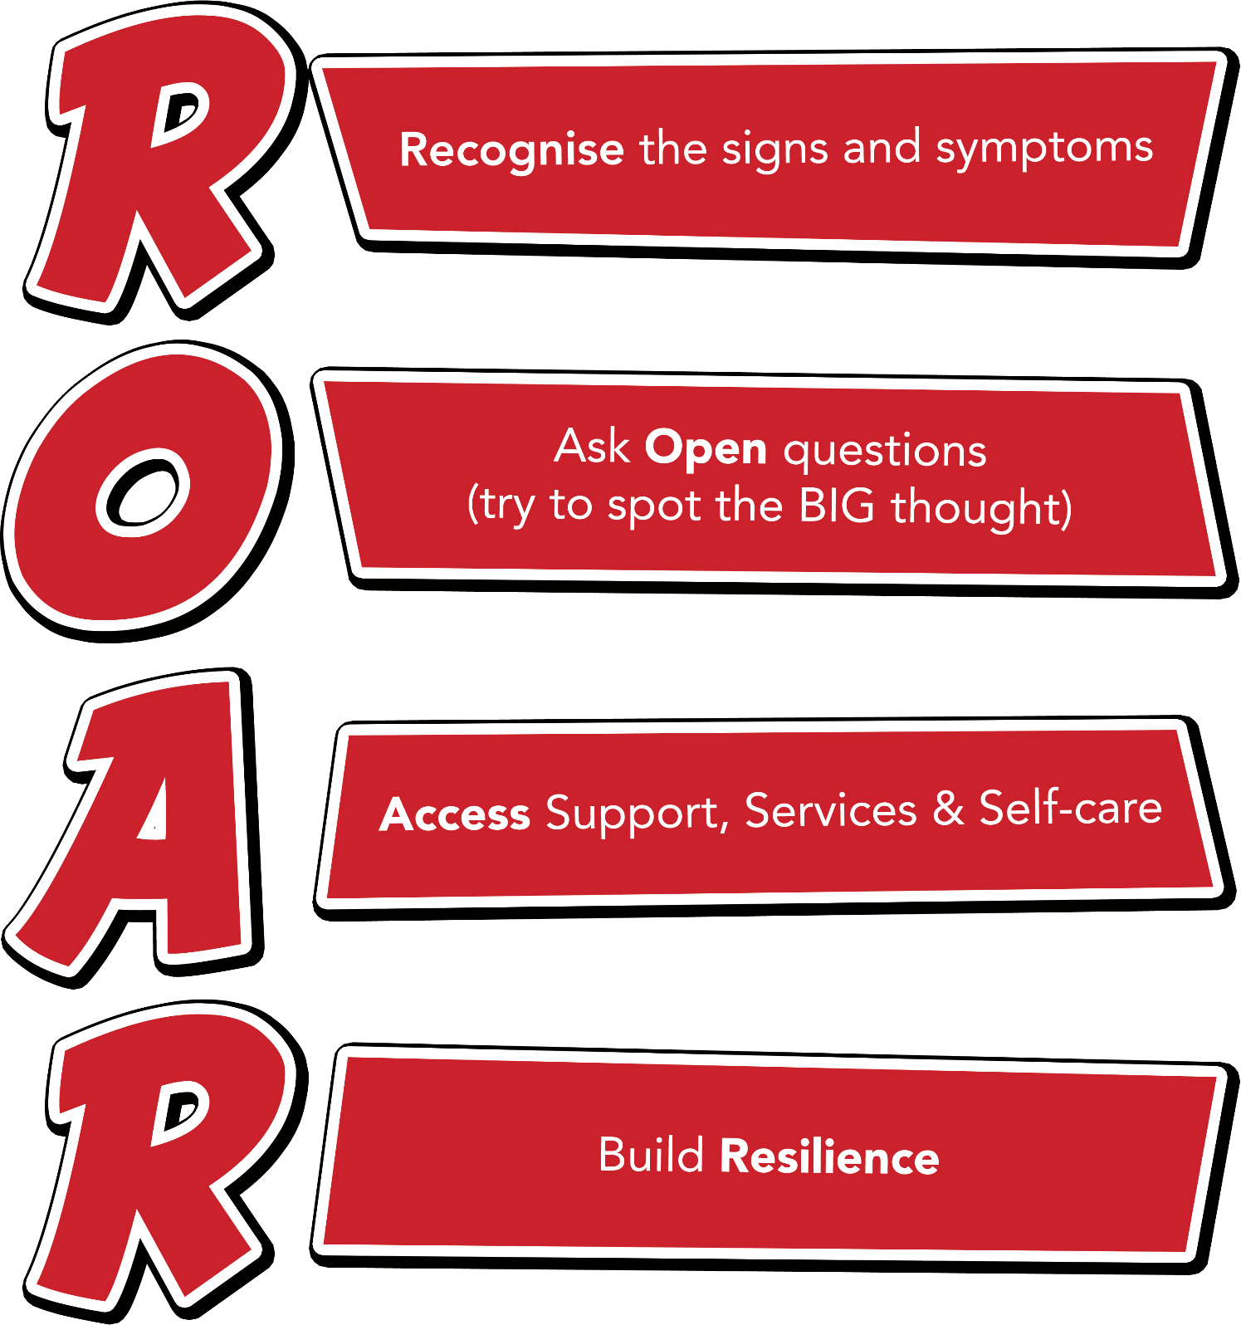
Notes:
Outline each section of the ROAR response. Emphasise that it’s about a first-line response but also about the ongoing resilience building support that schools can provide for their young people.

Slide 4
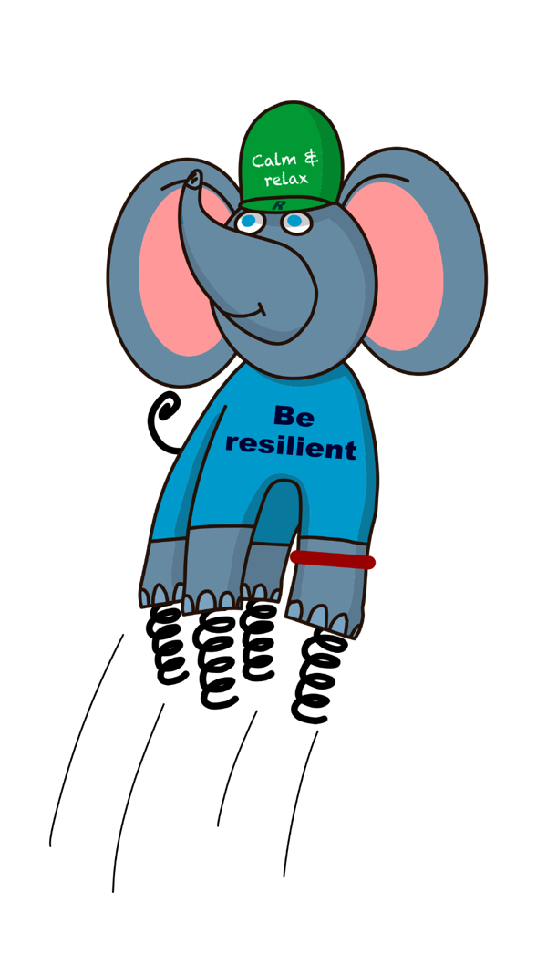
Ralph and the ResiliANTS
Basics Bob
Belonging Billy & Bella
Learning Leo
Coping Cody
Core-self Courtney
Notes:
Explain the background of the resiliANTS found on p18-19 of the handbook. The resiliants have been developed by primary school children based on the 5 key areas of resilience as outlined in professor Angie Hart’s resilience framework (p17). Give delegates a moment to look at this in the handbook.

Slide 5
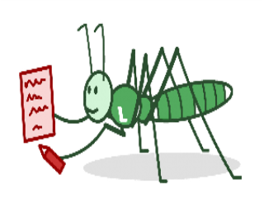
Learning Leo
I help children to achieve by breaking tasks down into small manageable tasks. I try to avoid lengthy instructions. When possible I like to provide written or visual instructions. I’ve noticed sometimes we all need help with organisation - checking that we have letters to take home and extra reminders to bring in anything you need.
I

Slide 6
What helps you learn well at school?
Who helps you learn?
What helps you get organised?
What do you want to achieve? What career do you want?
How do you develop life skills?

Slide 7


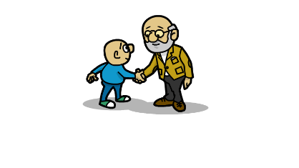

Work in class

Slide 8

Links with school values
Wisdom
Endurance
Humility
Creation
Courage
Trust

Slide 9

Let us pray

