Slide 1
Jesus we ask you to be with us as we worship here today
We welcome you with open hearts.

Slide 2

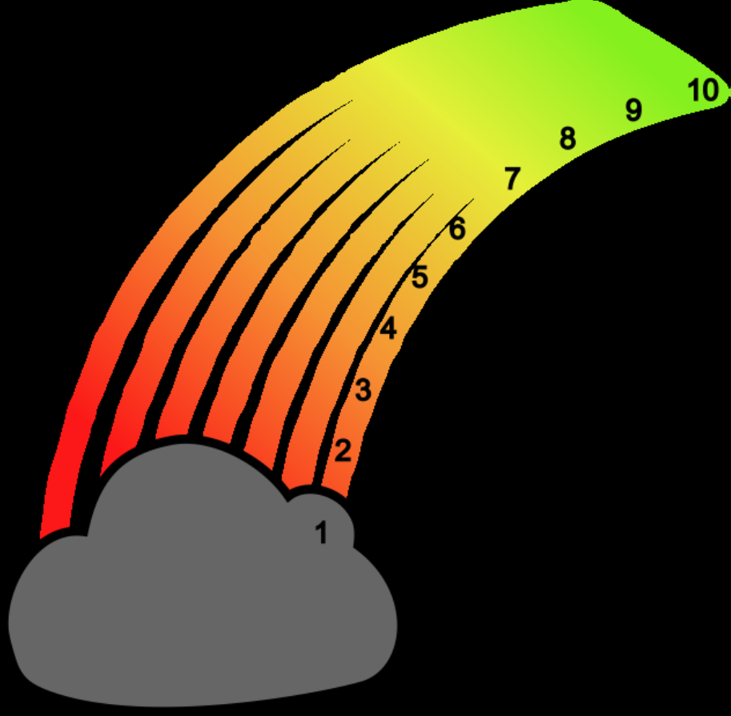
ROAR

Slide 3
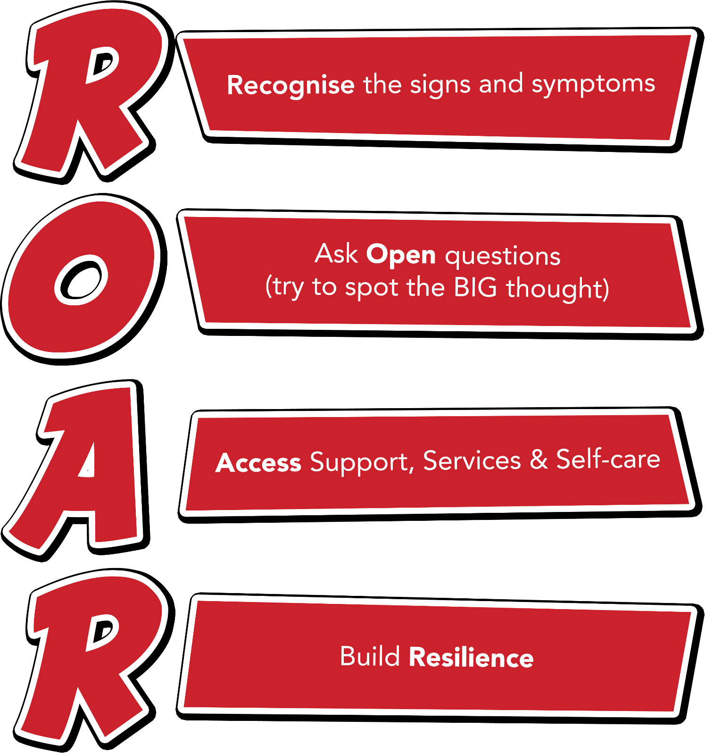
Notes:
Outline each section of the ROAR response. Emphasise that it’s about a first-line response but also about the ongoing resilience building support that schools can provide for their young people.

Slide 4
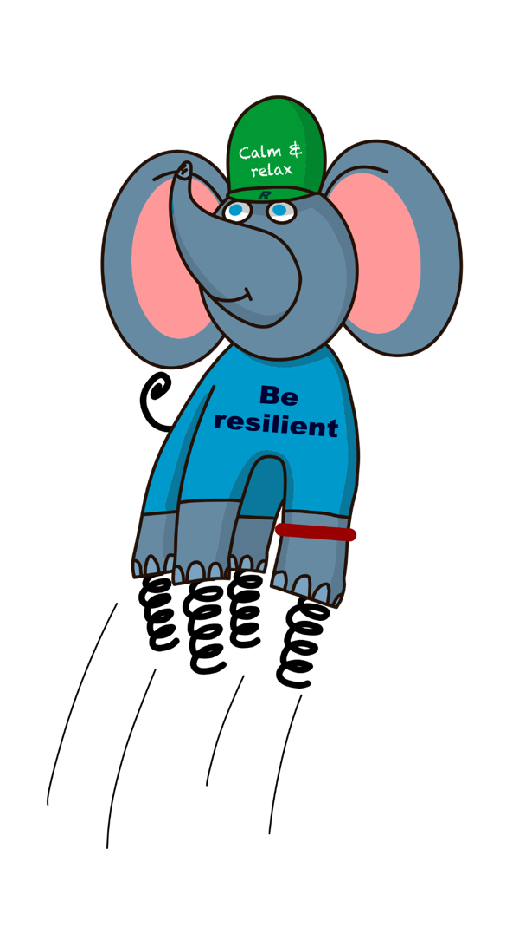
Ralph and the ResiliANTS
Basics Bob
Belonging Billy & Bella
Learning Leo
Coping Cody
Core-self Courtney
Notes:
Explain the background of the resiliANTS found on p18-19 of the handbook. The resiliants have been developed by primary school children based on the 5 key areas of resilience as outlined in professor Angie Hart’s resilience framework (p17). Give delegates a moment to look at this in the handbook.

Slide 5
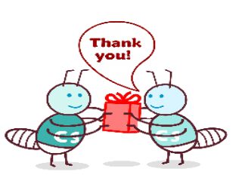
Core-Self Courtney
I like to encourage people and I always try to understand
how they feel. I know who I am and what I’m good at and I
love to help others to find the same out about themselves.

Slide 6
THINK ABOUT:
Do you empathise with other people?
Are you responsible for your own actions or is it always someone else’s fault?
Do you know where to get help and support if you need it and before it is too late?
Do you look at yourself and know your talents, your good points and your bad points too?

Slide 7

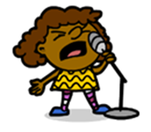
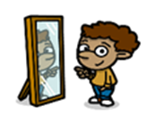




Work in class

Slide 8

Links with school values
Forgiveness
Humility
Hope
Peace
Friendship
Love

Slide 9

Let us pray

