Slide 1
Jesus we ask you to be with us as we worship here today
We welcome you with open hearts.

Slide 2

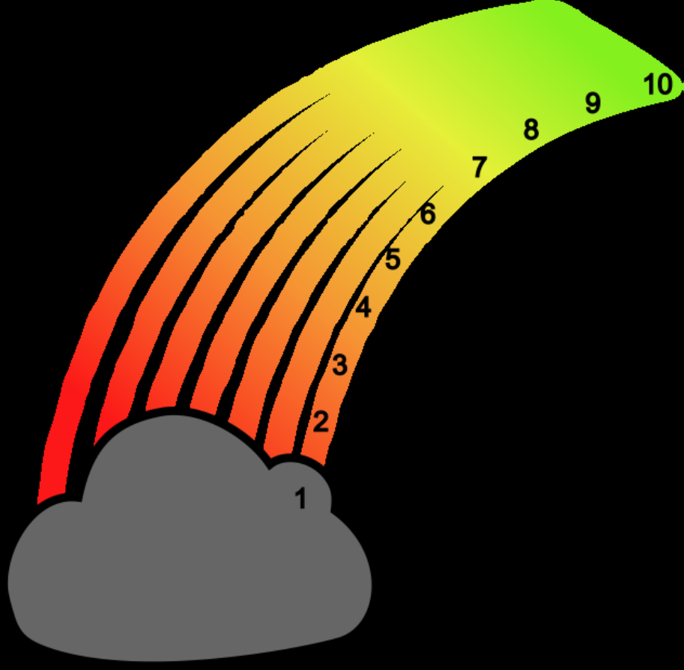
ROAR

Slide 3
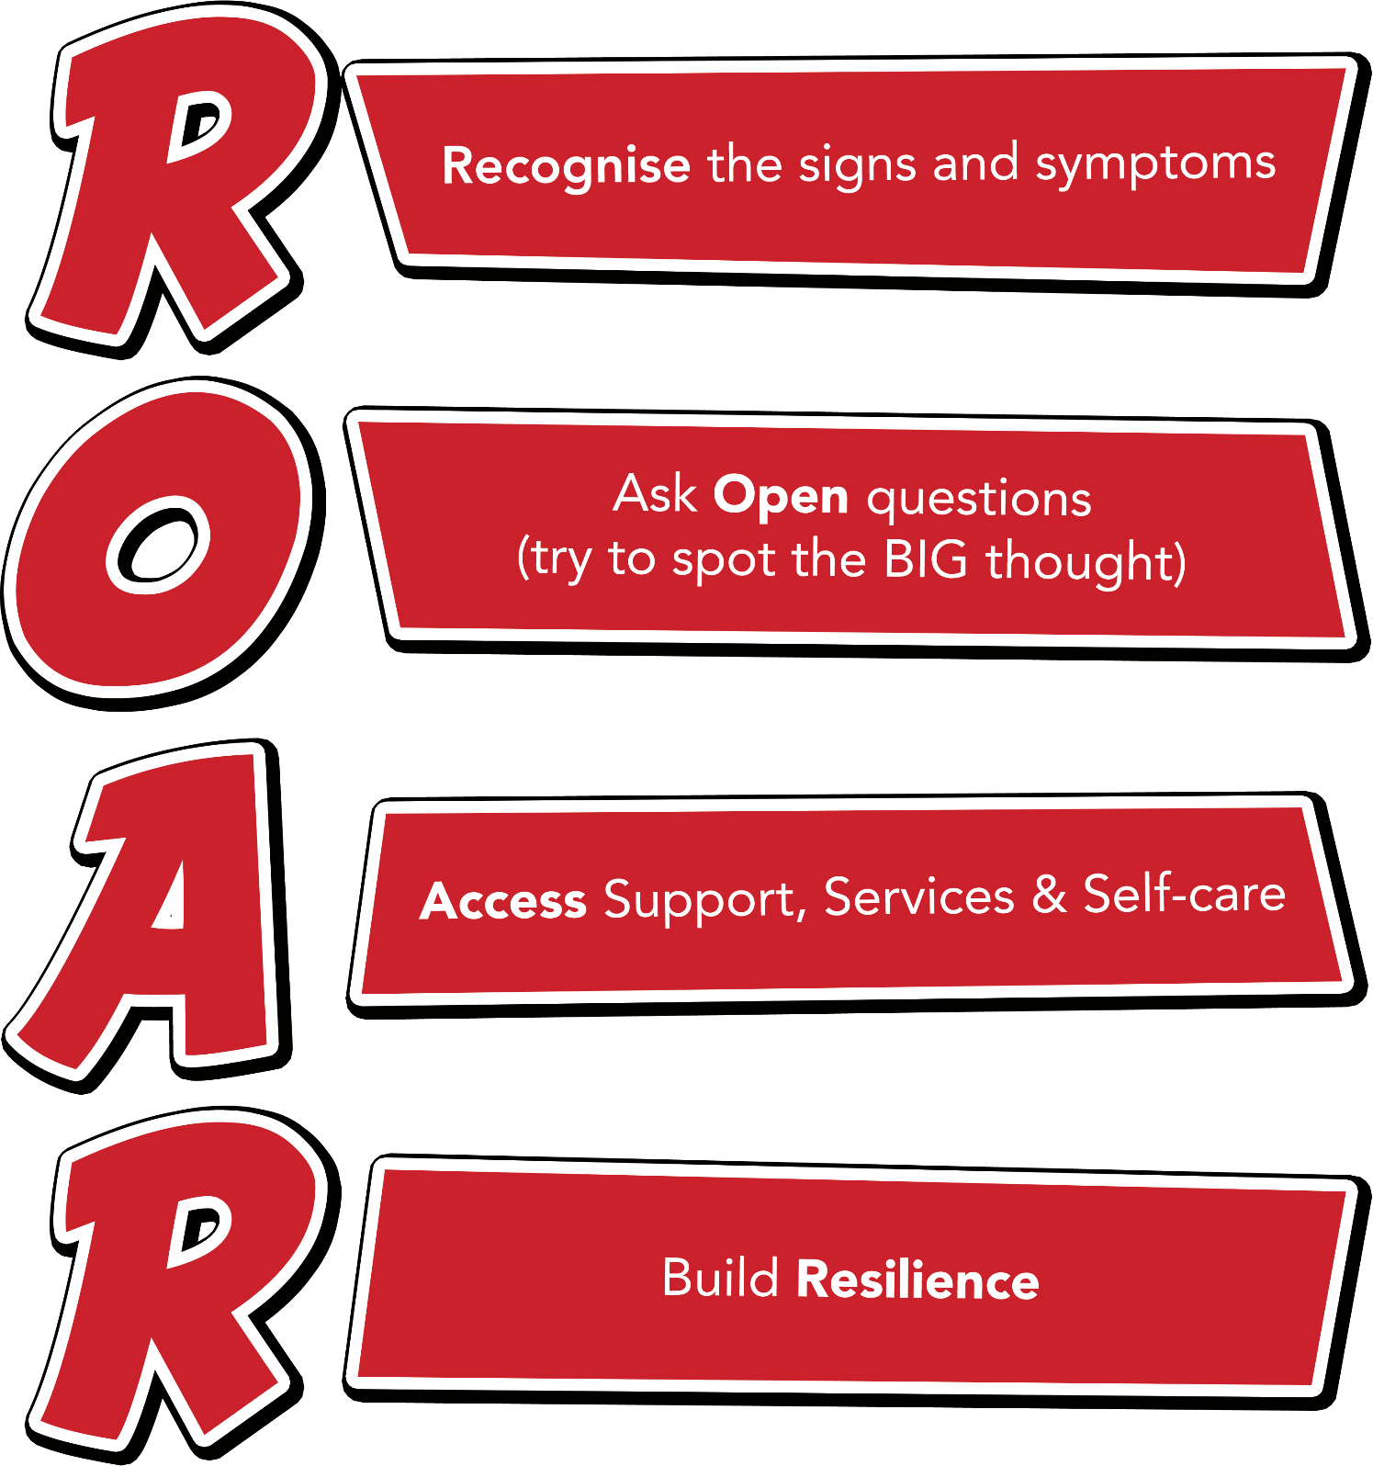
Notes:
Outline each section of the ROAR response. Emphasise that it’s about a first-line response but also about the ongoing resilience building support that schools can provide for their young people.

Slide 4
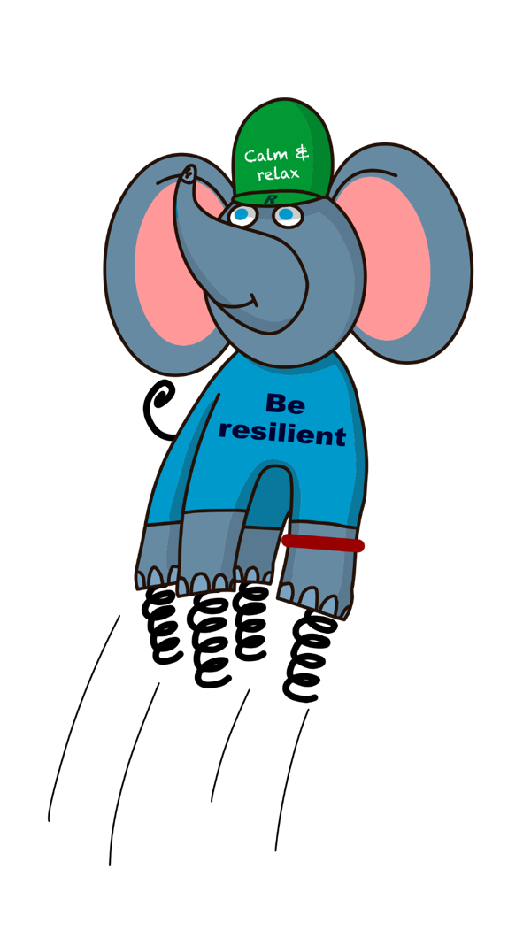
Ralph and the ResiliANTS
Basics Bob
Belonging Billy & Bella
Learning Leo
Coping Cody
Core-self Courtney
Notes:
Explain the background of the resiliANTS found on p18-19 of the handbook. The resiliants have been developed by primary school children based on the 5 key areas of resilience as outlined in professor Angie Hart’s resilience framework (p17). Give delegates a moment to look at this in the handbook.

Slide 5
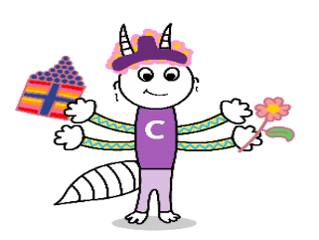
Coping Cody
I often face challenges, but I have a really good set of skills to help me to cope. I help others to be brave, solve problems and to ask for help. I can have a laugh and can dust myself off and start again. I love my rose-tinted glasses.

Slide 6

What does it mean – rose tinted glasses?
When were you brave?
What skills do you have to solve problems?
Can you see things from another point of view?
How do you chill out and calm down?
Who could you ask for help from?

Slide 7
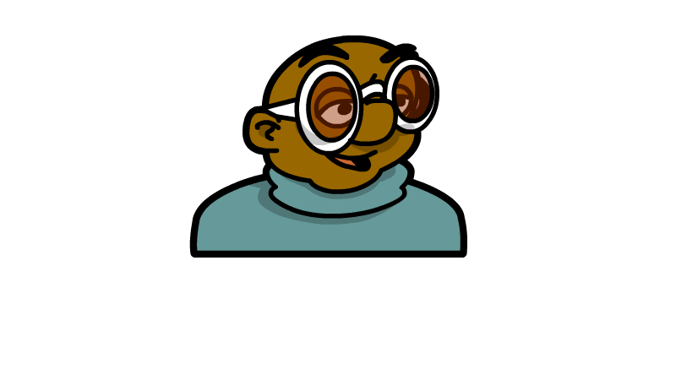
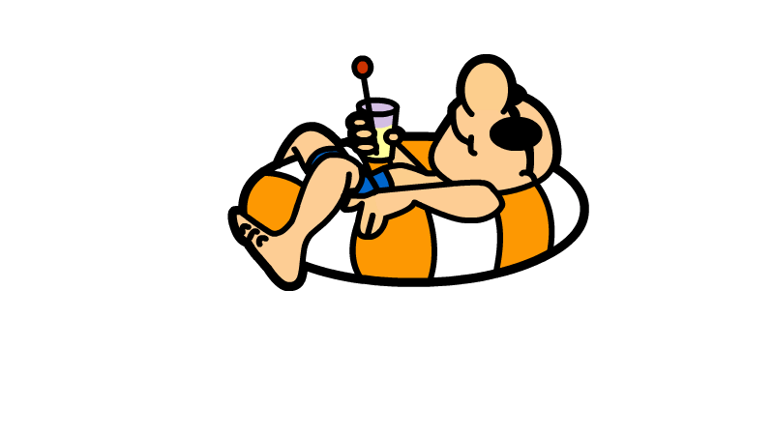
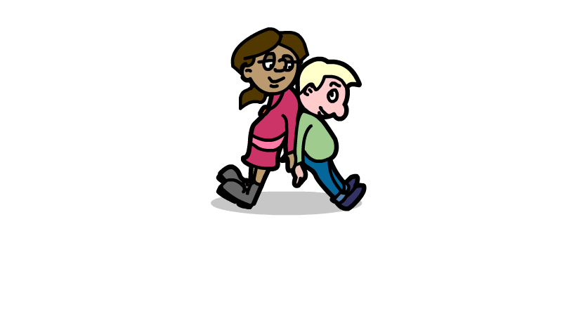
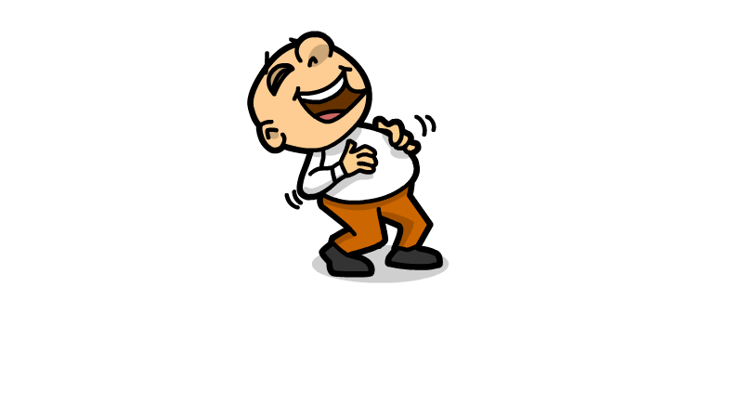
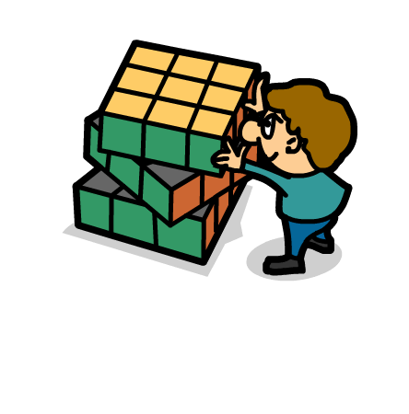
Work in class

Slide 8

Links with school values
Courage
Friendship
Endurance
Humility
Compassion
Hope

Slide 9

Let us pray

