Slide 1
Jesus we ask you to be with us as we worship here today
We welcome you with open hearts.

Slide 2

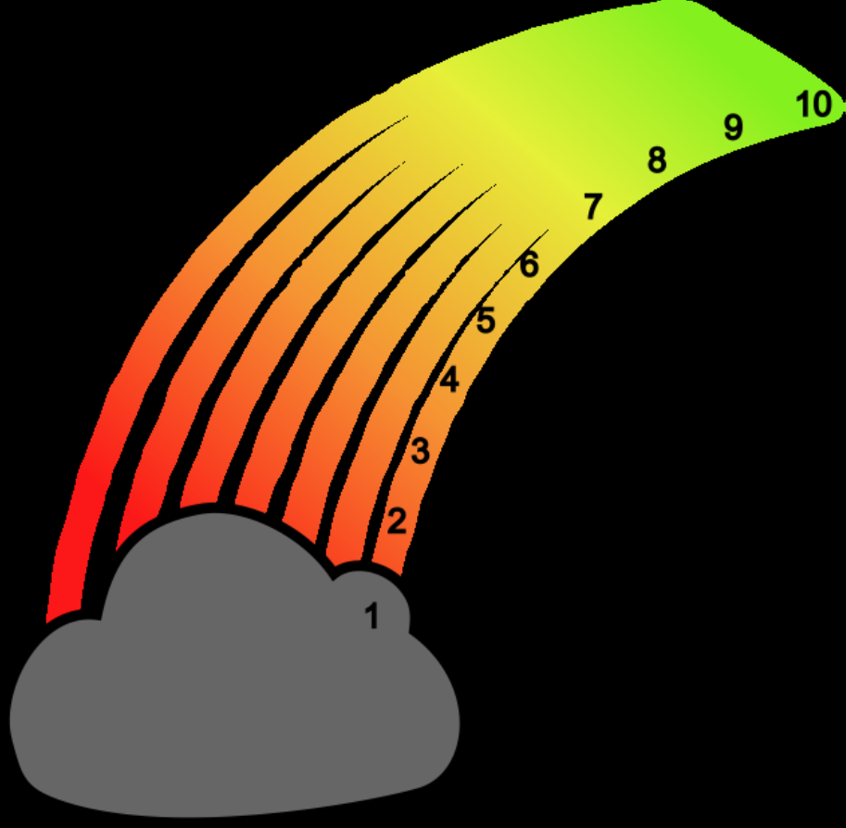
ROAR

Slide 3
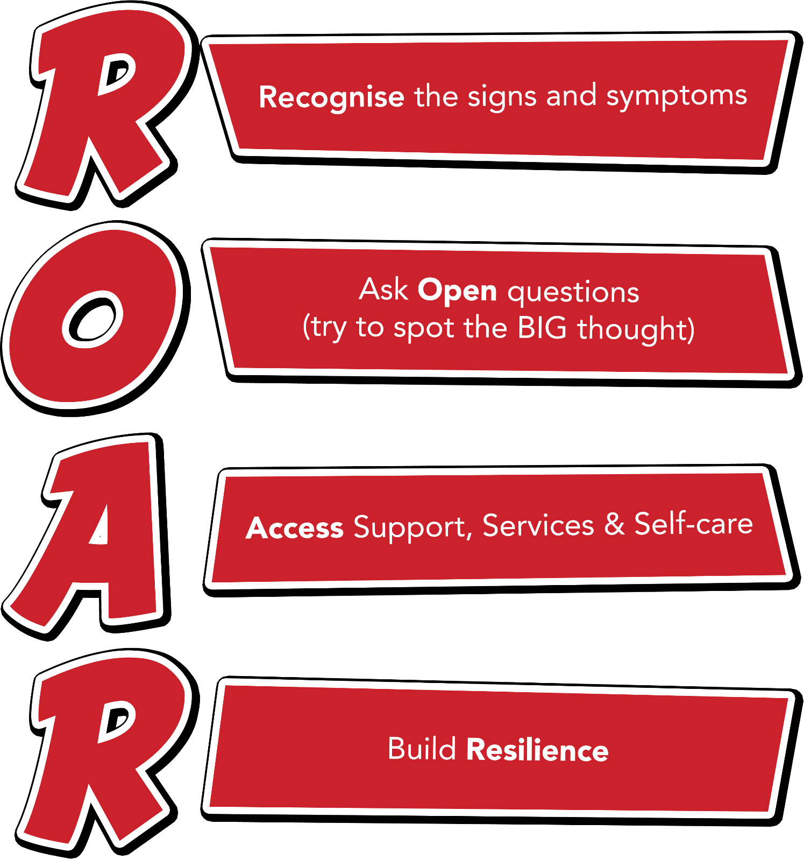
Notes:
Outline each section of the ROAR response. Emphasise that it’s about a first-line response but also about the ongoing resilience building support that schools can provide for their young people.

Slide 4
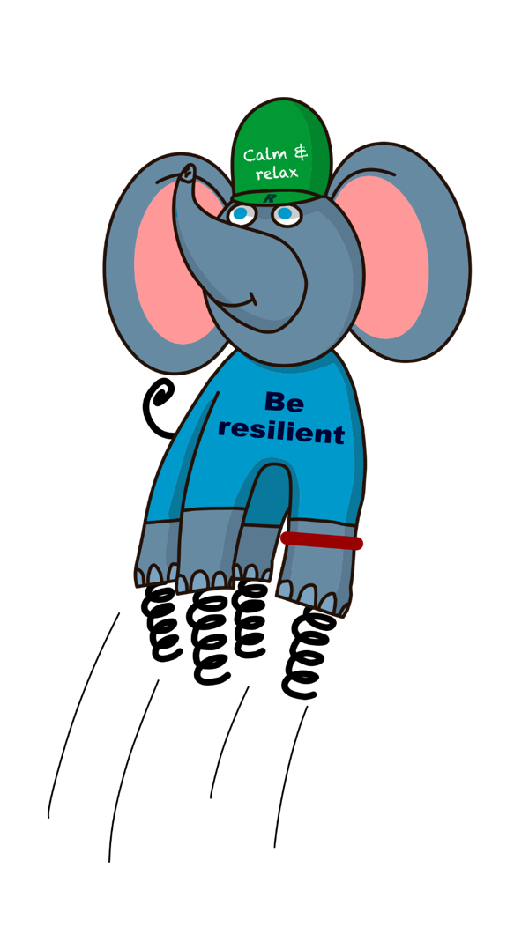
Ralph and the ResiliANTS
Basics Bob
Belonging Billy & Bella
Learning Leo
Coping Cody
Core-self Courtney
Notes:
Explain the background of the resiliANTS found on p18-19 of the handbook. The resiliants have been developed by primary school children based on the 5 key areas of resilience as outlined in professor Angie Hart’s resilience framework (p17). Give delegates a moment to look at this in the handbook.

Slide 5
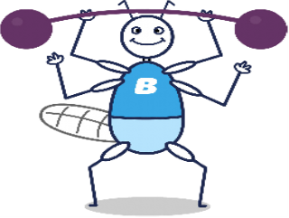
Basics Bob
I make sure we all have the basic things we need to be resilient:
healthy food, a safe place to live, enough sleep, exercise, transport and enough money.

Slide 6
What do we mean by:
-healthy food
- a safe place to live
- enough food
- enough sleep
- enough money?
Why are these ‘basics’ so important?

Slide 7
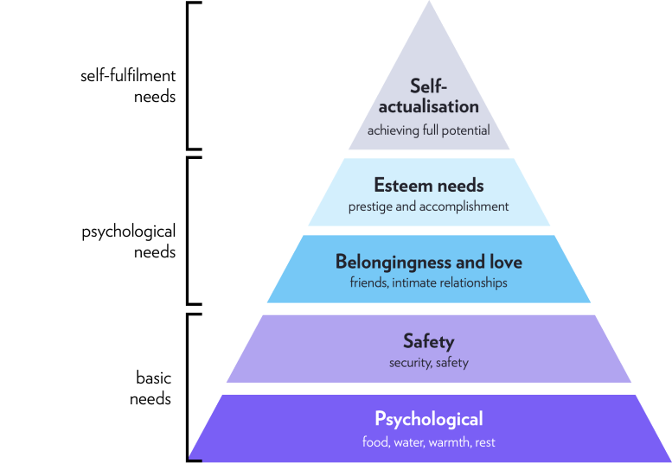
The basic needs of people are food, water, warmth and rest and safety. We need this to be fulfilled before we can move up the triangle.

Slide 8

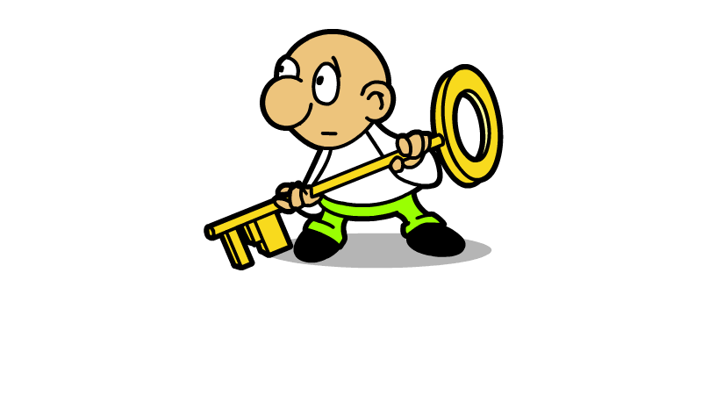
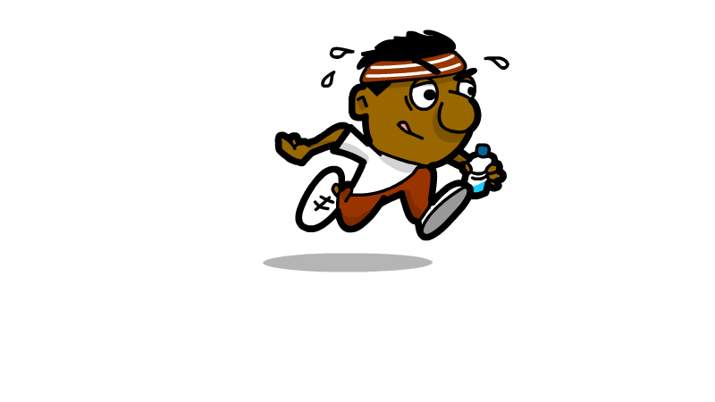

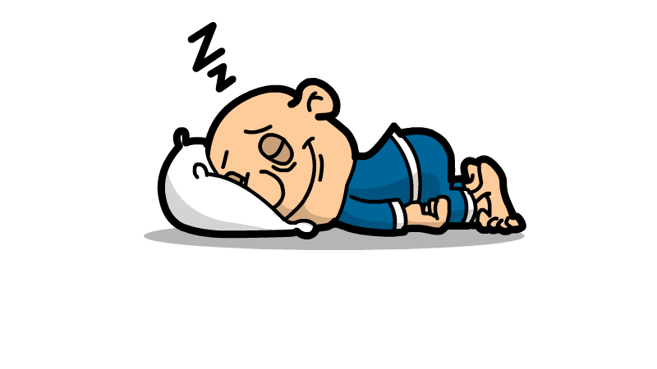
Work in class

Slide 9

Links with school values
Compassion
Humility
Love and peace
Trust
Courage
Generosity
Responsibility
Thankfulness

Slide 10
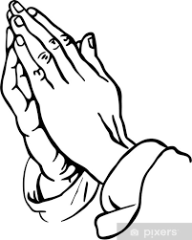
Let us pray

