Slide 1

ROAR
ROAR RAINBOW

Slide 2

What is mental health and who’s got it?
Mental Health is all about how we think and feel about ourselves, others, and the world around us. We ALL have it.
Notes:
Put up the definition on this slide. Then demonstrate that mental health is on a scale moving from good mental health to poor mental health using a piece of coloured rope. Hang up the outline of Ralph on the washing line. As the group what kind of things move ralph up and down this scale; for example if he fails a test he may move down closer to the poor mental health side, whereas if his best friend invites him out to the cinema he may move up towards the good mental health side.

Slide 3
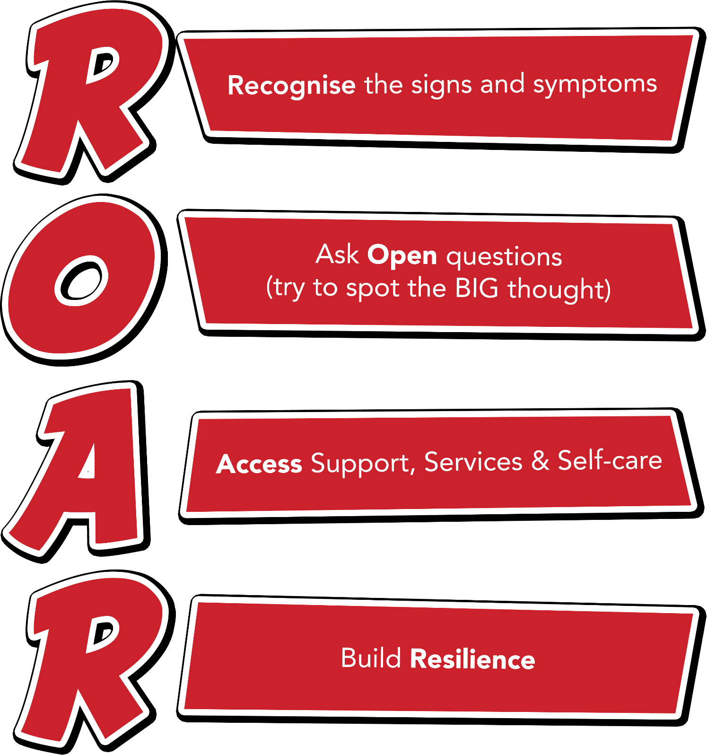
Notes:
Outline each section of the ROAR response. Emphasise that it’s about a first-line response but also about the ongoing resilience building support that schools can provide for their young people.

Slide 4

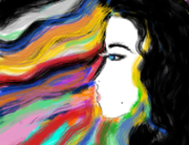

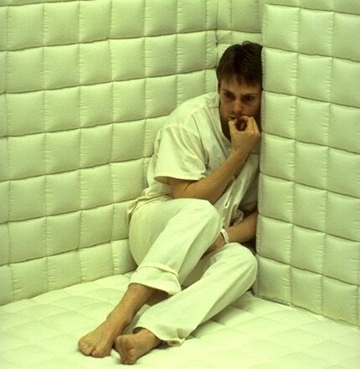
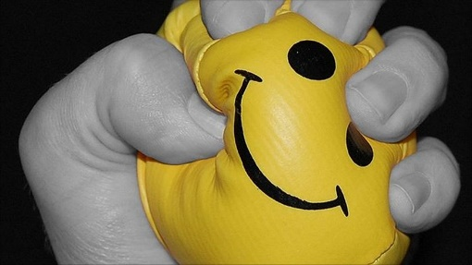
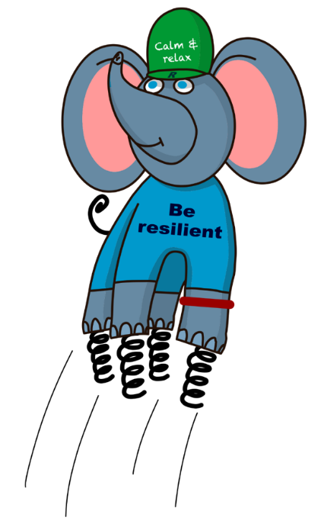
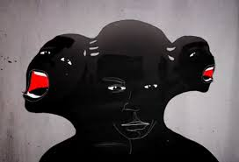
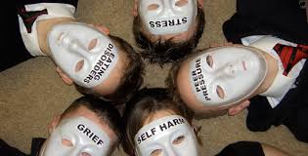


Meet Ralph
What is Mental
Health?
Notes:
Introduce Ralph and give the background of how he was created – designed by a year 4 pupil to represent resilience (see p18 of the handbook). Ask the question ‘What is mental health?’, then get the delegates to respond to this question by selecting a picture from those shown above, that they think best represents mental health. The pictures can be put up around the room and people can move and stand by them, however if you don’t have space you can use the ones on the slide. Once delegates have had chance to think and choose their picture, ask for some feedback/discussion around the ones that they have chosen.

Slide 5
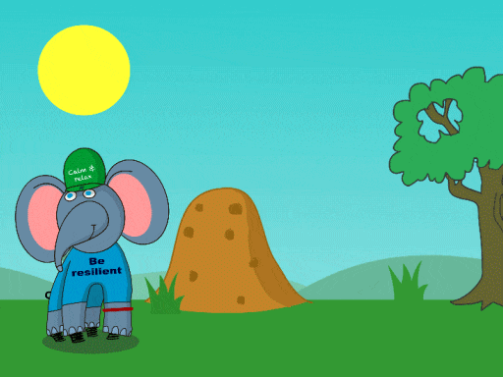
What makes you happy?
What makes you unhappy?
Notes:
Give delegates five minutes to mind-map this onto flip chart in their groups then feedback to a flip chart at the front.

Slide 6

Ralph and the ResiliANTS
Basics Bob
Belonging Billy & Bella
Learning Leo
Coping Cody
Core-self Courtney
Notes:
Explain the background of the resiliANTS found on p18-19 of the handbook. The resiliants have been developed by primary school children based on the 5 key areas of resilience as outlined in professor Angie Hart’s resilience framework (p17). Give delegates a moment to look at this in the handbook.

Slide 7
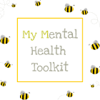

Mental Health Tool kit
A Mental Health Toolkit is not a fixed thing, but rather an ongoing process of discovery through trial and error to find out what works best for you and when.
Get into the practice of doing at least some of the things in your toolkit everyday.
The toolkit is not a quick fix. The toolkit is not a magic cure. Maybe we could make a class Toolkit to help us all.
It is important to adapt my routines and create variety, to keep them fresh.

Slide 8
Let us pray

