Slide 1

Looking After your child's emotional wellbeing.
Sefton Mental Health Support Team

Slide 2
Shana Boyd (EMHP)
Catherine Brindle (MHP)
Notes:
Introduce ourselves.

Slide 3
About MHST
  MHST - early intervention Mental Health support in school following green paper (2017) recommendations ‘transforming CYP’s MH provision’
  Early intervention for mild to moderate Mental Health difficulties.
  The MHP provides the “step up” support if further intervention required.

Slide 4

Aims and outcomes
We are going to focus on a few ways to support your child's mental health and emotional wellbeing using a technique called “special time”
This Photo by Unknown Author is licensed under CC BY-NC
Notes:
Explain to parents we only have half an hour and therefore we are going to focus on this technique, as it will have a positive domino effect on putting in place boundaries and routines.

Slide 5

What is wellbeing?
Notes:
It does not have one set meaning, and neither does it mean that your child has to be happy all of the time. Promoting positive well being in our children is about helping them to deal with the positives as well as some more of the challenges that they face in their day to day lives.

Slide 6
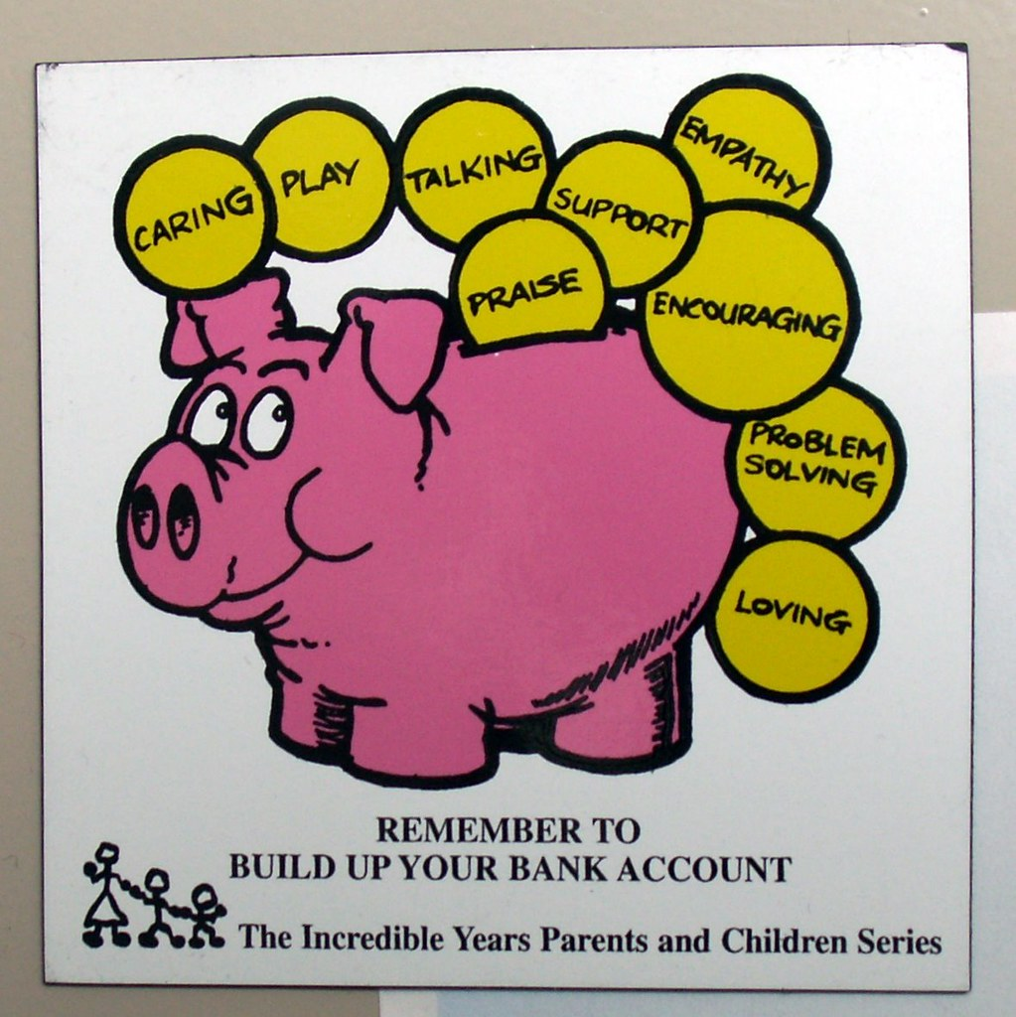
What is “special time”
This Photo by Unknown Author is licensed under CC BY-NC-ND
Notes:
Special time is a technique that enables our children to feel special and validated. Its not about spending hours and hours of time with a child, as we recognise that for parents/carers this can feel impossible. Its about spending quality time. 10 to 15 minutes per night is often all that is needed. It shows your child that you are available to them, both physically and emotionally. It’s a time to reconnect you both after a busy day in school. Using play or by doing other activities allows a conversation and allows you to check in with your child and see how they are feeling. It shows your child that they are important, mum/dad/carer has taken time out to be with them. Most important thing to remember here is to “label “ the time, and be consistent with it.

Slide 7

Menu.
Notes:
Specialtime can involve dong an activity together. My top tip is to create a menu and revisist it every couple of days to change things around a bit on it. The menu gives the child the choice to choose something, which gives them a sense of mastery and skill, and allows you to be able to manage and control the special time, examples, reading together, watch a favourite cartoon, drawing, make a few crispy cakes, ice some biscuits. Anything that can be done in 10 to 15 mins. Even play a game such as snap.

Slide 8

Why is special time important?
This Photo by Unknown Author is licensed under CC BY-SA
Notes:
It shows you are available. It helps to build up your emotional piggy bank and reserves as well as your child's. The benefit of this, is when you have to put a routine or boundary in place, it will feel easier. Discuss parent guilt and “letting children off the hook”. Sometimes it can feel really hard to put boundaries in place, we beat ourselves up, but if we know that we are putting special time in place for our child, out potential guilt about enforcing boundaries will not feel as hard for us. Also we can use it to say things such as we have had our special time now, its time for bed, and we will have more special time tomorrow, it gives you leverage.

Slide 9

Look after yourselves.
This Photo by Unknown Author is licensed under CC BY-SA-NC
Notes:
As parents/carers its important to look after our mental health, if our batteries are low, it can also feel harder to manage boundaries and routines, which we know children thrive in. Be mindful of your own wellbeing. Take some time out to do, its not about being selfish, its about being kind to yourselves.

Slide 10
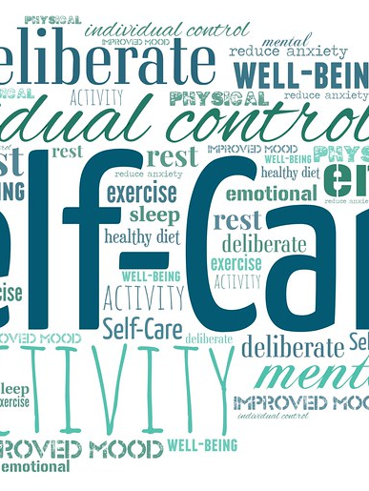
Self care.

Slide 11
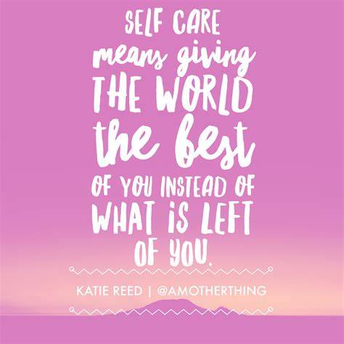

Slide 12
Sefton MHST.
Mental Health Lead in School.
School Nursing Service.
NHS Website .
Young minds.
NSPCC.
Fresh CAMHS Website.
Merseycare for adult mental health support.

Slide 13

Thank you.
Any questions?

