Slide 1

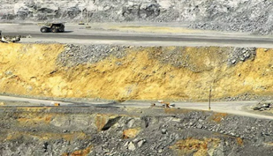

SEND At st. Philip’s ce
Alison Klaassen

Slide 2
Send vision
At St Philip’s CE Primary School we want all our children To achieve their very best, be confident and fulfilled and be successful on the next path.
Golden Threads –
All children will get the support they need
Barriers to learning will be acknowledged, addressed and removed where possible
All children and families will be involved in the learning process
All children will feel a sense of success

Slide 3
All children will get the support they need
Barriers to learning will be acknowledged, addressed and removed if possible
All children and families will feel involved
Children will be fulfilled
Confident
Achieve
Successful
All children will feel a sense of success

Slide 4
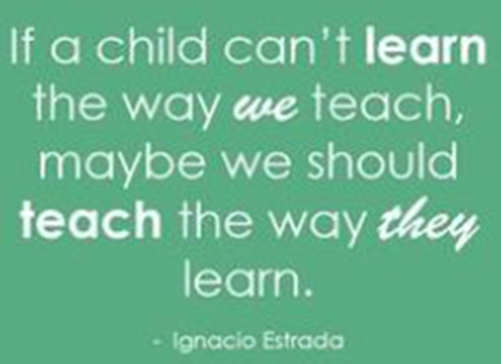

SEND non negotiables:
High Quality First Provision
Accessibility and Equality for all
Remove barriers to learning

Slide 5
Assessment
Assess, plan, do and review, Send review cycle
b squared, Aet toolkit, social communication checklist
Smart targets – link to subject and child
Parent and child voice
SEND nutshell

