Slide 1
to Worship

Slide 2

Jesus we ask you to be with us as we worship here today
We welcome you with open hearts and rejoice in your love

Slide 3
St Philip’s Standards
Be ready
Be Respectful
Be Responsible
Fantastic Walking

Slide 4
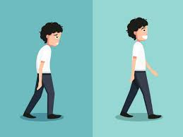
Fantastic Walking
Walking properly makes you feel great.
We are going to be doing fantastic walking, All THE TIME!
Head up
Arms by your sides
Slow pace.
I can’t wait to see you!

Slide 5


Slide 7
Prayer
Dear God
We bring our school before you.
We rejoice in thanks and praise for all that makes us sparkle.
We are sorry that we sometimes choose the wrong way.
Please accept these prayers from the heart of our school family.
Help us to follow our school standards so that our vision for our school comes true.
Amen

Slide 8
Let us go out into the world rejoicing and dazzle people with our St Philip’s Sparkle!
With Gods help we will Be Awesome.

Slide 9

Let’s rejoice – Individually we are amazing but together we are unstoppable.

