Slide 1

Enquiry
Why
Chronology

Slide 2


Chronology – what’s the time?
Enquiry – detective work – sources – what do we want to investigate?
Why? - know why – ask why – explain why

Slide 3

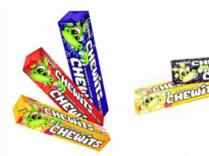
Non negotiables
Ladders to plan – Know that every lesson fits into an area on this – check if there are any gaps
The LO and Success Criteria for almost all lessons – speeds marking – next steps - differentiates
Chronology label for each unit – start and maybe even finish
Chronology activities – active – lining up
Read the progression document I give you so you know how you are moving pupils on – though bear in mind how little sticks from one year to next!
One significant piece of writing per unit – vocab! One enquiry project per year in KS2
Diversity presented and explained

Slide 4

Assessment
On going – know the whole child
Anything they do – if marked using the SC – builds up a picture of them
Enable the GD to flourish with written assessment whilst making sure those with less good writing can demonstrate knowledge and understanding BUT
In Y5 and Y6 – their written ability is crucial – can’t be GD in history if not able to write in a sophisticated way – don’t have to be GD English writers but should be competent – For able SEND consider recording a spoken answer – developed and organised as if it were w written piece

