Slide 1
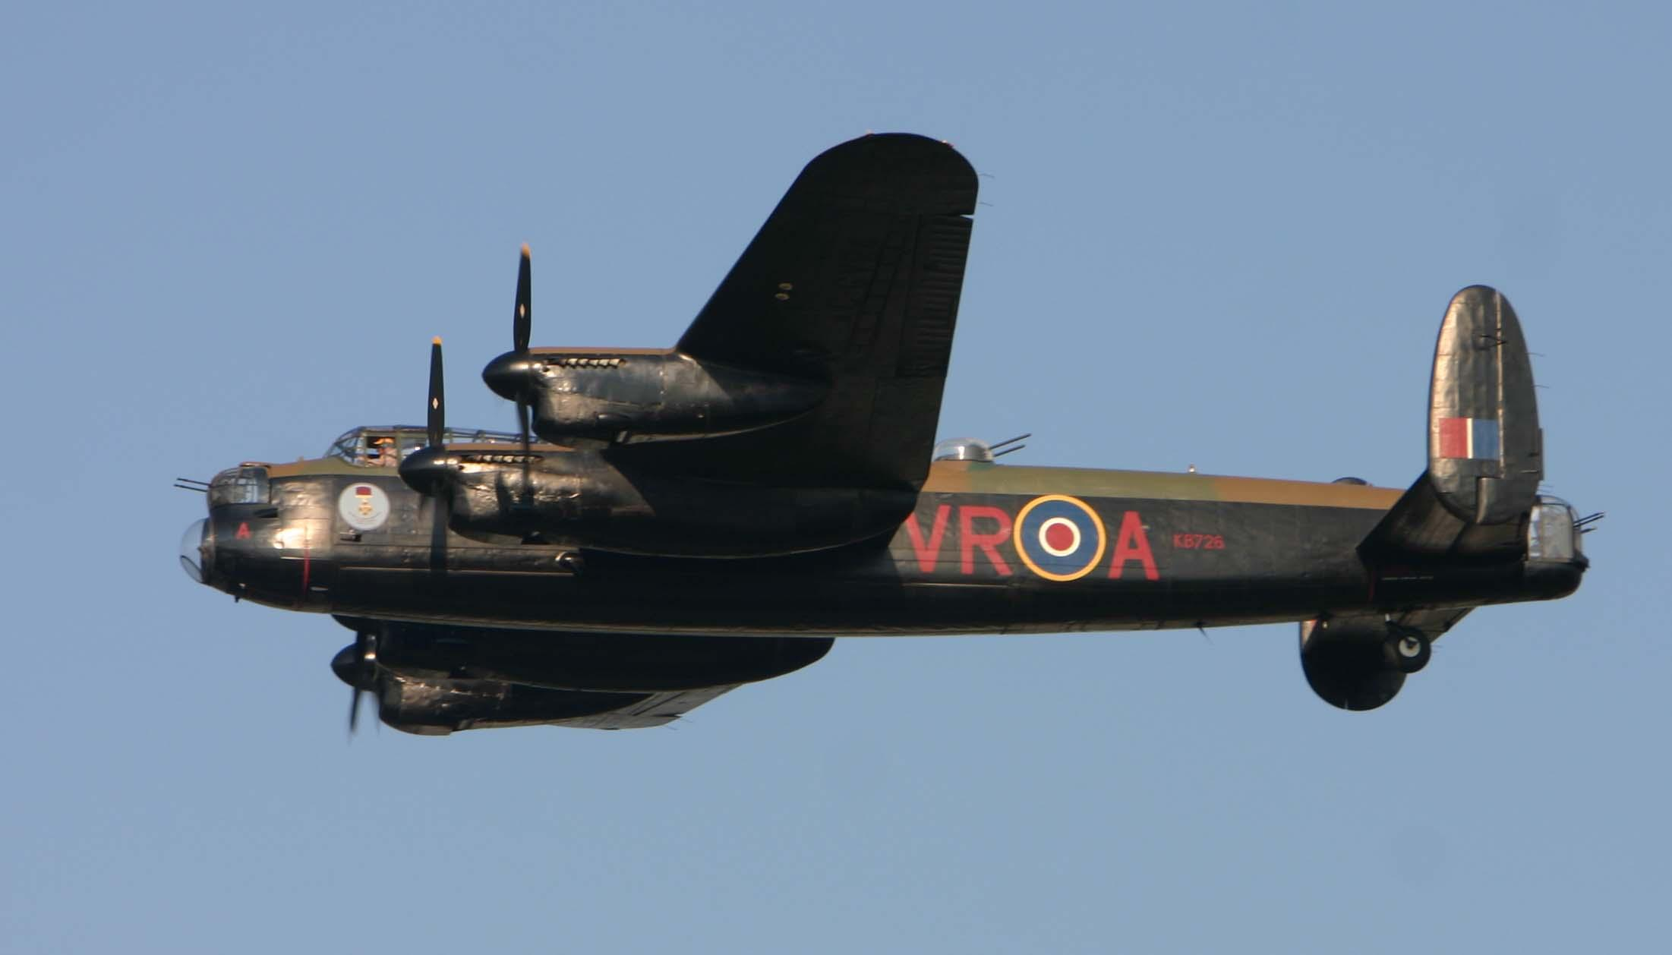
My War Hero
Hylton Lewis
The story of my Great Grandad during WW2

Slide 2
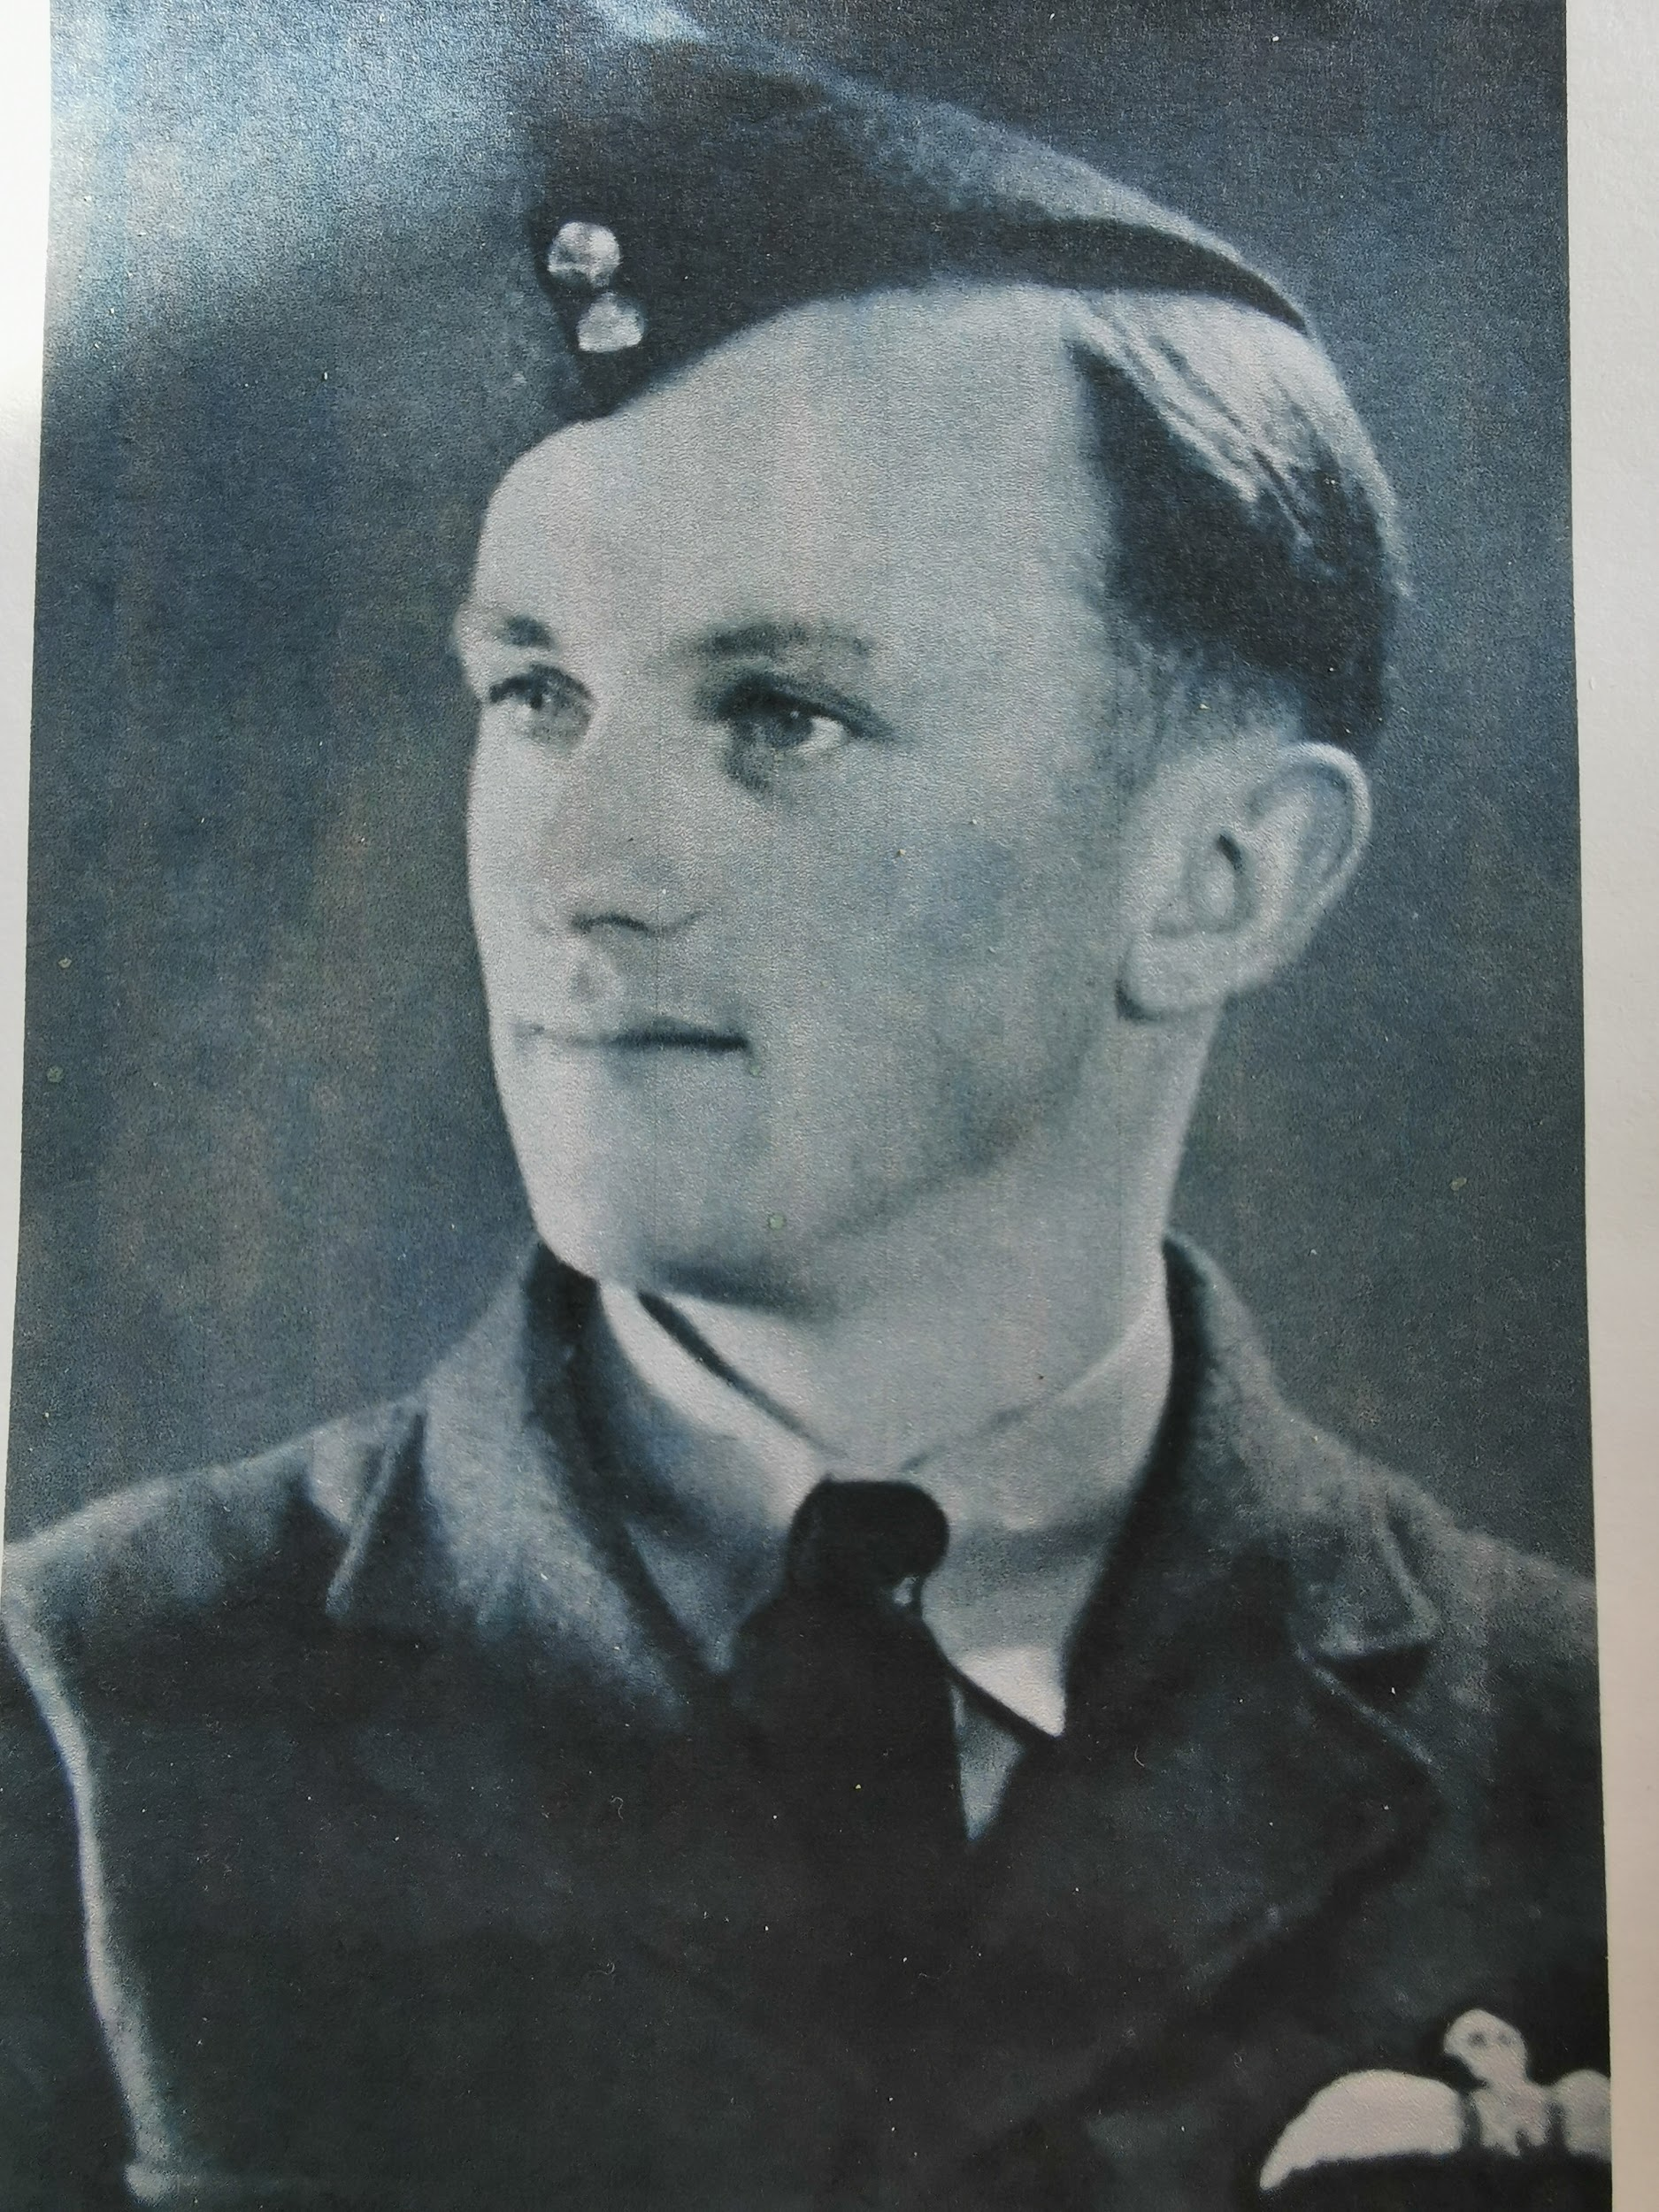
1939 - war broke out
My Great Grandad joined a club called
The Civil Air Guard to learn to fly just
before the war. On his first lesson they
got lost and landed in a field in the
middle of nowhere! But luckily that
didn’t put him off and he enlisted in the
RAF in October 1939.

Slide 3
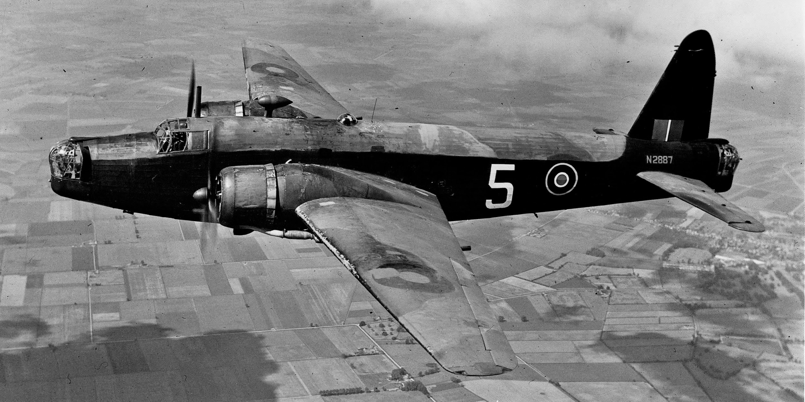
Training and first missions
After hectic training on Wellington bombers, he was ready to go on important bombing missions. This included night bombing raids. His first few trips were as a second pilot and his first bombing mission was cancelled due to thick fog! His second trip was to bomb the submarine pens at Wilhelmshaven in Germany.
A Wellington Bomber had 2 engines
and 2 gun turrets

Slide 4
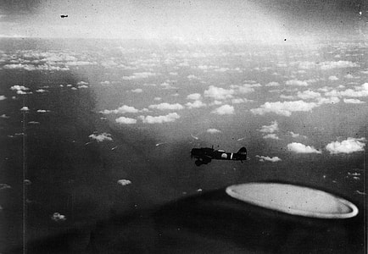
Preparing for the raids
Great Grandad said it was hard to sleep during the day because they were worried of what the night will bring but he always nearly fell asleep while flying over the North Sea , which was very dangerous.
“You couldn’t get much sleep during the day. Tension built when we were ordered for a briefing on the day of a raid.We were briefed at around 6pm when we were told about the likely weather conditions, which were not always accurate. When the target was announced there was a murmur from the crews especially if it was a ‘hairy’ one like Hamburg or Berlin. They knew what the flak , i.e , anti-aircraft fire around the target would be like. We took off between 11pm and midnight.”

Slide 5
Operations in the Wellington Bomber
One night on a bombing raid to Germany he flew into an electrical storm. Sparks were flying off the guns and anything metal. They had to turn back - one plane who didn’t turn back didn’t make it home.
While my great Grandad was in the Wellington the engine failed twice and he had to crash land in a field.
The chances of flying through the main phase of the war and surviving was very, very low. Great Grandad was very lucky to come home.
In May 1942 Great Grandad was told he was taking part in the first 1000 bomber raid - their target was Cologne.
It was very chaotic because there were so many planes in the air.
Great Grandad said it was an incredible sight!
On the way back their petrol gauges were showing empty and they an emergency landing. It turned out they were broken!

Slide 6
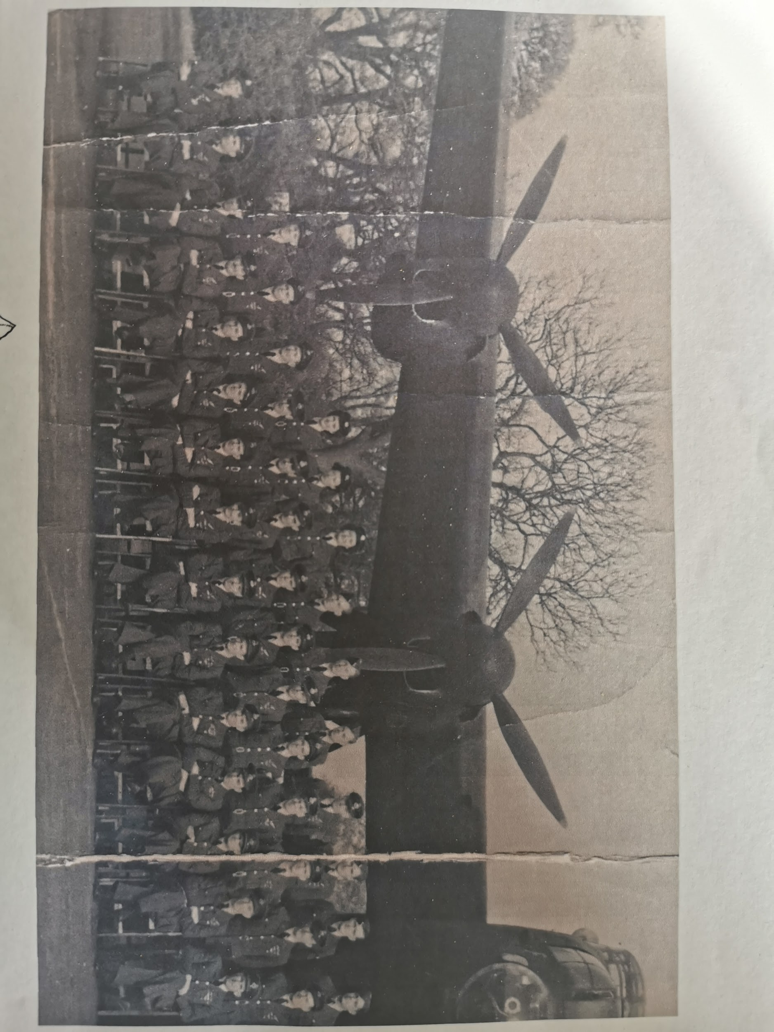
Pathfinders 1944 -1945
Great Grandad became a pathfinder, flying the famous Lancaster Bomber.
They flew higher and they had to wear oxygen masks.
Grandad said the air was so full now that collisions were a constant hazard. But he hated bright moonlight because they felt too visible to their opponents.
Grandad’s bomber squadron in front of a Lancaster

Slide 7
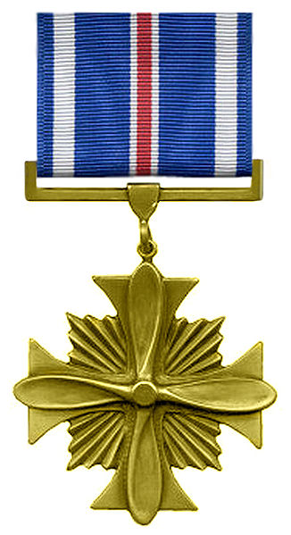
The End of the War
When the war finished Flight Lieutenant Lewis had flown 59 missions over enemy territory.
He was awarded two medals and the Path Finder Force badge. His medals were : D. F C. (distinguished flying cross) and the United States D.F.C for “extraordinary achievement in aerial flight against the enemy award despite his aircraft frequently suffering severe damage from enemy fire.”
I am very proud to call him my Great Grandad! He was so brave! My middle name is Hylton, named after a war hero.

