Slide 1
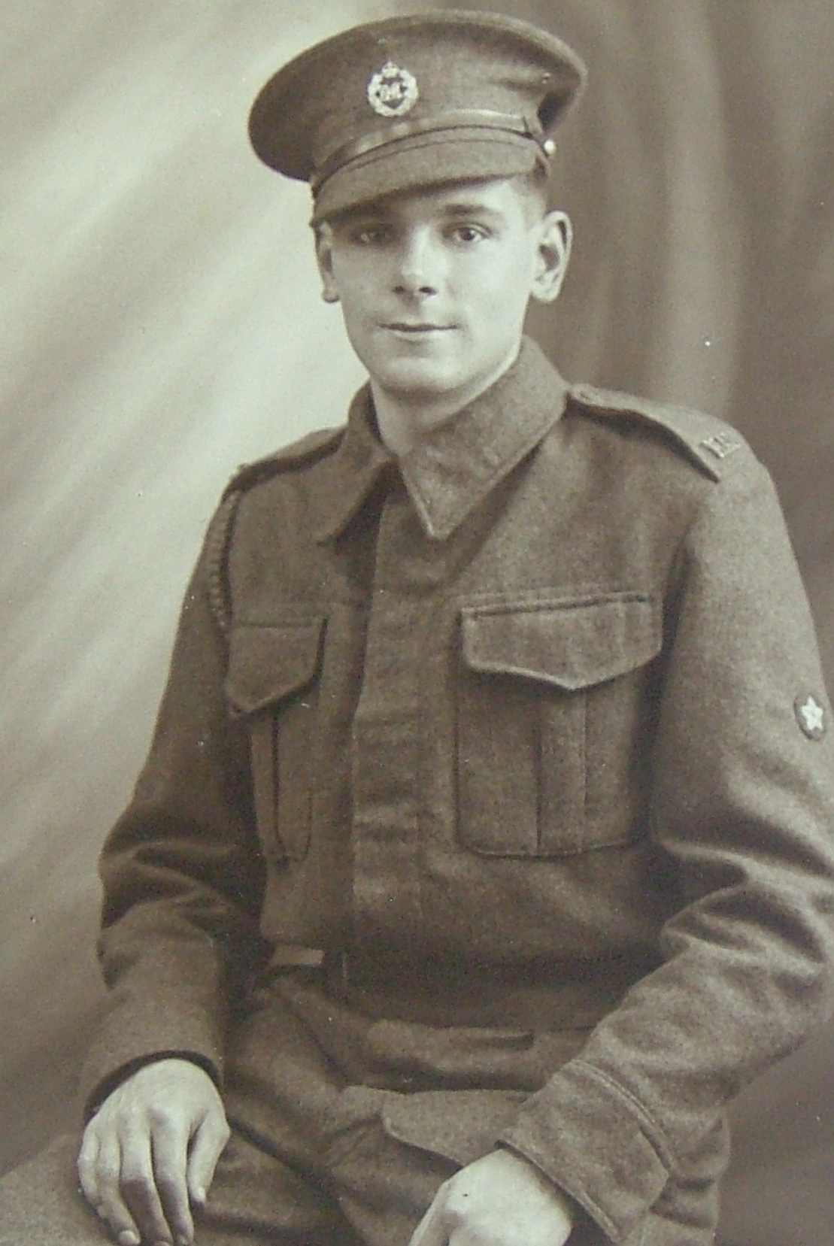
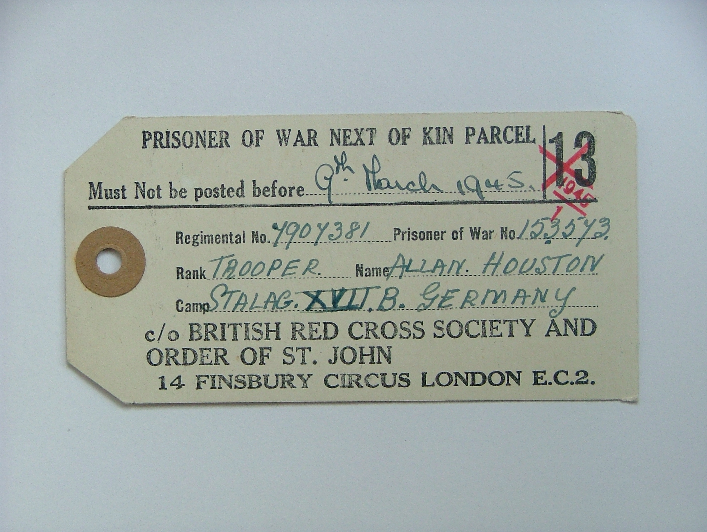
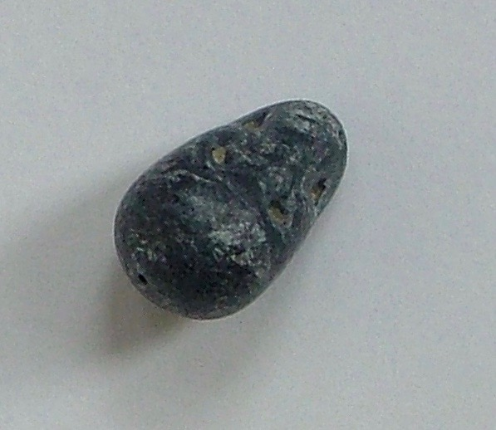
My V.E. Day hero by Emmeline Kay

Slide 2
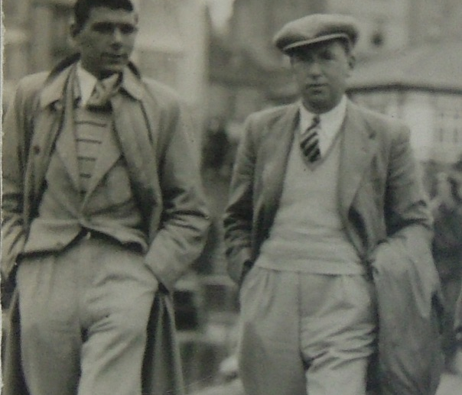
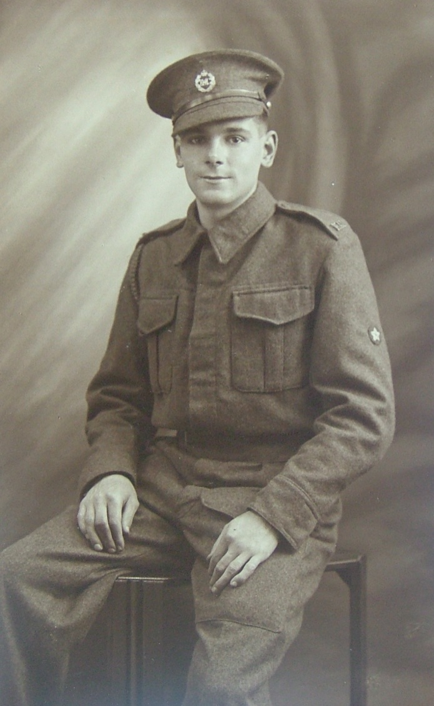
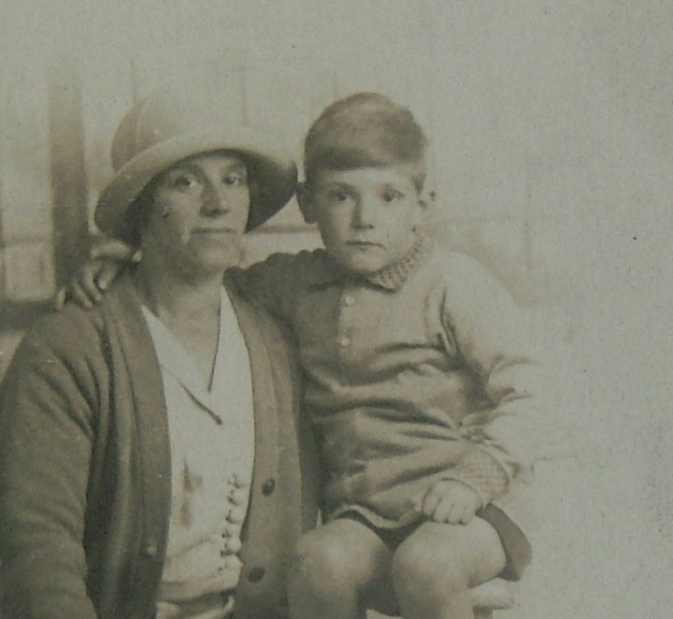
My Great-Grandad
My great-grandad was Allan Houston. He was born in 1919 and lived in Oldham in Lancashire with his mum and dad.
He was a bus conductor.
In the Second World War he joined the Cavalry & Royal Armoured Corps as a tank driver the 3rd British Tank Regiment.
He was only 22 years old when he enlisted in 1940 and went to fight for his country.
He fought bravely in Greece and the Middle East.

Slide 3
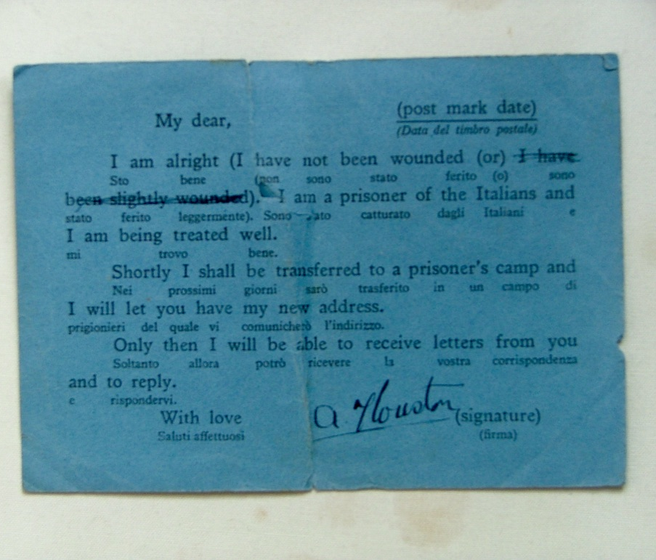
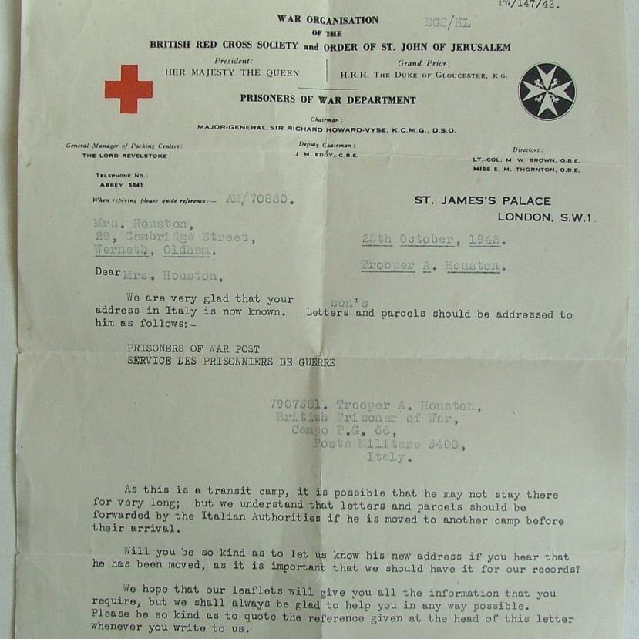
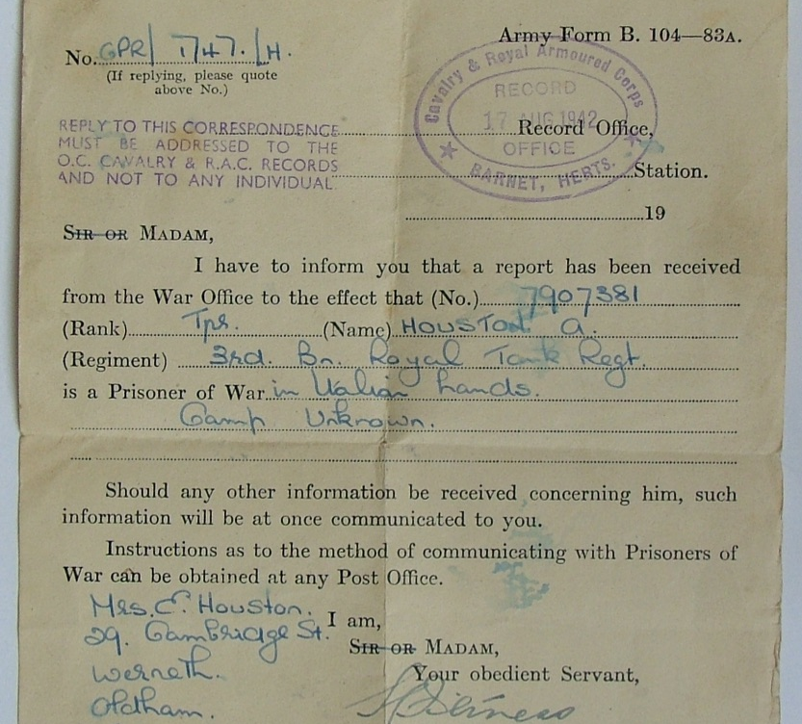
In May 1942 his unit was captured by the German army in a tank battle in Libya.
He was sent to a temporary PoW in Italy called Camp 66. PoW means Prisoner of War. This camp was near Naples in the south of Italy.
His mum and dad did not know where he was for months and months.

Slide 4
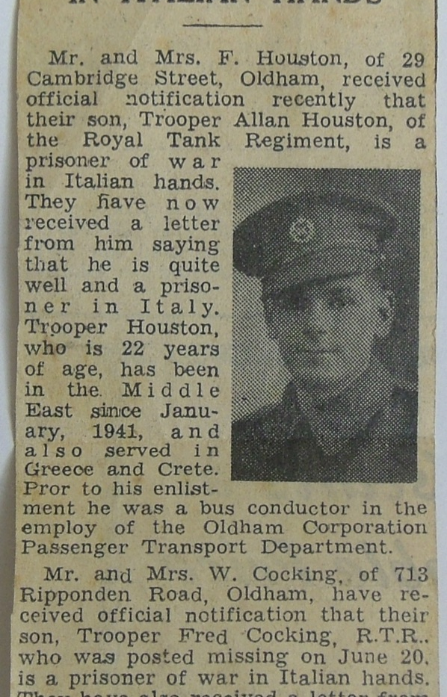
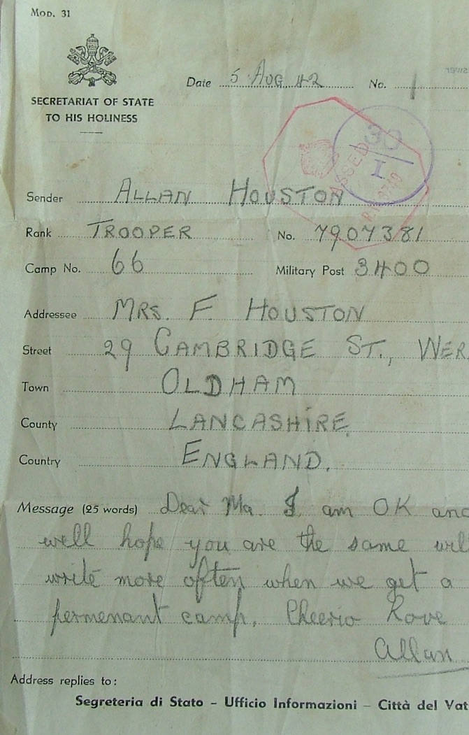
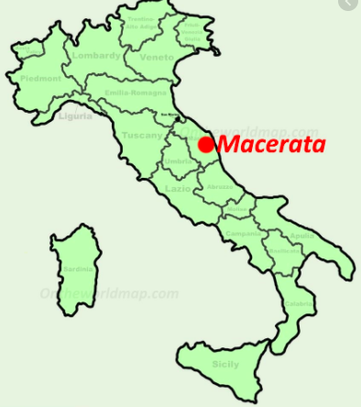
By October of 1942 he had been sent to Camp 53 in Italy. This is in a place called Sforzacosta, Macerata, Italy.
He was there for about 10 months.

Slide 5
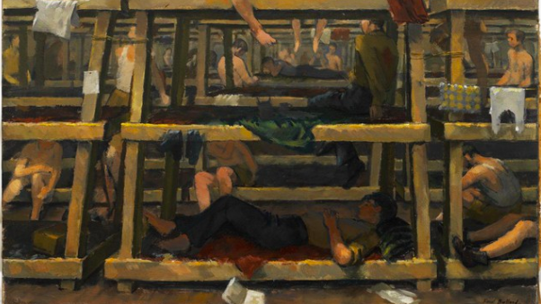
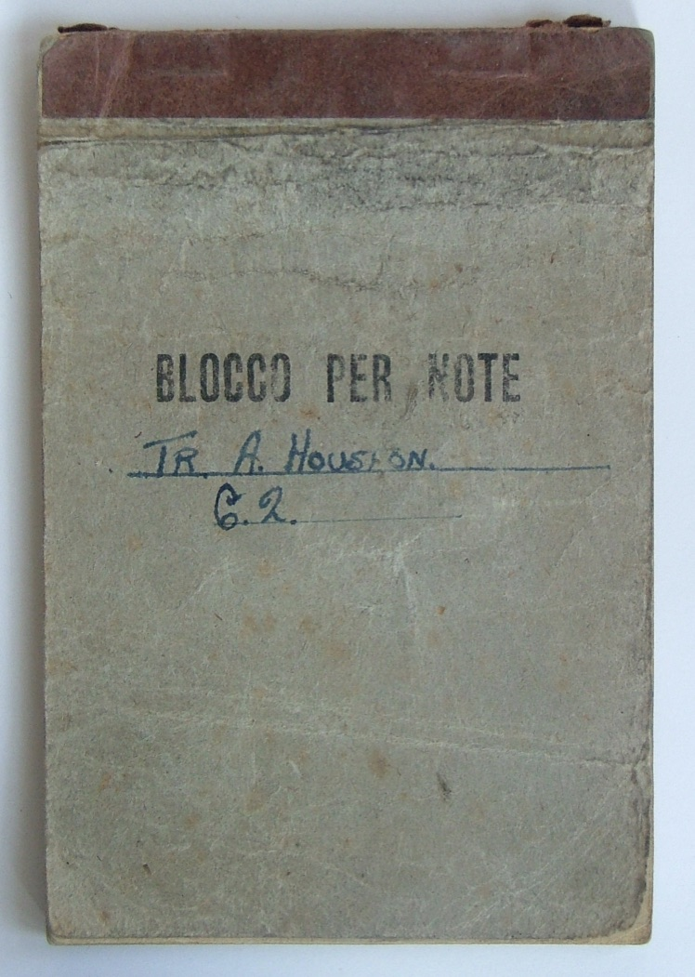
Allan was in Camp 53 with about 6000 other PoWs. This painting is of Camp 53 and is by Paul Bullard.
He kept a diary. He wrote a lot about not having enough food, his friends in the camp and looking forward to the Red Cross parcels and getting letters from home. Sometimes he was sad or frightened. Sometimes he was hopeful we would win the war.

Slide 6
Diary entry: Saturday Feb 27, 1943.
Coffee 7.00. Hot. Wash then roll call at 10.00. Nice day today. Getting warmer now. Bread cheese and tea 11.00. Dinner today bacon, tomatoes, and jam. Hope more arrive soon. More mail but none for us. News getting better. Won’t be long when we get March here. Lets get out of this. Roll call again 15.00 in field and one man shot dead by sentry. He was only stood too near the wire. Witness says it was murder. Red Cross inf. sentries all nervous these days. Mac up 17.00. Very nice. No super tonight just brew at 18.00 hrs. Usual talk before bed 21.00. Roll on Sunday.

Slide 7
Stallag 17B
The Italian’s surrendered in September 1943 and my great-grandad Allan should have been free.
He was told to wait for help to arrive. While he was waiting the German’s came and captured him and the other POWs again and took them away to other camps!
My great-grandad Allan was sent to Stallag 17B, near Krems in Austria.
Stallag 17B was one of the most notorious German PoW camps and a movie has been made about it. It held around 30,000 PoWs and was a lot bigger than his Italian camp.

Slide 8
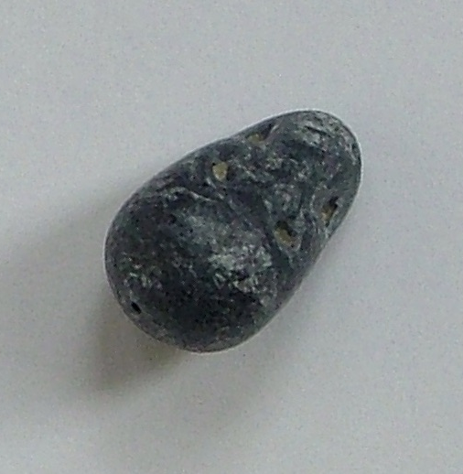
My great-grandad then survived forced evacuation from his camp by the Germans on a forced 18 day ʻdeath march’ west.
This was 280 miles across Austria in April 1945. He finally met American troops and was liberated (free) in May.
This is the stone he chewed because he was so thirsty and hungry.

Slide 9
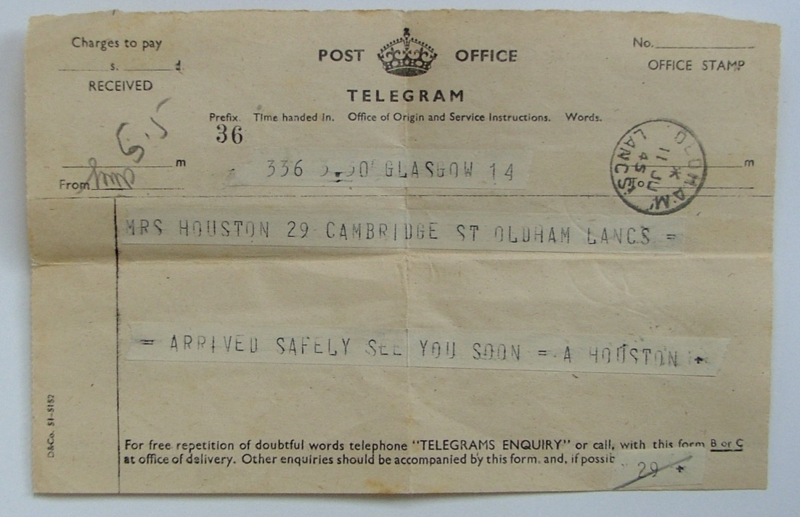
My great-grandad came home, got married and had a family!
However, he weighed just 7 stone in weight when he first came home and it took a long time to get well.

