Slide 1
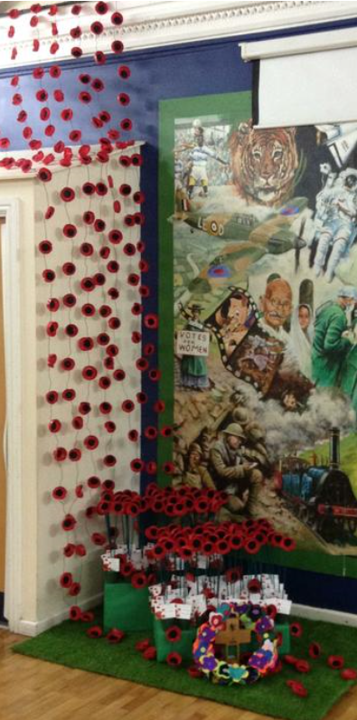

Remembrance

Slide 2
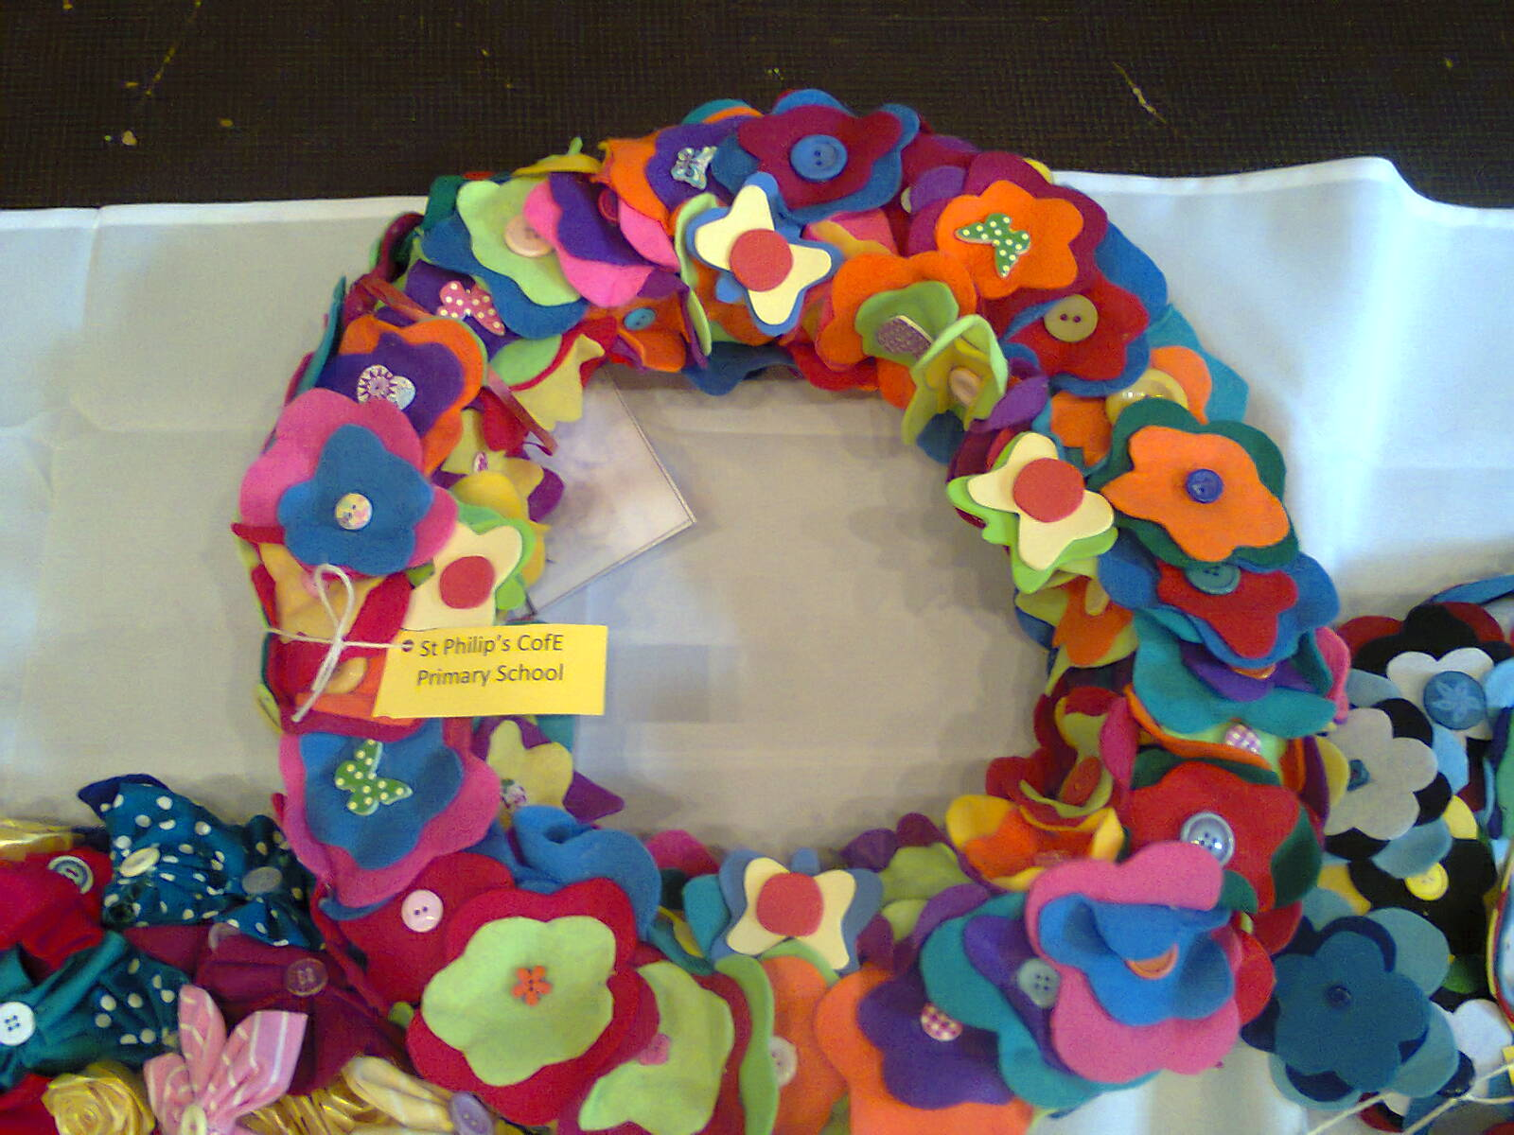

St Philip’s: Christ in everything we do
Our wreath for The Unremembered Project was on show in London

Slide 3
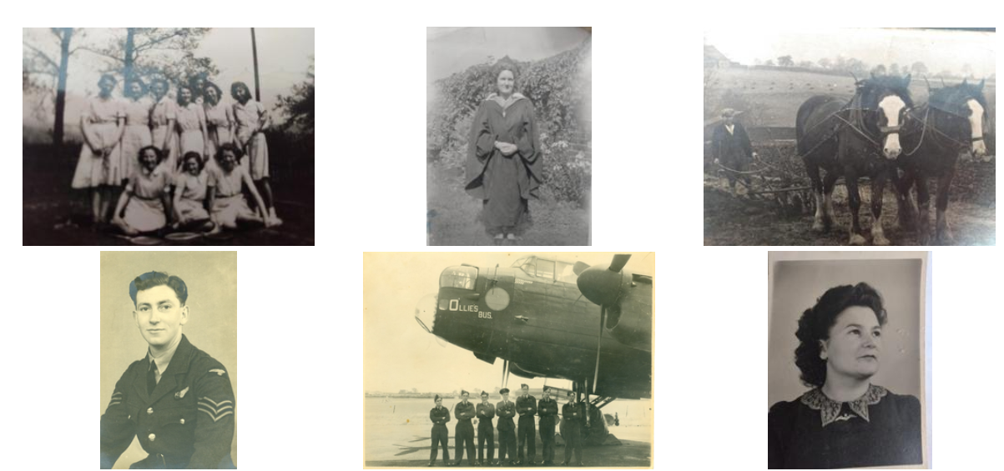

Slide 4
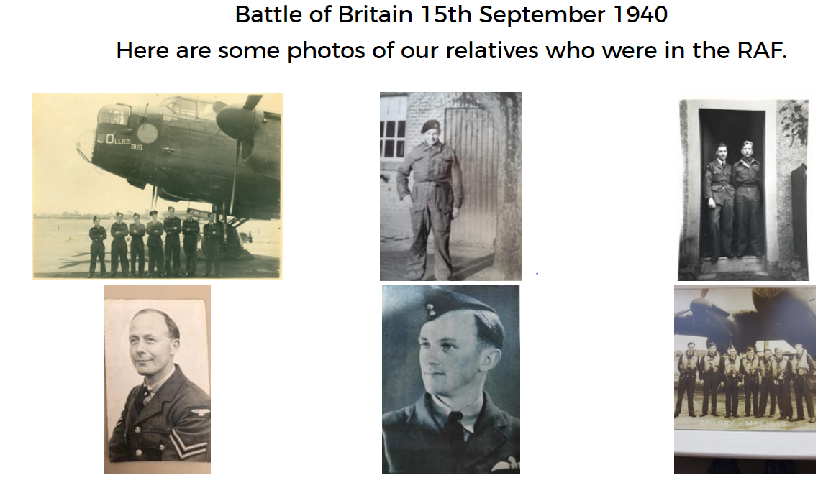

Slide 5


Slide 6


Slide 7
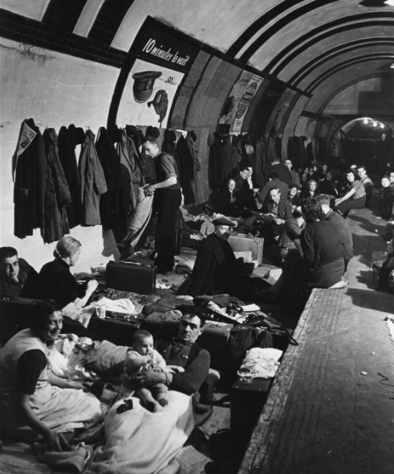

Slide 8
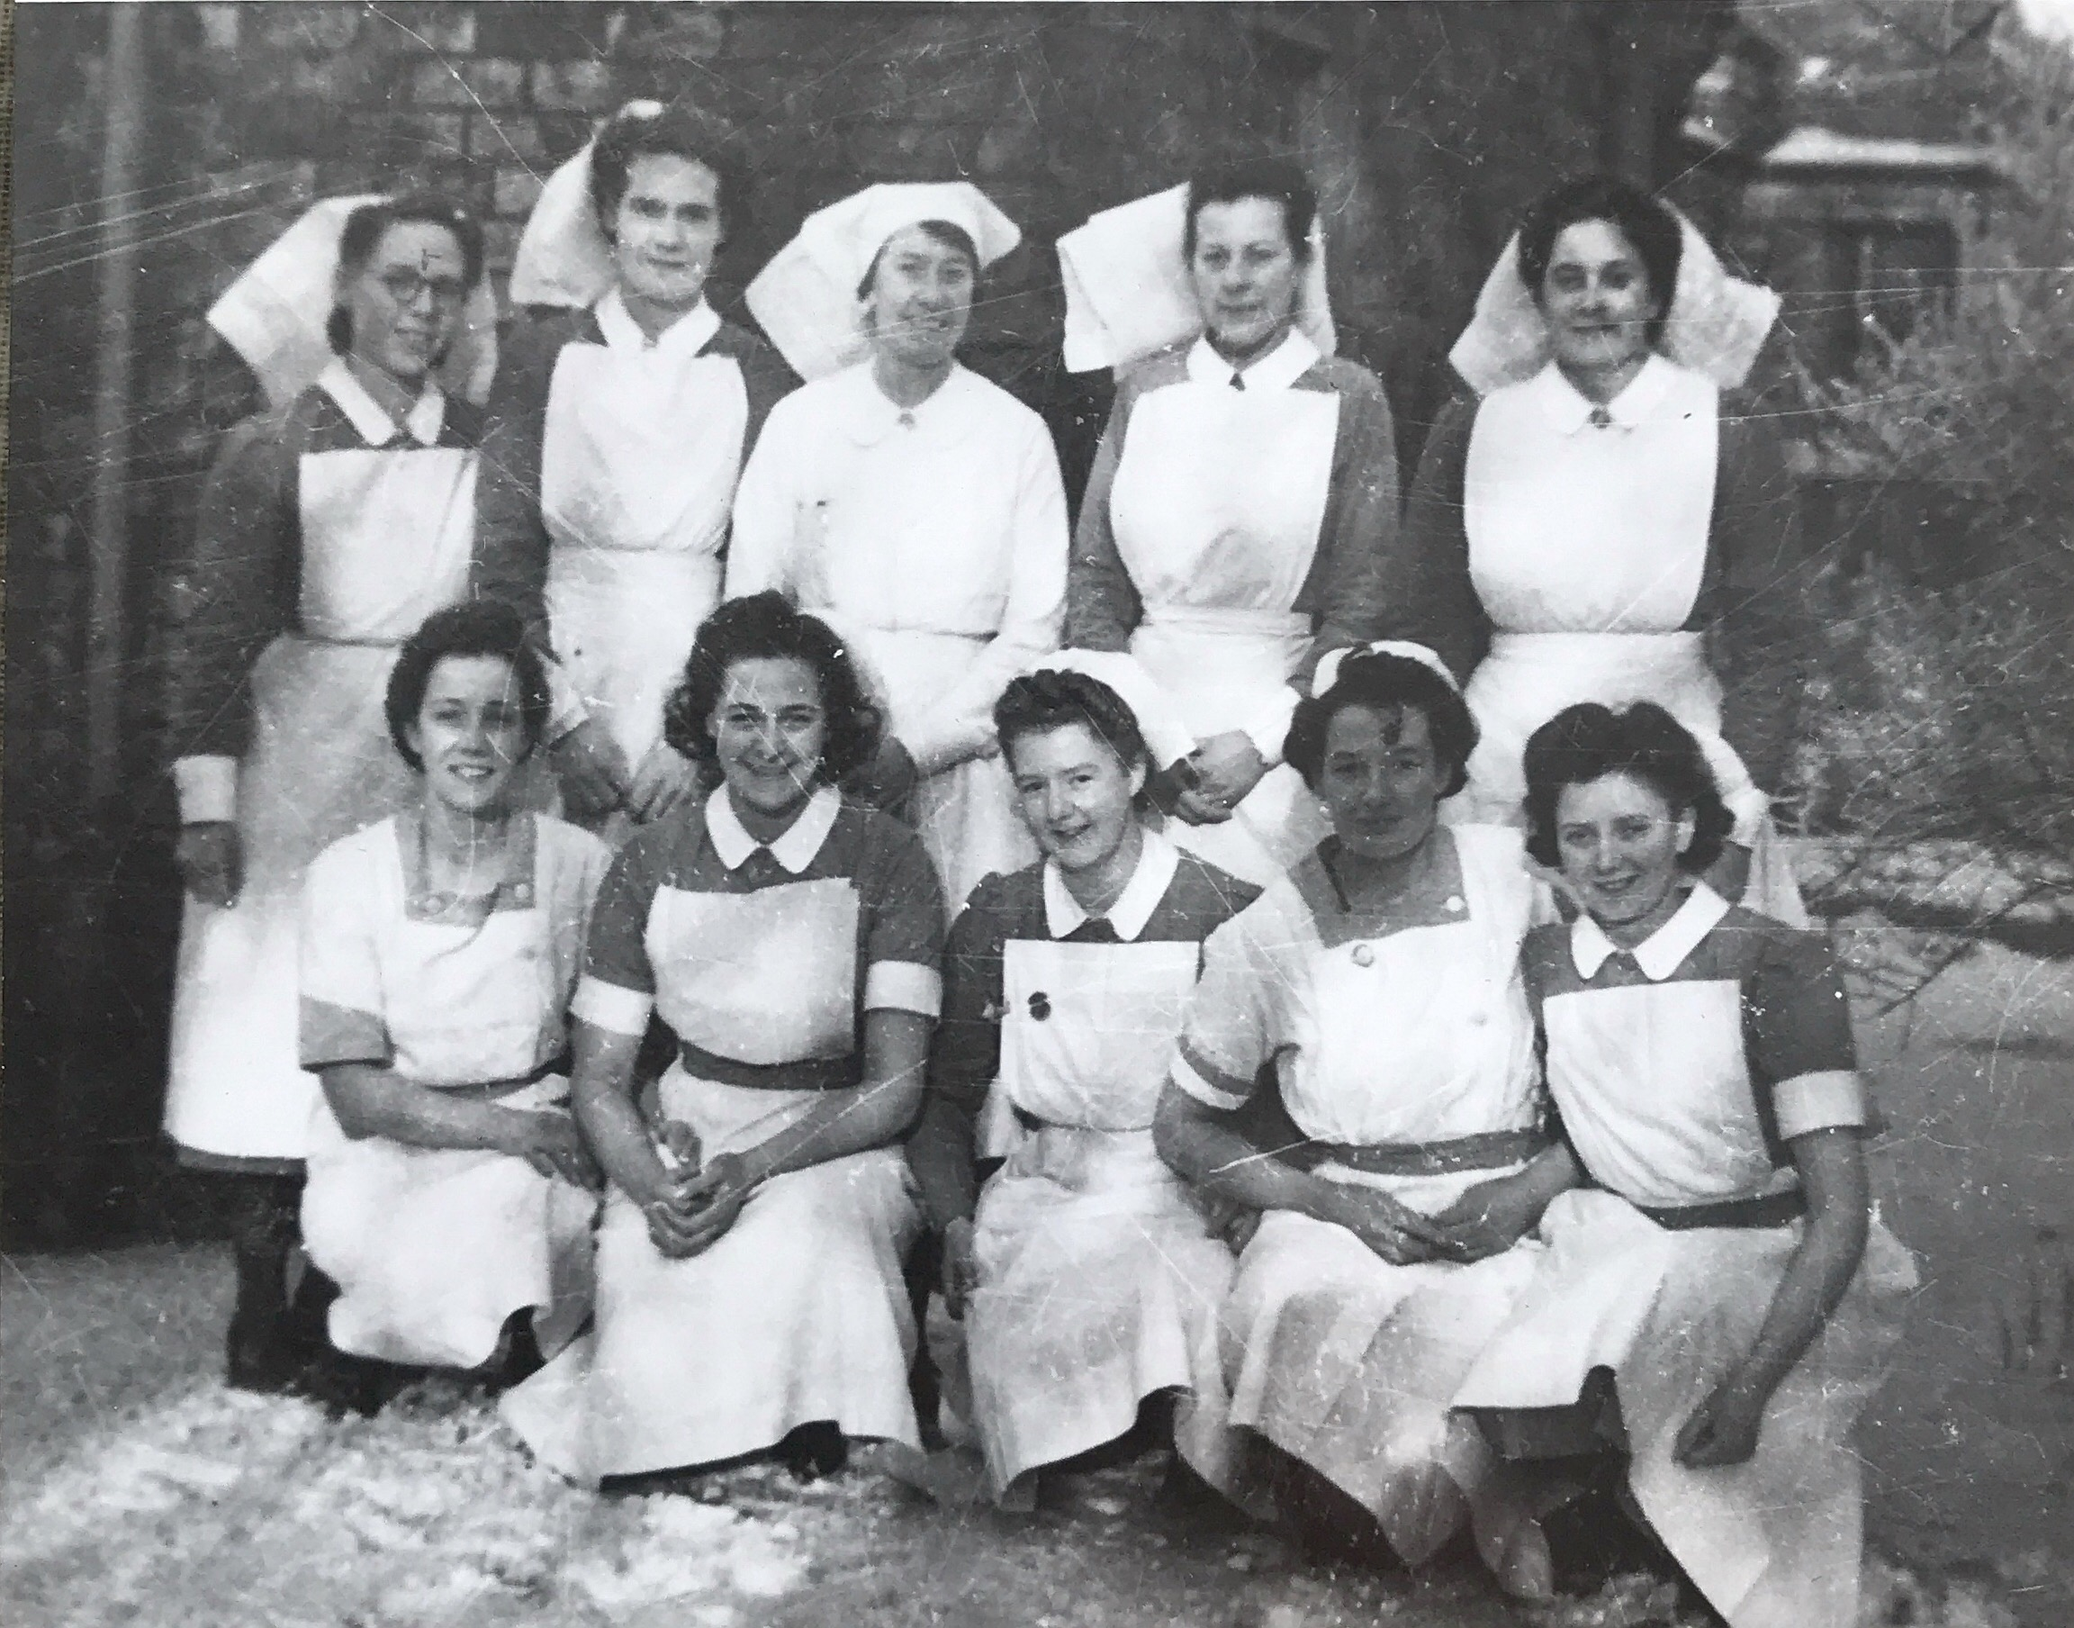
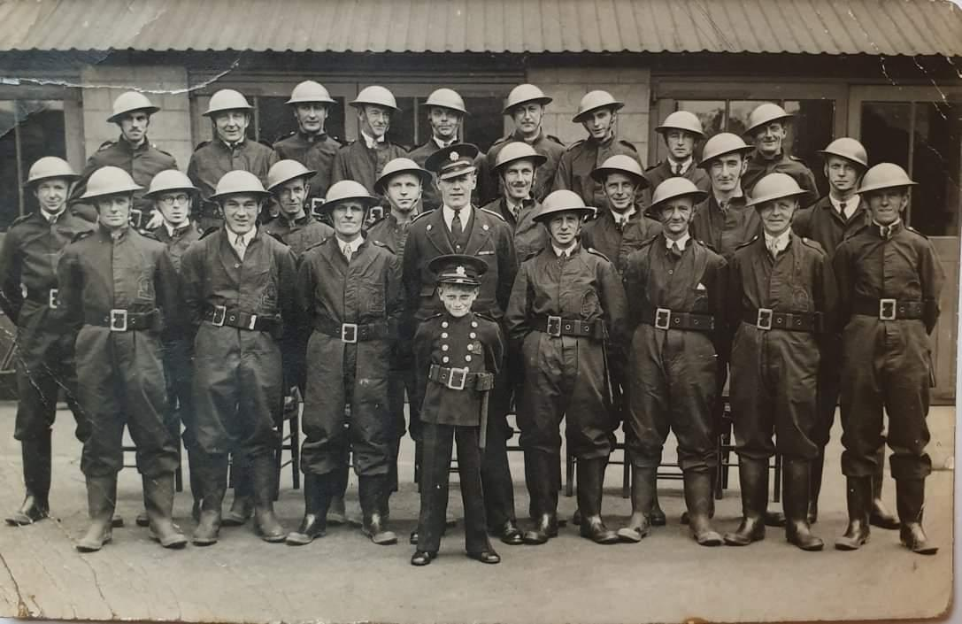

Slide 9
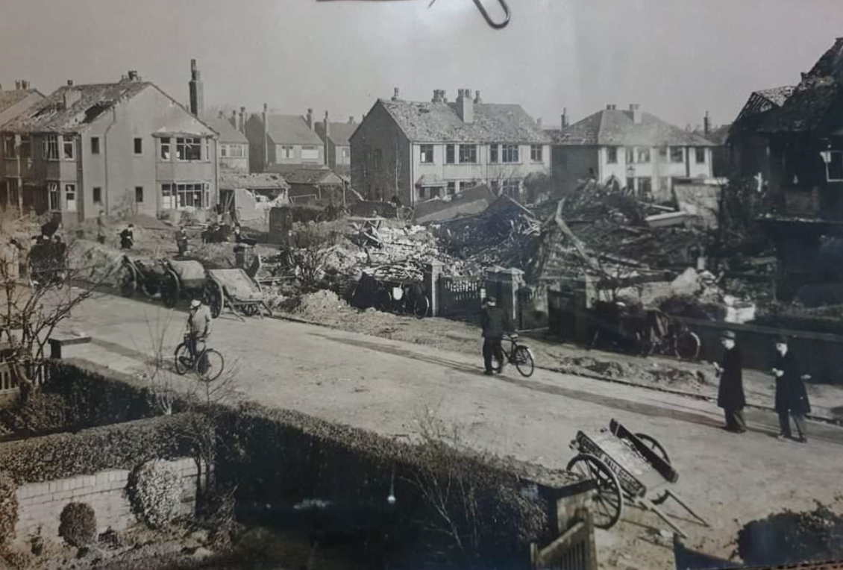
Stretton Drive in Southport

Slide 10
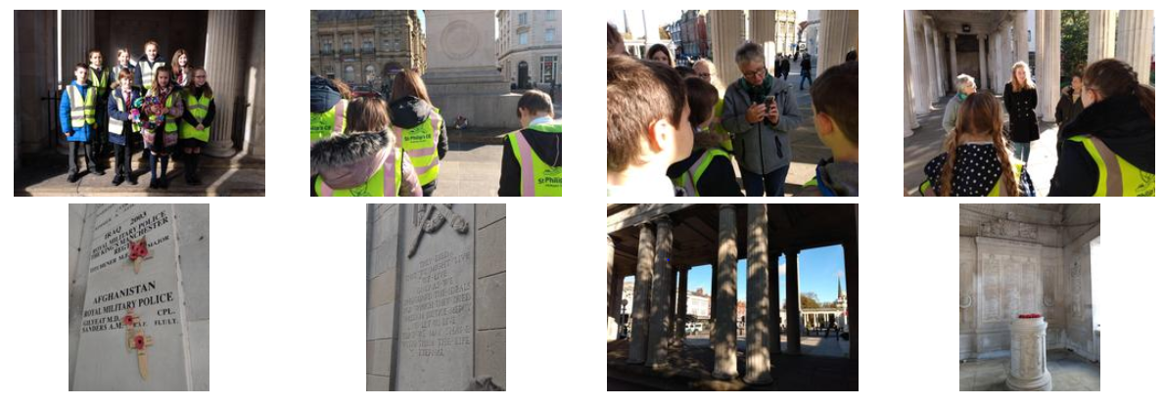

Slide 11


Slide 12


Slide 13


Slide 14


Slide 15



Slide 16


