Slide 1
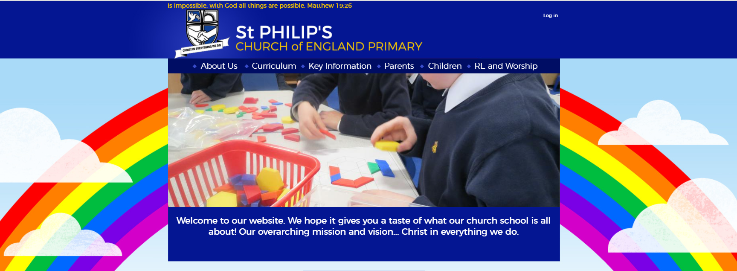

The Lord is with us -
His spirit is here

Slide 2
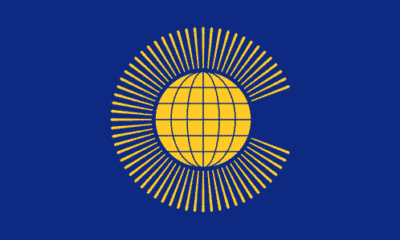
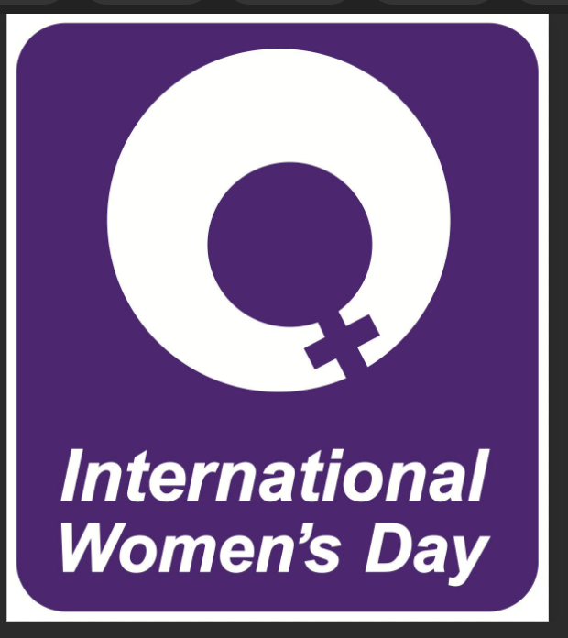

Together we can make a difference
Our window is to find out about the Commonwealth and International Women’s Day

Slide 3
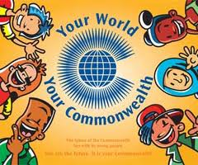
The Commonwealth is a family of 53 nations, spread over every continent and ocean in the world.
Notes:
The Commonwealth is a family of 54 nations, spread over every continent and ocean in the world.
Although the people of the Commonwealth are different in many ways, they work together

Slide 4
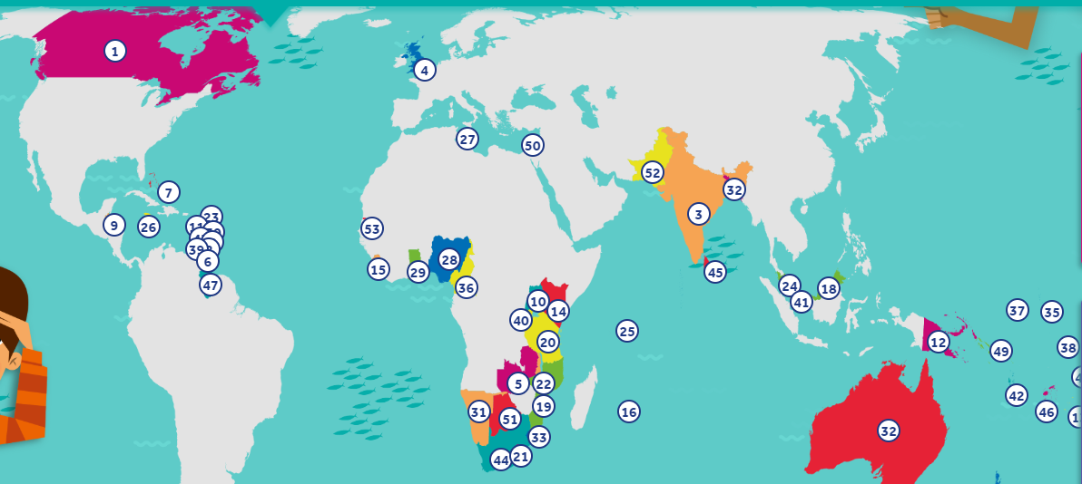
http://www.youngcommonwealth.org/members/
the Commonwealth is the countries that used to be in The British Empire

Slide 5
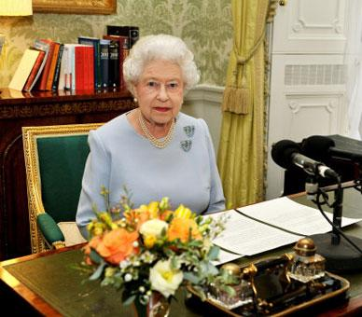
Commonwealth Day
The Queen is the head of the Commonwealth and its headquarters are in London

Slide 6
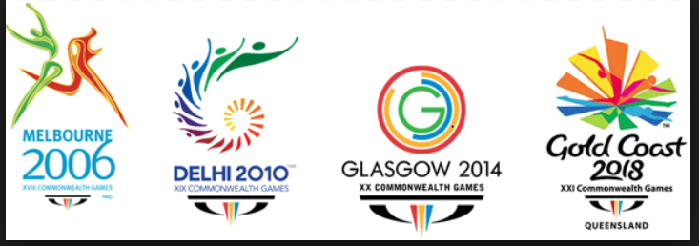

Commonwealth Games…these happen every 4 years
Notes:
Every four year the commonwealth games take place. These are the friendly games, where countries are working together, and individuals compete.

Slide 7

BRITISH VALUES are used across these countries…can you remember what they are?

Slide 8
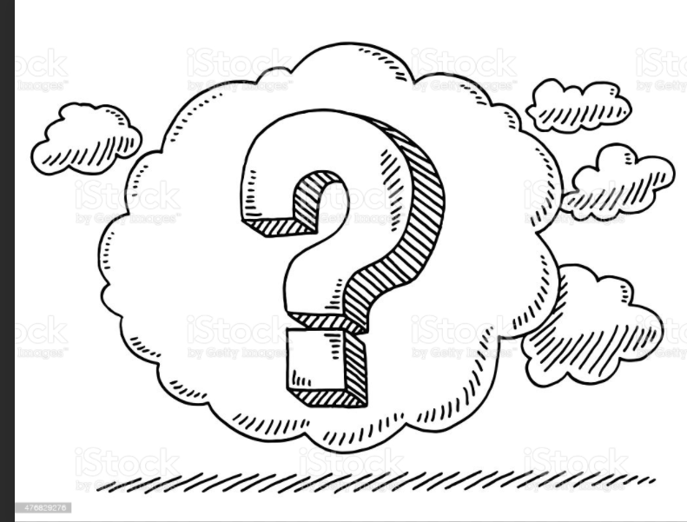

Slide 9
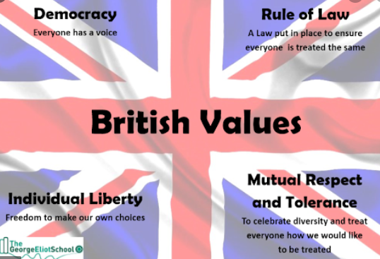

Slide 10
A BIG Part of this Democracy and the belief that everyone is equal

Slide 11

So…our mirror today is to look at

Slide 12
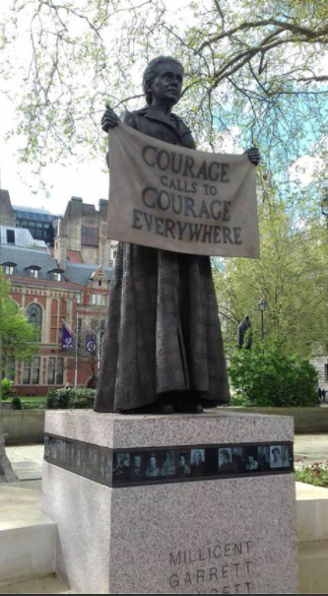
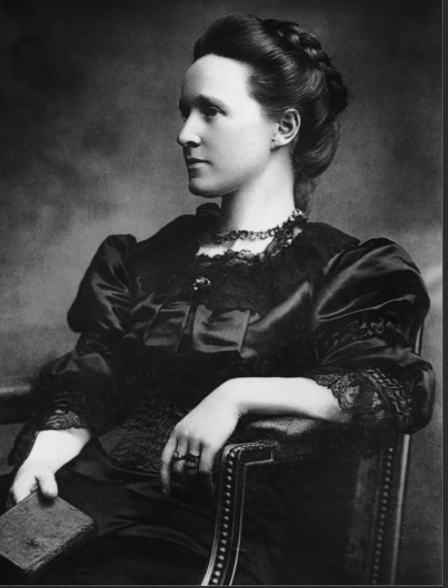
Together we can make a difference
Playing our part in acting out the values of The Commonwealth

Slide 13
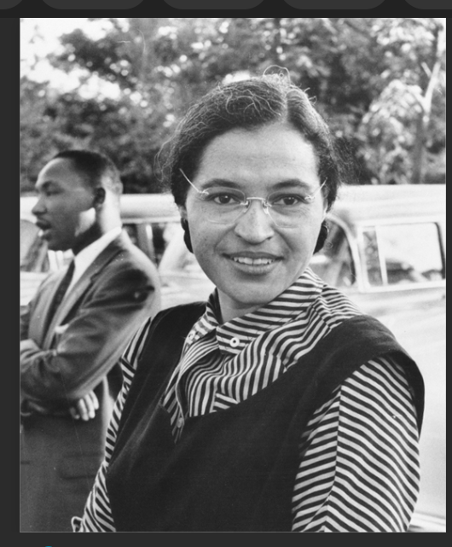

Slide 14

Our door is to find out more-
To take time to be grateful for the values we live with
Do our bit to make the world a fairer place
Playing our part in acting out the values of The Commonwealth

Slide 15
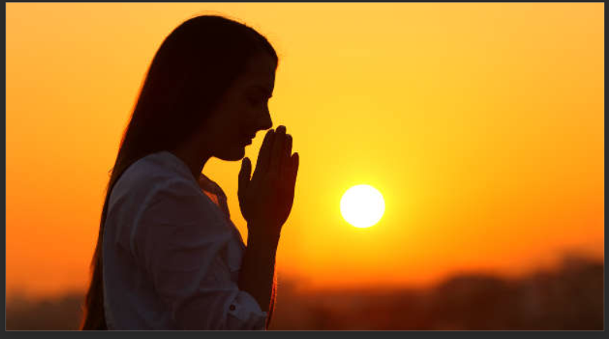
Horrible Histories Song: The Suffragettes' Song - CBBC – BBC
Horrible Histories Song: Rosa Parks - I Sat on a Bus - CBBC – BBC
http://www.youngcommonwealth.org/members/

