Slide 1
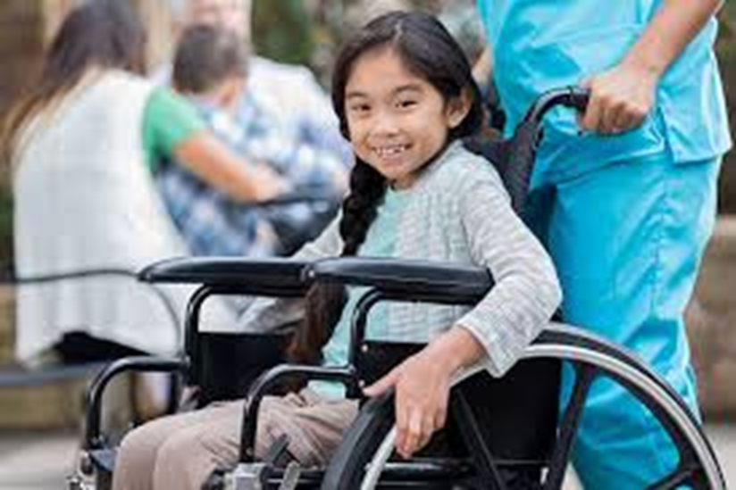
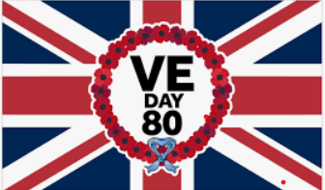
Significant – events
If World War 2 had never happened – if we had not won – lives would be very different now
We would not have
Our British Values of democracy (choosing our leaders) , liberty (freedom), respect and rule of law

Slide 2
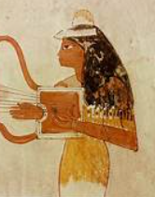
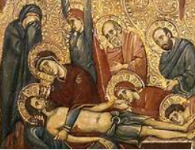
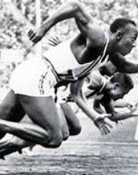
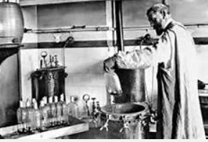
History is HUGE!
It covers all time – and all places – all events- people – there is a history to every subject in school – how many subjects is that?
The history of sport is about all sports – how many sports can you think of in just 10 seconds – there are SO many!!
It is impossible to learn about everything in history!

Slide 3
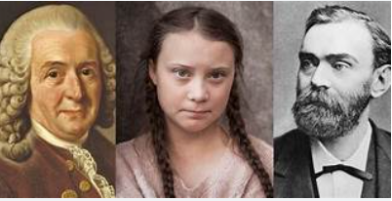
So – we cannot learn about everyone and everything in history
We have to choose what and who we learn about
This can be done by deciding who or what is most significant – this is another word for important

Slide 4
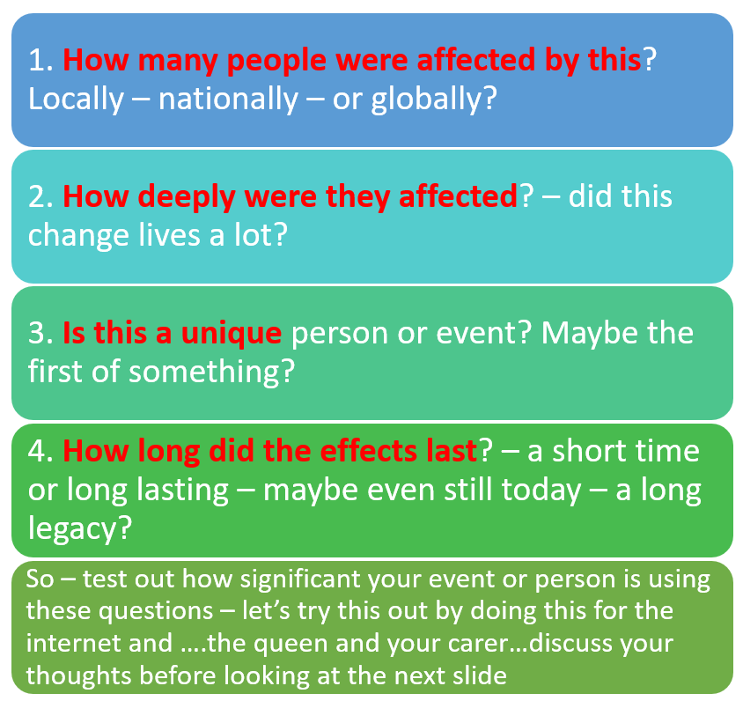
So – VE Day = Victory in Europe Day
This had a global effect – because it was the day World War Two ended.
The effects were deep– this war had lasted 6 long years and those years had changed peoples’ lives
It was a unique day – a one off – that was celebrated with huge happiness
Even now - 80 years later – we are remembering this day and being thankful for those who were brave enough to serve so that we are free today – they gave generously (our Christian Value this term) of their time and lives

Slide 5
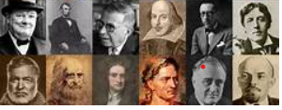
Because history used to be written by rich, white men in this country – guess what sort of people they thought were most significant?
These people also had the best chances in life – so were more likely to become famous scientists, writers, musicians etc.
World War Two was not just about the men who were fighters

Slide 6
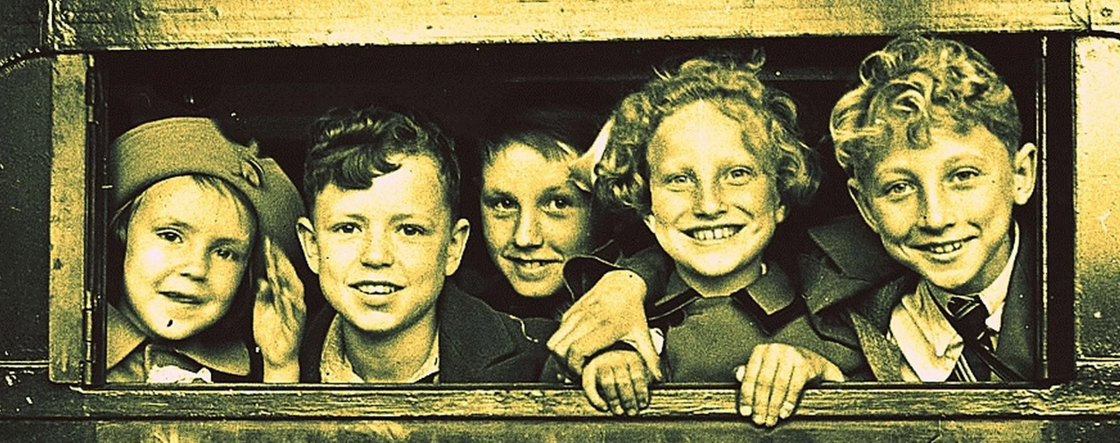
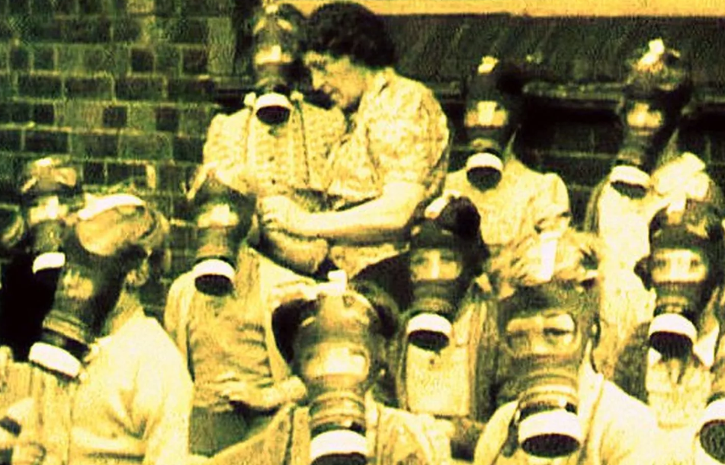
Hard and difficult times - children
Evacuation
Children from cities where there was a danger of bombing were moved to safer, countryside or seaside locations
Here in Southport 15,000 children arrived in just two days
Imagine how hard it must have been to leave home behind – parents didn’t come with you – their lives changed forever

Slide 7
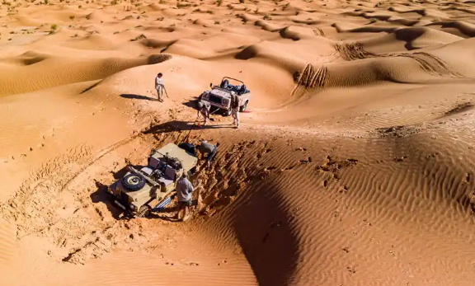
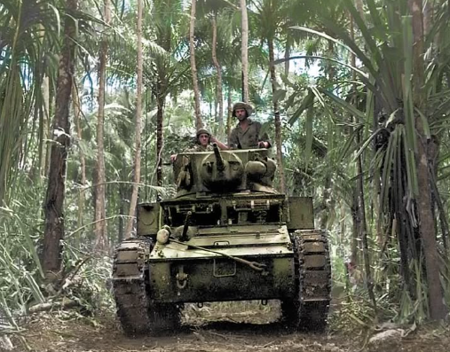
Hard and difficult times – fighting abroad
There was conscription – everyone of a certain age had to do something to help our country win the war
Many became soldiers and sailors fighting the enemy all around the world
Conditions were extreme fighting in deserts and jungles
Their lives changed forever

Slide 8
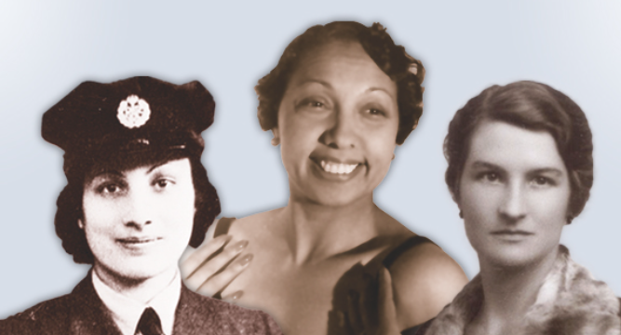
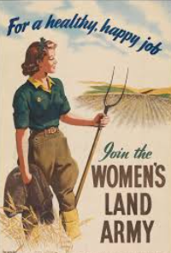
Hard and difficult times - women
Women had to take over all sorts of jobs here at home
Many became land girls – farming in all weathers to make sure there was food so that people did not starve
Those who could speak another language might become spies – risking their lives in other countries
Their lives changed forever

Slide 9
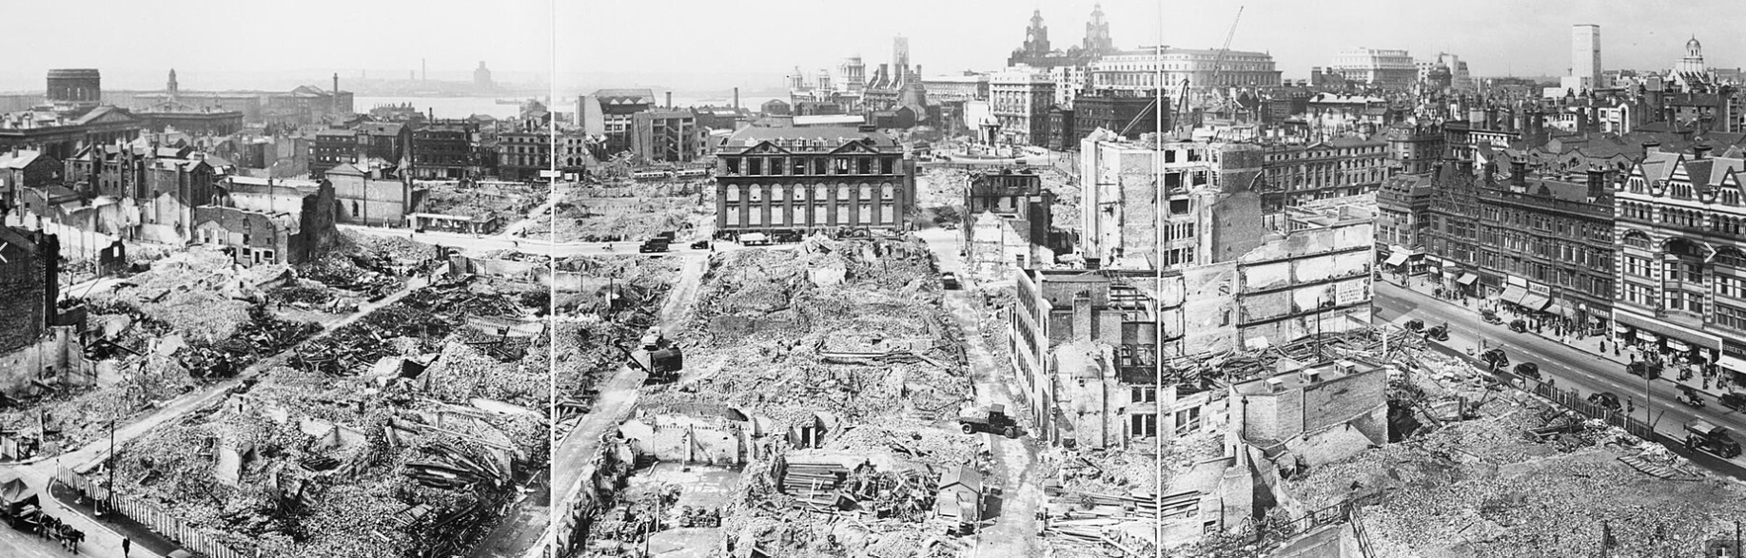
Hard and difficult times - bombs
Liverpool blitz
Almost 4,000 people were killed in the region during many bombing raids
Many thousands more were made homeless
Even here in Southport
17 people were killed and many more made homeless
These towns changed forever

Slide 10
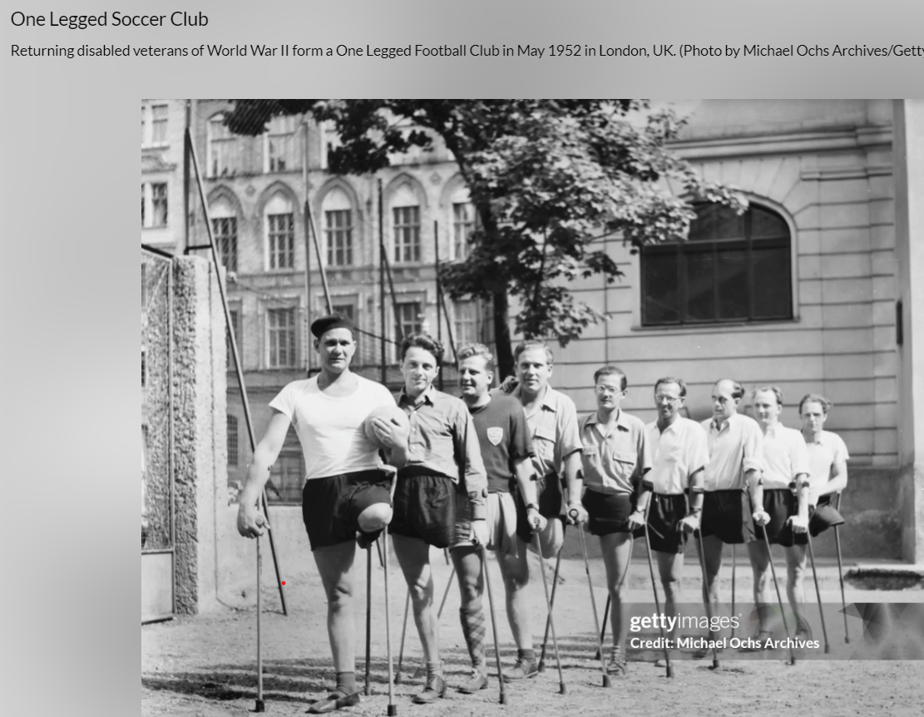
Disability – lives changed forever by injuries
Many people were injured by this war
They survived and rebuilt their lives
This is a one-legged football team from 1952!
The Paralympics grew out of teams and competitions from this time

Slide 11

Hard and difficult times here at home
Black out = at night no lights were allowed in case they led enemy planes to drop bombs there
SO there were lots of accidents as people tried to walk or drive in the dark
Rationing – people had to make do with smaller amounts of food because there was not enough food for everyone to have lots
Lots of food we take for granted were rare – sweets, fruits from abroad like bananas and oranges

Slide 12
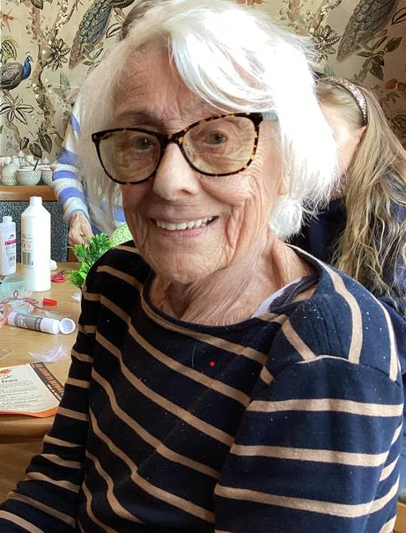
Lets hear some memories from the end of WW2 80 years ago
June was 7 when the war ended
She remembers bombs falling near where she lived
She knew families where young soldiers died
Her life changed because of the war

Slide 13
Significant – events
If World War 2 had never happened – if we had not won – lives would be very different now
We would not have
Our British Values of democracy (choosing our leaders) , liberty (freedom), respect and rule of law

Slide 14
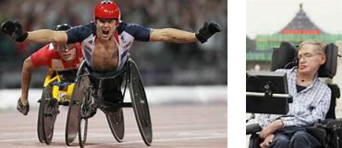
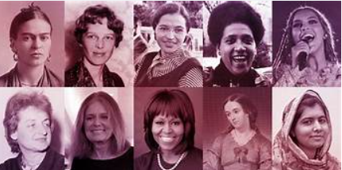
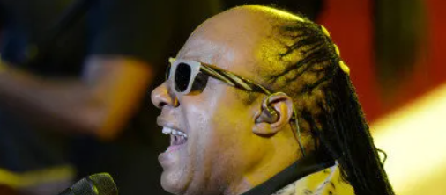
Now that history is written by lots of different people we see the importance/significance of different people and events
World War Two affected many different people in many different ways
Lives changed forever
We are thankful to those who served

