Slide 1
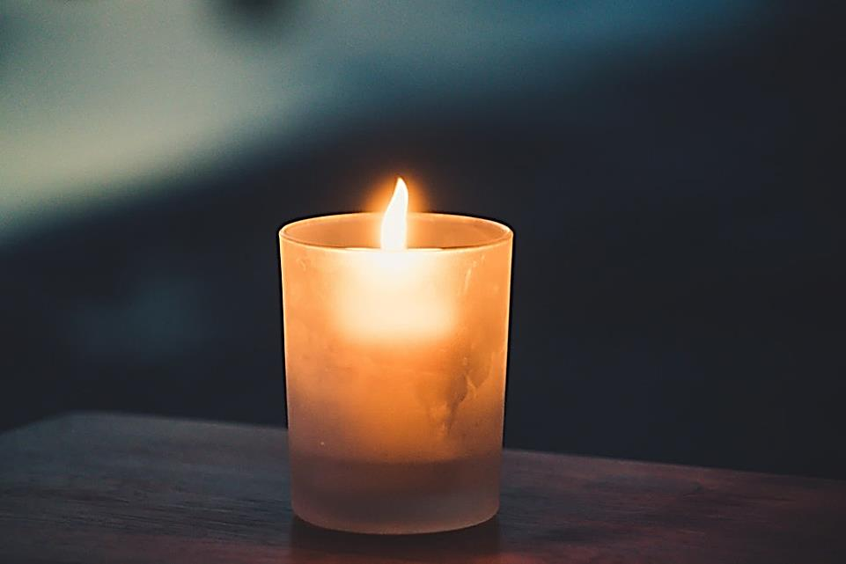


Welcome to worship

Slide 2

The Lord is here
His Spirit is with us

Slide 3


Safer Internet Day
Is it too good to be true?

Slide 4


Who enjoys going online? What do you enjoy most about it?

Slide 5

GOING ONLINE
Enjoy
Don’t enjoy
Connect with friends that are far away
Learning opportunities
Enjoyable
Finding information
Entertainment
Find things that may scare you
You could be scammed
Getting hacked and losing your information
Make your eyes hurt from too much screen time
Cyberbullying
Fake news

Slide 6

The internet is very useful but it is an unsafe place if we don’t know how to use it

Slide 7


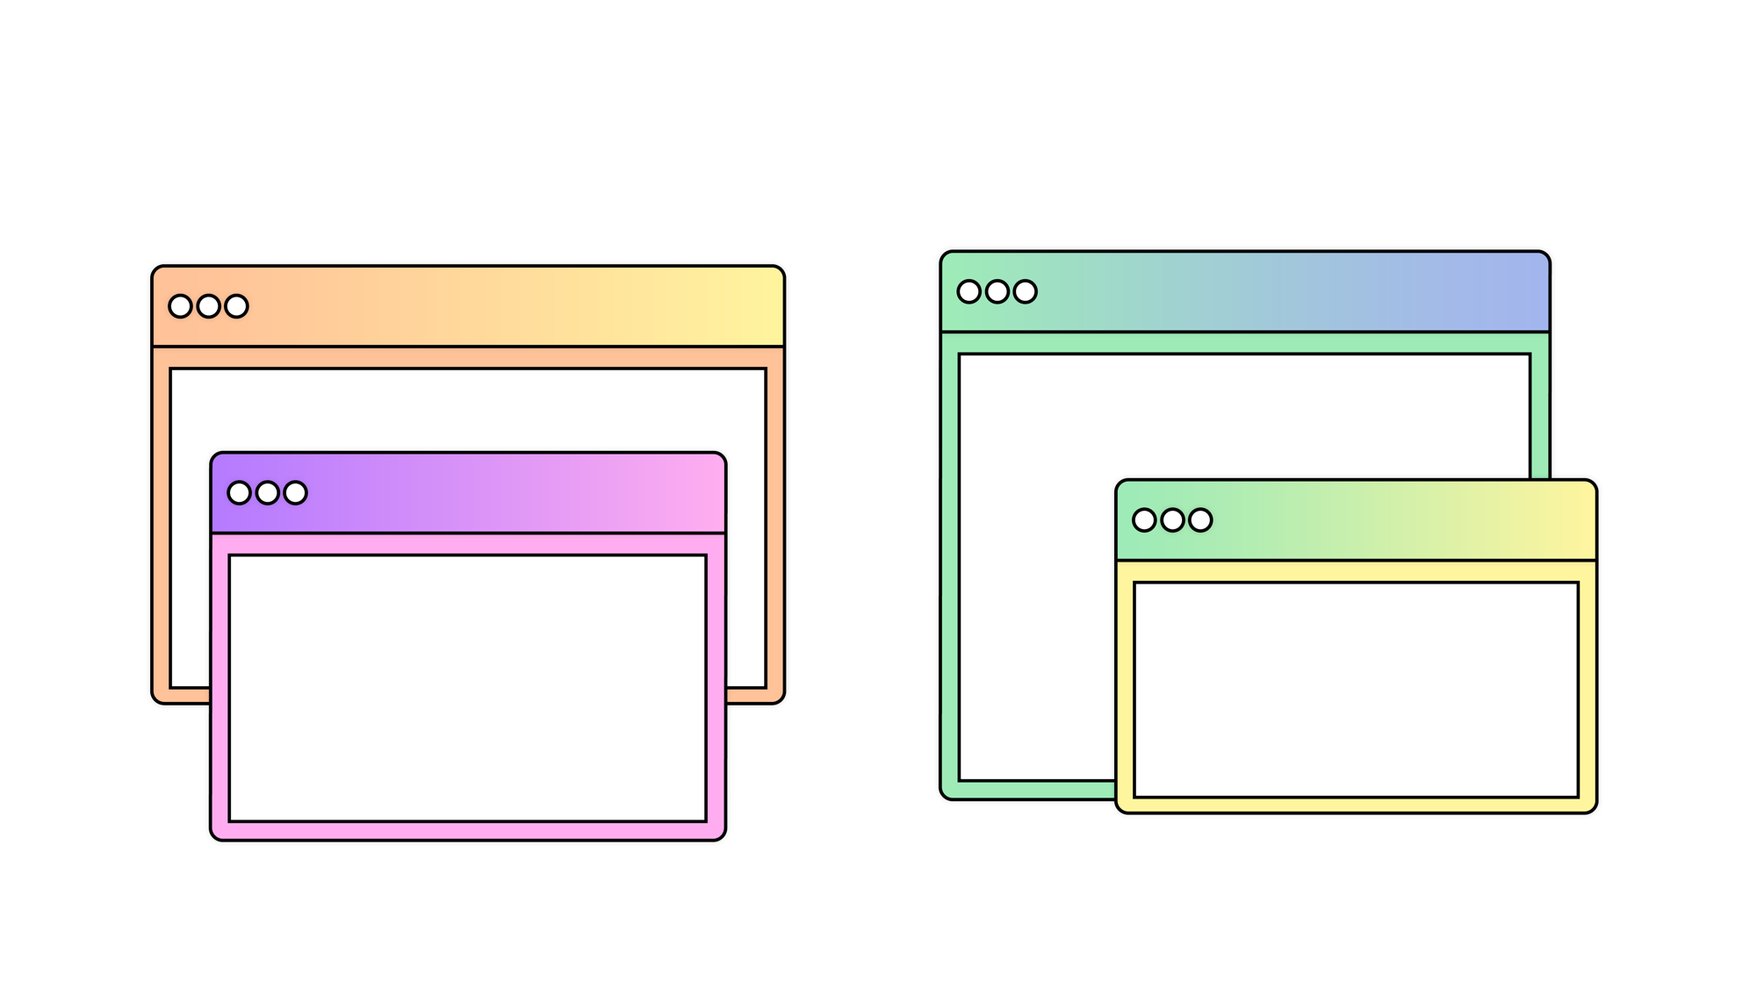

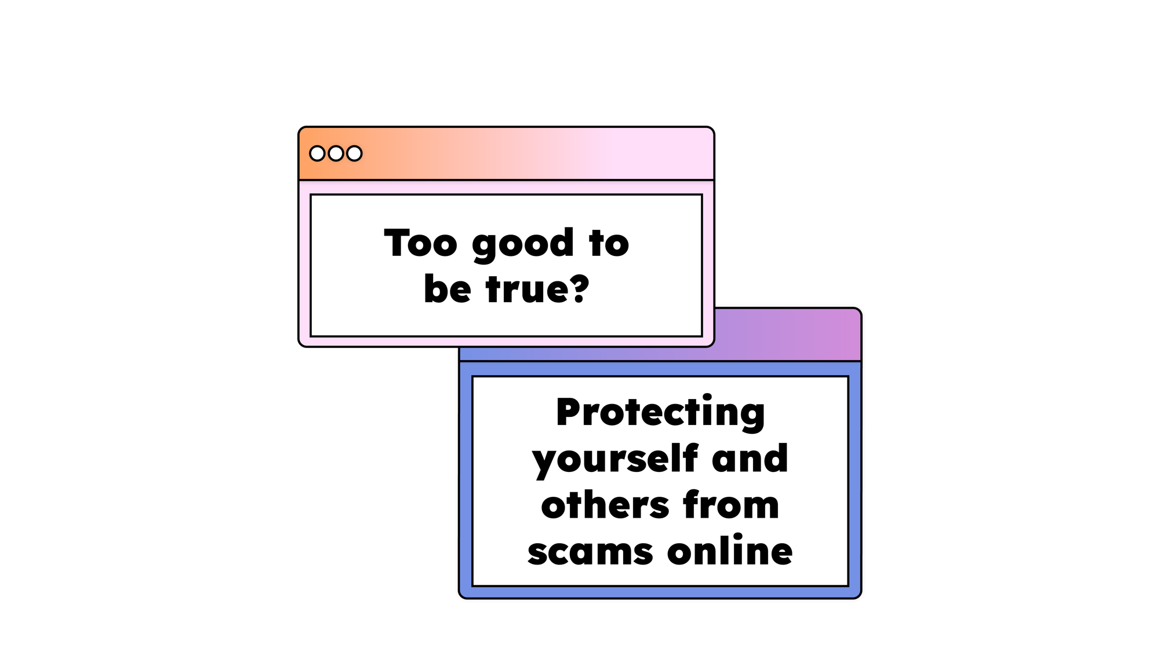

Slide 8




Slide 9
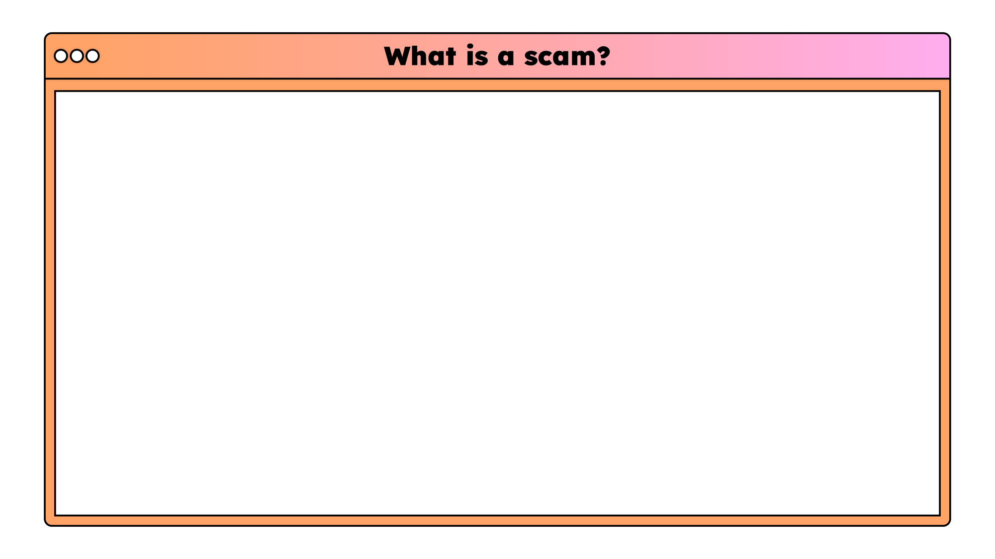

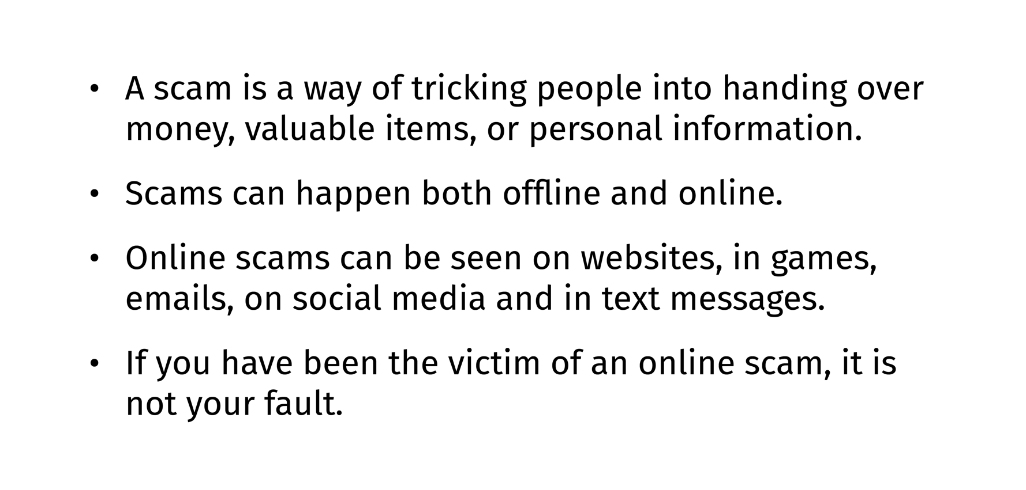

Slide 10

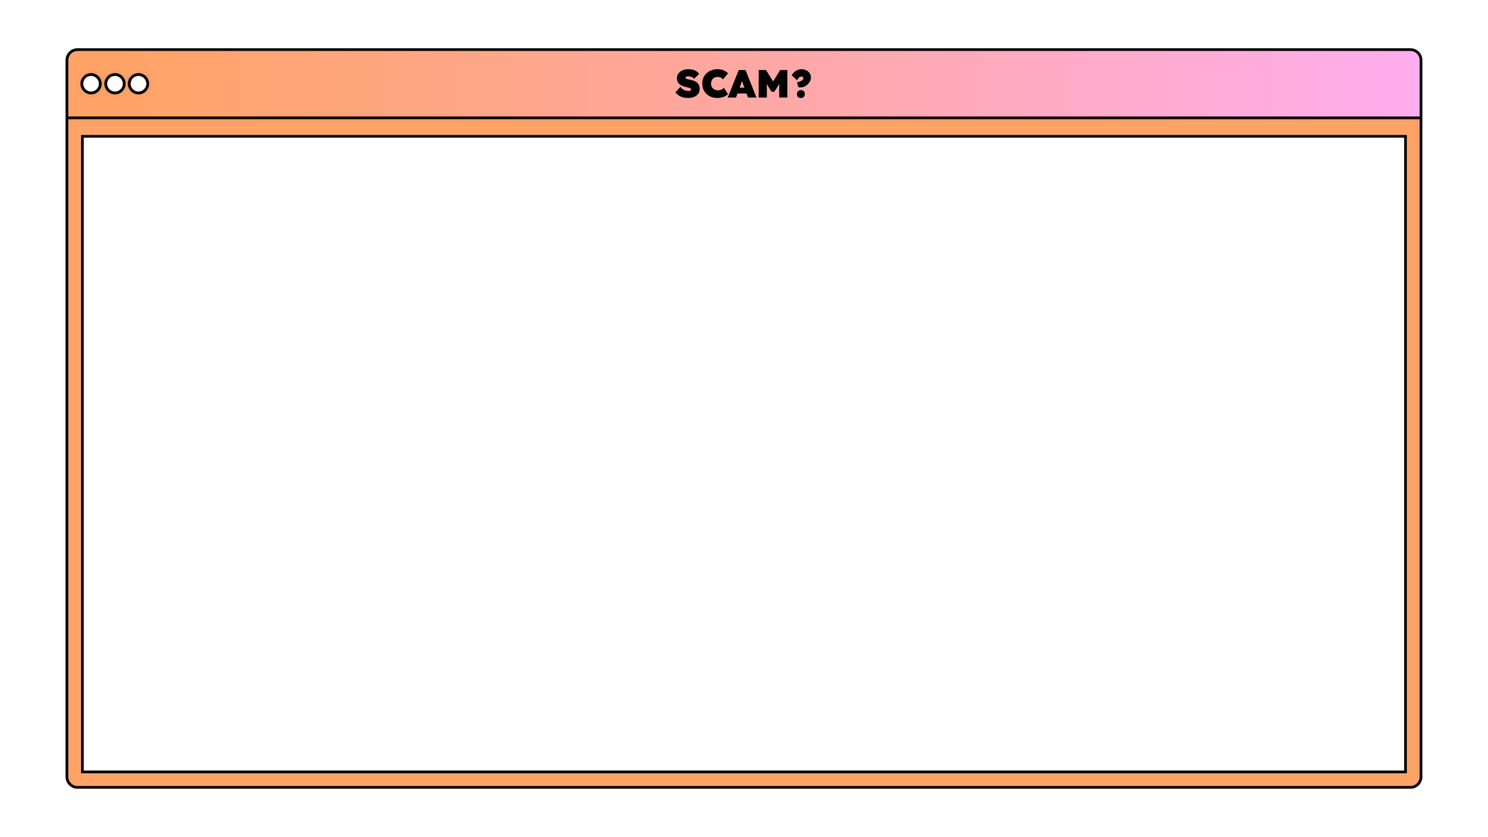




Slide 11

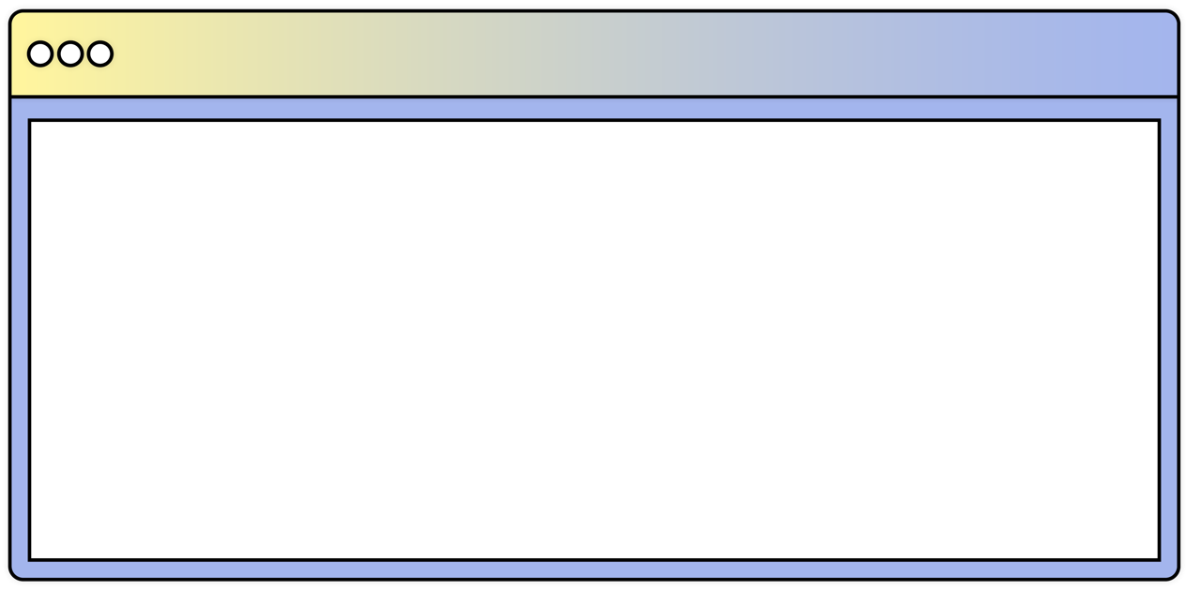


Slide 12



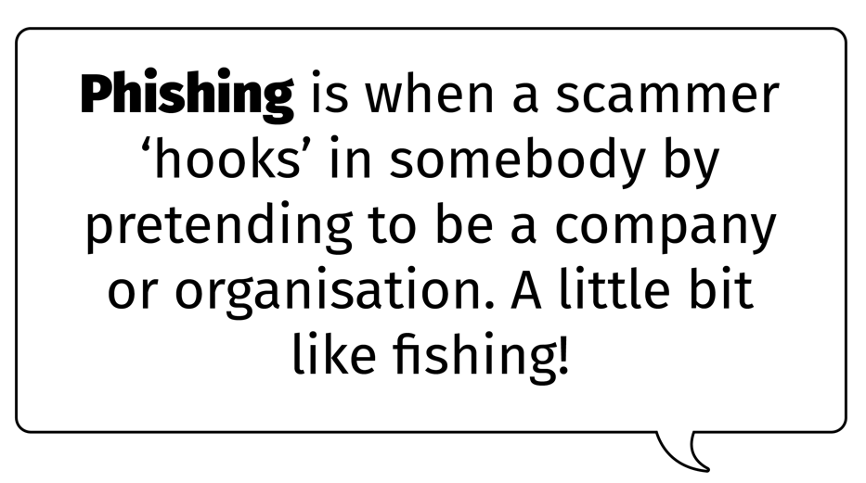



Slide 13

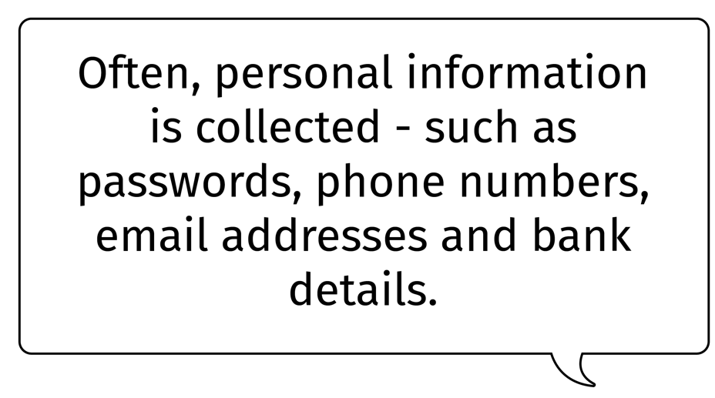





Slide 14




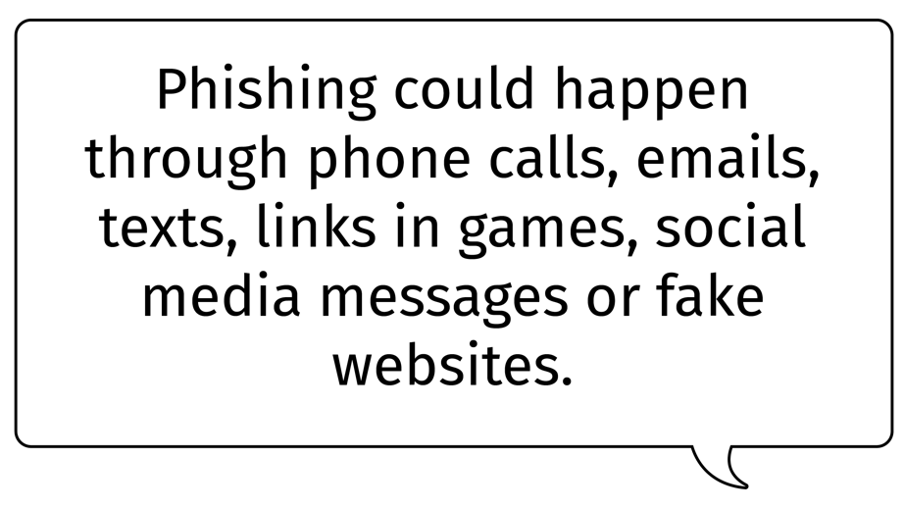


Slide 15



Slide 16
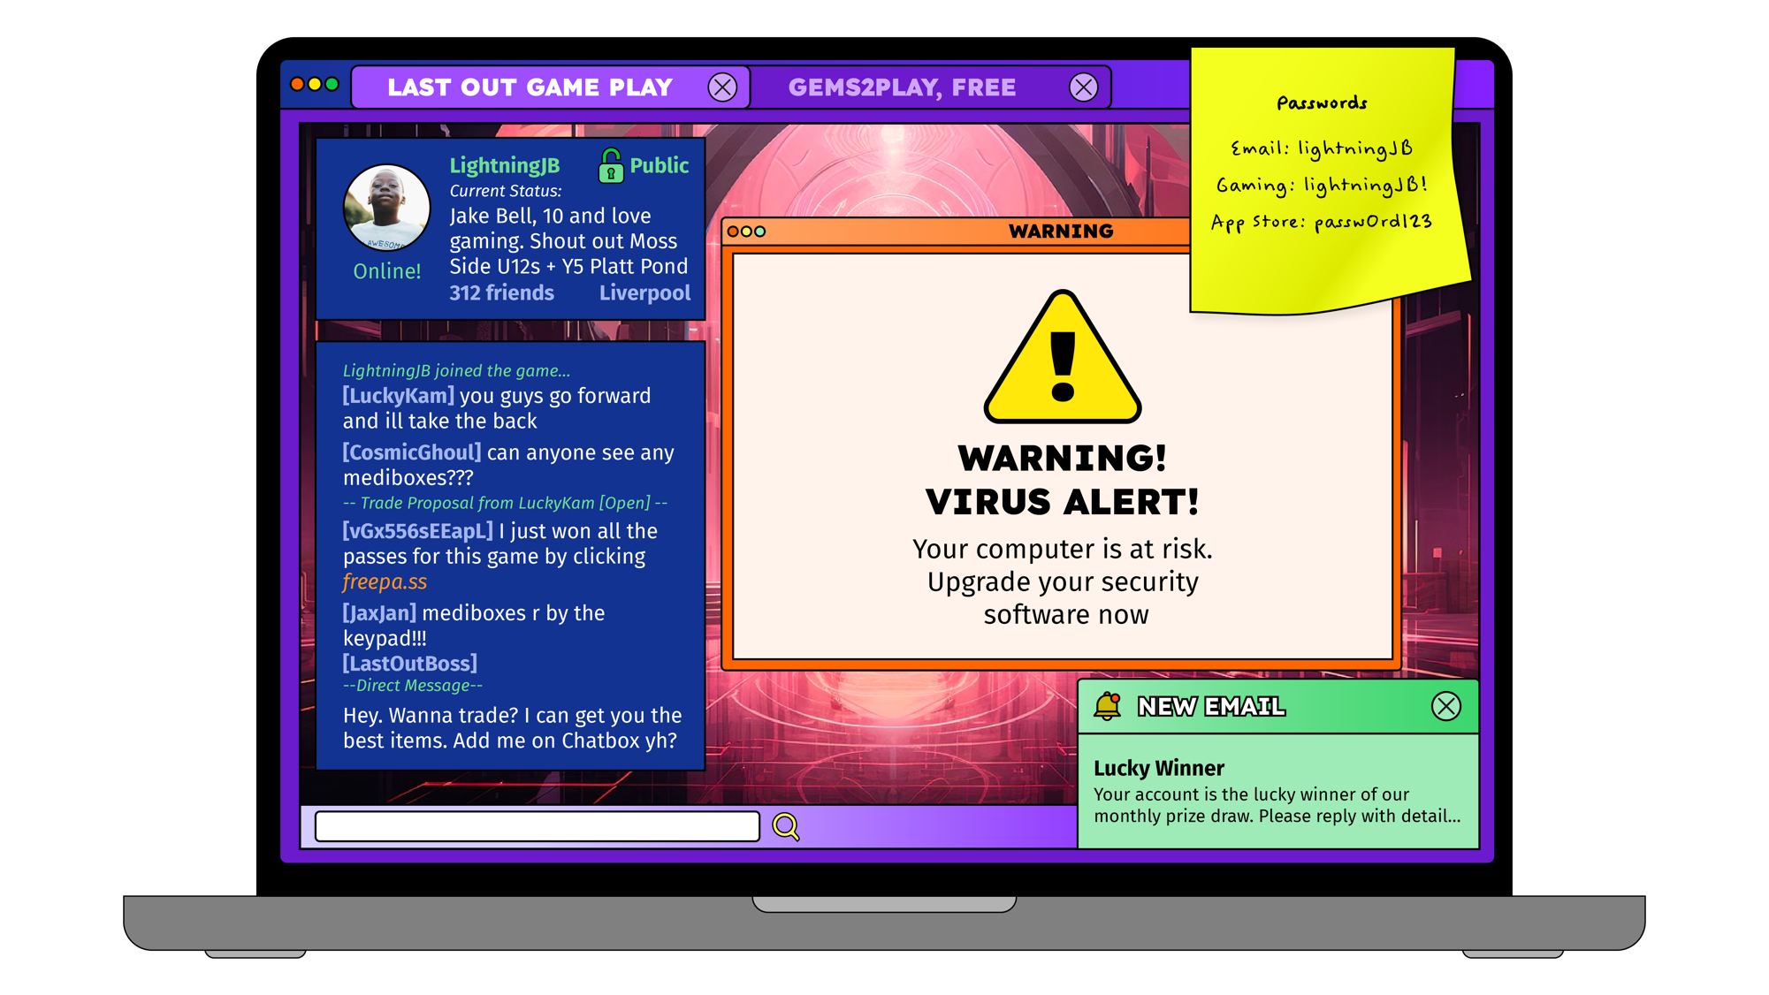



Slide 17
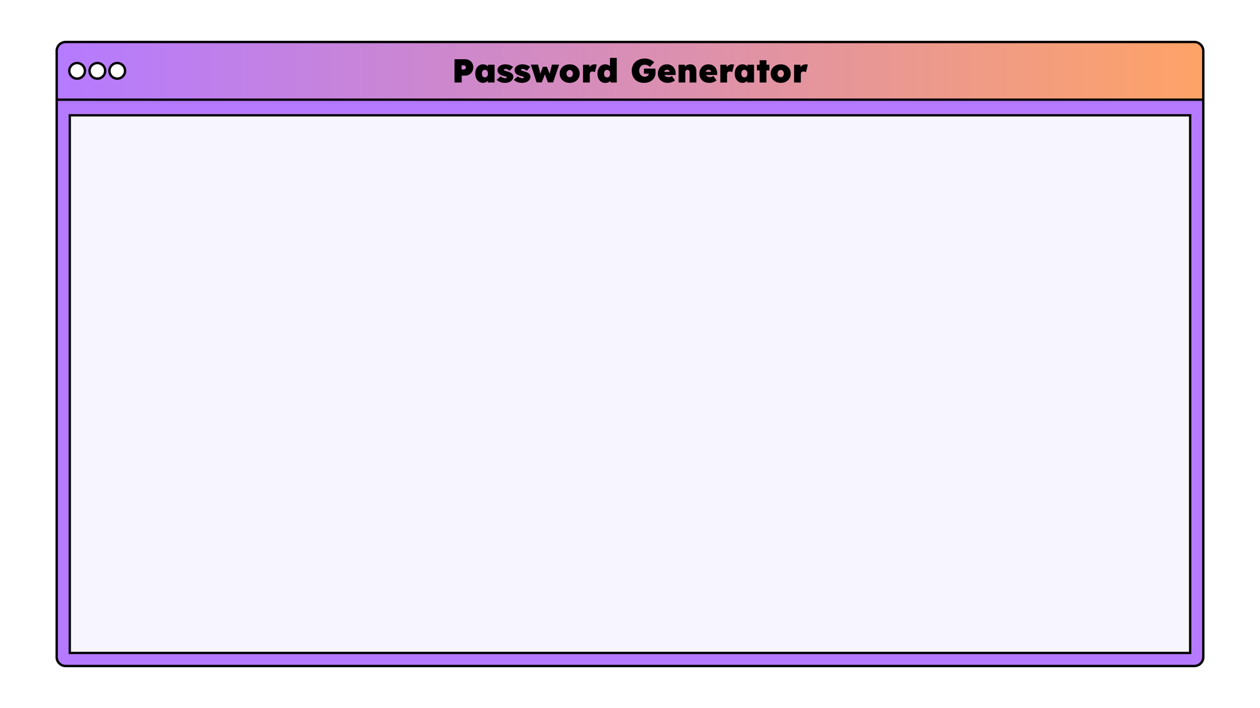

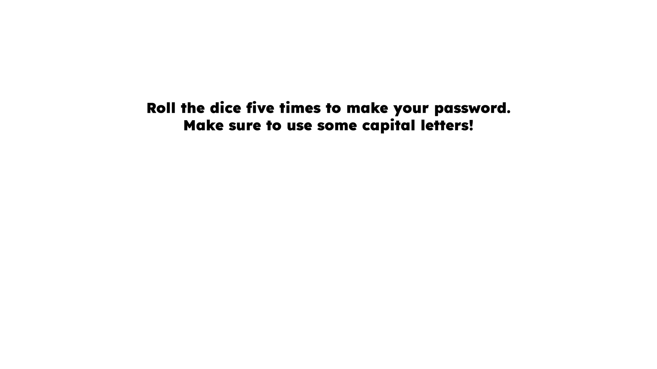
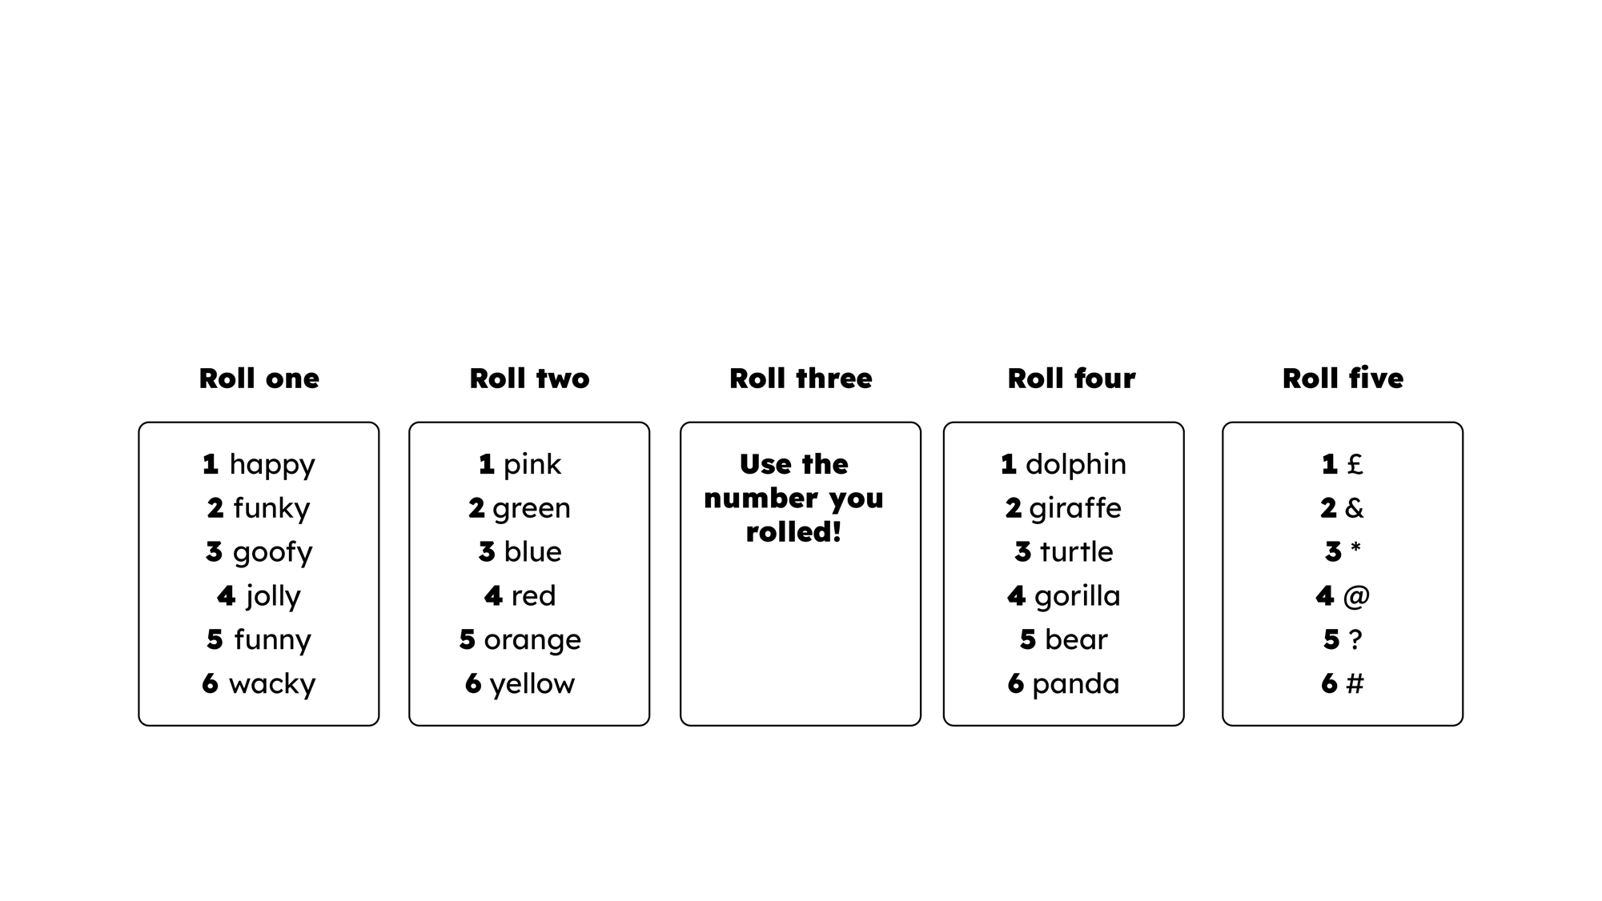

Slide 18

Window
Mirror
Door

Slide 19

Let us pray…

Slide 20
Window – We’ve looked out into the online world and seen how helpful it can be. We must keep ourselves safe like we do in real person.
Mirror – Have you ever seen something that doesn’t look right online? What would you do about it? How do I protect myself online?
Door – We can change passwords, install virus protection software, think about something before we do it, if we’re unsure then always ask a trusted adult

Slide 21
Protect yourself online – we would always protect ourselves in real life, so we need to do the same online too. There are a few different methods to do this such as locking devices, using secure Wi-Fi at home only, back up your information and change your passwords.

Slide 22
A prayer –
Dear God,
Please help us to recognise scams in our day-to-day lives. We are thankful for the internet and its many benefits but we remember its not always safe for us. We need to do all we can to keep ourselves and others safe. We pray this in your name,
Amen

