Slide 1


St Philips Primary School
Guide to Primary Assessment
Taken from James Pembroke - Insight

Slide 2

There are now five statutory assessment points across the primary phase, and one – key stage 1 – that is no longer statutory.

Slide 3
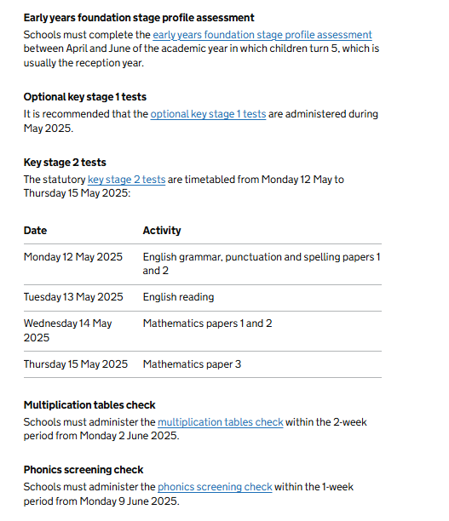

Slide 4
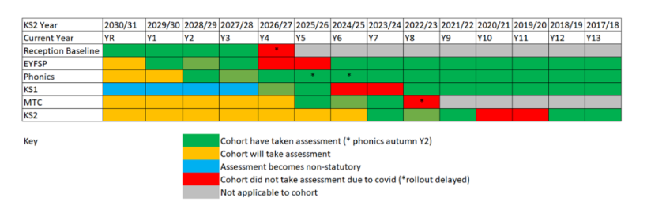
Table shows which assessments each year group has completed, which assessments were missed due to the pandemic, and which will be taken in the future. Insight..

Slide 5
The reception baseline assessment
Administered in the first half term of the reception year, when pupils are 4 or 5 years old.
Short, one-to-one assessment involving a series of tasks, which seek to evaluate a pupil’s literacy and numeracy skills.
Responses to each task are entered onto an online portal and stored by the department for education.
The main purpose of the assessment is to provide a baseline for the school’s key stage 2 (KS2) progress measures when pupils reach the end of year 6.
Each pupil’s KS2 test score will be compared to the national average KS2 test score of pupils with the same start point (i.E. The same rba score!)
The maximum rba score is 39. In our example, a pupil scores 22/39 in the rba. Seven years later, they sit the KS2 tests and in the reading test they attain a score of 98 (which means that they have not met the expected standard score of 100). We, however, are interested in how this pupil’s KS2 result (98) compares to other pupils with the same rba score. Let’s imagine that nationally, on average, pupils that scored 22/39 on the rba scored 93 in the KS2 reading test. 93 therefore becomes the progress benchmark for this particular group of pupils, and our example pupil has clearly exceeded that by 5 points. Their progress score is therefore +5. This is done for all pupils that have both an rba score and KS2 results.
Note that individual pupil progress scores are not published; they are averaged to calculate an overall progress score for the school cohort.

Slide 6
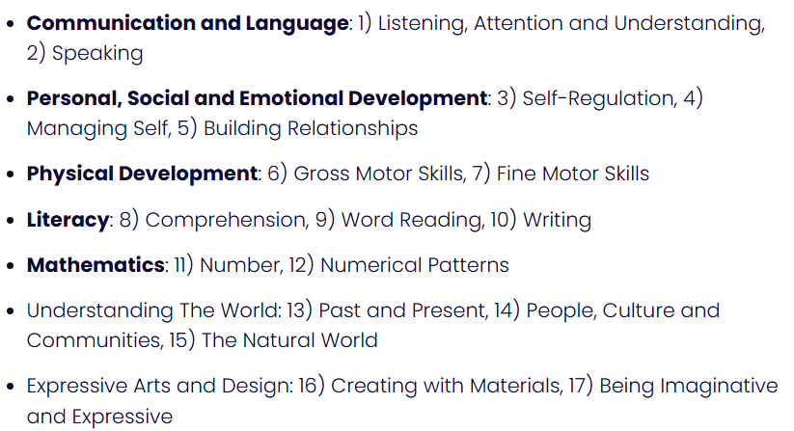
Early years foundation stage profile (EYFSP) assessment is made at the end of the reception year and marks the culmination of the early years’ phase of education.
It does not involve any tests; instead it is an observational assessment carried out in class, over time.
The EYFSP involves assessments made against 17 early learning goals grouped into 7 areas of learning as follows: in each of the 17 goals, pupils are assessed as either emerging or meeting the expected level of development. A key measure is reaching a good level of development, which is defined as reaching the expected level in each of the goals relating to the areas underlined above.
In each of the 17 goals, pupils are assessed as either emerging or meeting the expected level of development. A key measure is reaching a good level of development,

Slide 7
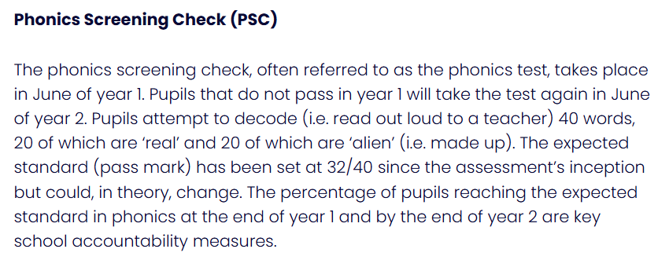
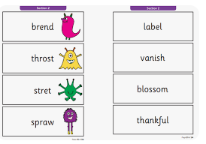

Slide 8
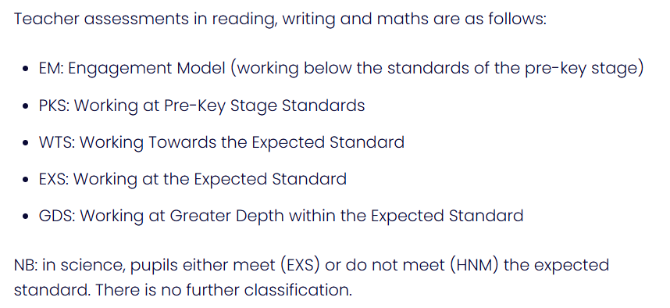
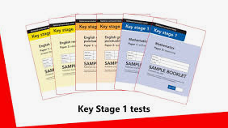

Slide 9
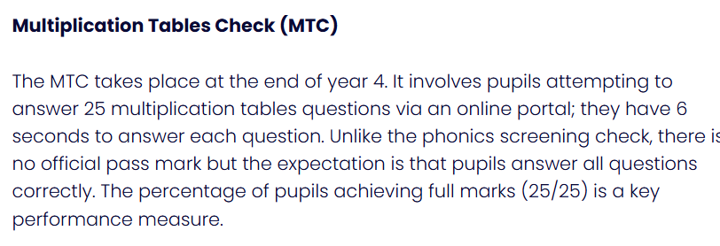
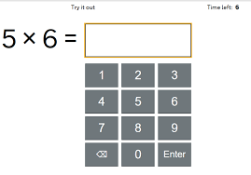

Slide 10


