Slide 1

Welcome to Year 4

Slide 2

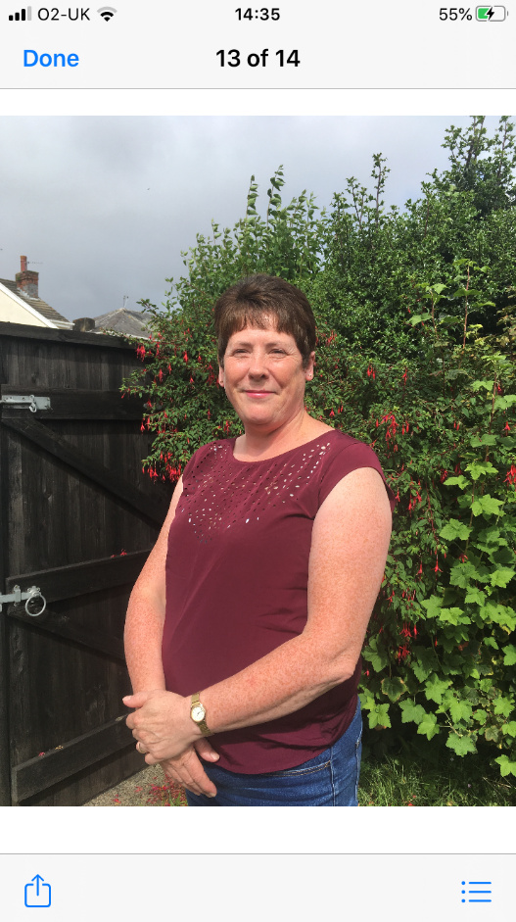
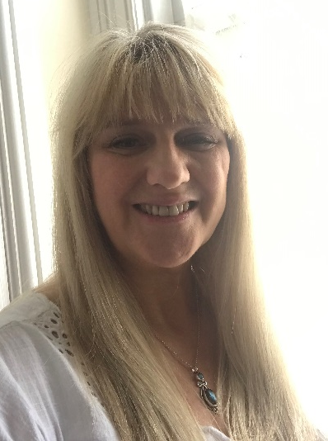
Meet the teachers
Miss Hankinson, Mrs Afford and Mrs Edwards
Emails: HankinsonE@sps.sefton.school affordj@sps.sefton.school

Slide 3

Our Christian Vision…
Happiness, love and security abound
Everyone is special
Every achievement is celebrated
Relationships and teamwork matter
A beacon of light in the community
Christ in Everything we Do!

Slide 4
St Philip’s Standards
Be ready
Be Respectful
Be Responsible
Fantastic Walking

Slide 5
Homework
Homework will be given out on a Friday, due in on the following Wednesday (to enable time for marking). Spellings will be tested on a Friday and we will continue with our weekly Maths Key Skills tests and daily class reading and/or IDL sessions before lunch.

Slide 6


REWARDS AND SANCTIONS
Good to be Green
Privilege cards
Class Dojos /dojo of the week
You’ve Been Spotted- our values
Star of The Week
Awesome Attitude Award (Y4)
Verbal warning
Warning Card - recorded
Red Card –parents informed

Slide 7
ST PHILIP’S CE PRIMARY SUPPORT TRIANGLE
SENDCO - Mrs Klaassen
SEN Support
Targeted Support
Enhanced Quality First
Quality First – Universal Offer for all
High Needs Funding
EHCP’s
Specialist

Slide 8
Covid and attendance…
Attendance at school is mandatory for all children unless they are sick or have and appointment.
The usual rules on absence continue to apply. Well children are expected to attend daily, arrive on time and have the things that they need. Reading books should be brought to school daily Limit the amount of things brought into school please.
Parents have a vital role to play in deciding when to keep a child off school but we appreciate that this is now complicated by the current situation. Children have already missed so much time in school so I would urge you to send them to school wherever possible.
It’s a difficult judgement call but if in the past you would have sent your child to school with a runny nose, slight tummy pain, minor headache or just a bit under the weather it is still probably ok, if you feel they can manage the day to send them in. We will always contact you if we have concerns about your child. Each case is different so feel free to speak to Mrs Edward.
First Response
If your child is absent you must contact the school office by telephone or email to report your child's absence giving clear details of the reason for absence. Failure to do so means that our First Response kicks in and if we cannot get hold of you and we are unable to make contact with you via your emergency contact details, it might be necessary for a senior leader to come to your house!!!!! This is part of our safeguarding response to ensure everyone is safe and well. As you can imagine, a home visit takes up a lot of time and it is usually the case that families have forgotten to call us. I’m sure you don’t want us on your doorstep so please remember to give us a call. Thank you
Some Covid reminders
Symptoms are Fever above 37.8, persistent cough, shortness of breath, loss of taste or smell
To Book at test call 119. If you or your child are awaiting a test result do not come to school and do not come to the playground even if you are symptom free.
See our Covid Pages of the website for additional guidance.

Slide 9
Any concerns….
If you have any concerns or need to give us any information regarding your child, or a change in circumstances you want us to know about, please email either or both of us
Mrs. Afford afford@sps.sefton.school
Miss Hankinson hankinsone@sps.sefton.school

