Slide 2



Diving into Mastery Guidance for Educators
Each activity sheet is split into three sections, diving, deeper and deepest, which are represented by the following icons:
These carefully designed activities take your children through a learning journey, initially ensuring they are fluent with the key concept being taught; then applying this to a range of reasoning and problem-solving activities.
These sheets might not necessarily be used in a linear way. Some children might begin at the ‘Deeper’ section and in fact, others may ‘dive straight in’ to the ‘Deepest’ section if they have already mastered the skill and are applying this to show their depth of understanding.
Diving
Deeper
Deepest

Slide 3
Aim
Recognise, find and write fractions of a discrete set of objects: unit fractions and non-unit fractions with small denominators.

Slide 4
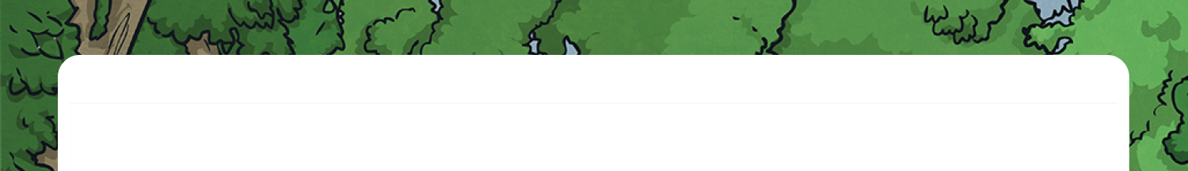





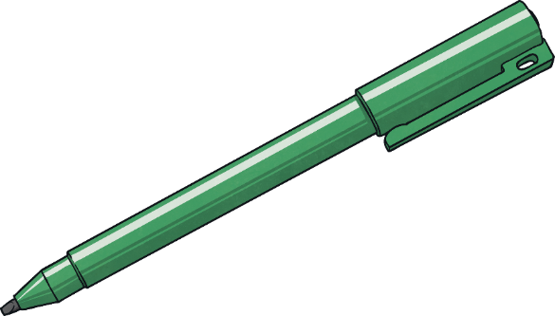
What Is a Fraction?
Diving
Have these shapes been split into fractions?
Yes, these are fractions. The four smaller triangles are identical.
No, these are not fractions because each part is not the same size.
Yes, these are fractions as the two halves are the same size.
No, these are not fractions as the sections are different sizes.

Slide 5
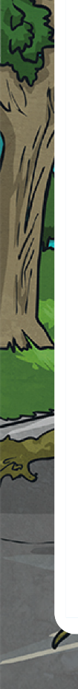



What Is a Fraction?
Diving
Complete the table.
Words | Fraction | Shape | Number Line | Quantity
three quarters
3
4
0
1
2
3
1
4
4
4
1
half
2
0
1
1
2

Slide 6
What Is a Fraction?
Diving
Look at the images and decide if each one is a unit fraction or a non-unit fraction.
Words | Fraction | Shape | Number Line | Quantity
three quarters
 | Unit Fraction | Non-Unit Fraction
3
4
✓
0
1
2
3
1
4
4
4
✓
3
half
4
✓
0
1
1
2

