Slide 2
Aim
Find the area of rectilinear shapes by counting squares.

Slide 3

Counting Squares
Diving
Match each shape to the correct area.
The area of this shape
is 6 squares.
The area of this shape
is 7 squares.

Slide 4

Counting Squares
Diving
Complete the table.
Shape | Description | Calculation
3
There are squares in each row.
There are rows altogether.
rows of squares equals squares.
3
×
5
=
15
5
or
5
3
5
×
3
=
15
15

Slide 5
Counting Squares
Diving
Count the squares of each colour and add them to find the area of the mosaic.
Blue = squares
Red = squares
White = squares
45
31
14
45
+
31
+
14
=
90
squares
Write a calculation to find the area of the mosaic.
10 × 9 = 90 squares

Slide 6
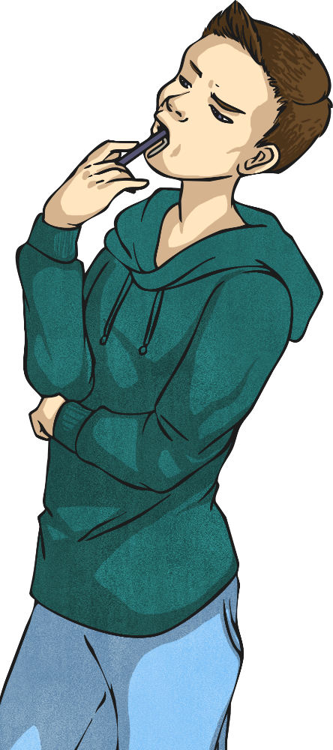
Counting Squares
Deeper
Do you agree or disagree with Tom? Explain your answer.
The area of this shape is 16 squares.
Disagree. There are 3 rows of 4 squares, which makes 12 altogether. The area of this shape is 12 squares.

Slide 7


Counting Squares
Deeper
Three children have each calculated the area of this rectilinear shape.
Who is right and who is wrong?
Explain how you know.
Tick or
Cross
Child
Calculation
How Do You Know?
Kai | 3 × 5 = 15 15 − 1 = 14
Ellie | 3 + 3 + 2 + 3 + 3 = 14
Alex | 5 × 3 = 15
Kai has written a multiplication calculation to find the area and then subtracted the missing square.
Ellie has added each column up correctly, but it is not the best method to use. It would be quicker and easier to use Kai’s method.
Alex has missed a step. He has multiplied, but has forgotten to subtract the missing square.

Slide 8

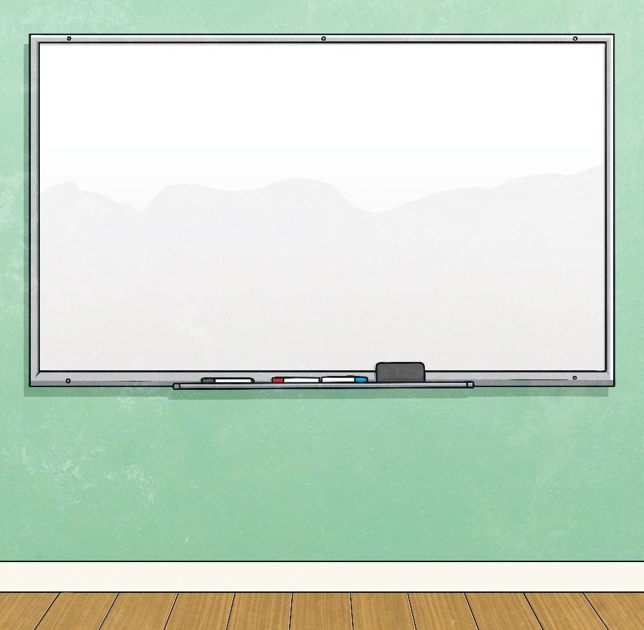
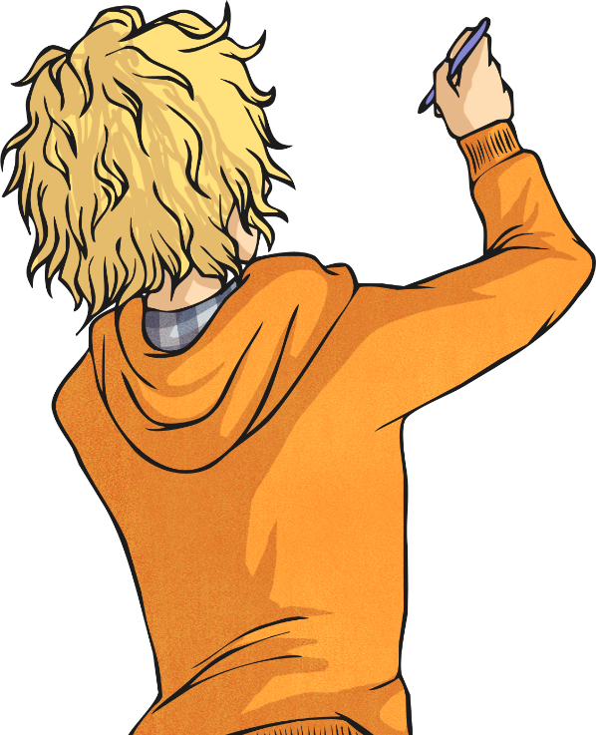
Counting Squares
Deepest
Logan has drawn three rectilinear shapes with a total area of 8 squares.
Here is one example he has drawn. Finish off his calculations.
1 square
Shape B
Area of shape A =
Area of shape B =
Area of shape C =
Shape C
4 squares
Shape A
3 squares
Total area =
1 + 4 + 3 = 8 squares

Slide 9
Counting Squares
Deepest
Sonia has also been drawing three rectilinear shapes with a total area of 8 squares. She has drawn a different shape A and shape B.
How many different ways could she draw shape C?
Shape B
Shape A
Examples of shapes
Shape C must contain 4 squares to make 8 in total. Here are the different shapes Sonia could have drawn.
Were any of your shapes the same but a different way round?

Slide 10
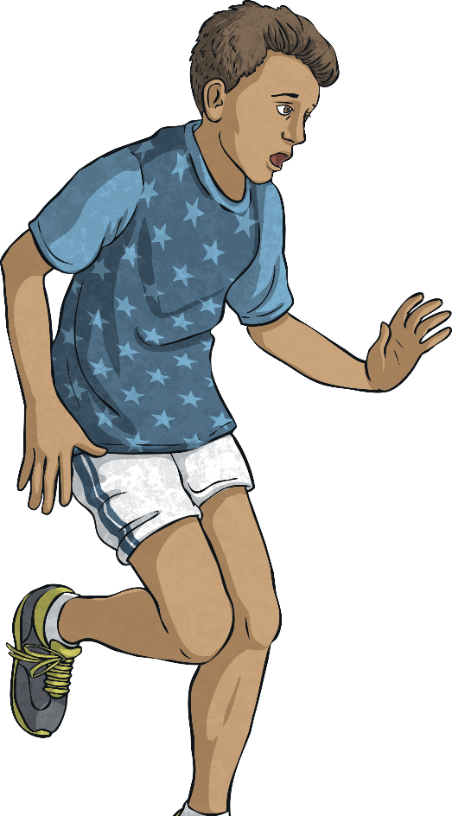
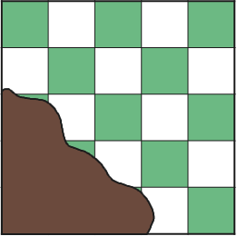

Counting Squares
Deepest
Omar has spilt coffee over his new tablecloth.
How many squares are on the tablecloth altogether?
The tablecloth has 5 rows with 5 squares in each row.
5 × 5 = 25 squares

Slide 11
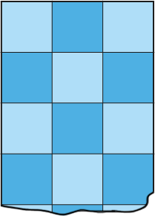

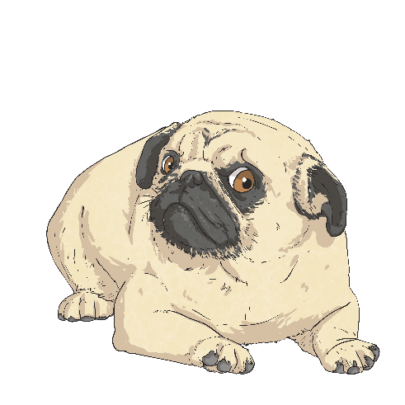
Counting Squares
Deepest
Sadie’s dog has torn off the bottom of her checked curtain.
What is the smallest possible area of the whole curtain?
5 × 3 = 15 squares
What is the largest possible area of the whole curtain if its original length was 7 squares?
3 × 7 = 21 squares

Slide 12


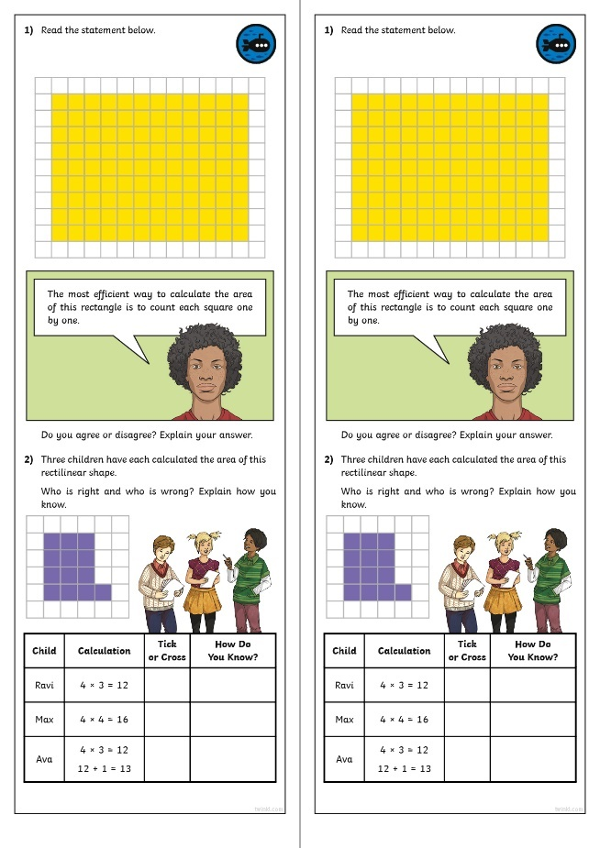
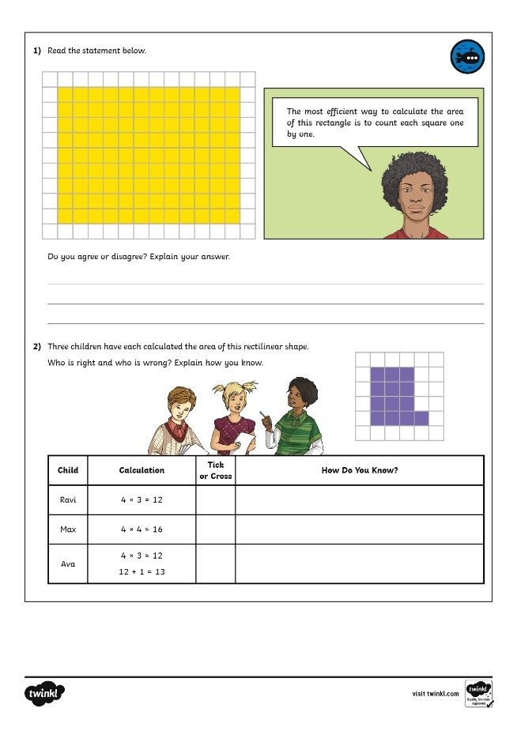
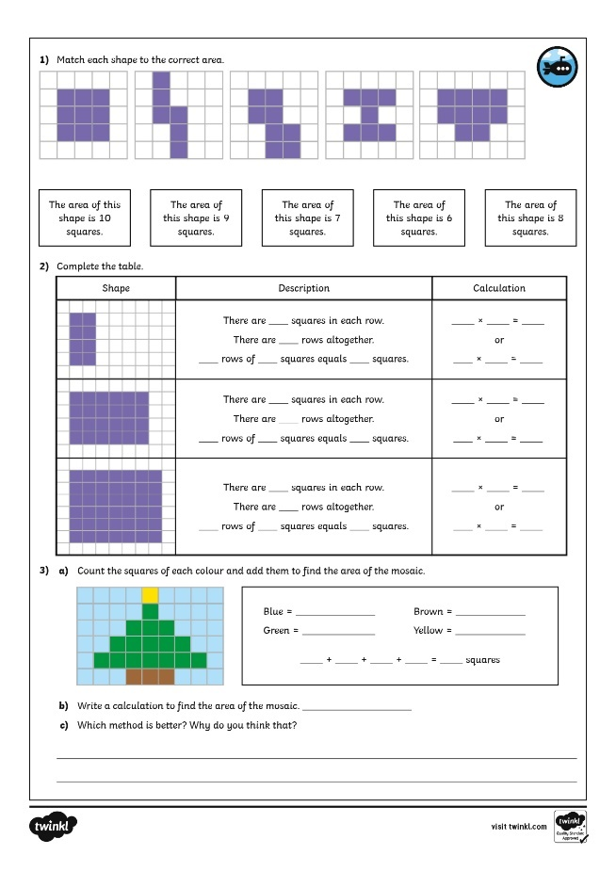
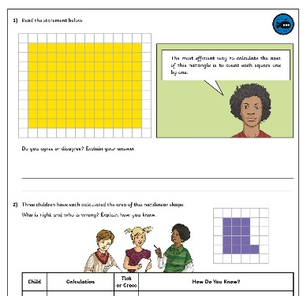
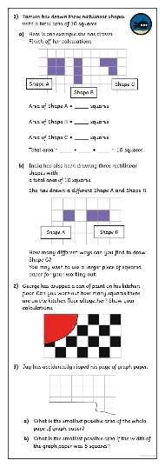
Counting Squares
Dive in by completing your own activity!

