Slide 1


Year 4 – Summer Block 1 – Decimals
Step 1: Make a Whole
© Classroom Secrets Limited 2018

Slide 2
Varied Fluency 1
Find the missing number in each bar model.
0.4
1
0.75
1
0.59
2
© Classroom Secrets Limited 2018

Slide 3
Varied Fluency 1
Find the missing number in each bar model.
0.4 | 0.6
1
0.75 | 0.25
1
0.59 | 1.41
2
© Classroom Secrets Limited 2018

Slide 4
Varied Fluency 2
Write statements to describe the hundred square.
© Classroom Secrets Limited 2018

Slide 5
Varied Fluency 2
Write statements to describe the hundred square.
0.43 + 0.57 = 1
0.57 + 0.43 = 1
1 – 0.43 = 0.57
1 – 0.57 = 0.43
© Classroom Secrets Limited 2018

Slide 6
Varied Fluency 3
You have 2 tenths and 3 hundredths.
Draw a bar model to find how many more hundredths you need to make one whole.
© Classroom Secrets Limited 2018

Slide 7
Varied Fluency 3
You have 2 tenths and 3 hundredths.
Draw a bar model to find how many more hundredths you need to make one whole.
You need 77 more hundredths to make one whole.
0.23 | 0.77
1
© Classroom Secrets Limited 2018

Slide 8
Varied Fluency 4
Each cube is worth one hundredth.
How many more cubes do you need to make one whole?
© Classroom Secrets Limited 2018

Slide 9
Varied Fluency 4
Each cube is worth one hundredth.
How many more cubes do you need to make one whole?
You need 67 more cubes.
© Classroom Secrets Limited 2018

Slide 10
Varied Fluency 5
True or false?
2 tenths and 5 hundredths and 8 tenths and 5 hundredths make one whole.
© Classroom Secrets Limited 2018

Slide 11
Varied Fluency 5
True or false?
2 tenths and 5 hundredths and 8 tenths and 5 hundredths make one whole.
False, it makes one whole and one tenth.
© Classroom Secrets Limited 2018

Slide 12
Problem Solving 1
Complete the calculation below.
How many different solutions can you find?
0.3◻ + 0.6◻ = 1
© Classroom Secrets Limited 2018

Slide 13
Problem Solving 1
Complete the calculation below.
How many different solutions can you find?
0.3◻ + 0.6◻ = 1
0.31 + 0.69 = 1, 0.32 + 0.68 = 1, 0.33 + 0.67 = 1
0.34 + 0.66 = 1, 0.35 + 0.65 = 1, 0.36 + 0.64 = 1
0.37 + 0.63 = 1, 0.38 + 0.62 = 1, 0.39 + 0.61 = 1
© Classroom Secrets Limited 2018

Slide 14
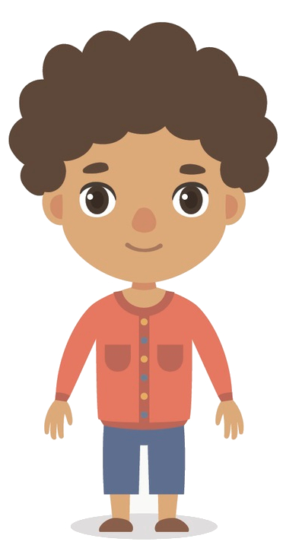
Reasoning 1
Toby says:
Is he correct? Explain why or why not.
If I have 0.24, I need to add on 0.86 to make a whole.
© Classroom Secrets Limited 2018

Slide 15
Reasoning 1
Toby says:
Is he correct? Explain why or why not.
Toby is not correct because…
If I have 0.24, I need to add on 0.86 to make a whole.
© Classroom Secrets Limited 2018

Slide 16
Reasoning 1
Toby says:
Is he correct? Explain why or why not.
Toby is not correct because 0.24 + 0.86 = 1 whole and 1 tenth. He needs to add 0.76 instead.
If I have 0.24, I need to add on 0.86 to make a whole.
© Classroom Secrets Limited 2018

