Slide 1


Year 4 – Summer Block 1 – Decimals
Step 3: Compare Decimals
© Classroom Secrets Limited 2018

Slide 2
Introduction
Find 6 complements of 1 on the grid below.
0.7 | 0.4 | 0.6 | 0.11 | 0.08
0.59 | 0.1 | 0.22 | 0.73 | 0.27
0.55 | 0.1 | 0.8 | 0.98 | 0.5
0.45 | 0.09 | 0.1 | 0.2 | 0.64
0.44 | 0.9 | 0.23 | 0.7 | 0.36
© Classroom Secrets Limited 2018

Slide 3
Introduction
Find 6 complements of 1 on the grid below.
0.7 | 0.4 | 0.6 | 0.11 | 0.08
0.59 | 0.1 | 0.22 | 0.73 | 0.27
0.55 | 0.1 | 0.8 | 0.98 | 0.5
0.45 | 0.09 | 0.1 | 0.2 | 0.64
0.44 | 0.9 | 0.23 | 0.7 | 0.36
© Classroom Secrets Limited 2018

Slide 4
Varied Fluency 1
Write down and compare these decimal numbers using >, < or =.
0.01
0.01
0.01
0.1
0.01
0.1
0.01
1
0.1
0.1
0.01
1
1
© Classroom Secrets Limited 2018

Slide 5
Varied Fluency 1
Write down and compare these decimal numbers using >, < or =.
0.01
0.01
0.01
0.1
>
0.1
0.01
0.01
1
0.1
0.1
0.01
1
1
2.23
1.23
© Classroom Secrets Limited 2018

Slide 6
Varied Fluency 2
Use >, < or = to compare these decimal numbers.
1 | 0.1 | 0.01
1 | 0.1 | 0.01
© Classroom Secrets Limited 2018

Slide 7
Varied Fluency 2
Use >, < or = to compare these decimal numbers.
1 | 0.1 | 0.01
1 | 0.1 | 0.01
<
2.34
3.05
© Classroom Secrets Limited 2018

Slide 8
Varied Fluency 3
Use > or < to compare these decimal numbers.
5.63 |  | 5.36
1.04 |  | 1.4
7.8 |  | 7.79
© Classroom Secrets Limited 2018

Slide 9
Varied Fluency 3
Use > or < to compare these decimal numbers.
5.63 | > | 5.36
1.04 | < | 1.4
7.8 | > | 7.79
© Classroom Secrets Limited 2018

Slide 10
Varied Fluency 4
Using digits from 1 to 9, make these statements correct.
0.54 > 0.5
0.1 < 0.18
0.72 = 0. 2
© Classroom Secrets Limited 2018

Slide 11
Varied Fluency 4
Using digits from 1 to 9, make these statements correct.
Various possible answers, for example:
3
0.54 > 0.5
0.1 < 0.18
0.72 = 0. 2
7
7
© Classroom Secrets Limited 2018

Slide 12
Problem Solving 2
Use >, < and = to compare the partitioned decimal numbers.
0.6 + 0.02 0.3 + 0.3
0.04 + 0.05 0.4 + 0.05
© Classroom Secrets Limited 2018

Slide 13
Problem Solving 2
Use >, < and = to compare the partitioned decimal numbers.
0.6 + 0.02 0.3 + 0.3
0.04 + 0.05 0.4 + 0.05
>
<
© Classroom Secrets Limited 2018

Slide 14
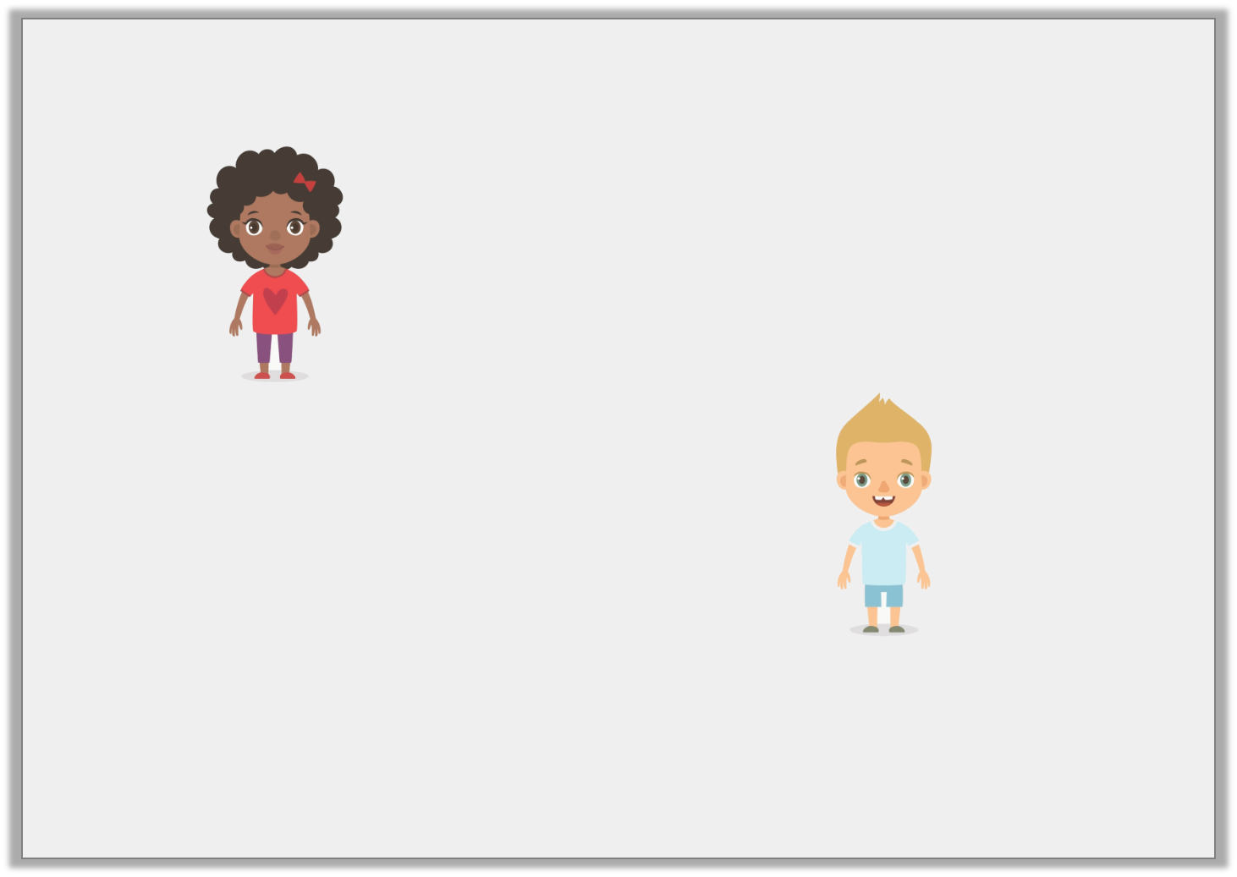
Reasoning 1
Agatha says:
Oscar says:
Who is correct? Explain why.
I have made the longest train track because it is 1.2m long.
I have made the longest train track because it is 0.21m long.
© Classroom Secrets Limited 2018

Slide 15
Reasoning 1
Agatha says:
Oscar says:
Who is correct? Explain why.
Agatha is correct because…
I have made the longest train track because it is 1.2m long.
I have made the longest train track because it is 0.21m long.
© Classroom Secrets Limited 2018

Slide 16
Reasoning 1
Agatha says:
Oscar says:
Who is correct? Explain why.
Agatha is correct because 1.2m is longer than 0.21m.
I have made the longest train track because it is 1.2m long.
I have made the longest train track because it is 0.21m long.
© Classroom Secrets Limited 2018

