Slide 2
Learning objective
To compare numbers with the same number of decimal places up to two decimal places.

Slide 3

Order Decimals
Diving
Write the numbers shown on the place value grid and put them in ascending order.
Ones | tenths | hundredths
1.05
Ones | tenths | hundredths
2.11
Ones | tenths | hundredths
1.12
In ascending order:
1.05
1.12
2.11

Slide 4

Order Decimals
Diving
Write the numbers in descending order:
6.3
34.6
3.04
In descending order:
34.6
6.3
3.04
Write the missing digits to make each statement correct:
9.22 > 8.17 > 8.13
2.71 < 3.29 < 4.03
4.18 > 4.09 > 4.03
There are many possible answers. For example:

Slide 5

Order Decimals
Deeper
In each set of numbers, one is in the wrong place. Spot this number and tell your partner where it should be.
In ascending order:
5.03
5.7
6.98
6.3
7.2
In descending order:
8.65
8.42
8.4
7.2
7.5

Slide 6

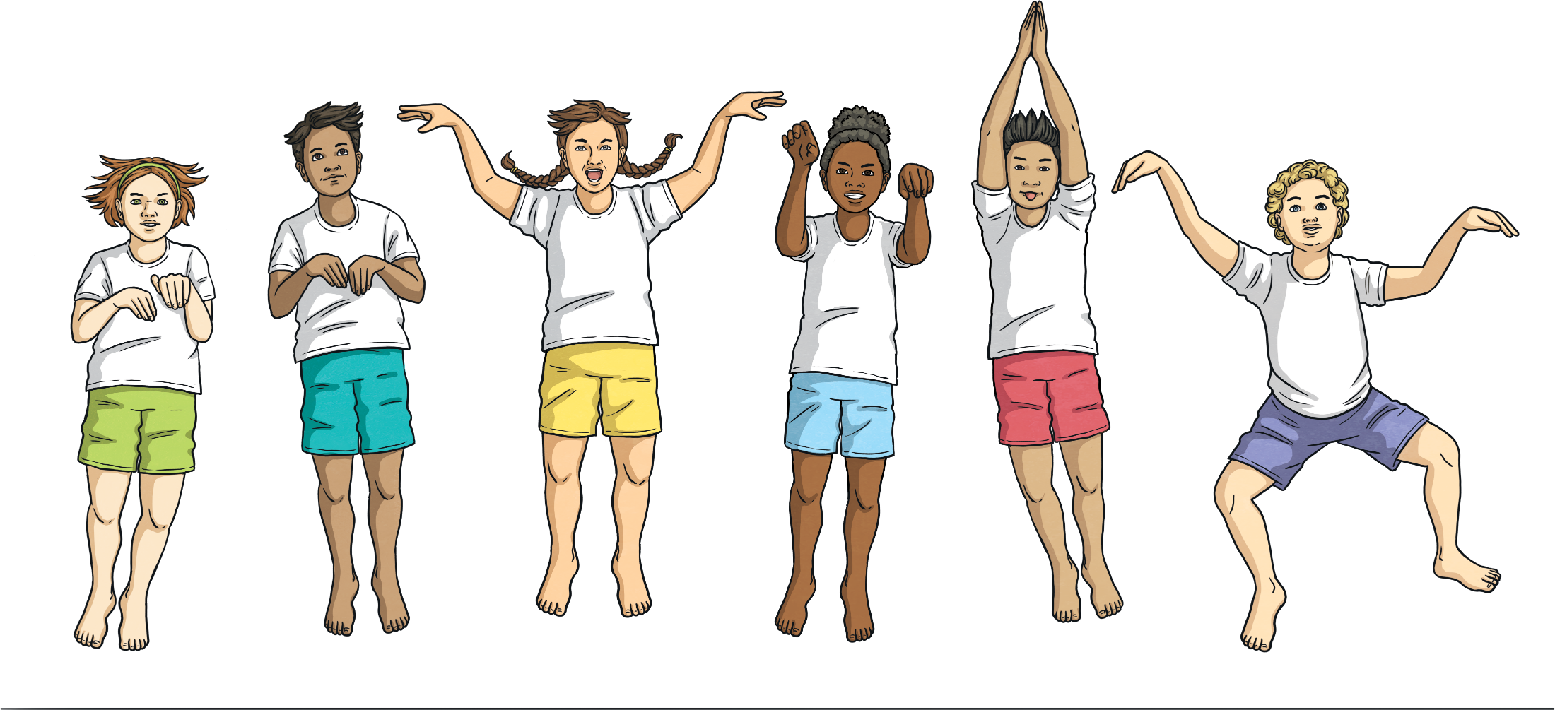
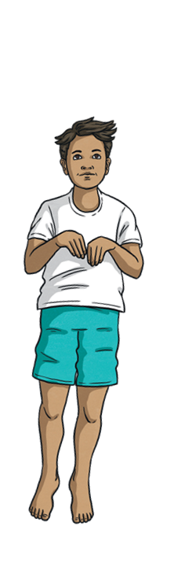
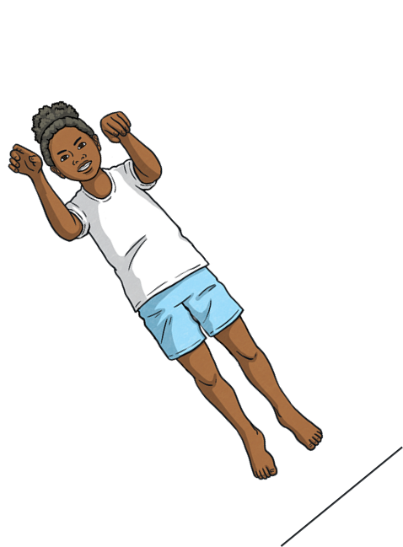

Order Decimals
Deepest
A group of children measured how far they could jump from a standing start. This table shows the distance they jumped:
Names | Distance
Bess | 2.45m
Kyle | 1.8m
Heena | 167cm
Kris | 1.05m
Betsy | 2.2m
Order the children in ascending order of the distance they jumped.
Kris
Heena
Kyle
Betsy
Bess

Slide 7

Order Decimals
Deepest
Using only the digits below, write four different numbers with one or two decimal places. Then, put them in ascending order.
1
2
3
3
3
4
4
5
6
6
7
There are many different answers.
Here is one solution:
2.76
3.4
5.33
6.14

