Slide 1


Year 4 – Summer Block 1 – Decimals
Step 5: Round Decimals
© Classroom Secrets Limited 2019

Slide 2
Introduction
Complete the missing numbers on the number line.
 |  |  | 1.8 |  | 2.0
© Classroom Secrets Limited 2019

Slide 3
Introduction
Complete the missing numbers on the number line.
1.5 | 1.6 | 1.7 | 1.8 | 1.9 | 2.0 | 2.1 | 2.2 | 2.3 | 2.4
© Classroom Secrets Limited 2019

Slide 4
Varied Fluency 1
Which of these decimals is closest to 1?
Which of these decimals is closest to 2?
1.2 | 1.7 | 1.6 | 1.4 | 1.3
1 |  |  |  |  | 1.5 |  |  |  |  | 2
© Classroom Secrets Limited 2019

Slide 5
Varied Fluency 1
Which of these decimals is closest to 1?
Which of these decimals is closest to 2?
1.2 is closest to 1
1.7 is closest to 2
1.2 | 1.7 | 1.6 | 1.4 | 1.3
1 |  |  |  |  | 1.5 |  |  |  |  | 2
© Classroom Secrets Limited 2019

Slide 6
Varied Fluency 2
Fill in the number line with the missing whole number and the decimals which round up to it.
5 | 5.1 | 5.2 | 5.3 | 5.4 | A | 5.6 | B | 5.8 | C | D
© Classroom Secrets Limited 2019

Slide 7
Varied Fluency 2
Fill in the number line with the missing whole number and the decimals which round up to it.
5 | 5.1 | 5.2 | 5.3 | 5.4 | A | 5.6 | B | 5.8 | C | D
A | = | 5.5
B | = | 5.7
C | = | 5.9
D | = | 6
© Classroom Secrets Limited 2019

Slide 8
Varied Fluency 3
Do the decimals round up or down?
Which whole number do they round to?
4.6 | 4.9 | 4.1 | 4.5 | 4.4
4 |  |  |  |  | 4.5 |  |  |  |  | 5
© Classroom Secrets Limited 2019

Slide 9
Varied Fluency 3
Do the decimals round up or down?
Which whole number do they round to?
4.6 rounds up to 5; 4.9 rounds up to 5;
4.1 rounds down to 4; 4.5 rounds up to 5;
4.4 rounds down to 4.
4.6 | 4.9 | 4.1 | 4.5 | 4.4
4 |  |  |  |  | 4.5 |  |  |  |  | 5
© Classroom Secrets Limited 2019

Slide 10
Varied Fluency 4
Fill in the gaps using these decimals and whole numbers.
________ rounds up to ________ .
________ rounds down to ________ .
________ rounds up to ________ .
6.4 | 7 | 6 | 6.5 | 9 | 8.8
© Classroom Secrets Limited 2019

Slide 11
Varied Fluency 4
Fill in the gaps using these decimals and whole numbers.
6.5 rounds up to 7.
6.4 rounds down to 6.
8.8 rounds up to 9 .
6.4 | 7 | 6 | 6.5 | 9 | 8.8
© Classroom Secrets Limited 2019

Slide 12
Problem Solving 1
Nia used number cards to make three decimals, but then her cards got mixed up!
She remembers that her decimals rounded to 3, 6 and 8.
What might have been the three decimals Nia made?
3
8
3
4
5
5
© Classroom Secrets Limited 2019

Slide 13
Problem Solving 1
Nia used number cards to make three decimals, but then her cards got mixed up!
She remembers that her decimals rounded to 3, 6 and 8.
What might have been the three decimals Nia made?
Various possible answers, for example: 3.4, 5.5, 8.3
3
8
3
4
5
5
© Classroom Secrets Limited 2019

Slide 14
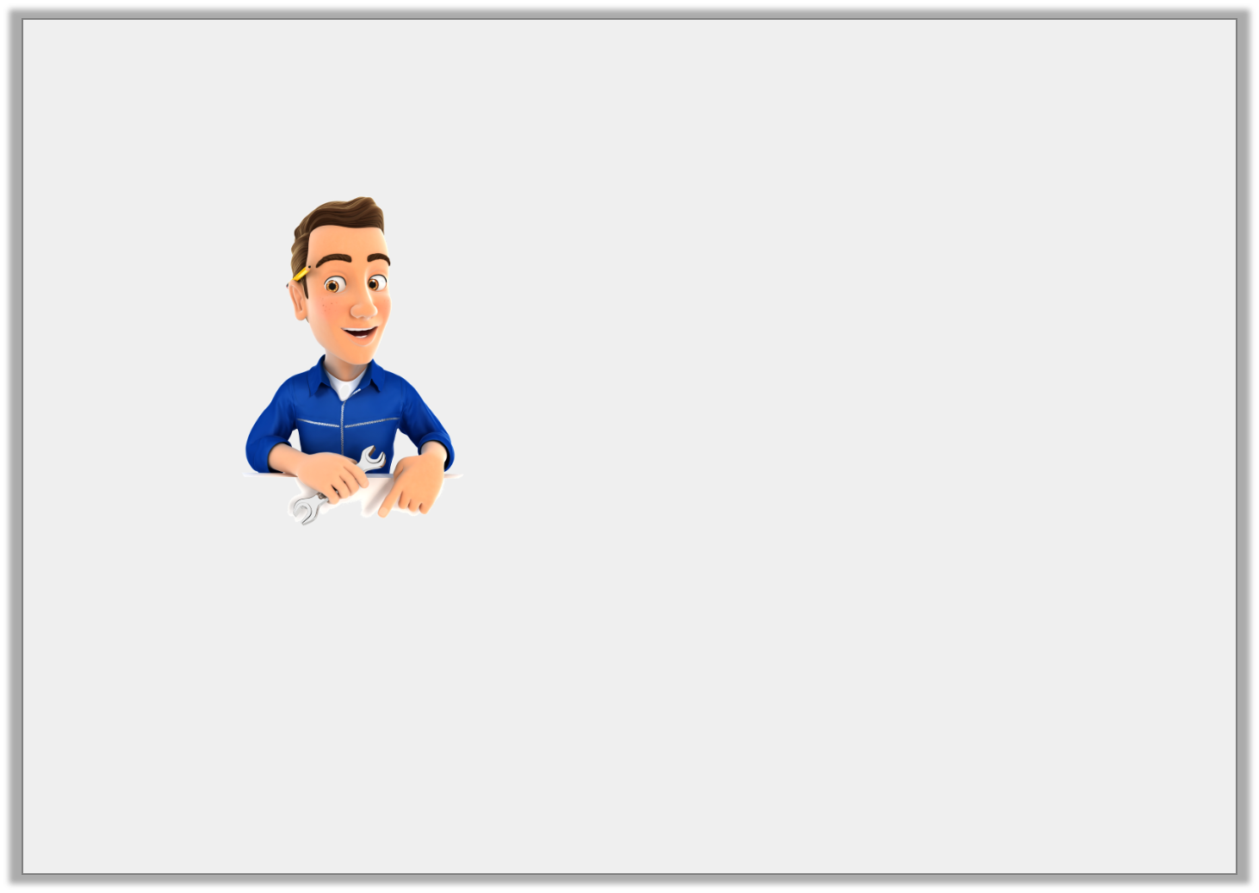
Reasoning 1
Two cars are different lengths. Both lengths round to 3m.
There is a difference of 0.7m between the actual lengths of the two cars.
Is what the mechanic says possible?
Explain your answer.
© Classroom Secrets Limited 2019

Slide 15
Reasoning 1
Two cars are different lengths. Both lengths round to 3m.
There is a difference of 0.7m between the actual lengths of the two cars.
Is what the mechanic says possible?
Explain your answer.
Yes it is possible because
© Classroom Secrets Limited 2019

Slide 16
Reasoning 1
Two cars are different lengths. Both lengths round to 3m.
There is a difference of 0.7m between the actual lengths of the two cars.
Is what the mechanic says possible?
Explain your answer.
Yes it is possible because one car could be 2.7m long and the other could be 3.4m long. Both lengths round to 3m and the difference between them is 0.7m.
There are other possible answers.
© Classroom Secrets Limited 2019

Slide 17
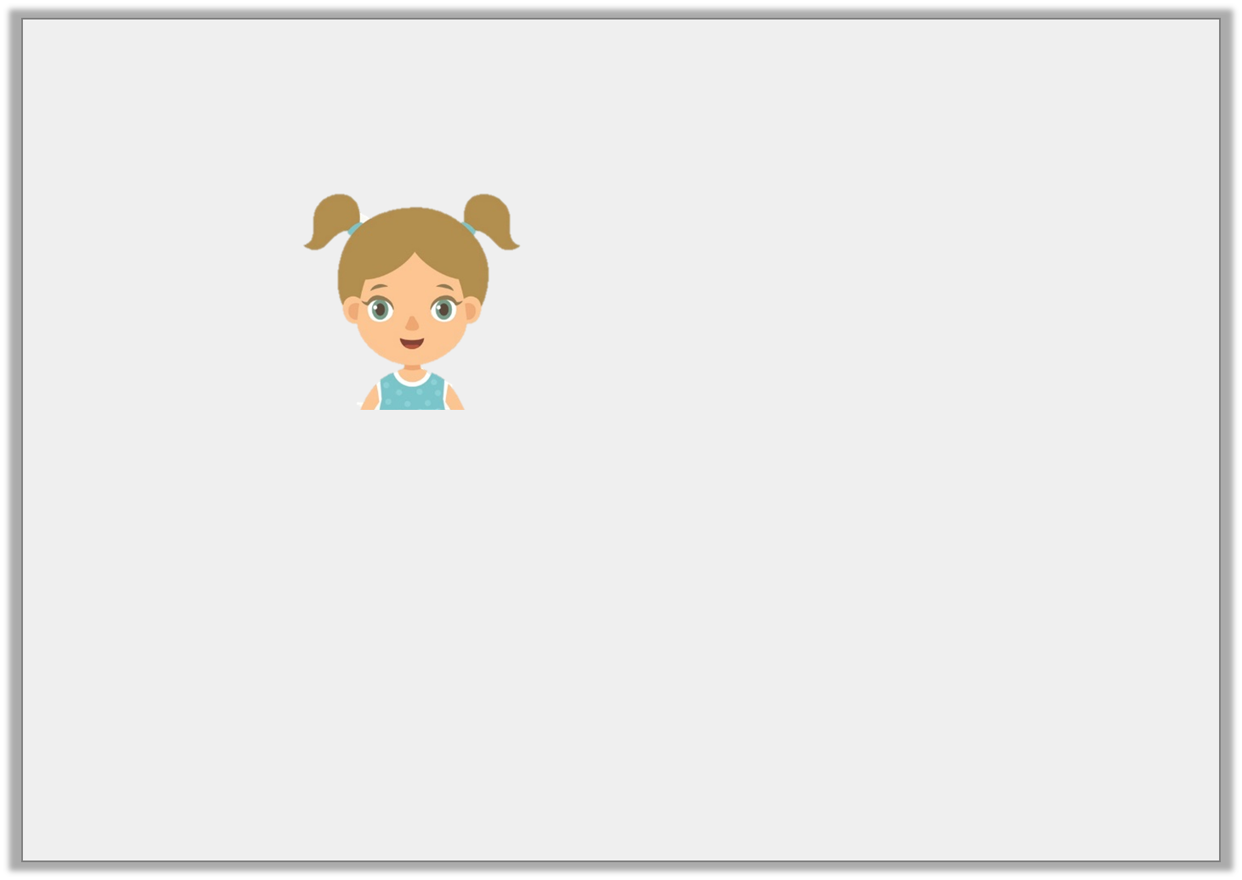
Problem Solving 2
Maya is thinking of a number.
What is Maya’s decimal?
My decimal does not contain the number 3. It rounds down to 5. The number of tenths in my decimal is odd.
© Classroom Secrets Limited 2019

Slide 18
Problem Solving 2
Maya is thinking of a number.
What is Maya’s decimal?
Maya’s decimal is 5.1
My decimal does not contain the number 3. It rounds down to 5. The number of tenths in my decimal is odd.
© Classroom Secrets Limited 2019

