Slide 1


Year 4 – Summer Block 1 – Decimals
Step 6: Halves and Quarters
© Classroom Secrets Limited 2019

Slide 2
Introduction
Which fraction of £100 would you choose? Why?
1
2
1
4
3
4
© Classroom Secrets Limited 2019

Slide 3
Introduction
Which fraction of £100 would you choose? Why?
1
2
1
4
3
4
This is the largest amount shown and would give you three quarters of the money.
© Classroom Secrets Limited 2019

Slide 4
Varied Fluency 1
Which fraction equals the decimal?
 |  | 5
 |  | 100
0.5 |  | 25
 |  | 100
 |  | 50
 |  | 100
© Classroom Secrets Limited 2019

Slide 5
Varied Fluency 1
Which fraction equals the decimal?
 |  | 5
 |  | 100
0.5 |  | 25
 |  | 100
 |  | 50
 |  | 100
© Classroom Secrets Limited 2019

Slide 6
Varied Fluency 2
Write a fraction and decimal to show how many coloured squares.
© Classroom Secrets Limited 2019

Slide 7
Varied Fluency 2
Write a fraction and decimal to show how many coloured squares.
, , or and 0.75 or any other correct
equivalent fraction.
75
100
3
4
6
8
9
12
© Classroom Secrets Limited 2019

Slide 8
Varied Fluency 3
Which decimal is shown on the place value grid?
What fraction would this be?
Ones | tenths | hundredths
© Classroom Secrets Limited 2019

Slide 9
Varied Fluency 3
Which decimal is shown on the place value grid?
What fraction would this be?
0.25 and , , or or any other correct
equivalent fraction.
Ones | tenths | hundredths
25
100
1
4
2
8
3
12
© Classroom Secrets Limited 2019

Slide 10
Varied Fluency 4
Fill in <, > or = to make the statement true.
2 |  |  |  | 0.5
8
© Classroom Secrets Limited 2019

Slide 11
Varied Fluency 4
Fill in <, > or = to make the statement true.
2 |  | < |  | 0.5
8
© Classroom Secrets Limited 2019

Slide 12
Problem Solving 1
Match the pairs. Which is the odd one out?
0.5
0.75
1
4
50
100
0.25
© Classroom Secrets Limited 2019

Slide 13
Problem Solving 1
Match the pairs. Which is the odd one out?
0.5
0.75
1
4
50
100
0.25
© Classroom Secrets Limited 2019

Slide 14
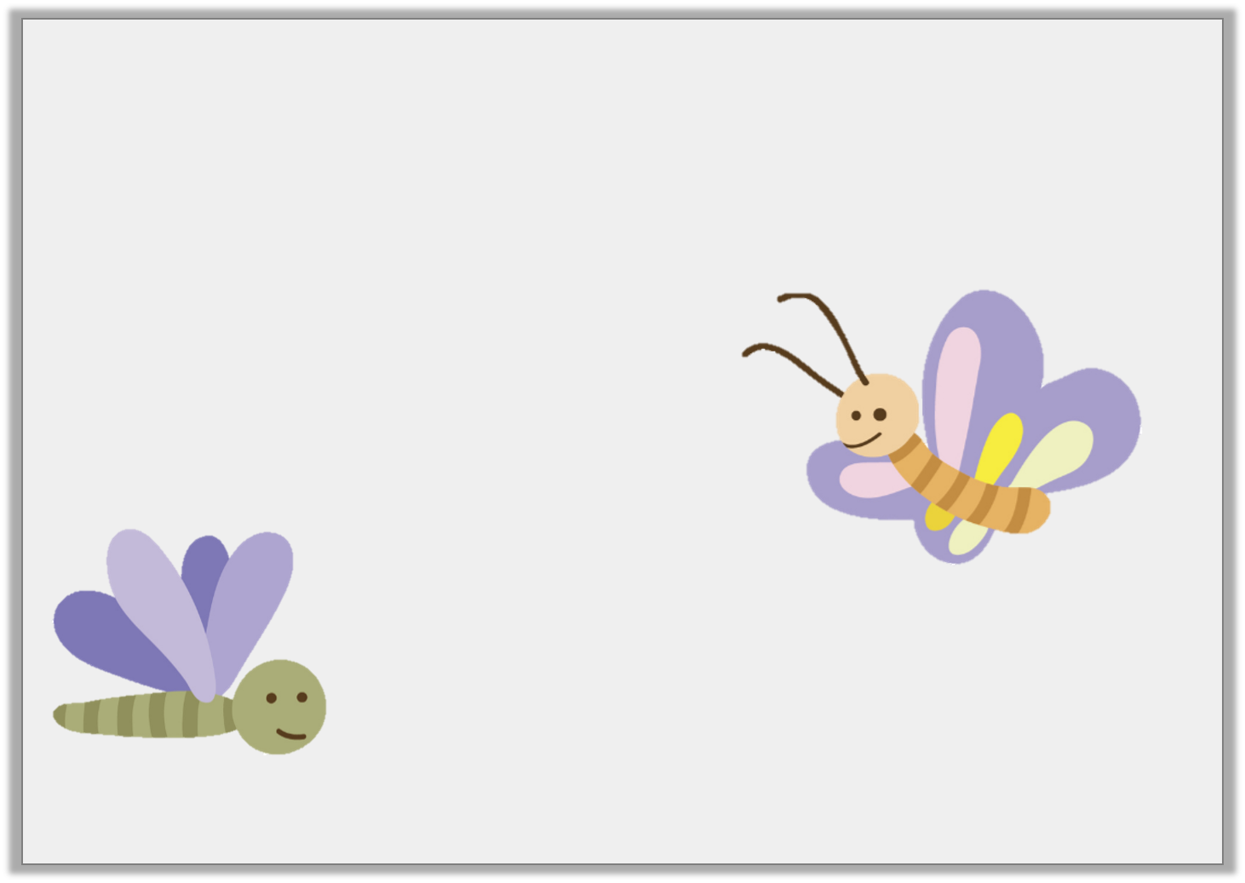
Reasoning 1
Bunty the butterfly flies 0.5m in one minute.
Monty the moth travels m in one minute.
Who travels furthest?
Explain how you know.
25
100
© Classroom Secrets Limited 2019

Slide 15
Reasoning 1
Bunty the butterfly flies 0.5m in one minute.
Monty the moth travels m in one minute.
Who travels furthest?
Explain how you know.
Bunty the butterfly
travels furthest because 0.5m is equivalent to m and Monty the moth only travels m or m or 0.25m.
25
100
1
2
25
100
1
4
© Classroom Secrets Limited 2019

Slide 16
Problem Solving 2
I’m thinking of a fraction.
The denominator is 100.
It is equal to 0.75.
What is my fraction?
© Classroom Secrets Limited 2019

Slide 17
Problem Solving 2
I’m thinking of a fraction.
The denominator is 100.
It is equal to 0.75.
What is my fraction?
75
100
© Classroom Secrets Limited 2019

