Slide 2
Learning objective
Estimate, compare and calculate different measures, including money in pounds and pence.

Slide 3

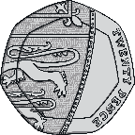
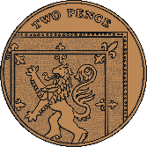
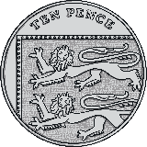
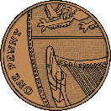
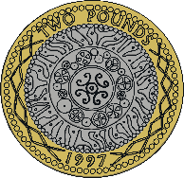
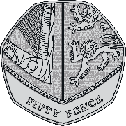
Pounds and Pence
Diving
Complete the sentences to calculate how much money is in
the savings jar.
83
In the savings jar, there is pence.
In the savings jar, there is pounds.
This is £ and pence.
There is £ in the savings jar.
2
2
83
2.83

Slide 4
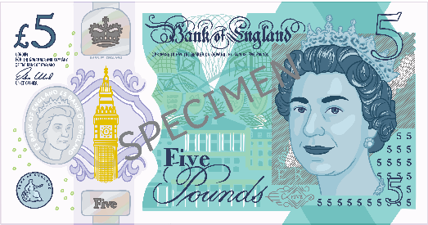

Pounds and Pence
Diving
Complete the part-whole model, writing the amount using the £ sign. Which notes or coins could you use?
£6.34
£5.10
£1.24
e.g.
£1.24 can be represented using many different coins.
Which coins did you use?

Slide 5
Pounds and Pence
Diving
Write these amounts in pounds and pence using a £ sign.
217p = __ pounds and __ pence = £__.__
27p = __ pounds and __ pence = £__.__
270p = __ pounds and __ pence = £__.__
2
17
2
17
0
27
0
27
2
70
2
70

Slide 6
Pounds and Pence
Deeper
One of these is correct. The other is incorrect.
Which is the correct answer?
Explain the error that has been made and write the correct answer.
Pence | Using £ Sign | or ✗ ? | Error/Correct Answer
907p | £9.07
840p | £8.4
✓
There should be 2 digits after the decimal point. £8.40 is the correct answer.
✗

Slide 7
Pounds and Pence
Deeper
Luckman has 5 coins that make £1.26 in total. Four of the coins are given. Explain which of the following sets of coins Luckman could have and write what the missing coin is.
50p, 50p, 20p, 5p, ?p
✓ Luckman could have this set of coins as they total £1.25 and the missing coin is a 1p.
1p
£1, 10p, 10p, 2p, ?p
Luckman cannot have this set of coins as they total £1.22 so the missing amount is 4p, which cannot be made with 1 coin.
£1, 10p, 5p, 1p, ?p
✓ Luckman could have this set of coins as they total £1.16 and the missing coin is a 10p.
10p

Slide 8

Pounds and Pence
Deepest
Here are some coins:
Lucas has 4 of these coins. Decide whether these statements about the coins are always, sometimes or never true. Explain why you think this and give examples to prove it.
Lucas has more than £4.
Never.
If Lucas had the 4 greatest value coins, the total would be £2 + £1 + 50p + 20p = £3.70 so he can never have more than £4.

Slide 9
Pounds and Pence
Deepest
Here are some coins:
Lucas has 4 of these coins. Decide whether these statements about the coins are always, sometimes or never true. Explain why you think this and give examples to prove it.
b) Lucas has less than 10p.
Sometimes
If Lucas had the 4 smallest value coins, the total would be 5p + 2p + 1p + 1p = 9p so this is less than 10p so the statement is not true.
However, if Lucas had 20p + 10p + 10p + 5p this makes a total of 45p which is greater than 10p so the statement is true.
Overall, the statement is sometimes true.

Slide 10


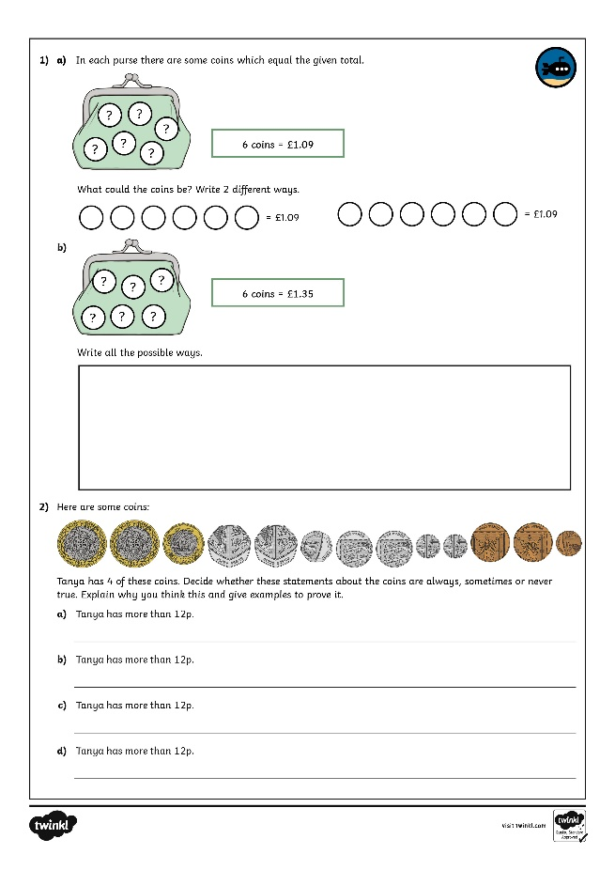
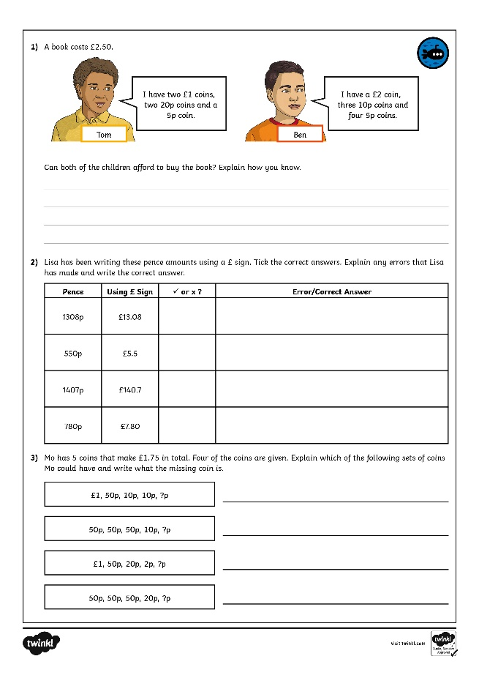
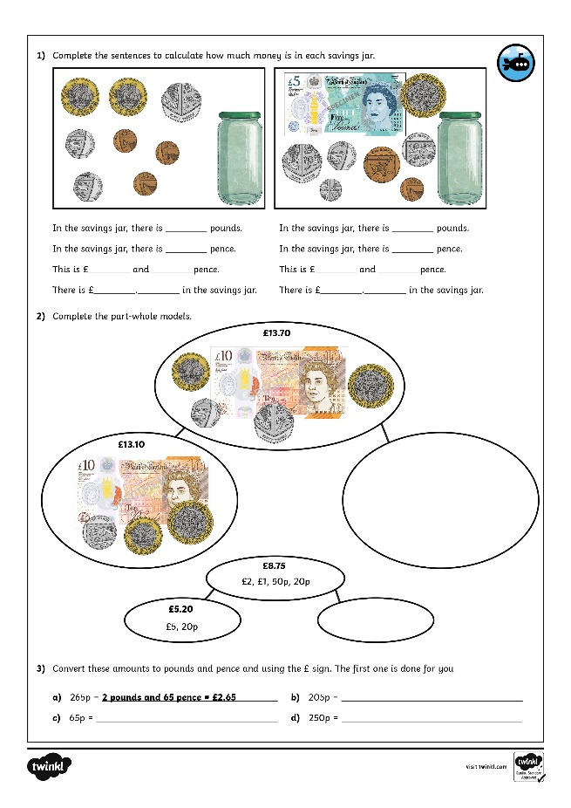
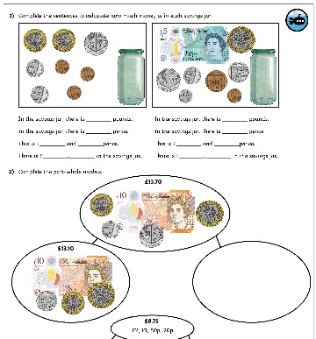

Pounds and Pence
Dive in by completing your own activity!

