Slide 1


LIFE/work balance
We have started a #LIFEworkbalance campaign and we need your help to complete our LIFE/work balance survey.
We hope to publish the results soon, so please give 15 minutes of your time to help us get a true picture of school life.
Want to be a part of this campaign? Take the survey on our website and share it with your colleagues!
© Classroom Secrets Limited 2019

Slide 2

Year 4 – Summer Block 3 – Time – Years, Months, Weeks and Days
About This Resource:
This PowerPoint has been designed to support your teaching of this small step. It includes a starter activity and an example of each question from the Varied Fluency and Reasoning and Problem Solving resources also provided in this pack. You can choose to work through all examples provided or a selection of them depending on the needs of your class.
Teaching Note:
The questions in this resource do not refer to leap years unless specifically stated.
National Curriculum Objectives:
Mathematics Year 4: (4M4c) Solve problems involving converting from hours to minutes; minutes to seconds; years to months; weeks to days
More Year 4 Time Resources.
Did you like this resource? Don’t forget to review it on our website.
© Classroom Secrets Limited 2018

Slide 3
Year 4 – Summer Block 3 – Time
Step 2: Years, Months, Weeks and Days
© Classroom Secrets Limited 2018

Slide 4
Introduction
Which months have the most days?
Which month has the fewest days?
How many months have 28 days?
How many days are in one year?
How many weeks are in two years?
How often do leap years occur?
Which month gets an extra day in a leap year?
© Classroom Secrets Limited 2018

Slide 5
Introduction
Which months have the most days?
January, March, May, July, August, October and December
Which month has the fewest days?
February
How many months have 28 days?
All of them
How many days are in one year?
365
How many weeks are in two years?
104
How often do leap years occur?
Every four years
Which month gets an extra day in a leap year?
February
© Classroom Secrets Limited 2018

Slide 6
Varied Fluency 1
Complete the statements.
There are |  | days in January.
There are |  | months in half a year.
There are |  | days in 5 weeks 3 days.
© Classroom Secrets Limited 2018

Slide 7
Varied Fluency 1
Complete the statements.
There are | 31 | days in January.
There are | 6 | months in half a year.
There are | 38 | days in 5 weeks 3 days.
© Classroom Secrets Limited 2018

Slide 8
Varied Fluency 2
Circle the true statement.
There are 17 days in 3 weeks.
There are 24 months in 2 years.
There are 50 weeks in 1 year.
© Classroom Secrets Limited 2018

Slide 9
Varied Fluency 2
Circle the true statement.
There are 17 days in 3 weeks.
There are 24 months in 2 years.
There are 50 weeks in 1 year.
© Classroom Secrets Limited 2018

Slide 10
Varied Fluency 3
Match the durations.
28 days
14 days
2 weeks
1 and a half years
18 months
4 weeks
© Classroom Secrets Limited 2018

Slide 11
Varied Fluency 3
Match the durations.
28 days
14 days
2 weeks
1 and a half years
18 months
4 weeks
© Classroom Secrets Limited 2018

Slide 12
Varied Fluency 4
Circle the longest duration.
1 month
3 days
2 weeks
© Classroom Secrets Limited 2018

Slide 13
Varied Fluency 4
Circle the longest duration.
1 month
3 days
2 weeks
© Classroom Secrets Limited 2018

Slide 14
Problem Solving 1
Amit is 8 years and 11 months old.
Jerry is 5 months older than Amit.
Alex is 6 months younger than Jerry.
How old is Alex?
Alex is |  | years and |  | months old.
© Classroom Secrets Limited 2018

Slide 15
Problem Solving 1
Amit is 8 years and 11 months old.
Jerry is 5 months older than Amit.
Alex is 6 months younger than Jerry.
How old is Alex?
Alex is | 8 | years and | 10 | months old.
© Classroom Secrets Limited 2018

Slide 16
Problem Solving 2
George is going camping.
He starts his trip on the 28th March.
He camps for 2 weeks in Cornwall, then camps for 5 days in Devon.
What date does he finish camping?
Mon | Tue | Wed | Thurs | Fri | Sat | Sun
 |  | 28 | 29 | 30 | 31
April
 |  |  |  |  |  | 1
2 | 3 | 4 | 5 | 6 | 7 | 8
9 | 10 | 11 | 12 | 13 | 14 | 15
16 | 17 | 18 | 19 | 20 | 21 | 22
© Classroom Secrets Limited 2018

Slide 17
Problem Solving 2
George is going camping.
He starts his trip on the 28th March.
He camps for 2 weeks in Cornwall, then camps for 5 days in Devon.
What date does he finish camping?
Jack finishes camping on Monday 16th April.
Mon | Tue | Wed | Thurs | Fri | Sat | Sun
 |  | 28 | 29 | 30 | 31
April
 |  |  |  |  |  | 1
2 | 3 | 4 | 5 | 6 | 7 | 8
9 | 10 | 11 | 12 | 13 | 14 | 15
16 | 17 | 18 | 19 | 20 | 21 | 22
© Classroom Secrets Limited 2018

Slide 18
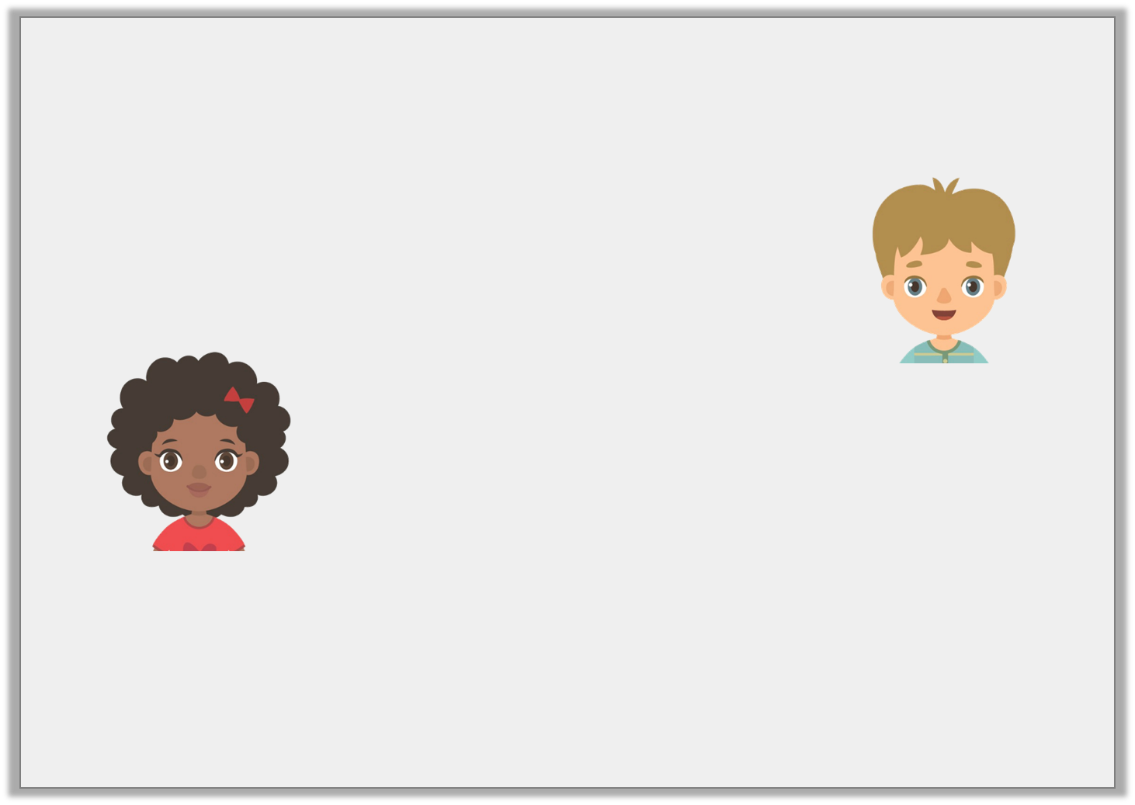
Reasoning 1
Erica and Elijah are discussing weeks.
Who is correct? Explain why.
There are 49 days in 7 weeks.
Elijah
There 50 days in 7 weeks.
Erica
© Classroom Secrets Limited 2018

Slide 19
Reasoning 1
Erica and Elijah are discussing weeks.
Who is correct? Explain why.
Elijah is correct because…
There are 49 days in 7 weeks.
Elijah
There 50 days in 7 weeks.
Erica
© Classroom Secrets Limited 2018

Slide 20
Reasoning 1
Erica and Elijah are discussing weeks.
Who is correct? Explain why.
Elijah is correct because there are 7 days in 1 week.
7 x 7 = 49 days.
There are 49 days in 7 weeks.
Elijah
There 50 days in 7 weeks.
Erica
© Classroom Secrets Limited 2018

