Slide 2
Learning objectives;
To read, time on analogue and digital 12- and 24-hour clocks.
To write and convert time between analogue and digital 12- and 24-hour clocks.

Slide 3
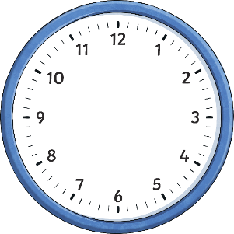
Analogue to Digital – 12 Hour
Which answers correctly match the time
shown on each analogue clock?
20 minutes past 7
quarter past 7
a.m.
7:15 a.m.

Slide 4
Analogue to Digital – 12 Hour
Which answers correctly match the time
shown on each analogue clock?
25 minutes past 3
quarter past 3
p.m.
3:12 p.m.

Slide 5
Analogue to Digital – 12 Hour
Which answers correctly match the time
shown on each analogue clock?
10 minutes past 9
ten past 9
p.m.
9:05 p.m.

Slide 6


Analogue to Digital – 12 Hour
This clock is running 11 minutes fast.
Sebastian
I think the correct time is 9:54 a.m.
p.m.
I think the correct time is 10:16 a.m.
Balvinder
Sebastian is correct. When a clock is fast, that means that the real time is 11 minutes before the time shown on the clock. This means that you need to count backwards 11 minutes from the time shown in order to find the correct time. 10:05 a.m. – 11 minutes = 9:54 a.m.
Which child do you agree with and why?

Slide 7


Analogue to Digital – 12 Hour
On this clock, the hour hand is hidden. Seren and Conor are thinking of times the clock could be showing. Explain if you agree or disagree with each of their statements.
Seren
I think that the clock could be showing 3:20 p.m.
p.m.
Seren is incorrect. You would be able to see the hour hand if the time was 3:20 p.m. as it would be just after the 3 on the clock.

Slide 8
Analogue to Digital – 12 Hour
On this clock, the hour hand is hidden. Seren and Conor are thinking of times the clock could be showing. Explain if you agree or disagree with each of their statements.
Seren
Conor
I think that the clock could be showing 3:20 p.m.
I think the clock could be showing 10:20 p.m.
p.m.
Conor is correct. The hour hand would be just past 10 on the clock if the time was 10:20 p.m. so it would be covered up. The minute hand would be visible and pointing at 4 to show that is 20 past the hour.

Slide 9
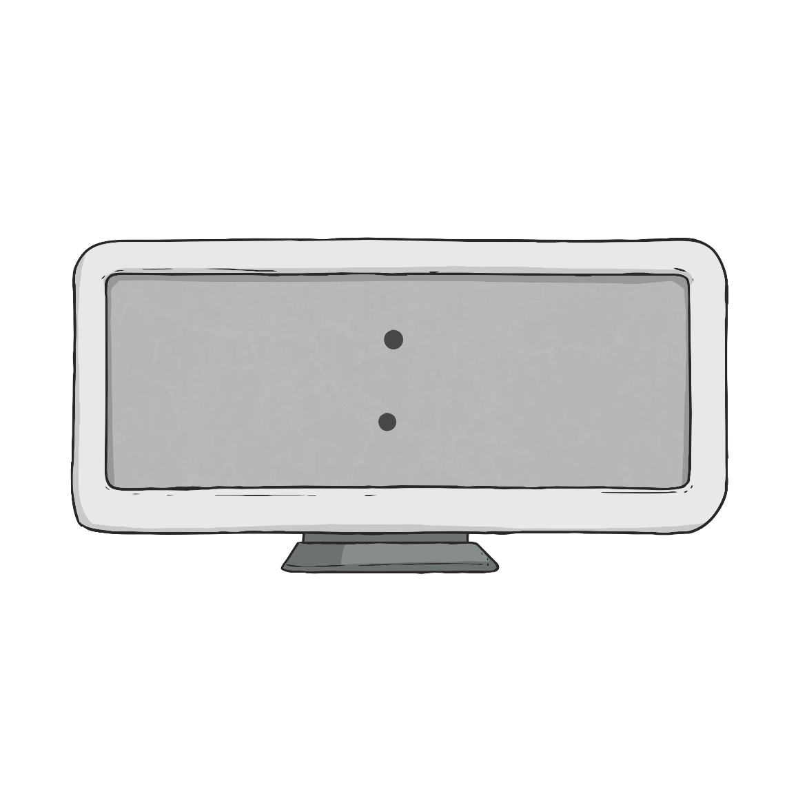
Analogue to Digital – 12 Hour
What time am I?
My hour is an even number.
2, 4, 6, 8, 10, 12
I am a p.m. time.
If I was shown on an analogue clock, my minute hand would be opposite the number 12 on the clock face.
?? ??
10 30
pointing at 6
My hour is 120 minutes before midnight.
10
Can you make up your own ‘What time am I?’ question like this one?
I am 10:30 p.m.

