Slide 2
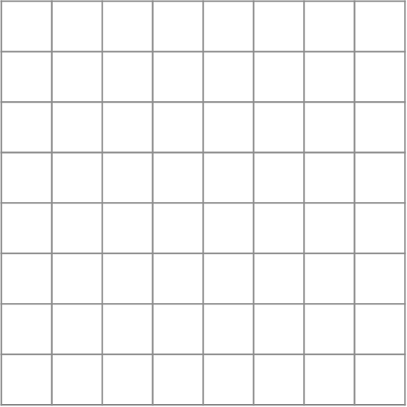
Vertical Lines of Symmetry
When lines of symmetry are not vertical on the page, turn them
around so that they are.

Slide 3
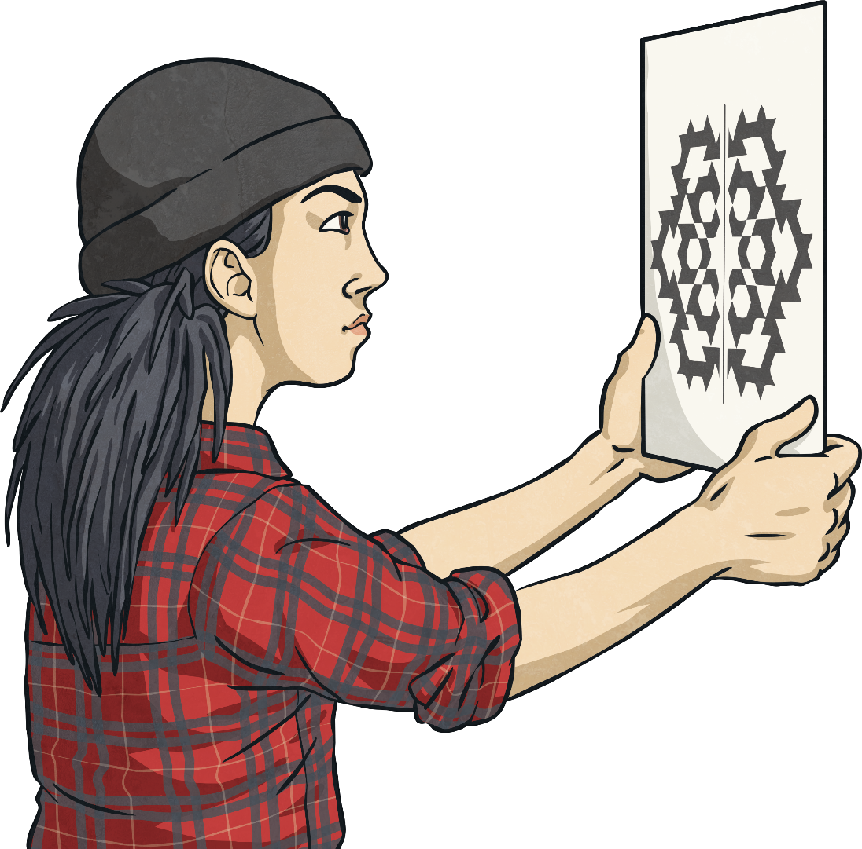
Hold It Up Vertically!
Where possible, hold any symmetrical shape up vertically in front of your face with the line of symmetry also vertical (in line with your nose.)

Slide 4
Vertical Lines of Symmetry
One way to draw the shape is to match the corners of the shape.

Slide 5
Diagonal Symmetry
When lines of symmetry are not vertical on the page, turn them
around so that they are.

Slide 6
Diagonal Symmetry
When lines of symmetry are not vertical on the page, turn them
around so that they are.

