Slide 1


Money – Using Rounding to Estimate Money
National Curriculum Objectives:
Mathematics Year 4: (4M1)
Compare different measures, including money in pounds and pence
Mathematics Year 4: (4M2)
Estimate different measures, including money in pounds and pence
Mathematics Year 4: (4M9)
Calculate different measures, including money in pounds and pence
© Classroom Secrets Limited 2018

Slide 2
Year 4 – Summer Block 2 – Money
Step 3: Using Rounding to Estimate Money
© Classroom Secrets Limited 2018

Slide 3
Introduction
Round each number to the nearest 100 and match
it to the number line.
851
126
575
386
100 | 200 | 300 | 400 | 500 | 600 | 700 | 800 | 900
164
849
270
548
655
© Classroom Secrets Limited 2018

Slide 4
Introduction
Round each number to the nearest 100 and match
it to the number line.
164
386
575
849
100 | 200 | 300 | 400 | 500 | 600 | 700 | 800 | 900
126
270
548
655
851
© Classroom Secrets Limited 2018

Slide 5
Varied Fluency 1
Which whole pounds does the given amount come in between?
Round the amount to the nearest pound.
£7.82
© Classroom Secrets Limited 2018

Slide 6
Varied Fluency 1
Which whole pounds does the given amount come in between?
Round the amount to the nearest pound.
£8.00
£7.82
£7.00
£8.00
© Classroom Secrets Limited 2018

Slide 7
Varied Fluency 2
Match the amounts to the letters on the number line.
A
B
C
£5
£6
£5.95
559p
£5.05
© Classroom Secrets Limited 2018

Slide 8
Varied Fluency 2
Match the amounts to the letters on the number line.
A
B
C
£5
£6
£5.95 | C
559p | B
£5.05 | A
© Classroom Secrets Limited 2018

Slide 9
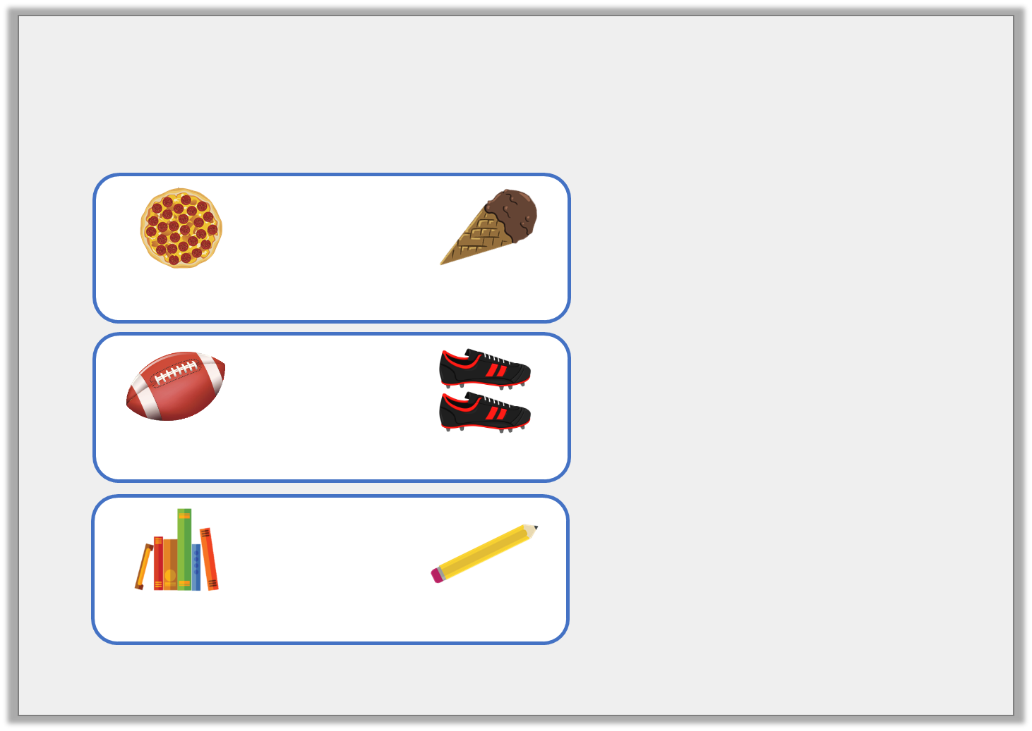
Varied Fluency 3
Match the items to the rounded totals.
 | +
468p |  | £1.67
£4.00
£7.00
£9.00
 | +
225p |  | £6.89
 | +
£3.44 |  | 72p
© Classroom Secrets Limited 2018

Slide 10
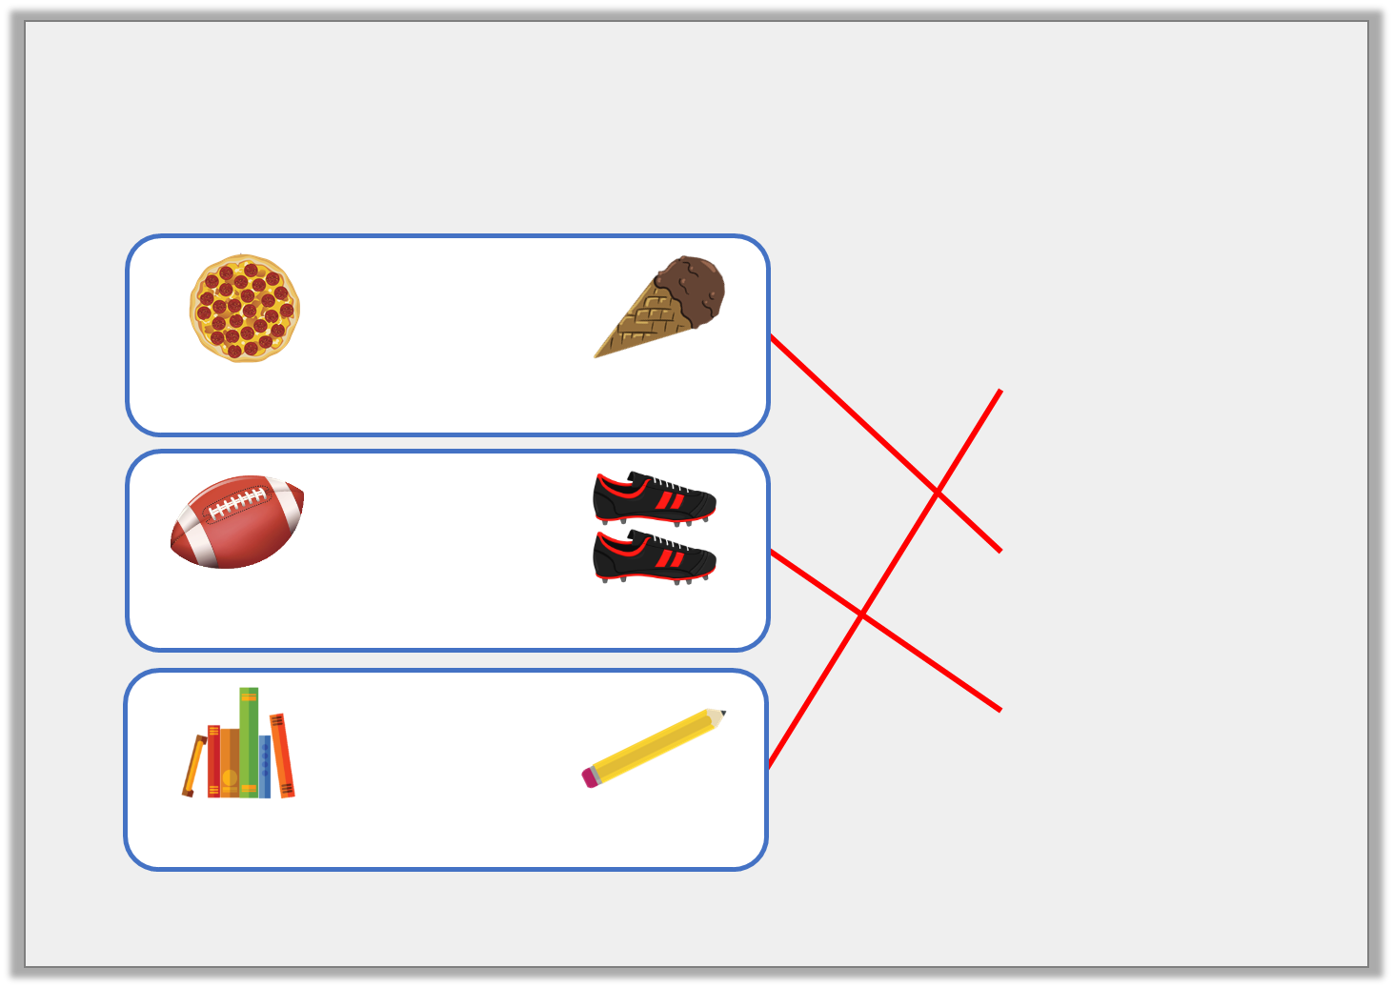
Varied Fluency 3
Match the items to the rounded totals.
 | +
468p |  | £1.67
£4.00
£7.00
£9.00
 | +
225p |  | £6.89
 | +
£3.44 |  | 72p
© Classroom Secrets Limited 2018

Slide 11
Varied Fluency 4
James wants to buy a pair of shorts for £4.54
and a t-shirt for £5.28.
What does each amount round to?
He has £12.00.
How much change will he receive approximately?
© Classroom Secrets Limited 2018

Slide 12
Varied Fluency 4
James wants to buy a pair of shorts for £4.54
and a t-shirt for £5.28.
What does each amount round to?
£5.00 and £5.00
He has £12.00.
How much change will he receive approximately?
£12 – £10 = £2.00
© Classroom Secrets Limited 2018

Slide 13
Reasoning 1
What amount could the arrow be pointing to?
Explain why.
500p
600p
© Classroom Secrets Limited 2018

Slide 14
Reasoning 1
What amount could the arrow be pointing to?
Explain why.
The arrow is pointing to less than a quarter of the way along the number line, so the amount must be less than…
500p
600p
© Classroom Secrets Limited 2018

Slide 15
Reasoning 1
What amount could the arrow be pointing to?
Explain why.
The arrow is pointing to less than a quarter of the way along the number line, so the amount must be less than 525p or £5.25. The price could be between £5.10 or 510p and £5.20 or 520p.
500p
600p
© Classroom Secrets Limited 2018

Slide 16
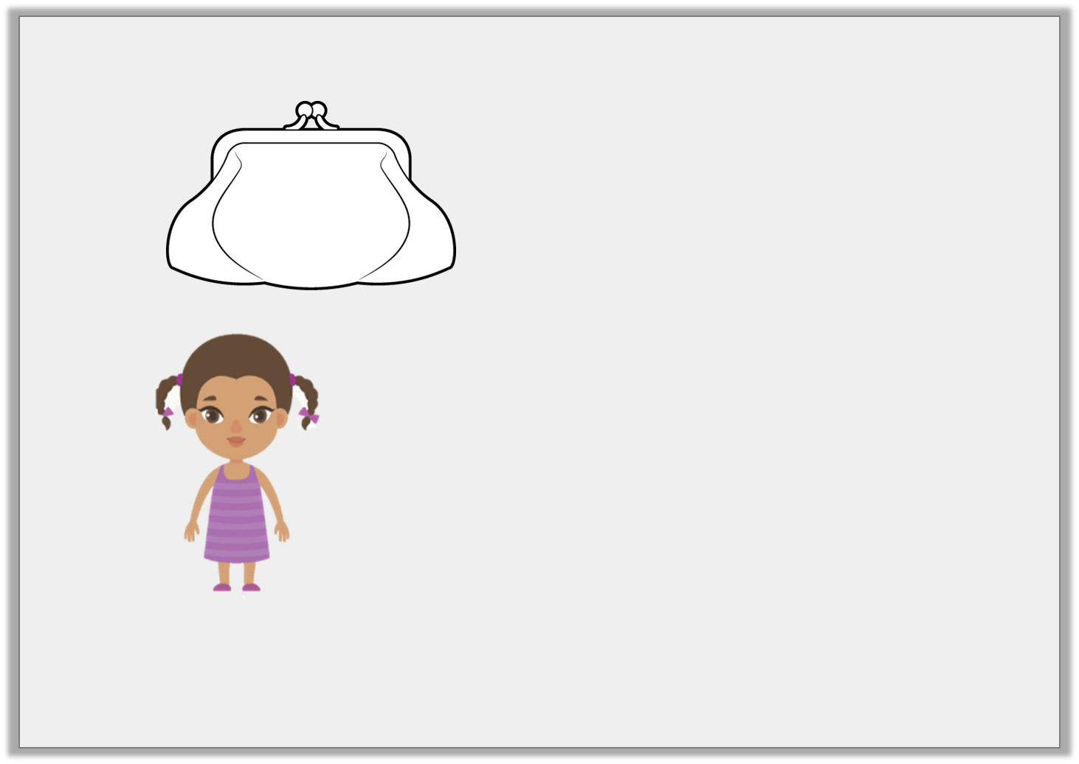
Reasoning 2
Cleo has:
She says,
Do you agree? Explain why.
£2.32
My amount rounds to £3.
© Classroom Secrets Limited 2018

Slide 17
Reasoning 2
Cleo has:
She says,
Do you agree? Explain why.
I disagree because…
£2.32
My amount rounds to £3.
© Classroom Secrets Limited 2018

Slide 18
Reasoning 2
Cleo has:
She says,
Do you agree? Explain why.
I disagree because any amount less than £2.50 rounds down to £2.00. £2.32 is less than £2.50 and is nearer to £2.00 than £3.00.
£2.32
My amount rounds to £3.
© Classroom Secrets Limited 2018

Slide 19
Problem Solving 1
Kaylum has these digit cards:
Find all the amounts he can make which round to 500p.
5
4
1
9
© Classroom Secrets Limited 2018

Slide 20
Problem Solving 1
Kaylum has these digit cards:
Find all the amounts he can make which round to 500p.
491p 514p
495p 519p
451p 541p
459p 549p
5
4
1
9
© Classroom Secrets Limited 2018

