Slide 2
Coordinates
y
10
9
8
7
6
5
4
3
2
1
x
0
1
2
3
4
5
6
7
8
9
10

Slide 3
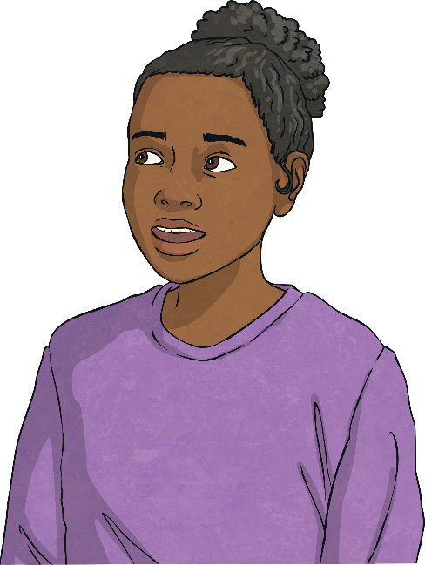
A to B
Laura says: “The movement from point A to point B is 4 squares to the right and 7 squares up.”
y
10
9
B
8
7
6
A to B is 4 squares to the left and 6 squares up.
5
4
3
A
2
If Laura was correct, what would be the coordinates of point B?
1
x
0
1
2
3
4
5
6
7
8
9
10
(11, 10)

Slide 4
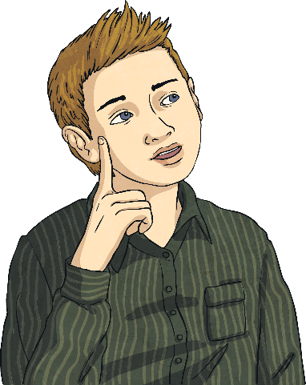
A to B to C
y
Alfie translates point A to point B by moving right 3 squares and up 6 squares. He then translates B to C by moving right 2 squares and down 4 squares.
10
9
B
8
7
6
Where is point C?
5
C
4
How can you combine the translations without finding point B?
3
A
2
1
x
B is (5,9)
C is (7,5)
0
1
2
3
4
5
6
7
8
9
10
Combine:
right 3 and right 2 = right 5 (3 + 2 = 5)
up 6 and down 4 = up 2 (6 – 4 = 2)

Slide 5
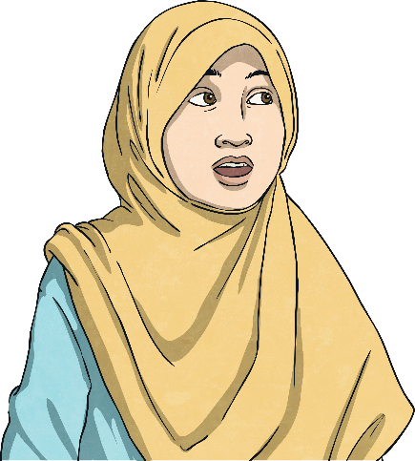
Reverse
y
Fatima says, “To translate E to F you move 4 squares to the left and 6 squares up.”
10
9
8
7
F
Alfie then says, “So to translate F to E, you reverse, making the translation 6 squares to the right and 4 squares down.”
6
5
4
3
Why do you agree and disagree with Alfie?
2
1
E
x
0
1
2
3
4
5
6
7
8
9
10
Reverse is correct, but Alfie has also swapped the numbers. F to E is 4 squares to the right and 6 squares down.

Slide 6

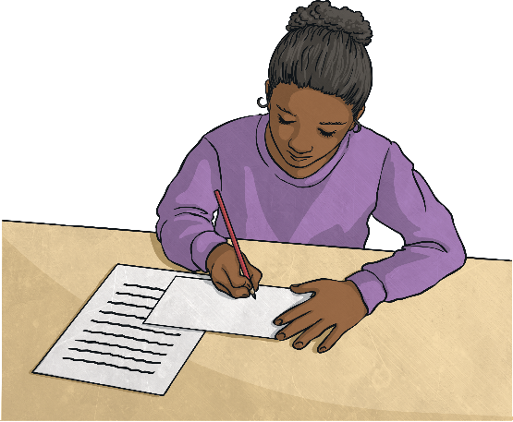
Rectangle
y
Laura translates the rectangle so point R moves to (6,7).
10
9
8
Fatima says the other corners of the rectangle will be (6,9) (3,7) and (3,9)
7
6
5
4
3
R
Write the coordinates of a rectangle.
2
1
x
0
1
2
3
4
5
6
7
8
9
10
The other points should be (6,5) (9,7) (9,5). Fatima has the right size rectangle but in effect has reflected it.

