Slide 2
Coordinates
y
10
9
8
7
6
5
4
3
2
1
x
0
1
2
3
4
5
6
7
8
9
10

Slide 3
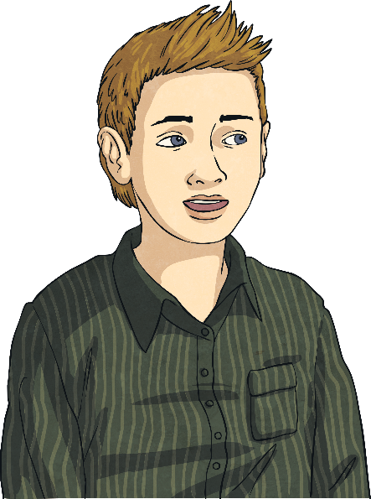
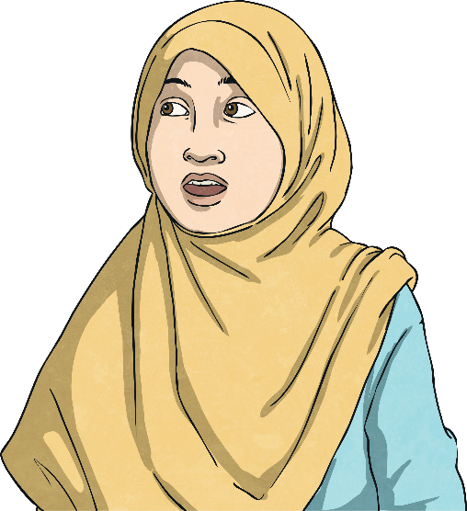
Coordinates
Here is a coordinates grid.
Y
10
Fatima says the dot is at (3, 7).
9
Alfie says the dot is at (7, 3).
8
7
Who is correct? Why?
6
5
4
3
2
1
x
0
1
2
3
4
5
6
7
8
9
10

Slide 4
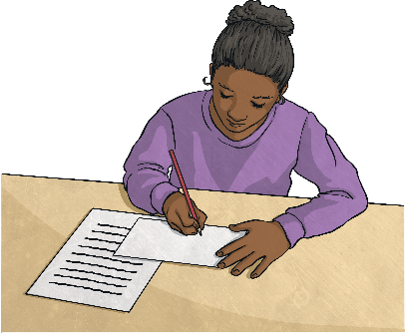
Coordinates Grid
Laura draws a coordinates grid. Think about all the features that she must include and what she could include
A coordinates grid should always have:
Horizontal axis with an arrow on the right-hand end labelled x.
Vertical axis, which crosses the horizontal x-axis, with an arrow at the top labelled y.
y
A coordinates grid usually has:
Evenly spaced numbers marking each axis, with 0 where the axes cross.
Evenly spaced horizontal and vertical grid lines matching each number.
10
9
8
7
6
5
4
3
2
1
x
0
1
2
3
4
5
6
7
8
9
10

Slide 5
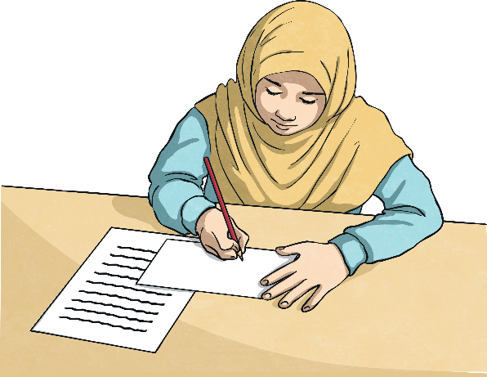
Using a Coordinates Grid
y
10
Fatima writes some instructions for using a coordinates grid. Can you spot any mistakes?
9
8
7
6
5
“Here is a numbered coordinates grid. If I want to mark the point (8, 1), I count 8 squares up and 1 square across and shade the square.”
4
3
2
1
x
0
1
2
3
4
5
6
7
8
9
10
Can you improve Fatima’s explanation?

Slide 6
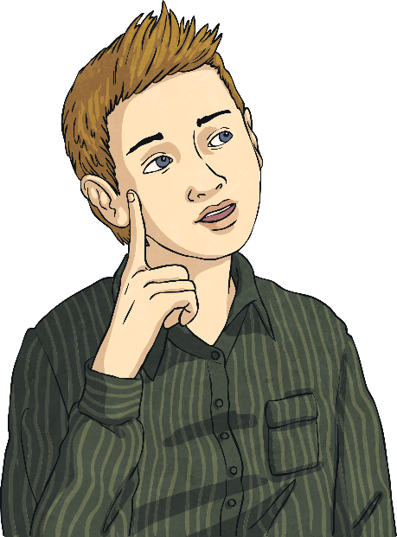
Spot the Difference
Alfie has 2 different coordinates grids. He wants to know what is different about the two grids. Can you list the differences?
y
10
10
9
9
8
8
7
7
6
6
5
5
4
4
3
3
2
2
1
1
x
A
B
C
D
E
F
G
H
I
J
0
1
2
3
4
5
6
7
8
9
10

Slide 7
Spot the Difference Answers
y
10
10
9
9
8
8
7
7
6
6
5
5
4
4
3
3
2
2
1
1
x
A
B
C
D
E
F
G
H
I
J
0
1
2
3
4
5
6
7
8
9
10
Uses numbers on the vertical axis and letters on the horizontal axis.
Uses numbers on both axes.
The letters are places in the middle of each square.
The numbers are placed by the lines of the grid.
The axes are not labelled x and y, nor are there arrows.
The axes are labelled x and y and there are arrows pointing away from 0.

