Slide 2

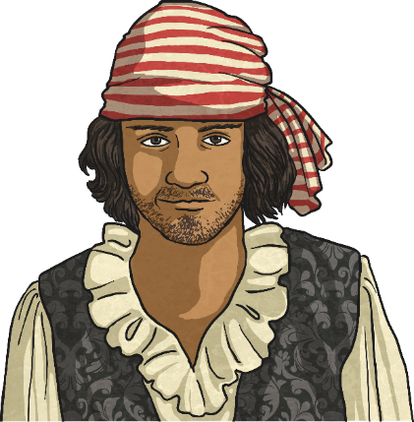

Aims
Describe positions on a 2D grid as coordinates in the first quadrant. 3
Describe movements between positions as translations of a given
unit to the left/right and up/down. 6
Plot specified points and draw sides to complete a given polygon. 9

Slide 3
Describe positions on a 2D grid as coordinates in the first quadrant
Find the stars on the grid and write down their coordinates.
_{y}
(A,1)
(D,7)
(G,5)
(I,8)
(E,3)
(A,8)
(H,2)
(C,4)
(J,6)
₁₀
1
Reveal Answer
6
Reveal Answer
₉
₈
6
4
2
Reveal Answer
7
Reveal Answer
₇
2
₆
9
3
Reveal Answer
8
Reveal Answer
₅
3
₄
8
4
Reveal Answer
9
Reveal Answer
₃
5
₂
7
5
Reveal Answer
₁
1
x
₀
_{A}
_{B}
_{C}
_{D}
_{E}
_{F}
_{G}
_{H}
_{I}
_{J}

Slide 4
Describe positions on a 2D grid as coordinates in the first quadrant
Write down the coordinates of each letter
_{y}
(3,4)
(6,9)
(0,8)
(4,1)
(9,10)
(6,0)
(7,5)
(2,1)
(2,10)
(1,0)
₁₀
I
E
A
Reveal Answer
F
Reveal Answer
₉
B
₈
C
B
Reveal Answer
G
Reveal Answer
₇
₆
C
Reveal Answer
H
Reveal Answer
₅
G
₄
A
₃
D
Reveal Answer
I
Reveal Answer
₂
₁
H
D
E
Reveal Answer
J
Reveal Answer
J
F
x
₀
₁
₂
₃
₄
₅
₆
₇
₈
₉
₁₀
Freddy says that the star coordinate is (8,2) and Marta says it is (2,8). Explain who is correct and what mistake was made.

Slide 5

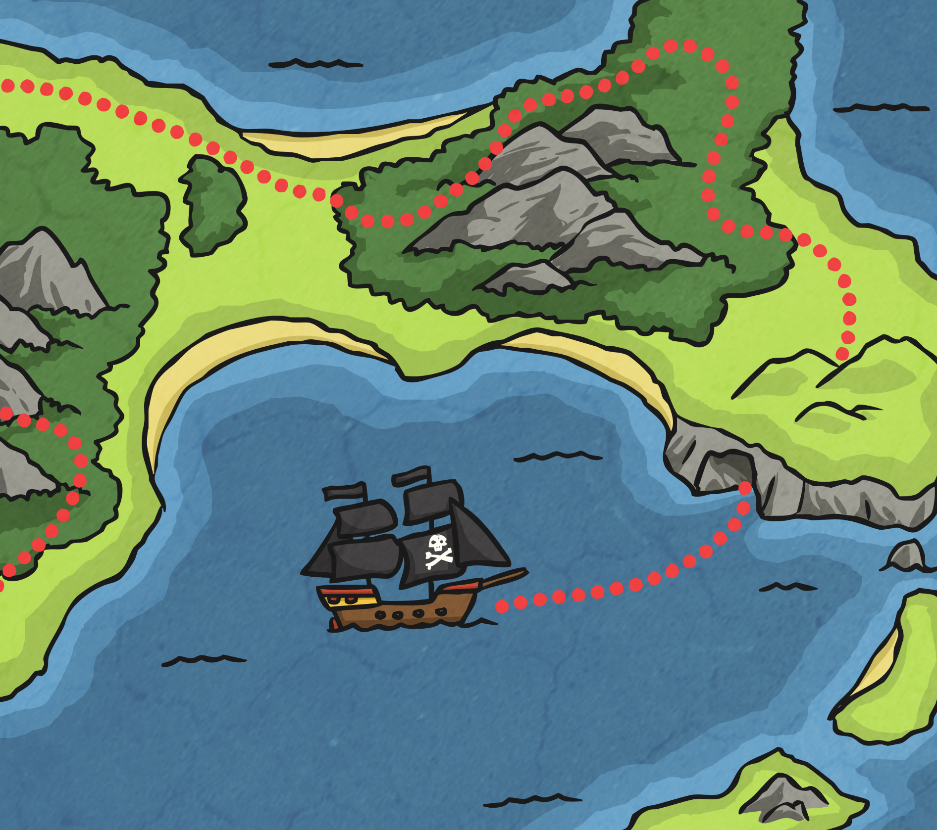



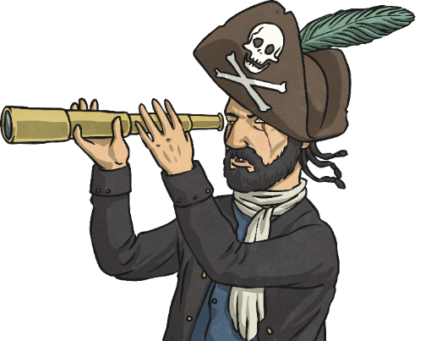
Describe positions on a 2D grid as coordinates in the first quadrant
Find the Gems
_{y}
₁₀
There are 3 diamonds, 4 red rubies and 5 green emeralds on your grid. Take it in turns to select a coordinate on the grid. Say the coordinate out loud and click on
the square to find the
hidden gems. Can
you find them all?
₉
₈
₇
₆
₅
₄
₃
₂
₁
_{x}
₀
₁
₂
₃
₄
₅
₆
₇
₈
₉
₁₀

Slide 6

Describe movements between positions as translations of a given unit to the left/right and up/down
_{y}
Describe the movement between positions A and B.
₁₀
₉
B
Reveal Answer
A to B is 3 squares left and 3
squares up.
₈
₇
₆
A
₅
₄
₃
₂
₁
x
₀
₁
₂
₃
₄
₅
₆
₇
₈
₉
₁₀

Slide 7
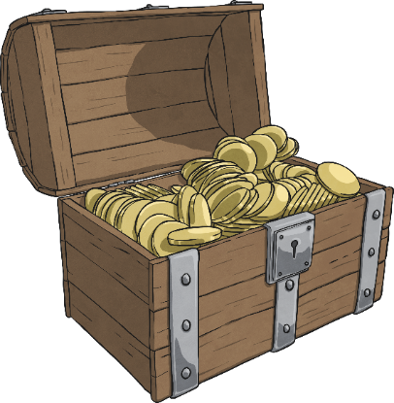
Describe movements between positions as translations of a given unit to the left/right and up/down
_{y}
Describe the movement between positions A and B.
₁₀
₉
B
Reveal Answer
A to B is 4 squares left and 7
squares up.
₈
₇
₆
₅
₄
₃
₂
A
₁
x
₀
₁
₂
₃
₄
₅
₆
₇
₈
₉
₁₀

Slide 8

Describe movements between positions as translations of a given unit to the left/right and up/down
_{y}
Look at the grid. What are the coordinates of E?
₁₀
Reveal Answer
₉
F
(6,0)
₈
Nadeem translates point E to point F by moving 2 squares right and 9 squares up. What are the coordinates of point F?
₇
₆
Reveal Answer
₅
(8,9)
₄
Now translate point F
to point G by moving 5
squares left and 6
squares down.
₃
G
₂
₁
Reveal Answer
(3,3)
E
_{x}
₀
₁
₂
₃
₄
₅
₆
₇
₈
₉
₁₀

Slide 9

Describe movements between positions as translations of a given unit to the left/right and up/down
_{y}
If point H moves to (2,4), write down the other coordinates.
₁₀
Reveal Answer
₉
₈
H
K
Henry says that when you describe the movement of each point from its original position to its new position, they are all different.
Is Henry correct?
Henry is incorrect because each point moves 3 left and 4 down, therefore each point moves the
same number of squares.
₇
₆
I
J
₅
₄
H
K
(4,4)
Reveal Answer
₃
₂
(2,2)
I
J
(4,2)
₁
_{x}
₀
₁
₂
₃
₄
₅
₆
₇
₈
₉
₁₀

Slide 10


Plot specified points and draw sides to complete a given polygon
_{y}
Where would you plot the final point in order to make a square?
₁₀
(3,1)
Reveal Answer
₉
₈
₇
₆
₅
₄
₃
₂
₁
_{x}
₀
₁
₂
₃
₄
₅
₆
₇
₈
₉
₁₀

Slide 11
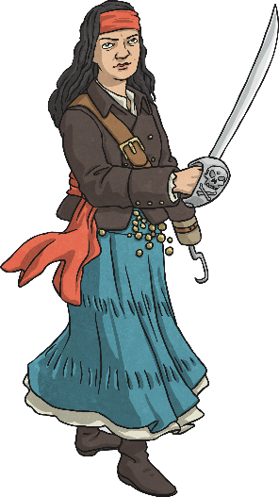
Plot specified points and draw sides to complete a given polygon
_{y}
Where would you plot the final point in order to make a right-angled triangle?
₁₀
₉
Accept any answer that produces a right-angled triangle.
₈
Reveal Answer
₇
₆
₅
₄
₃
₂
₁
_{x}
₀
₁
₂
₃
₄
₅
₆
₇
₈
₉
₁₀

Slide 12

Plot specified points and draw sides to complete a given polygon
_{y}
Where would you plot the final point in order to make a hexagon?
₁₀
₉
(9,4)
Reveal Answer
₈
₇
₆
₅
₄
₃
₂
₁
_{x}
₀
₁
₂
₃
₄
₅
₆
₇
₈
₉
₁₀

Slide 13

Plot specified points and draw sides to complete a given polygon
_{y}
List the coordinates to complete
the octagon.
₁₀
₉
Accept any answer which
produces a regular or
irregular octagon.
Reveal Answer
₈
₇
₆
₅
₄
₃
₂
₁
_{x}
₀
₁
₂
₃
₄
₅
₆
₇
₈
₉
₁₀

Slide 14

Plot specified points and draw sides to complete a given polygon
_{y}
Where would you plot the final points in order to make a scalene triangle?
₁₀
₉
Accept any answer which produces a triangle where
no sides or angles are equal.
₈
Reveal Answer
₇
₆
₅
₄
₃
₂
₁
_{x}
₀
₁
₂
₃
₄
₅
₆
₇
₈
₉
₁₀

Slide 15

Plot specified points and draw sides to complete a given polygon
_{y}
Where would you plot the final points in order to make an
isosceles triangle?
₁₀
₉
Accept any answer which produces a triangle with
two equal sides and
two equal angles.
₈
Reveal Answer
₇
₆
₅
₄
₃
₂
₁
_{x}
₀
₁
₂
₃
₄
₅
₆
₇
₈
₉
₁₀

Slide 16
Aims
Describe positions on a 2D grid as coordinates in the first quadrant. 3
Describe movements between positions as translations of a given
unit to the left/right and up/down. 6
Plot specified points and draw sides to complete a given polygon. 9

