Slide 1


LIFE/work balance
We have started a #LIFEworkbalance campaign and we need your help to complete our LIFE/work balance survey.
We hope to publish the results soon, so please give 15 minutes of your time to help us get a true picture of school life.
Want to be a part of this campaign? Take the survey on our website and share it with your colleagues!
© Classroom Secrets Limited 2019

Slide 2


Year 4 – Summer Block 1 – Decimals – Halves and Quarters
About This Resource:
This PowerPoint has been designed to support your teaching of this small step. It includes a starter activity and an example of each question from the Varied Fluency and Reasoning and Problem Solving resources also provided in this pack. You can choose to work through all examples provided or a selection of them depending on the needs of your class.
National Curriculum Objectives:
Mathematics Year 4: (4F6a) Recognise and write decimal equivalents to 1/4 , 1/2 , 3/4
More Year 4 Decimals resources.
Did you like this resource? Don’t forget to review it on our website.
© Classroom Secrets Limited 2019

Slide 3
Year 4 – Summer Block 1 – Decimals
Step 6: Halves and Quarters
© Classroom Secrets Limited 2019

Slide 4
Introduction
Which fraction of £100 would you choose? Why?
1
2
1
4
3
4
© Classroom Secrets Limited 2019

Slide 5
Introduction
Which fraction of £100 would you choose? Why?
1
2
1
4
3
4
This is the largest amount shown and would give you three quarters of the money.
© Classroom Secrets Limited 2019

Slide 6
Varied Fluency 1
Which fraction equals the decimal?
 |  | 5
 |  | 100
0.5 |  | 25
 |  | 100
 |  | 50
 |  | 100
© Classroom Secrets Limited 2019

Slide 7
Varied Fluency 1
Which fraction equals the decimal?
 |  | 5
 |  | 100
0.5 |  | 25
 |  | 100
 |  | 50
 |  | 100
© Classroom Secrets Limited 2019

Slide 8
Varied Fluency 2
Write a fraction and decimal to show how many coloured squares.
© Classroom Secrets Limited 2019

Slide 9
Varied Fluency 2
Write a fraction and decimal to show how many coloured squares.
, , or and 0.75 or any other correct
equivalent fraction.
75
100
3
4
6
8
9
12
© Classroom Secrets Limited 2019

Slide 10
Varied Fluency 3
Which decimal is shown on the place value grid?
What fraction would this be?
Ones | tenths | hundredths
© Classroom Secrets Limited 2019

Slide 11
Varied Fluency 3
Which decimal is shown on the place value grid?
What fraction would this be?
0.25 and , , or or any other correct
equivalent fraction.
Ones | tenths | hundredths
25
100
1
4
2
8
3
12
© Classroom Secrets Limited 2019

Slide 12
Varied Fluency 4
Fill in <, > or = to make the statement true.
2 |  |  |  | 0.5
8
© Classroom Secrets Limited 2019

Slide 13
Varied Fluency 4
Fill in <, > or = to make the statement true.
2 |  | < |  | 0.5
8
© Classroom Secrets Limited 2019

Slide 14
Problem Solving 1
Match the pairs. Which is the odd one out?
0.5
0.75
1
4
50
100
0.25
© Classroom Secrets Limited 2019

Slide 15
Problem Solving 1
Match the pairs. Which is the odd one out?
0.5
0.75
1
4
50
100
0.25
© Classroom Secrets Limited 2019

Slide 16
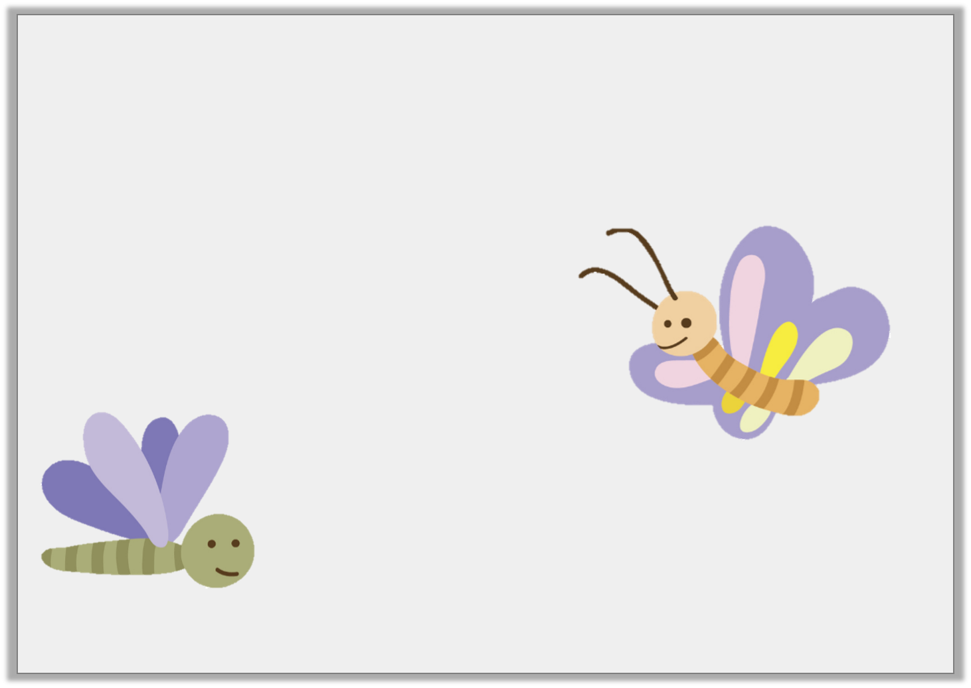
Reasoning 1
Bunty the butterfly flies 0.5m in one minute.
Monty the moth travels m in one minute.
Who travels furthest?
Explain how you know.
25
100
© Classroom Secrets Limited 2019

Slide 17
Reasoning 1
Bunty the butterfly flies 0.5m in one minute.
Monty the moth travels m in one minute.
Who travels furthest?
Explain how you know.
Bunty the butterfly
travels furthest because 0.5m is equivalent to m and Monty the moth only travels m or m or 0.25m.
25
100
1
2
25
100
1
4
© Classroom Secrets Limited 2019

Slide 18
Problem Solving 2
I’m thinking of a fraction.
The denominator is 100.
It is equal to 0.75.
What is my fraction?
© Classroom Secrets Limited 2019

Slide 19
Problem Solving 2
I’m thinking of a fraction.
The denominator is 100.
It is equal to 0.75.
What is my fraction?
75
100
© Classroom Secrets Limited 2019

