Slide 1
Tuesday 3rd November
LO: To add and subtract numbers with up to 3 digits, using formal written methods of columnar addition and subtraction.

Slide 2
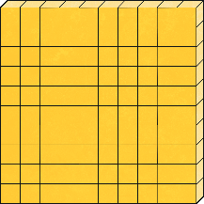

Add and Subtract 2-Digit and 3-Digit Numbers – Not Crossing 100
Complete the table.
Calculation | Model/Image |  |  | Column Method
 | H | T | O
1
5
6
-
4
2
156 - 42 = 114
1
1
4

Slide 3


Add and Subtract 2-Digit and 3-Digit Numbers – Not Crossing 100
Use column addition to solve this bar model.
968
927 | 41

Slide 4
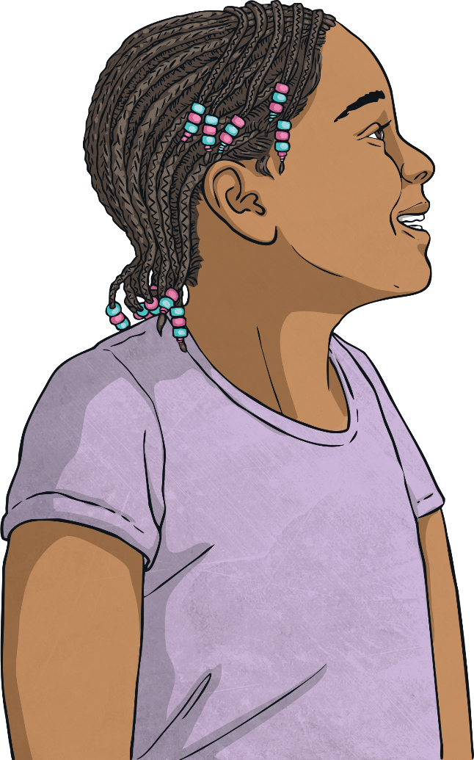
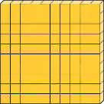
Add and Subtract 2-Digit and 3-Digit Numbers – Not Crossing 100
Maisie has been using base ten to calculate the answer to this number sentence. Check her work and spot the mistake she has made.
335 + 52 = 855
H | T | O
Maisie has not lined the digits up correctly in the calculation. She has placed the 5 tens for the number 52 into the hundreds column and the two ones into the tens column. This has resulted in Maisie calculating the wrong answer. Next time, she must remember to line the digits up in the correct column. The answer to the calculation should be 387.

Slide 5

Add and Subtract 2-Digit and 3-Digit Numbers – Not Crossing 100
Find the missing digits from these number sentences.
497 - 63 = 4 + 33
0
1

Slide 6
Add and Subtract 2-Digit and 3-Digit Numbers – Not Crossing 100
Arrange 7 counters onto the place value grid to make a 3-digit number and a 2-digit number that add together to make 223.
Can you find all eight possible solutions?
Hundreds | Tens | Ones
2
2
3
200 + 23, 201 + 22, 202 + 21, 203 + 20, 210 + 13, 211 + 12, 212 + 11, 213 + 10

Slide 7


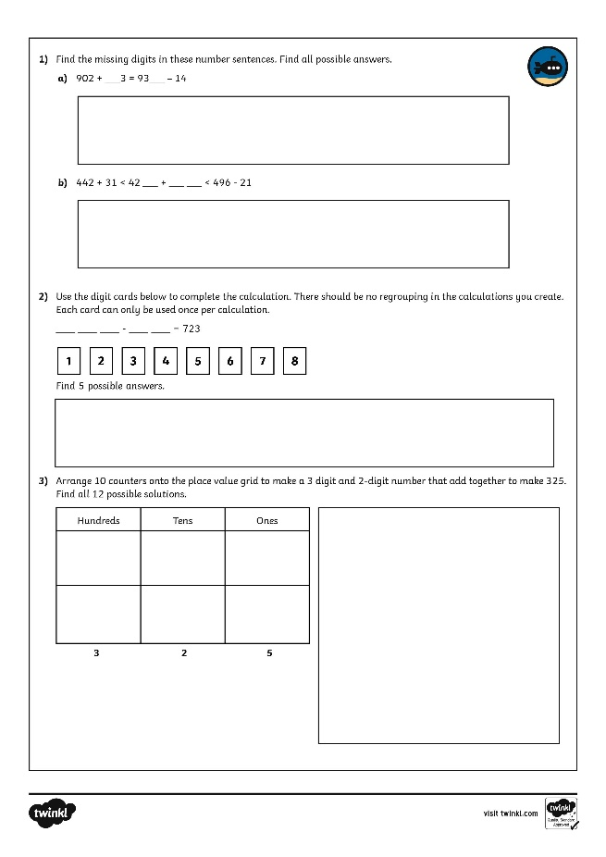
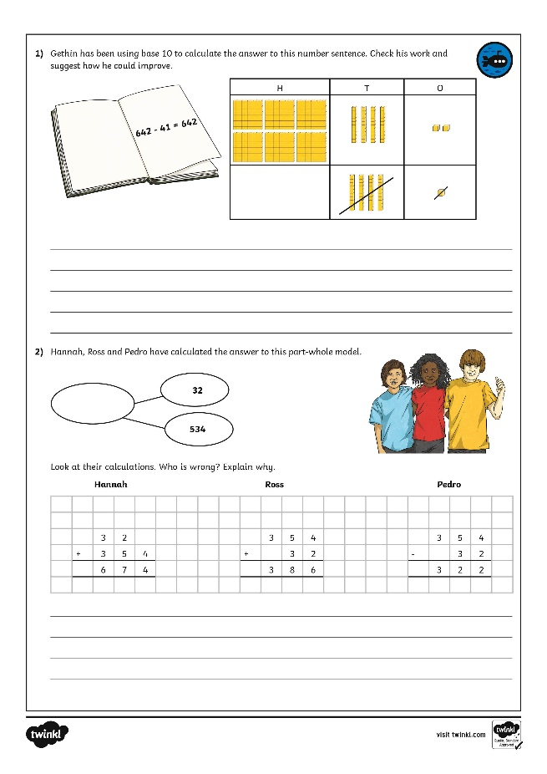
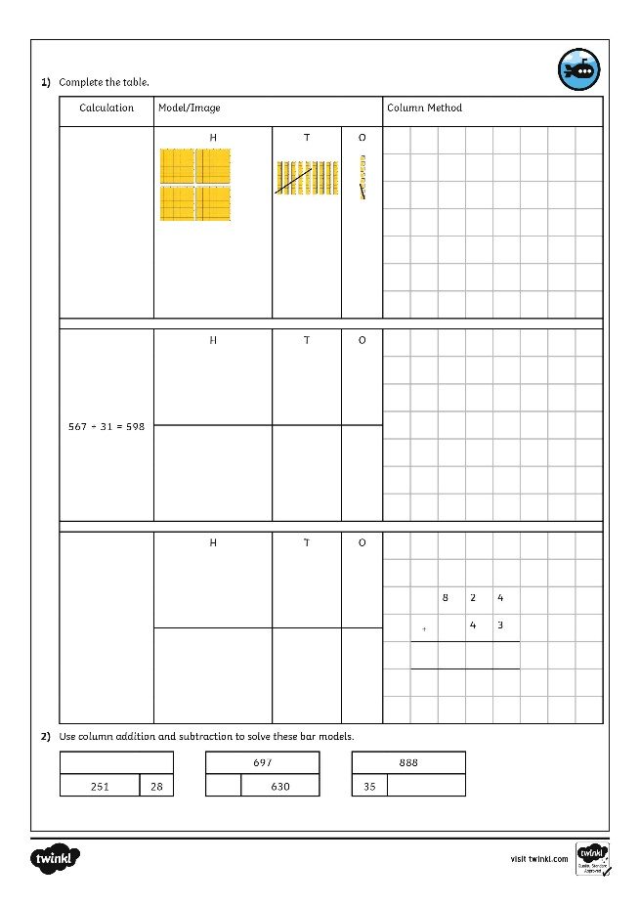
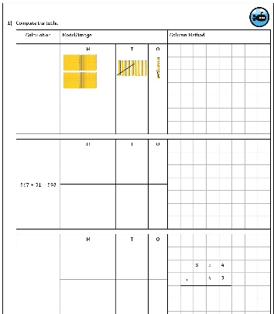
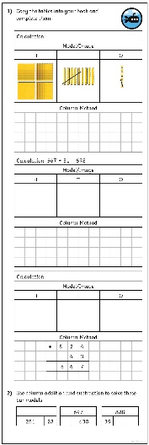
Add and Subtract 2-Digit and 3-Digit Numbers – Not Crossing 100
Dive in by completing your own activity!

