Slide 1


Slide 3
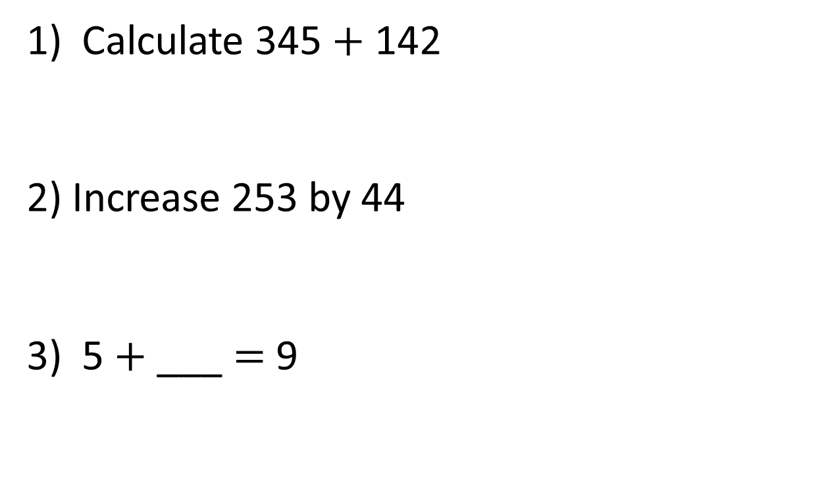
1) Calculate 345 $+$ 142
2) Increase 253 by 44
3) 5 $+$ ___ $=$ 9

Slide 4
1) Calculate 345 $+$ 142
2) Increase 253 by 44
3) 5 $+$ ___ $=$ 9
487
297
4

Slide 6




1,731 + 3,052 =
4,783
Th | H | T | O
H | T | O
2 | 6 | 4
1 | 2 | 5
3 | 8 | 9
H | T | O
4 | 2 | 3
3 | 2 | 5
7 | 4 | 8
H | T | O
5 | 0 | 1
1 | 6 | 6
6 | 6 | 7
Th | H | T | O
3 | 0 | 5 | 2
1 | 7 | 3 | 1
+
4
7
8
3

Slide 7
358 + 5,231 =
5,589
Th | H | T | O
H | T | O
2 | 6 | 4
1 | 2 | 5
3 | 8 | 9
H | T | O
4 | 2 | 3
3 | 2 | 5
7 | 4 | 8
H | T | O
5 | 0 | 1
1 | 6 | 6
6 | 6 | 7
Th | H | T | O
5 | 2 | 3 | 1
 | 3 | 5 | 8
+
5
5
8
9

Slide 8
Have a go at questions 1 – 3 on the worksheet

Slide 9
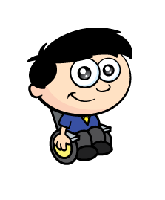
On Monday, Dexter completes a race which is 3,123 m long.
On Tuesday, he races for 3,075 m.
How far are the races altogether?
6,198 m
H | T | O
2 | 6 | 4
1 | 2 | 5
3 | 8 | 9
H | T | O
4 | 2 | 3
3 | 2 | 5
7 | 4 | 8
H | T | O
5 | 0 | 1
1 | 6 | 6
6 | 6 | 7
Th | H | T | O
3 | 1 | 2 | 3
3
+
0
7
5
7
5
6
1
9
8

Slide 10


In the morning, Annie scores 4,021 points.
In the afternoon, she scores 537 more points than she did in the morning.
How many points does she score in the whole day?
8,579
Just add 4,021 and 537
Th | H | T | O
4 | 0 | 2 | 1
 | 5 | 3 | 7
4 | 5 | 5 | 8
Th | H | T | O
4 | 5 | 5 | 8
4 | 0 | 2 | 1
8 | 5 | 7 | 9
537
4,021
Morning
?
Afternoon
4,558

Slide 11
Have a go at questions 4 – 6 on the worksheet

Slide 12
Th | H | T | O
 | 1 |  | 8
1 |  | 4
6 | 3 | 4 | 9
5
0
+
2
1

Slide 13

Have a think
Th | H | T | O
 | 0 |  | 6
3 |  | 2
4 | 1 | 3 | 7
Th | H | T | O
3 | 3
 |  | 1 | 1
8 | 5 | 5 | 2
1
1
4
1
+
1
1
+
5
2

Slide 14
Have a go at the rest of the worksheet

