Slide 1


Slide 3
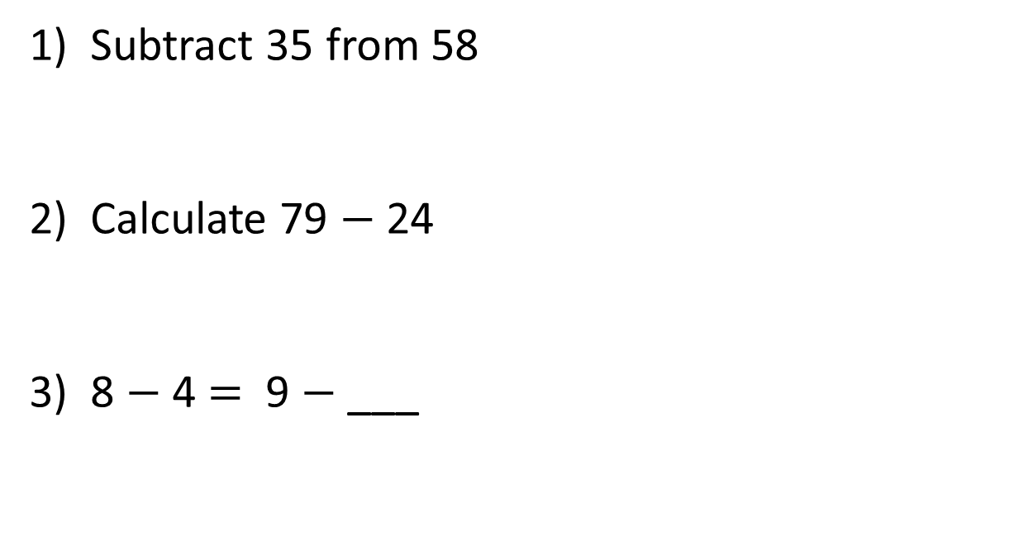
1) Subtract 35 from 58
2) Calculate 79 $−$ 24
3) 8 $−$ 4 $=$ 9 $−$ ___

Slide 4
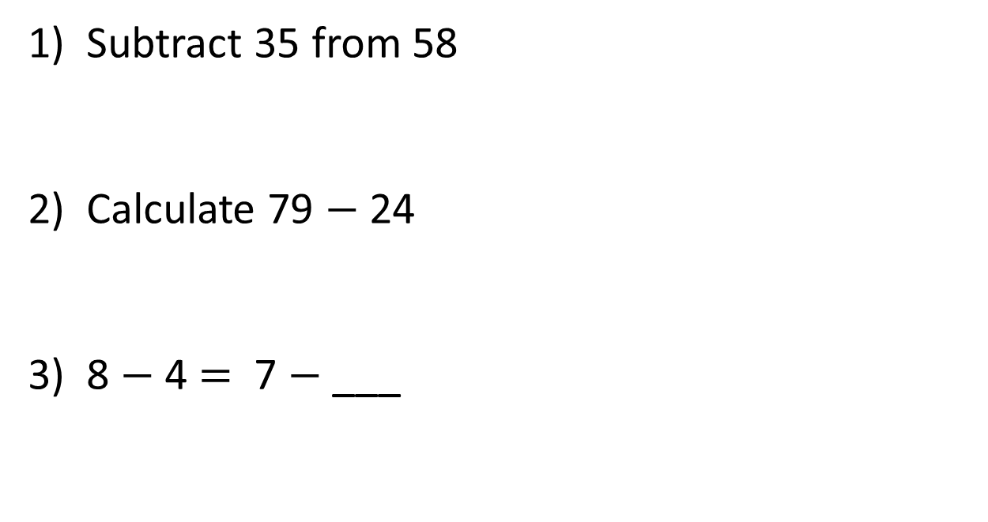
1) Subtract 35 from 58
2) Calculate 79 $−$ 24
3) 8 $−$ 4 $=$ 7 $−$ ___
23
55
3

Slide 6

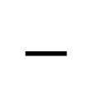
Hundreds | Tens | Ones
Have a think
H | T | O
3 | 4 | 8
1 | 3 | 5
$$−$$
2
1
3

Slide 7

Dexter has 137 stickers.
Rosie has 449 stickers.
How many more stickers does Rosie have than Dexter?
137 + 449 =
H | T | O
4 | 4 | 9
1 | 3 | 7
312
?
D
137
R
449
$$−$$
3
1
2

Slide 8
Have a go at questions
1 – 3 on the worksheet

Slide 9
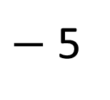
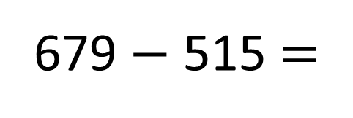
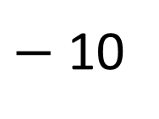
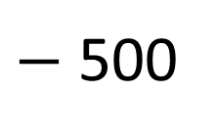
679 $−$ 515 =
164
$−$ 5
$−$ 10
$−$ 500
164
169
179
679
515
500
5
10

Slide 10
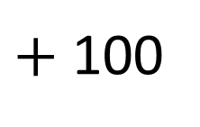
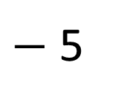
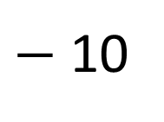
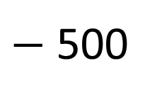
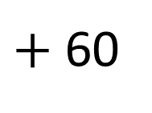
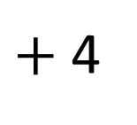
679 $−$ 515 =
164
Have a think
$−$ 5
$−$ 10
$−$ 500
164
169
179
679
$+$ 100
$+$ 60
$+$ 4
515
615
675
679

Slide 11

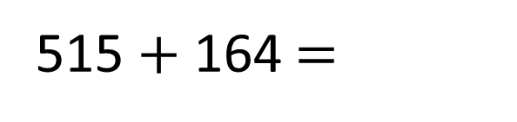
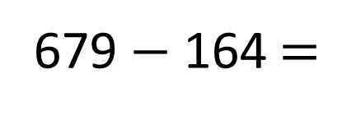
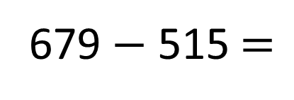
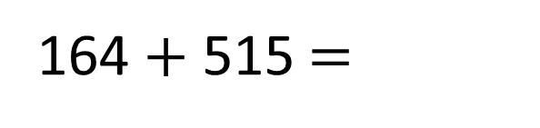
679
679 $−$ 515 $=$
164
679 $−$ 164 $=$
515
515 $+$ 164 $=$
679
164 $+$ 515 $=$
679
515
164

Slide 12
Have a go at questions
4 – 6 on the worksheet

Slide 13
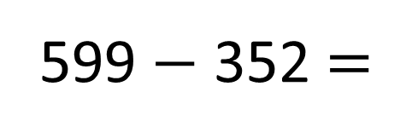
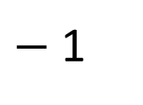
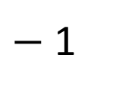
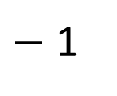
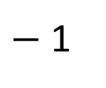
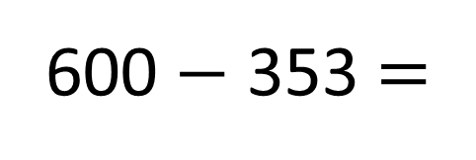

600 $−$ 353 =
Have a think
$−$ 1
$−$ 1
What’s the same?
What’s different?
599 $−$ 352 =
353
3
600
?
6
247
9
H | T | O
5 | 9 | 9
3 | 5 | 2
$−$ 1
$−$ 1
$−$ 1
$−$ 1
$$−$$
3
?
599
352
247
8
5
2
4
7
Constant difference

Slide 14
Have a go at the rest of the worksheet

