Slide 1


Slide 3
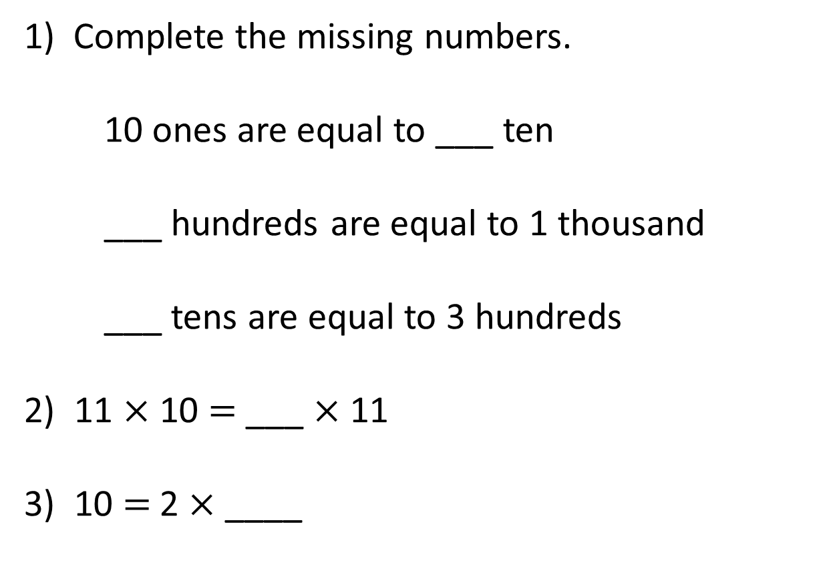
1) Complete the missing numbers.
10 ones are equal to ___ ten
___ hundreds are equal to 1 thousand
___ tens are equal to 3 hundreds
2) 11 $×$ 10 $=$ ___ $×$ 11
3) 10 $=$ 2 $×$ ____

Slide 4
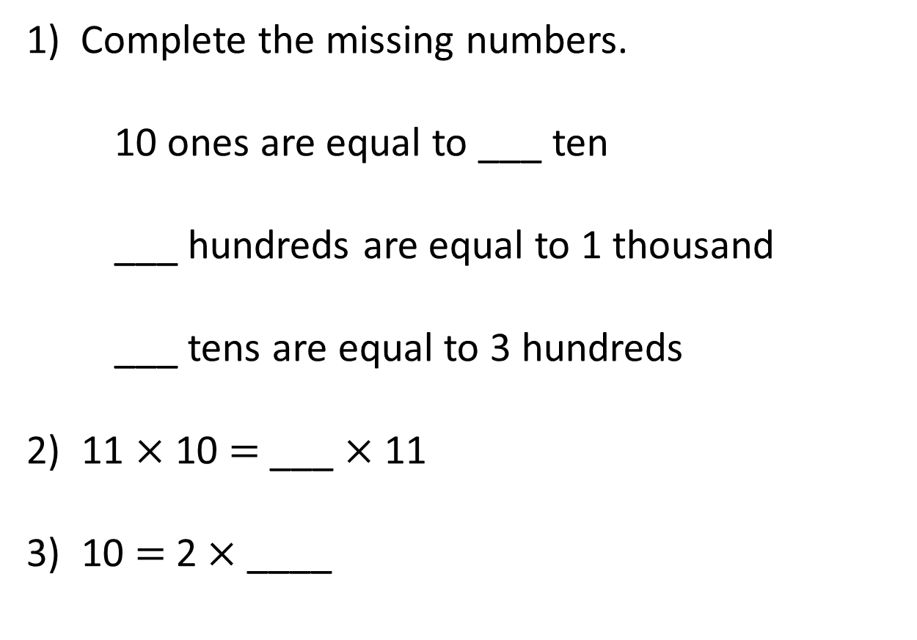
1) Complete the missing numbers.
10 ones are equal to ___ ten
___ hundreds are equal to 1 thousand
___ tens are equal to 3 hundreds
2) 11 $×$ 10 $=$ ___ $×$ 11
3) 10 = 2 × ____
1
10
30
10
5

Slide 6


4 groups of 10
10 | 10 | 10 | 10
4 × 1 ten =
4 tens
4 × 10 =
40

Slide 7
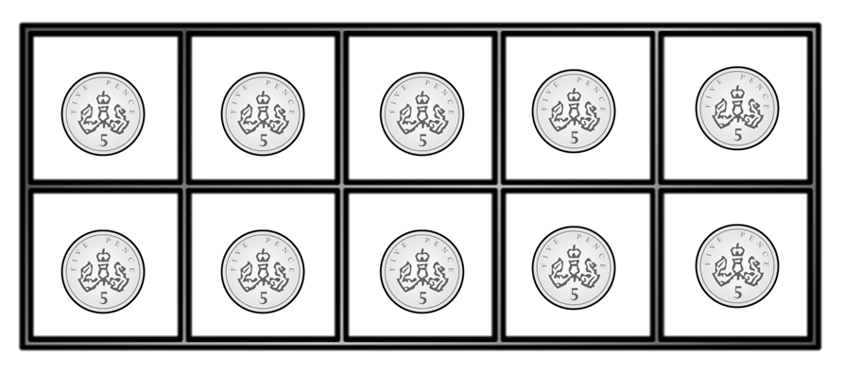

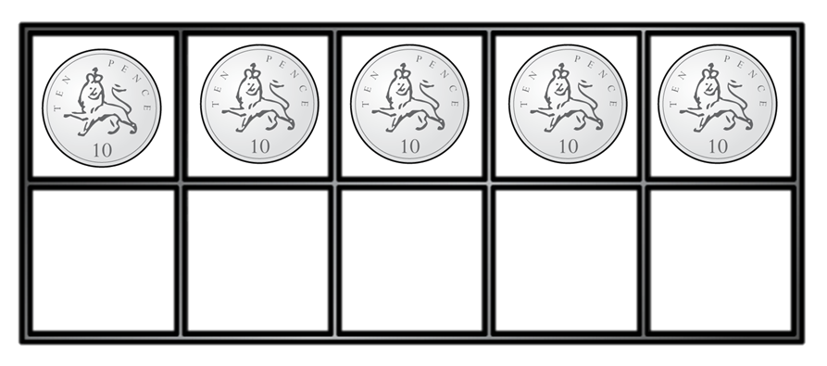
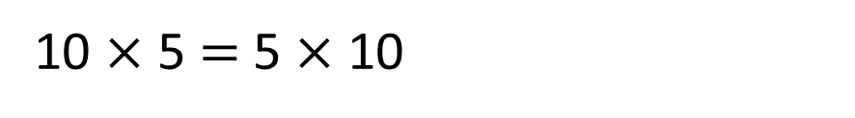
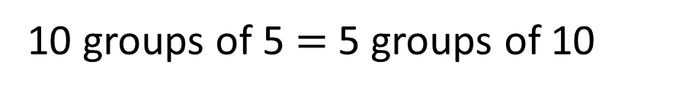
Have a think
What’s the same?
What’s different?
10 groups of 5 $=$ 5 groups of 10
5 | 5 | 5 | 5 | 5 | 5 | 5 | 5 | 5 | 5
10 $×$ 5 $=$ 5 $×$ 10
10 | 10 | 10 | 10 | 10

Slide 8
Have a go at questions 1 to 4 on the worksheet

Slide 9


H | T | O
Each row has 2 tens and 1 one.
Each row has 21
There are 10 rows.
The calculation is
21 × 10 =
2
1
0

Slide 10
Have a think
H | T | O
3
Each row has ___ tens
and ___ ones.
2
32
Each row has _____
10
There are ___ rows.
The calculation is
___ × ____ = ______
32
10
320

Slide 11
Have a go at questions 5 to 7 on the worksheet

Slide 12
1 ten is 10 times the size of 1 one
1 hundred is 10 times the size of 1 ten
1 thousand is 10 times the size of 1 hundred

Slide 13
Th | H | T | O
10 times
the size
10 times
the size
10 times
the size
2
4
0
24 × 10 =

Slide 14
Th | H | T | O
10 times
the size
10 times
the size
10 times
the size
4
2
0
42 × 10 =

Slide 15
Have a go at the rest of the worksheet

