Slide 1
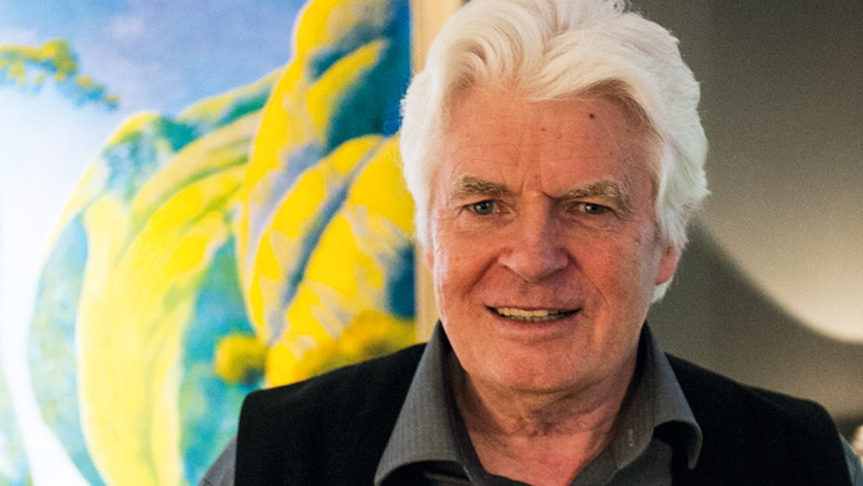
Roger Dean
British artist 1944 – present day

Slide 2
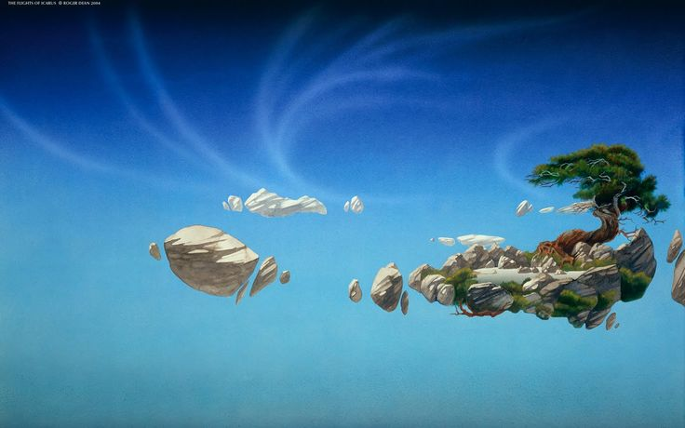
Learning objectives:
To learn about the artist Roger Dean.
To be able to talk about some of his work.
To debate whether Cameron used Dean’s work as a stimulus for the film ‘Avatar’
To create your own fantasy world composition.

Slide 3
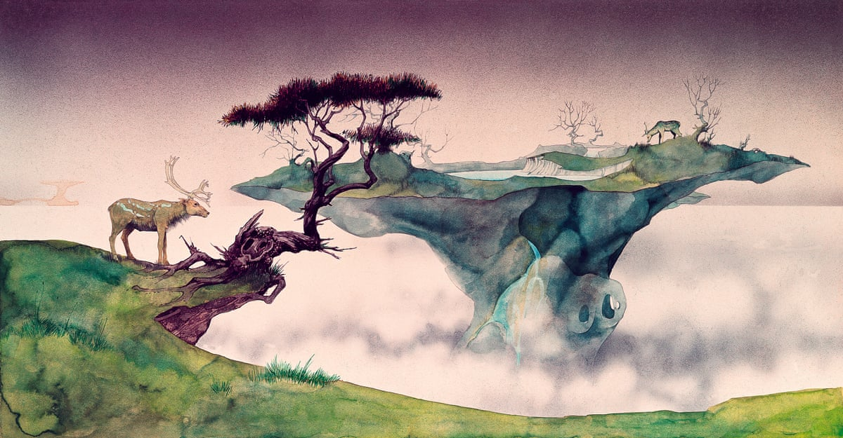
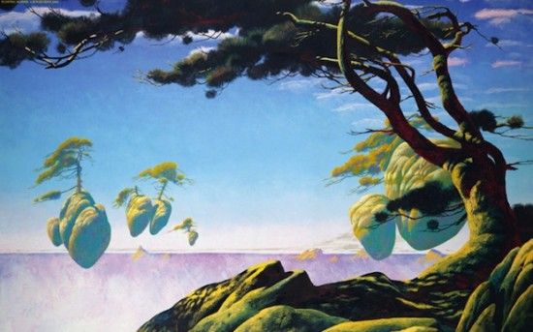
Floating Islands
Characteristic landscapes show graceful stone arches or floating islands, while many paintings portray organic-seeming habitats. Though he primarily works with watercolour paints, many of his paintings make use of multiple media, including gouache, ink, crayon, enamel and collage.

Slide 4
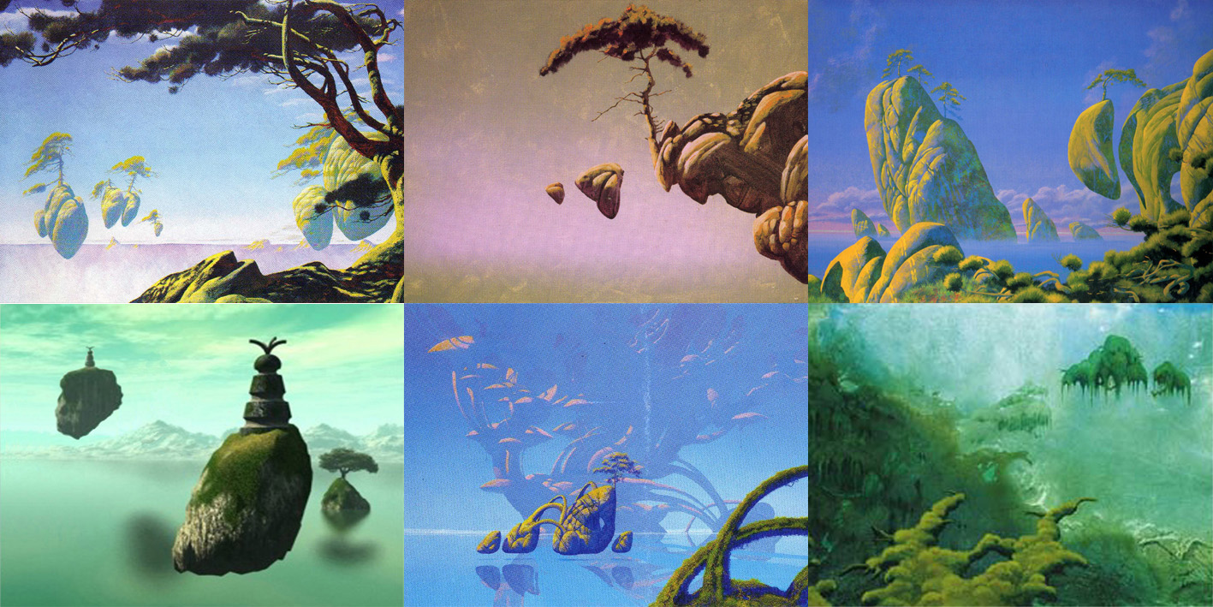
Roger Dean’s artwork depicting rocky mountains and floating islands. Do you see any similarity to Avatar?

Slide 5
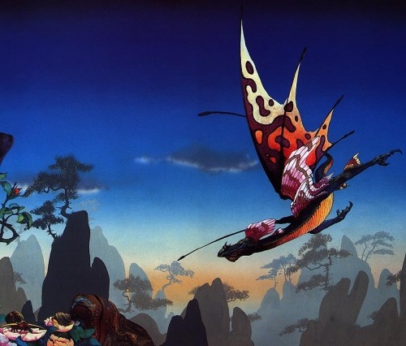
Roger Dean or James Cameron?
Many people believe that the floating islands and the arches did not in any way come out of director James Cameron’s imagination and the flying steads are straight out of “Morning Dragon” by Dean.

Slide 6
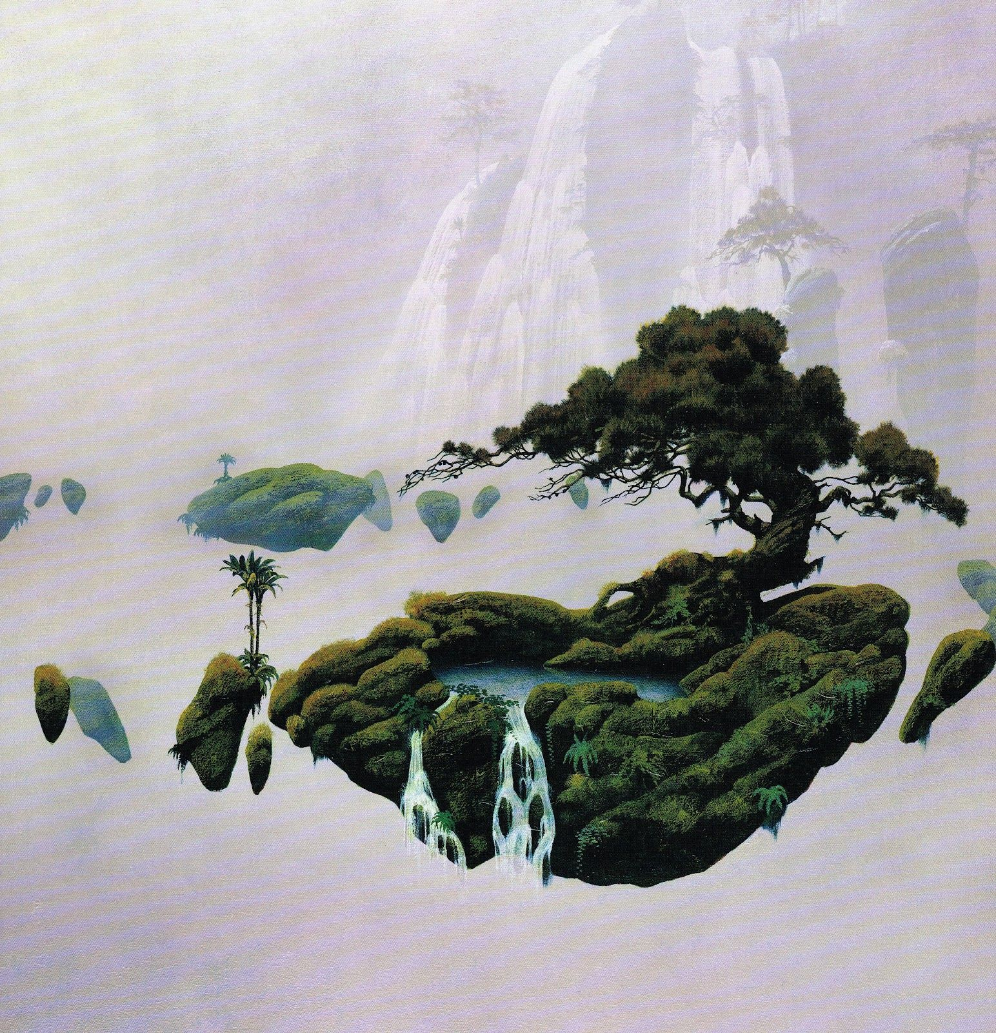
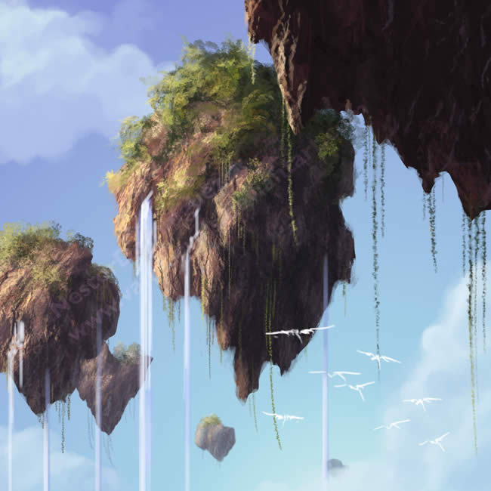
The similarity is very strong and on first watching Avatar, I was reminded of Dean’s earlier album covers. However, a court ruled that this was not the case in 2016.
Floating Islands by Dean
Vs
Floating Islands from the film

Slide 7
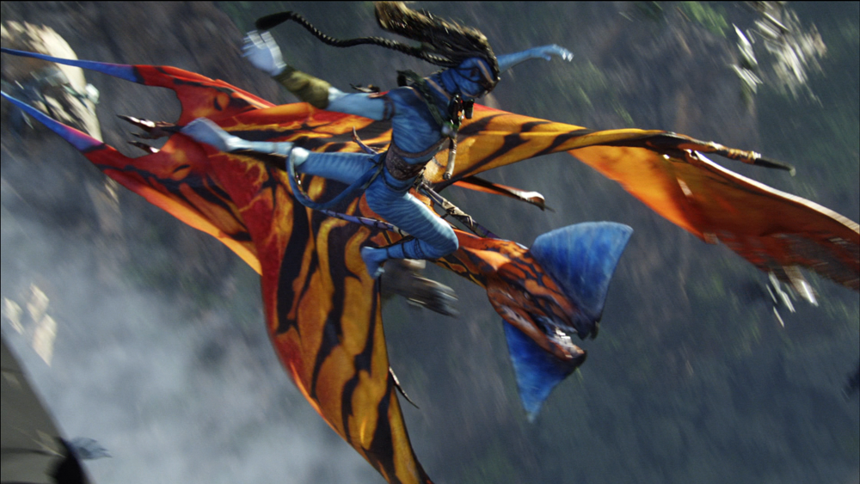
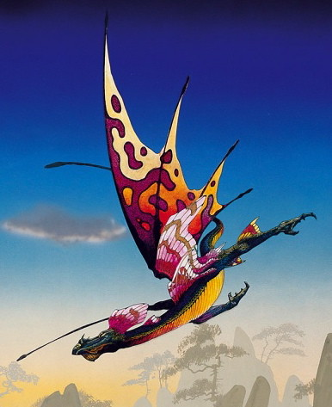
Watch this clip on YouTube from the film ‘Avatar’.
https://www.youtube.com/watch?v=wCnxJOhZmC4
This is the scene showing the Hallelujah Mountains.
Look at the waterfalls as well as the floating islands and mountains.
The bridge they cross is very similar to some of Roger Dean’s bridges.
Then there are their mode of transport. Very, very similar to Dean’s Morning Dragon!
What do you think?
Do you agree or disagree?
Avatar’s Great Leonopteryx
Dean’s Morning Dragon

Slide 8
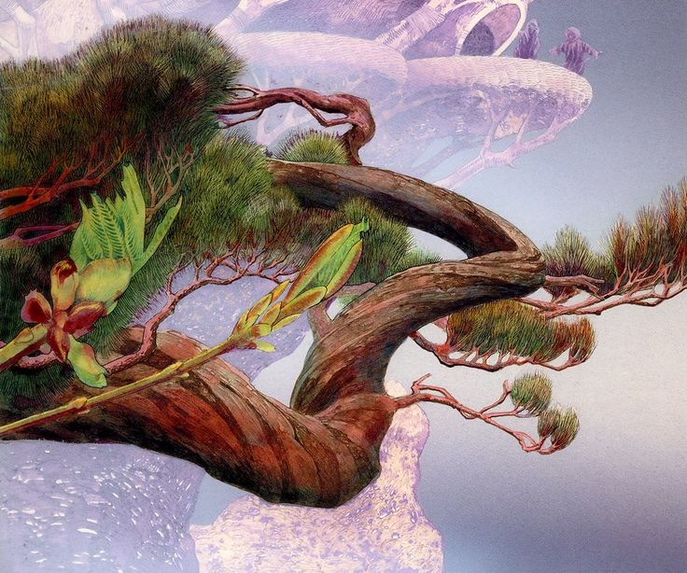
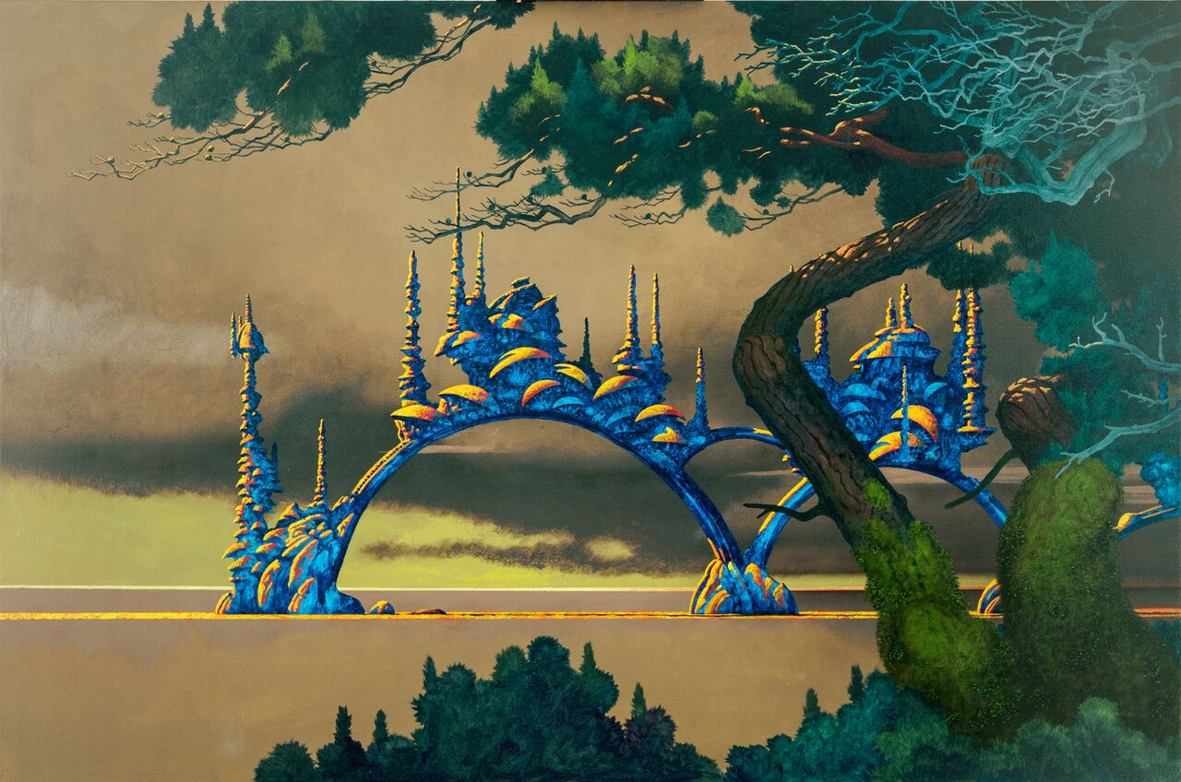
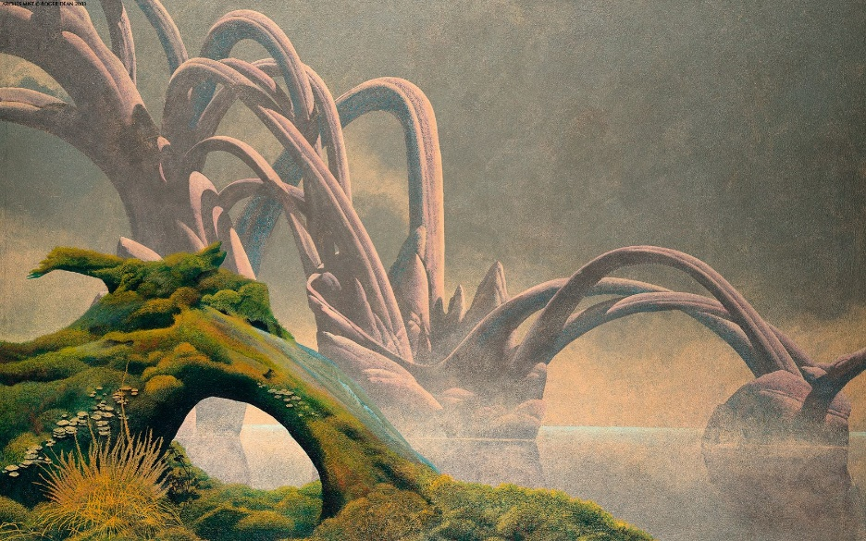
Dean’s fantasy arches and bridges

Slide 9


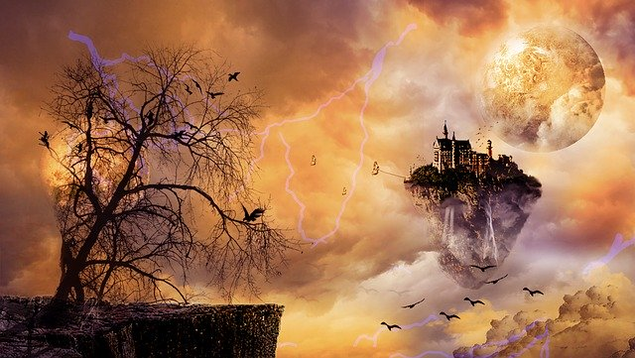
Let me know what you think.
Email me with your ideas and responses.
Now you have seen all this wonderful fantasy art, I would like you to create your own fantasy world.
Send me photographs of your wonderful creations.

