Slide 1
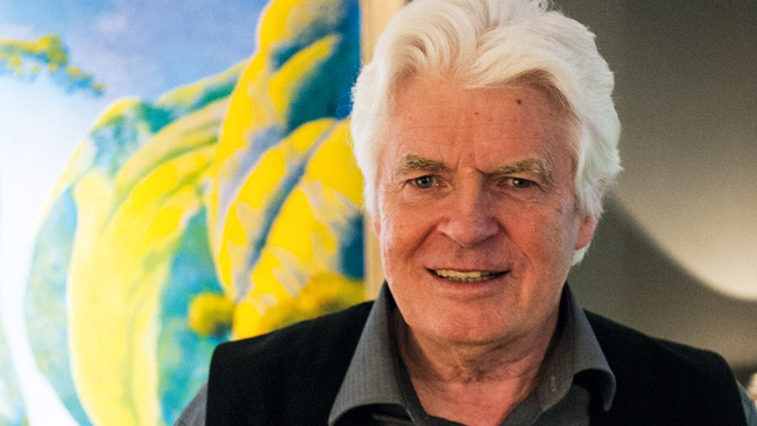
Roger Dean
British artist 1944 – present day

Slide 2
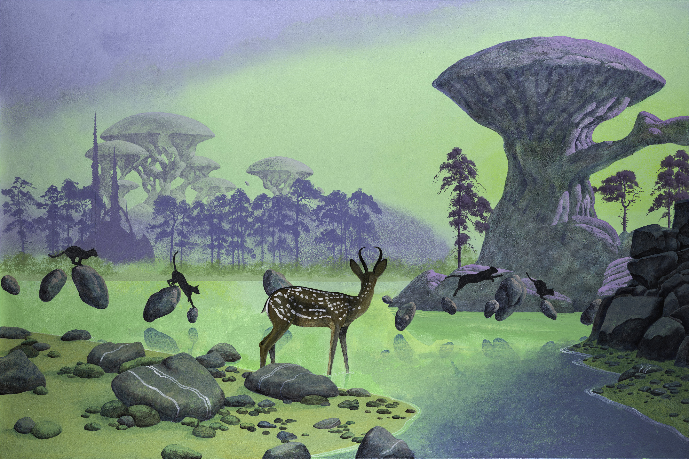
Learning objectives:
To learn about the artist Roger Dean.
To be able to talk about some of his work.
To create your own fantasy world composition.

Slide 3
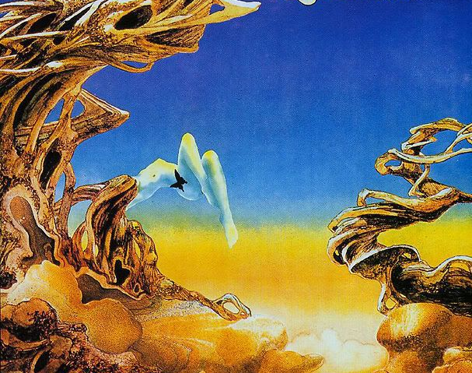
William Roger Dean, known as Roger Dean, is an English artist, designer, and publisher. He is best known for his work on posters and album covers for musicians, which he began painting in the late 1960s. The artists for whom he did the most art are English rock bands Yes and Asia.

Slide 4
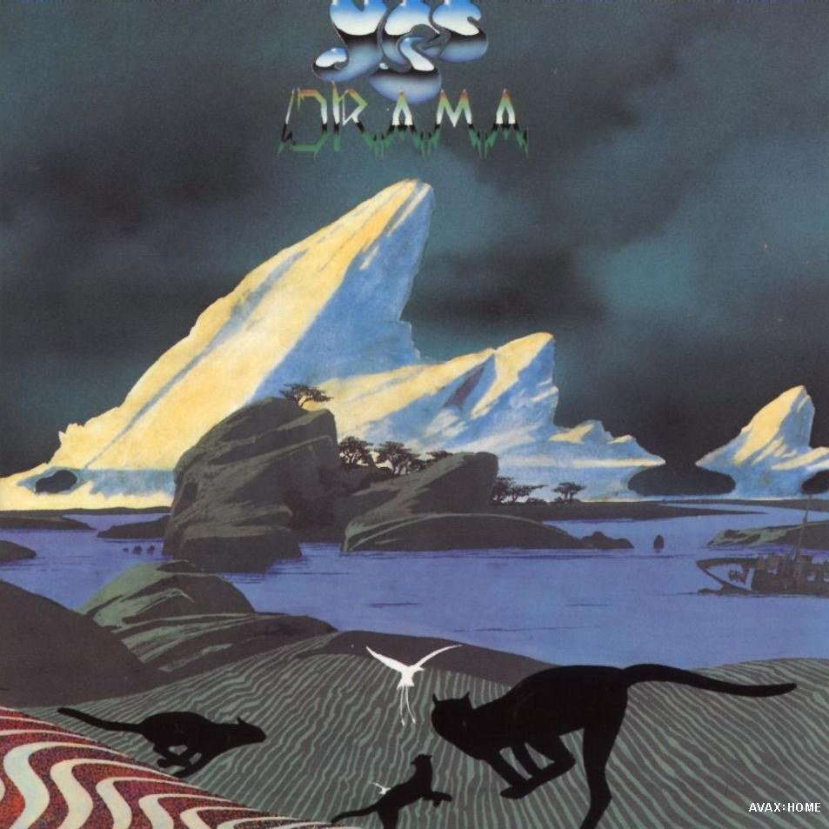
The Album cover for ‘Yes’ designed by Roger Dean
The covers often feature exotic fantasy landscapes. His work has sold more than 150 million copies worldwide.

Slide 5
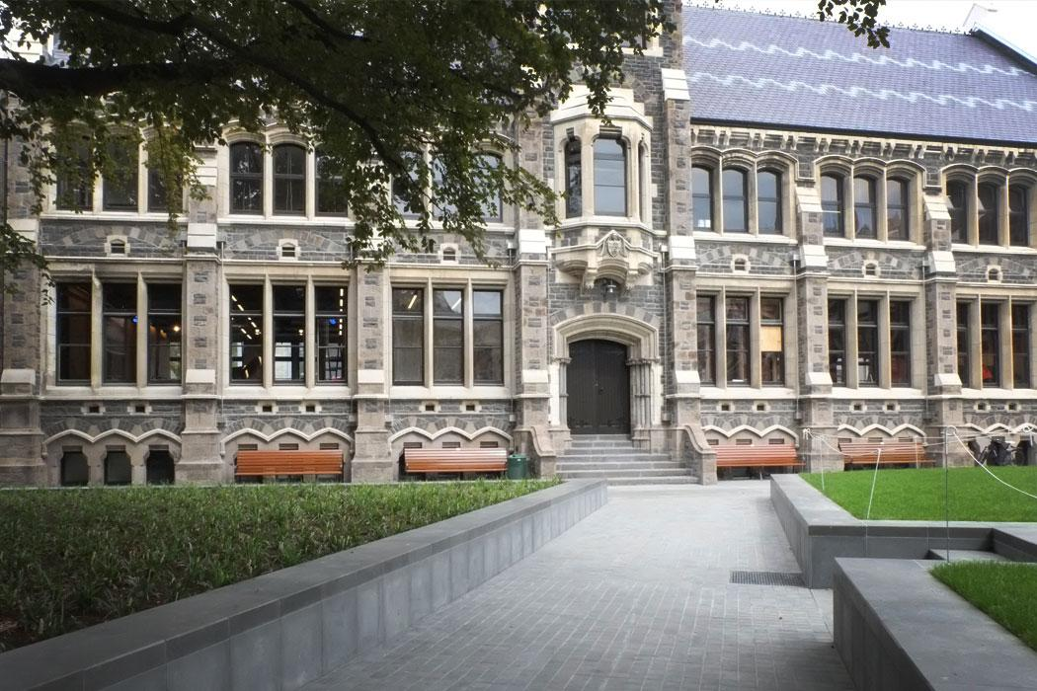

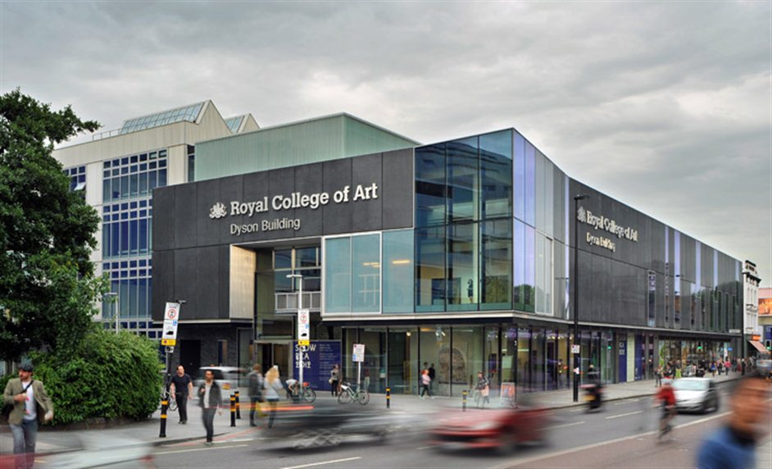
In 1961 he went to the Canterbury College of Art
Whilst there, one of his tutors recommended that Dean study at the Royal Collage of Art, London.
He enrolled at the college in 1965 to study furniture design. Dean graduated from the college in 1968 with a masters first class honours degree.

Slide 6
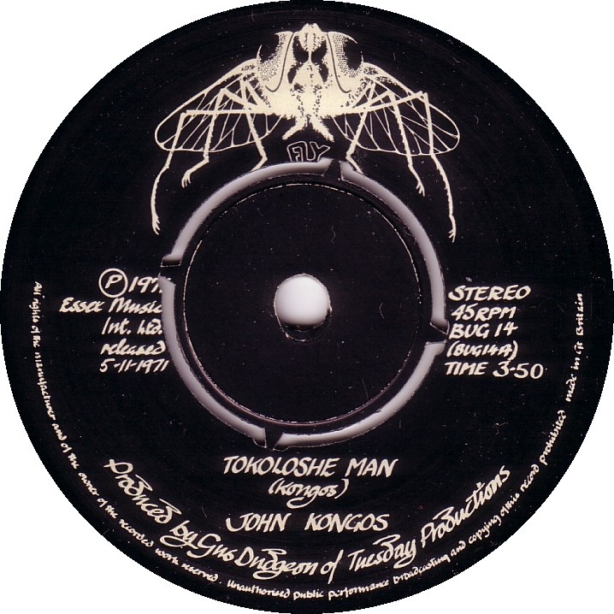
Dean designed the logo to the independent label ‘Fly Records’.
The label's staffers were enthusiastic about his work and this gave Dean the confidence to pursue more handwriting, logo, and graphic work

Slide 7
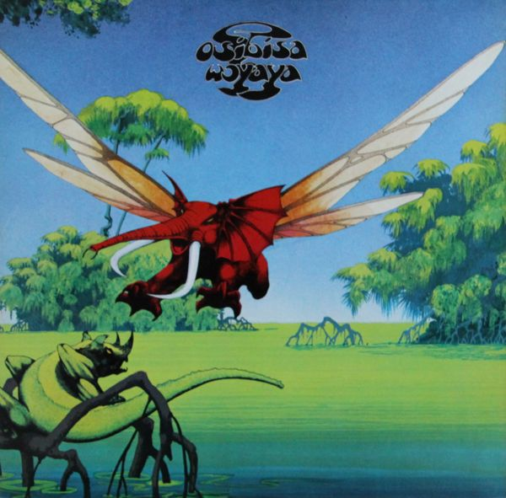
Osibisa 1971
By 1971, Dean's desire to produce artwork for rock bands had grown though he continued to pursue architecture and headed a small exhibition of his work in Florence.
Following discussions with A&R man David Howells, Dean agreed to work on the cover ‘Osibisa’ for the band Osibisa. The design is a result of a brief that Dean described as "credible African fairytale imagery" and features "flying elephants and not architecture", which became an early representation of the style he later achieved fame with.

Slide 8
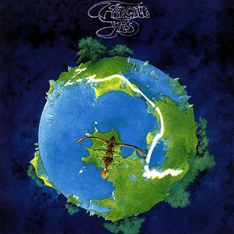
In mid-1971, during his search for work affiliated with rock bands, Dean sent a portfolio to numerous executives including Carson, Manager of Atlantic Records.
Carson hired Dean to design the cover of Yes's fourth album, ‘Fragile’ 1971.
From this point forward, Dean became famous for his artwork and album covers.
He continued to work with Yes and Asia but also other bands, popular at the time.

Slide 9
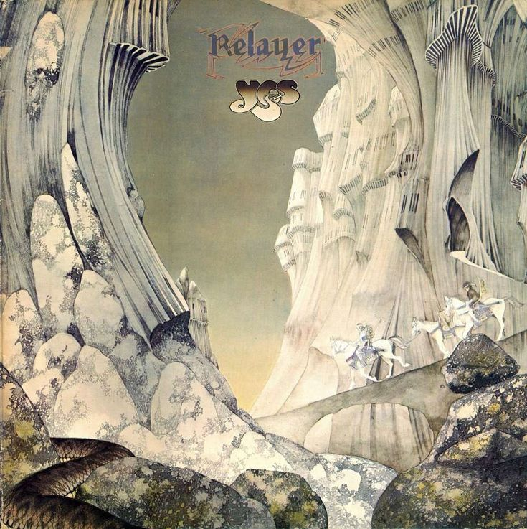
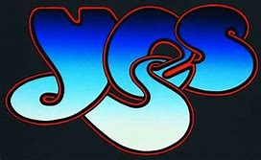
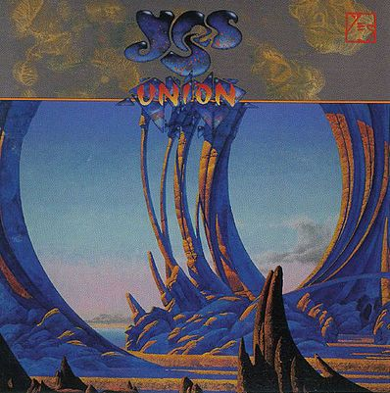
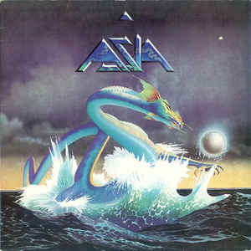
Known primarily for the dreamy, other-worldly scenes he has created for Yes, Asia, Budgie, Uriah Heep, Gentle Giant and other bands, Dean has described himself primarily as a landscape painter.
In addition to his cover paintings, Dean is respected for his calligraphic work, designing logos and titles to go with his paintings.

Slide 10
Don’t forget to look at the second part - ‘Floating Islands’

